Slide 1

Analysis of case-cohort study with the additive hazards model
Kate Hu
April, 2024

Slide 2
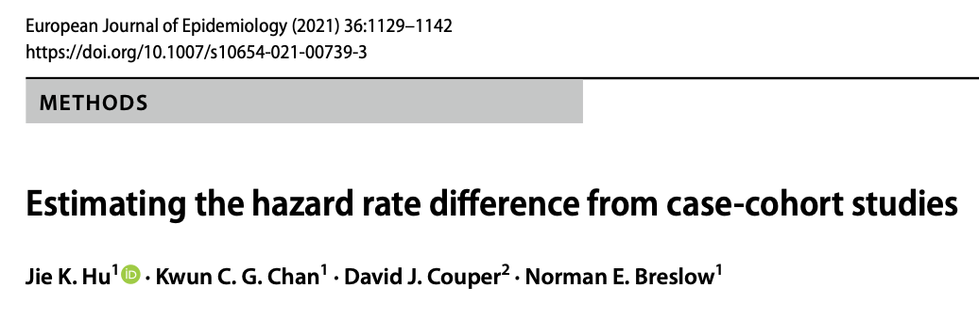

Slide 3
Topics
Additive Hazards Models
Case-Cohort Studies
Analysis R code
Construct Weight
Handle Missing Covariates
Use Auxiliary Information to Improve Precision
Biomarkers
Open-source exercise code and datasets for practice
Notes:
How to select .

Slide 4
Links
http://www.katehu.com/proxies/
Notes:
116

Slide 5
Scientific Questions
Whether elevated levels of high sensitivity C-reactive protein (hs-CRP) is associated with the increased risk of Coronary Heart Disease (CHD)
Individual risk prediction based on traditional risk factors and the new biomarker hs-CRP together, particularly among people with low density lipoprotein cholesterol (LDL-C)
Impact: hs-CRP may Identify some patients traditional risk factor measurements could not identify for subsequent preventive therapies
Notes:
116

Slide 6
Data sets
Background
Atherosclerosis Risk in Communities Study (ARIC) study
(ARIC Investigators, 1989):
prospective epidemiologic study
to investigate the causes, the outcomes and the risk factors related to cardiovascular diseases
A Biomarker sub-study (Ballantyne et al. 2004)
hs-CRP and Lp-PLA2 were assessed for a subset

Slide 7
Data structure
Datasets
The main cohort was followed for a CHD event and measured for traditional risk factors
A cohort random sample (CRS) was selected using stratified sampling
sex
race
age
hs-CRP were assessed for the CRS members and the subsequently identified CHD cases using stored plasma

Slide 8
Survival Analysis for Case-Cohort Studies
Aim
investigate the association between a biomarker and a disease
Study Design
Auxiliary covariates collected for
Cohort: 15792 participants
Subcohort: 777 members
Case: 604 incidents
Biomarker measurements for
⎨
Notes:
Subcohort was selected by stratified sampling on sex, race and age at baseline
777 subcohort members and 604 incident CHD are measured for hs-CRP

Slide 9



Two-Phase Sampling Design Reduces Study Costs A Sample Survey Approach to Analyzing Case-Cohort Studies
Phase I sample e.g., cohort
(N = 15792)
Stratification
Sampling
Collect inexpensive covariates
Population
Phase II sample
e.g., case-cohort
(n = 1381)
Inference
Subsampling
Collect expensive covariates, e,g., biomarkers
Notes:
Simplify

Slide 10
Incorporate Auxiliary Information to Improve Efficiency in Two-Phase Sampling Studies
Phase I
(N = 15792)
Inexpensive covariates
Improve precision
Population
Inference
Phase II sample
(n = 1381)
collects expensive covariates
Notes:
Phase I include sample include coveriates. These coveraites routine information we collect information from

Slide 11
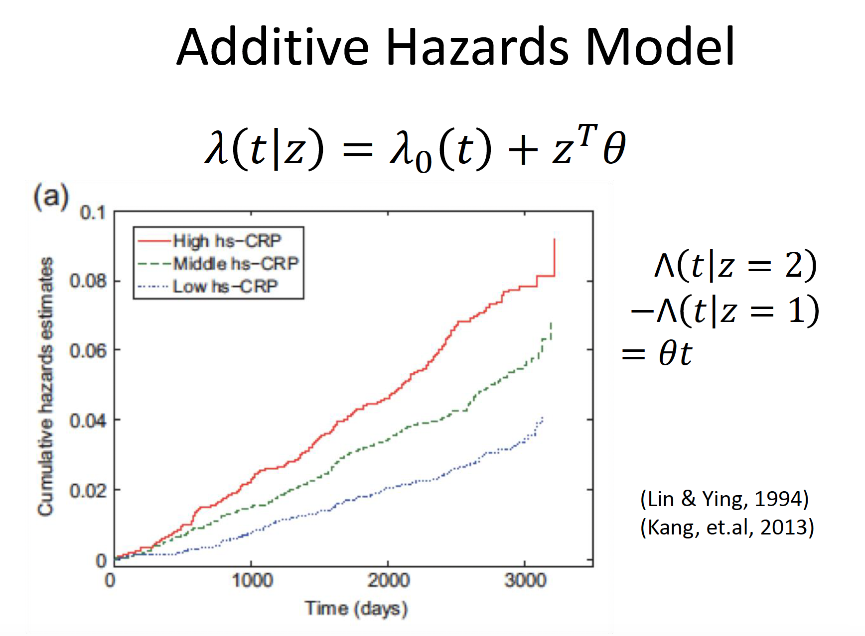

Slide 12
Benefits of the Additive Hazards Models
the absolute effect in the unit of cases per person-time of observation
more relevant than the relative risk when evaluating the public health impact of an intervention or a risk factor
unlike the hazard ratio (HR) the hazard difference (HD) is transportable across study populations and the conditional effect obtained by the AH model is equal to the marginal effect
a constant HR assumed by the Cox model for each cause-specific hazard does not guarantee a constant HR for all-cause mortality while this inconsistency is not present for the HD.
the most natural for measuring interaction effects
Notes:
How to select .

Slide 13
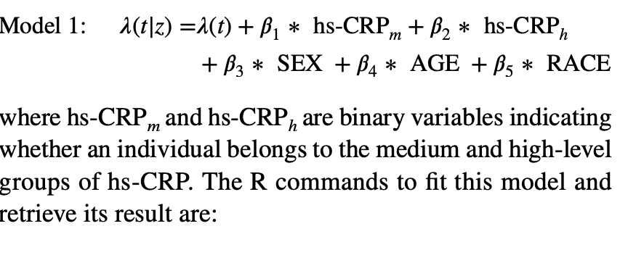
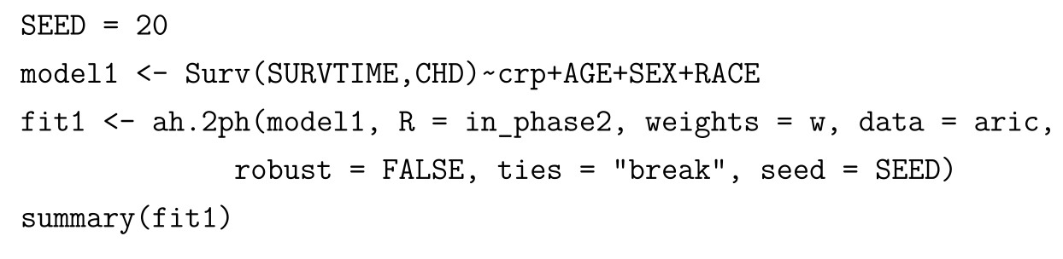
Incorporate Auxiliary Variables in R
R Package addhazard for Fitting the Additive Hazards Model to Case-Cohort Study Data
Notes:
Introduce additive harzards models

Slide 14
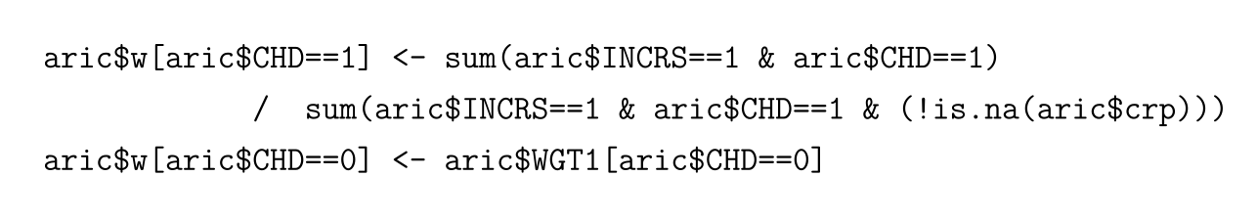
Incorporate Auxiliary Variables in R
Weights Construction
Notes:
Introduce additive harzards models

Slide 15
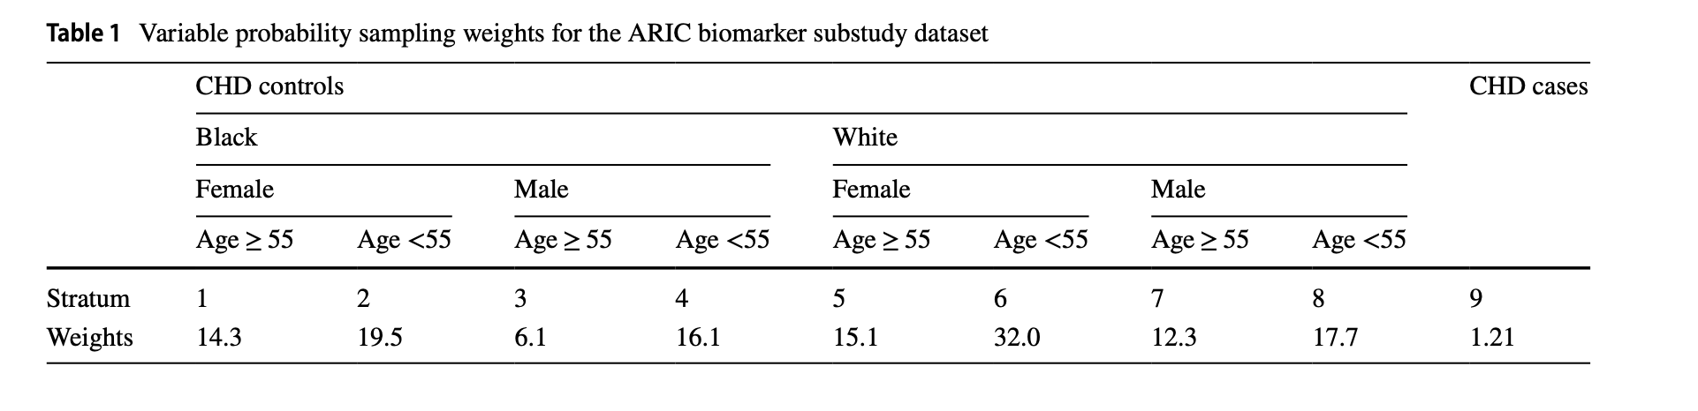
Incorporate Auxiliary Variables in R
Results: Weights
Notes:
Introduce additive harzards models

Slide 16
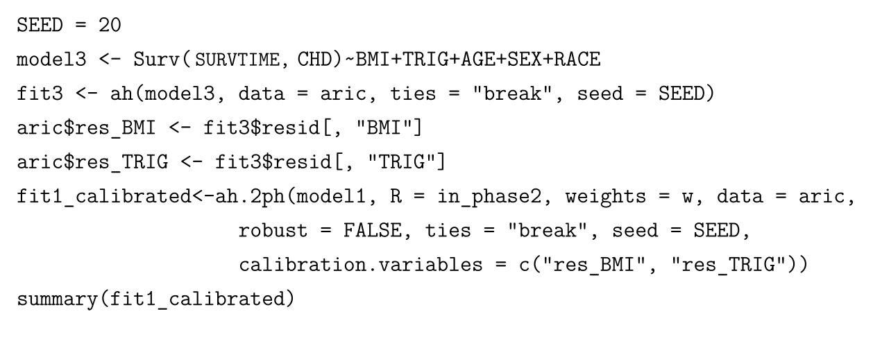
Incorporate Auxiliary Variables in R
R Code to Easily Incorporate Auxiliary Variables
Calibration variables to consider: age, age^2, continuous outcome variable T, the binary outcome variables Δ, etc.
Notes:
Add biomarer

Slide 17
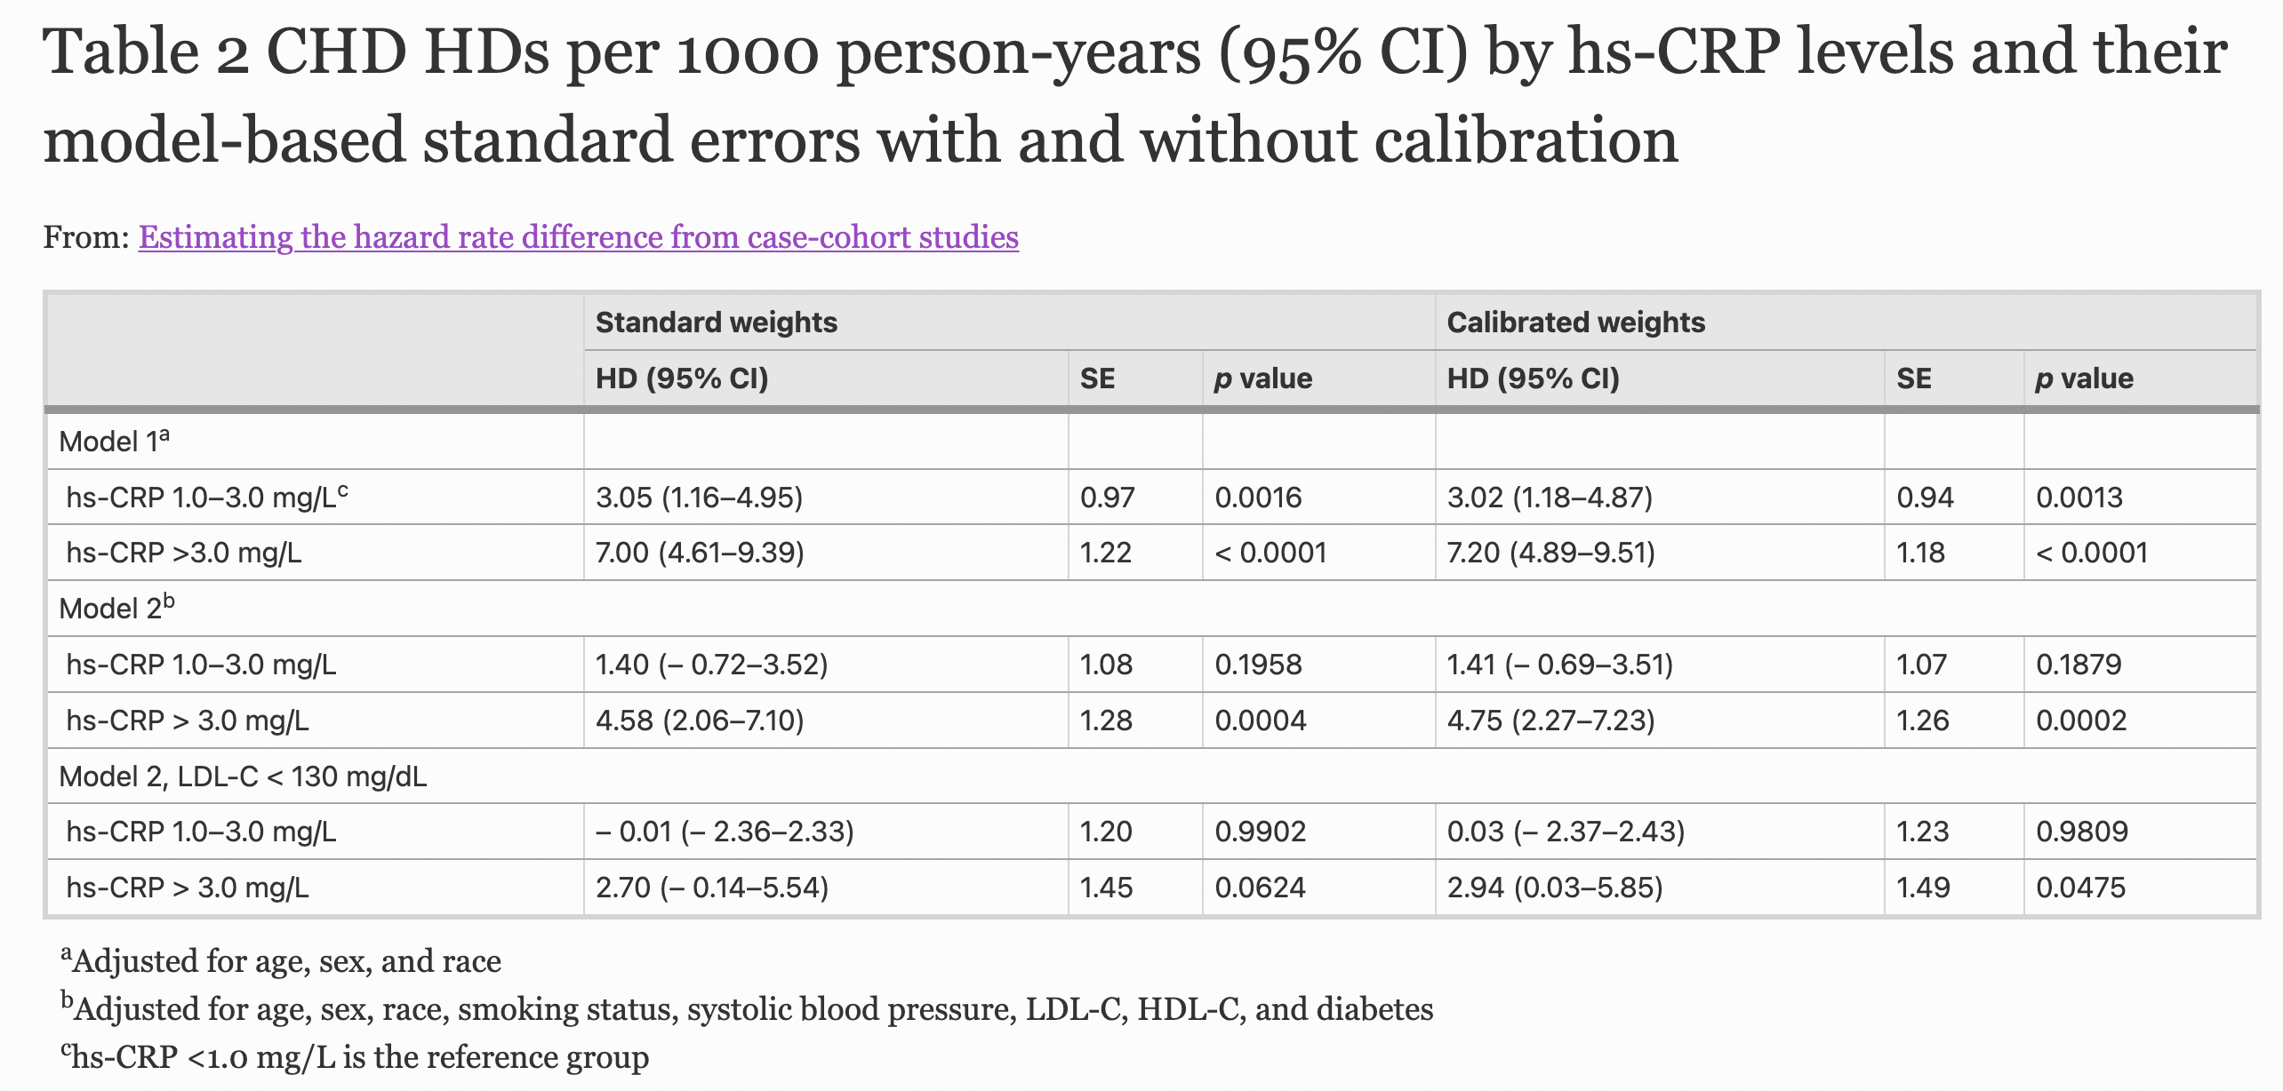
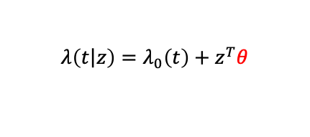
Results
Results: Precision for Estimators Improves
$$λ\left(\left.t\right|z\right)=λ_{0}\left(t\right)+z^{T}θ$$
Notes:
Before I introduce the technical details, I will first give the results
Precision improves without recruiting more study subjects

Slide 18
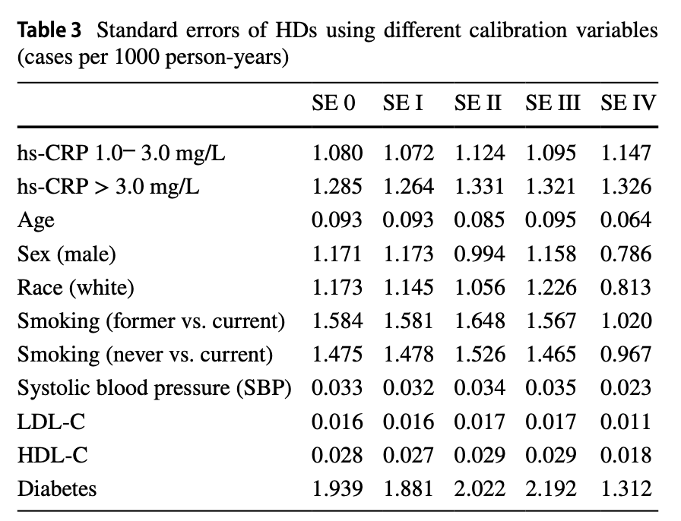
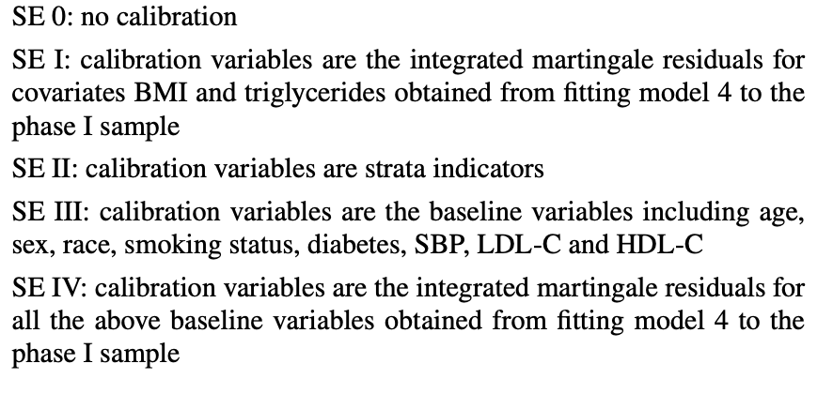
Results
Results: Auxiliary Variable Choice
Notes:
Before I introduce the technical details, I will first give the results
Precision improves without recruiting more study subjects

Slide 19
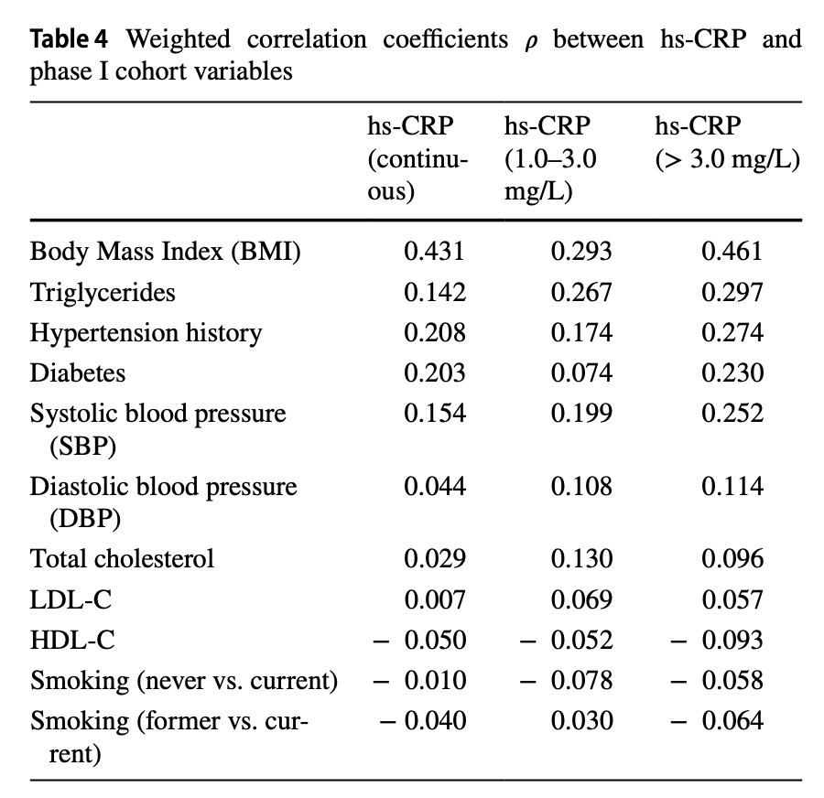
Results
Proxies are Weak
Notes:
Before I introduce the technical details, I will first give the results
Precision improves without recruiting more study subjects

Slide 20
Results
Results: Auxiliary Variable Choice
Notes:
Before I introduce the technical details, I will first give the results
Precision improves without recruiting more study subjects

Slide 21
Results
Summary
improvement in estimation precision by calibration is very specific—we see improvement only for the explanatory variables that are related to the calibration variables.
not only the strength of the relationship between the calibration variables and the explanatory variable matters for improving estimation precision but also how these variables should be used
Notes:
Before I introduce the technical details, I will first give the results
Precision improves without recruiting more study subjects

Slide 22
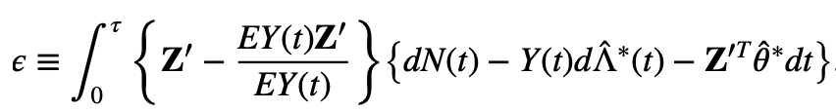

Asymptotic results
Insights: Information About the Covariance Matters

Slide 23
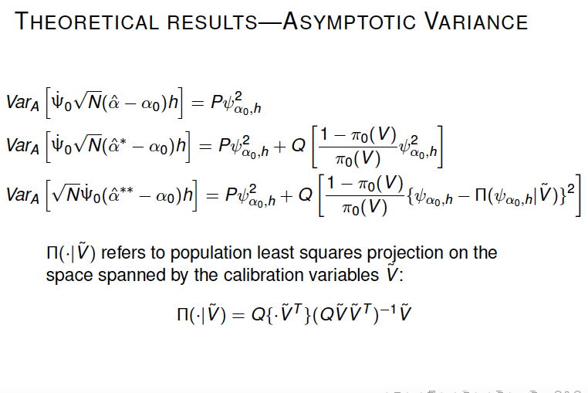
Asymptotic results
Insights: Theoretical Results on Asymptotic Variance

Slide 24
Related Topics
Estimation Methods
Calibration Techniques
Risk Prediction
Simulation Results
Finite population stratified sampling
Interaction effects of Lp-PLA2 and hs-CRP
Notes:
How to select .

Slide 25
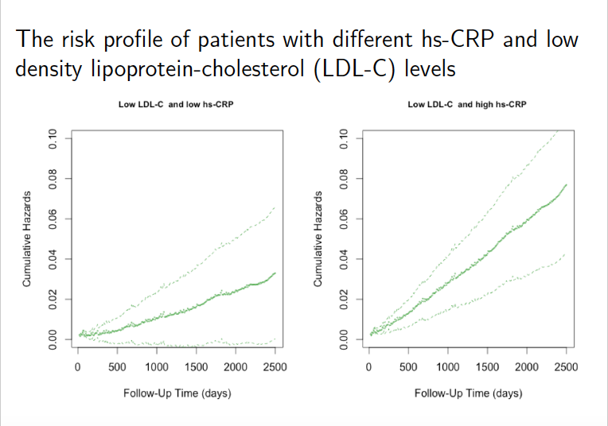
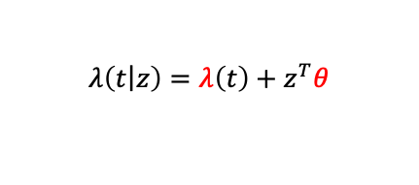
Results
Can Use the Biomarker to Identify and Visualize High-risk Individuals
$$λ\left(\left.t\right|z\right)=λ\left(t\right)+z^{T}θ$$
Jie Hu. University of Washington ResearchWorks Archive PhD Diss.
Notes:
I didn’t stop at
I build a tool to estimate the covariat-specific
Doctors to use this too
Even though this example is using ah mode my method is general enough to apply to other semiparmetric models
Based on the additive hazards models,

Slide 26
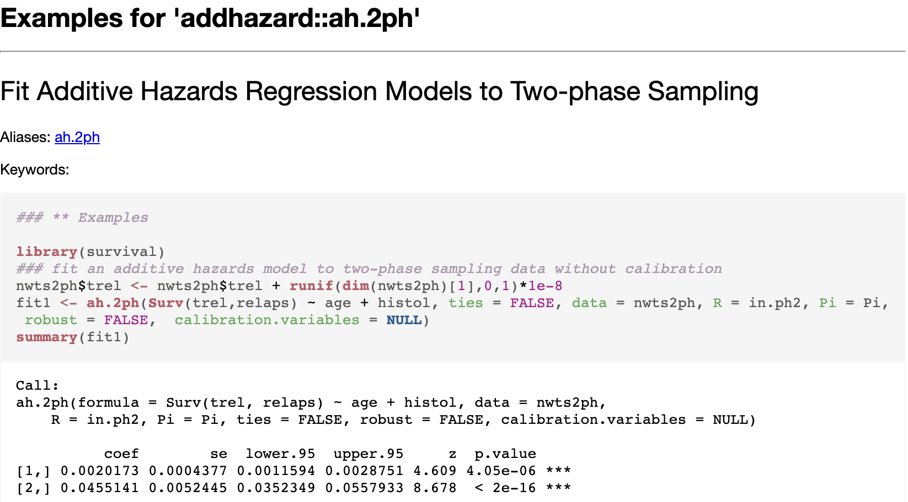
Results
Public Datasets to Practice: National Wilms Tumor Study
R library addhazard
?nwts2ph
Notes:
I didn’t stop at
I build a tool to estimate the covariat-specific
Doctors to use this too
Even though this example is using ah mode my method is general enough to apply to other semiparmetric models
Based on the additive hazards models,

Slide 27
Results
Public Datasets to Practice: Breast Cancer dataset
Data: https://www.mn.uio.no/math/english/research/groups/statistics-data-science/handbook-of-case-control-studies/chapter-17/
Tutorial:
https://www.mn.uio.no/math/english/research/groups/statistics-data-science/handbook-of-case-control-studies/chapter-17/bc_ah_analysis_for_table_17.4.html
http://www.katehu.com/proxies/
Notes:
I didn’t stop at
I build a tool to estimate the covariat-specific
Doctors to use this too
Even though this example is using ah mode my method is general enough to apply to other semiparmetric models
Based on the additive hazards models,

Slide 28
Summary
Additive Hazards Models
Case-Cohort Studies
Analysis R code
Use Auxiliary Information to Improve Precision
Construct Weight
Handle Missing Covariates
Biomarkers
Open-source exercise code and dataset
Notes:
How to select .

Slide 29
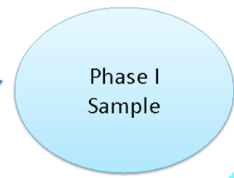


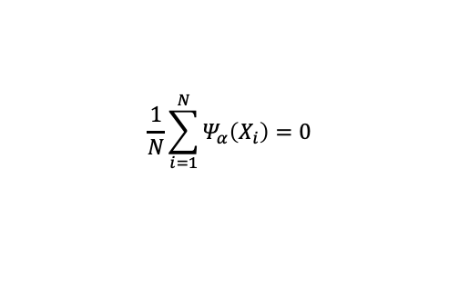

Improved Z-estimators from Two-phase VPS
Estimating Equations for Phase I Sample Estimator $\hat{α}$
$$\frac{1}{N}\sum_{i=1}^{N}{Ψ_{α}\left(X_{i}\right)}=0$$
$α$ = ($θ$, $Λ)$
N : phase I sample size
$Ψ_{α}\left(X_{i}\right)$ : a function of X derived from a model
Notes:
Now iwant to go the technical detail

Slide 30
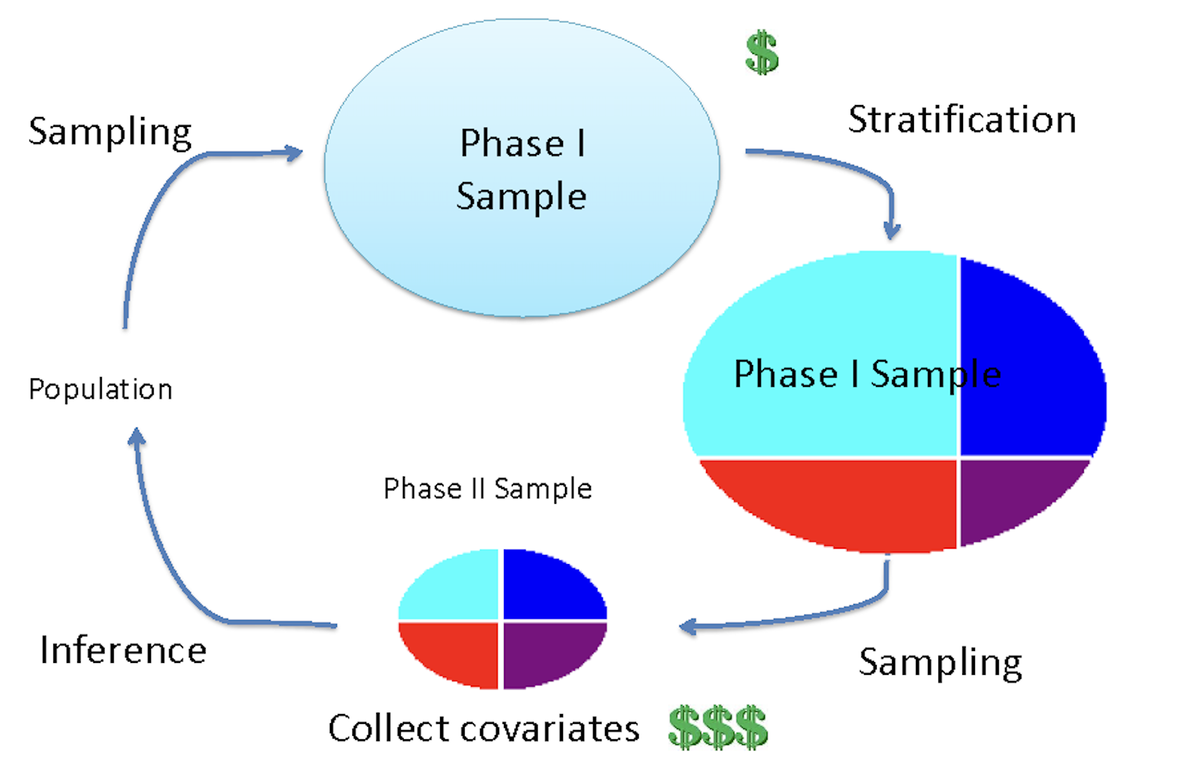
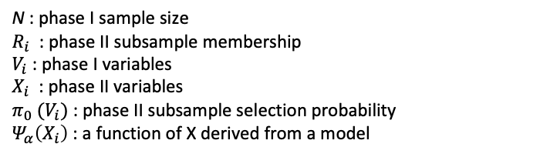

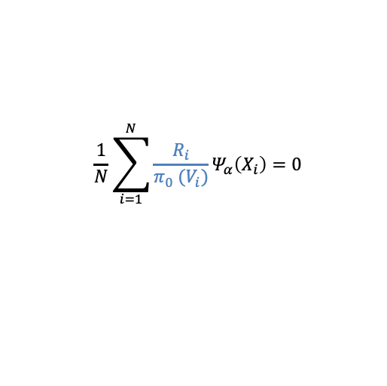

Improved Z-estimators from Two-phase VPS
Solution: IPW Estimating Equations for Two-phase Sampling Estimator $\hat{θ}$*
$$\frac{1}{N}\sum_{i=1}^{N}{{\frac{R_{i}}{π_{0} (V_{i})}Ψ}_{α}\left(X_{i}\right)}=0$$
$α$ = ($θ$, $Λ)$
N : phase I sample size
$R_{i}$ : phase II subsample membership
$V_{i}$ : phase I variables
$X_{i}$ : phase II variables
$π_{0} (V_{i})$ : phase II subsample selection probability
$Ψ_{α}\left(X_{i}\right)$ : a function of X derived from a model
Notes:
Now iwant to go the technical detail

Slide 31
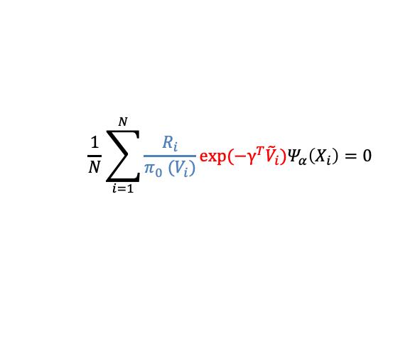

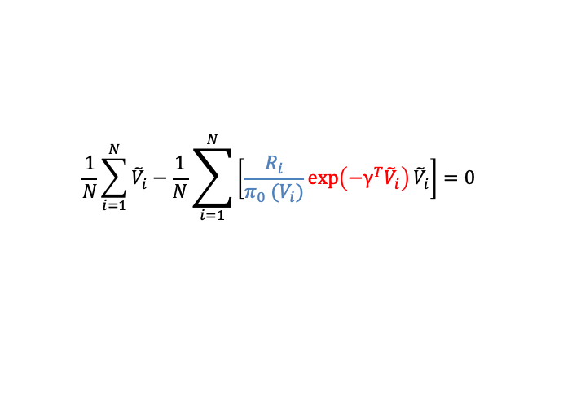
Improved Z-estimators from Two-phase VPS
Weight Calibration to Incorporate Auxiliary Variables
${\tilde{V}}_{i}$: auxiliary variables (calibration variables) allowing to be a function of any phase I variables $V_{i}$
$$\frac{1}{N}\sum_{i=1}^{N}{{\frac{R_{i}}{π_{0} (V_{i})}exp(−γ^{T}{\tilde{V}}_{i})Ψ}_{α}\left(X_{i}\right)}=0$$
$$\frac{1}{N}\sum_{i=1}^{N}{{\tilde{V}}_{i}}−\frac{1}{N}\sum_{i=1}^{N}{{\left[\frac{R_{i}}{π_{0} (V_{i})}\exp\left(−γ^{T}{\tilde{V}}_{i}\right){\tilde{V}}_{i}\right]=0}_{}}$$
Phase I observation
Phase II estimates
Notes:
The weights are ad345
justed so that the totals of V~ calculated based on the phase I observations
346 are exactly estimated by their phase II estimates with the adjusted weights
347 and the Poisson deviation between the original and the adjusted weights is
348 minimized. Using the Lagrange multipliers method yields a new set of
349 EEs taking the form as follows:

Slide 32
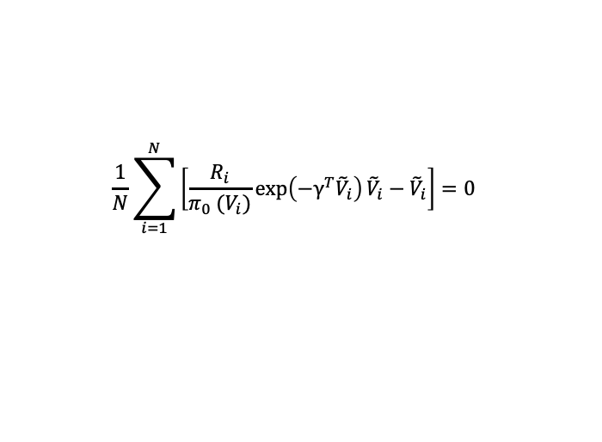
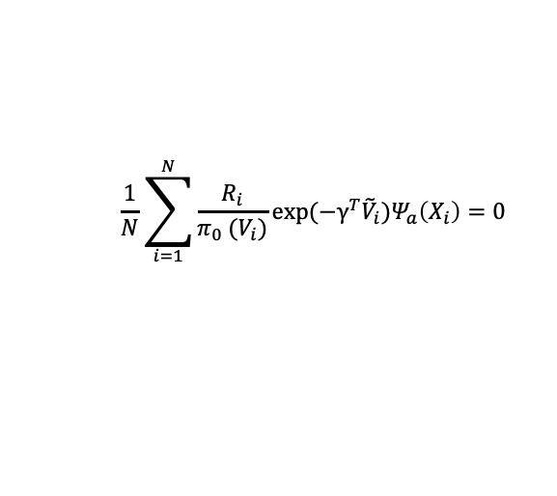


Improved Z-estimators from Two-phase VPS
New Inverse Probability Weighted Estimating Equation for Calibrated Z-estimator $\hat{a }$**
$$\frac{1}{N}\sum_{i=1}^{N}{{\frac{R_{i}}{π_{0} (V_{i})}exp(−γ^{T}{\tilde{V}}_{i})Ψ}_{a}\left(X_{i}\right)}=0$$
$$\frac{1}{N}\sum_{i=1}^{N}{{\left[\frac{R_{i}}{π_{0} (V_{i})}\exp\left(−γ^{T}{\tilde{V}}_{i}\right){\tilde{V}}_{i}−{\tilde{V}}_{i}\right]=0}_{}}$$
${\tilde{V}}_{i}$: auxiliary variables allowing to be a function of any phase I variables $V_{i}$

Slide 33
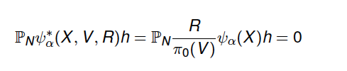
Inverse Probability Weighted Estimating Equation
$α$ is in a Banach space, e.g., $α$ = ($θ$, $Λ)$
$Ψ_{a}$ is a map in a Banach space: ${ Ψ}_{a} ε{ l}^{∞}\left(H\right)$
${\text{Given} h ∈H, Ψ}_{a}: h↦Ψ_{a}$ $h,{ Ψ}_{a}h∈R$

Slide 34
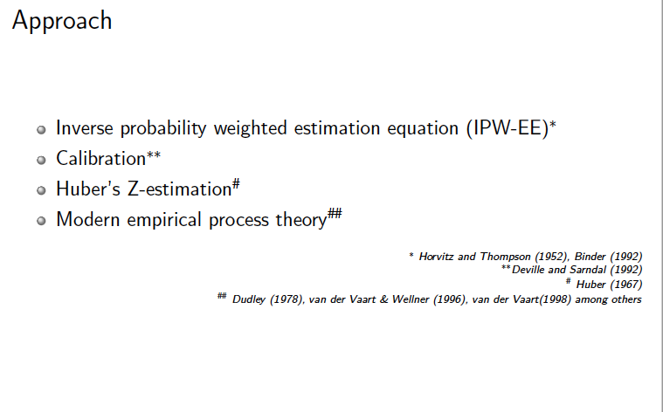
Solution: A Z-estimation System

Slide 35
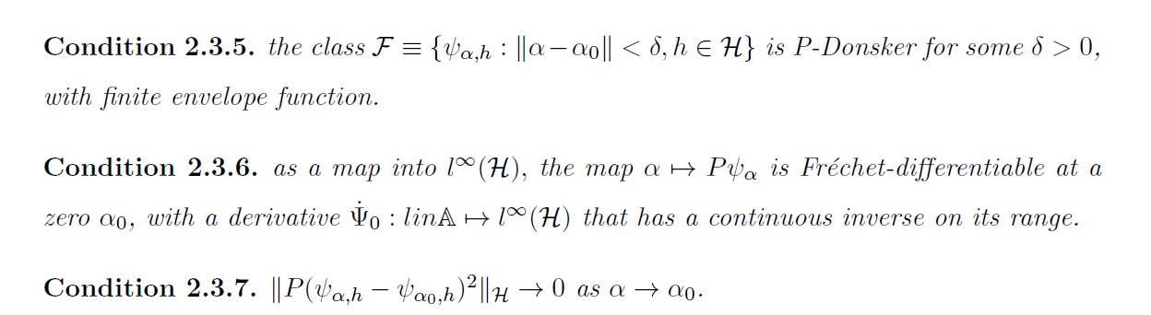
Asymptotic results
Main Conditions
Consistency
Limiting distribution

Slide 36
Reference
Norm E. Breslow, Jie Hu, Jon A. Wellner. Z-estimation and Stratified Samples: Application to Survival Models. Lifetime Data Analysis 21, 493-516.
Jie Hu. A Z-estimation system for two-phase sampling with applications to additive hazards models and epidemiologic studies.University of Washington ResearchWorks Archive PhD Diss.
Jie Hu, Norman E. Breslow, Gary Chan, Couper David. Estimating the Hazard Difference from Case-Cohort Studies”, European Journal of Epidemiology 36(11), 1129-1142.
Norman Breslow and Jie Hu. Survival Analysis of Case-Control Data: A Sample Survey Approach. Handbook of Statistical Methods for Case-Control Studies, Chapman and Hall/CRC.
Notes:
Victoria Ding and Jie Hu, R Shiny app: Additive Hazards
Jie Hu, Fit Additive Hazards Models for Survival Analysis, CRAN - Package addhazard
Tutorial: Analysis of a National Wilms Tumor Study dataset [code]

Slide 37
Reference
Victoria Ding and Jie Hu, R Shiny app: Additive Hazards
Jie Hu, Fit Additive Hazards Models for Survival Analysis, CRAN - Package addhazard

