Slide 1
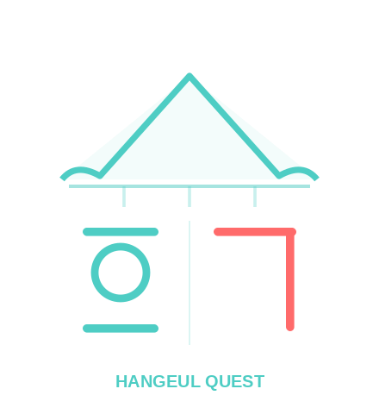


HANGEUL QUEST
Korean for the Real World
HQ Kids
Hangeul Quest
📱 Mobile App
hangeulquest.com · hangeulquestkids.com

Slide 2
😫
No Real Context
Why another
Korean app?
Grammar without situations doesn't stick.
📖
Textbook-Only
Kids tune out when it feels like homework.
Most Korean tools feel like textbooks — vocabulary lists, grammar drills, and sentences you'd never actually use.
🚫
No Clear Goal
No connection to real proficiency milestones.

Slide 3
OUR APPROACH
Language Learned Through Life, Not Through Lists.
1
2
3
4
🎬
📝
🔑
🎮
Scene
Vocab
Grammar
Practice
A real-life episode sets the stage — market, kitchen, school, park.
Words emerge naturally from the story you just watched.
Patterns in plain English, tied to what you just heard.
Games, quizzes, sentence building — not rote drills.
💡 Our Signature Approach:
Scene dialogs use casual teen speech (반말). Real Life sections model adult formal speech (존댓말).
Students hear — and feel — the difference naturally, in context, not from a rule chart.
Natural Exposure to Both Speech Registers — From Day One

Slide 4
Two Tracks, One Goal
Real Korean fluency — at every age.
HQ Kids
Hangeul Quest
👦👧 Ages 5–12, elementary level
🧑‍🎓 Teens & adults
🎮 Game-based micro-lessons
🎬 Scene-First episodes (drama-style)
🔤 Alphabet → grammar, step by step
🇰🇷 Culture + language, always together
⭐ Stars, rewards & adventure map
📋 TOPIK-aligned, structured progression
📱 hangeulquestkids.com
🌐 hangeulquest.com

Slide 5
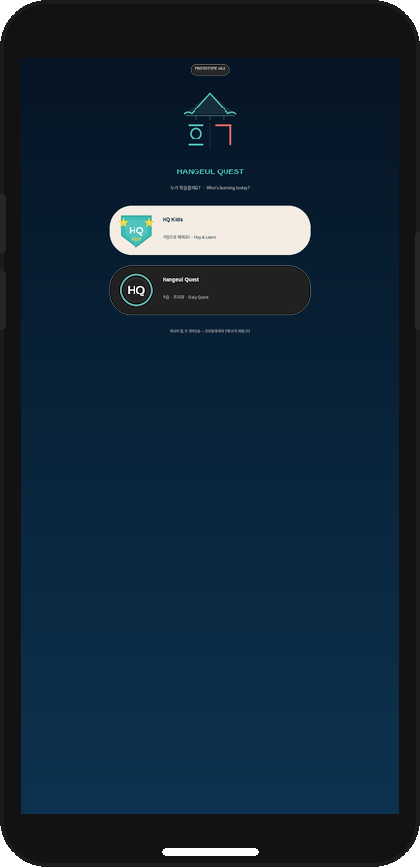
MOBILE APP
Korean in Your Pocket
5-minute daily sessions that build real habits — no app store needed.
📲 Installs from browser — no app store (PWA)
🛡 HQ Kids: adventure map + block-building games
⭕ HQ: episode replay + SRS flashcard review
🔥 Daily streak + star rewards
🔄 Progress syncs with full web platform

Slide 6
Clear Path to Real Proficiency
Our curriculum maps directly to TOPIK — the international Korean proficiency standard.
HQ Kids
Hangeul Quest
L1
Alphabet & Phonics
L1
Everyday Korean
Consonants, vowels, syllable blocks
Real conversations · TOPIK 1급 (A1–A2)
L2
Grammar Foundations
Subjects, objects, locations, verbs
L2
Real-Life Fluency
Complex expressions · TOPIK 2급 (A2–B1)
L3
Grammar Building
Past/future, negation, questions · A1
↔
L3+
Advanced Expression
L4–L6
TOPIK Prep & Pass
Nuanced speech · TOPIK 3–4급 (B1–B2)
TOPIK 1급 preparation → pass
TOPIK Aligned

Slide 7
What's Inside Every Lesson
🎬
Scene Episodes
🔊
Pro Audio (TTS)
🃏
Grammar Cards
Relatable real-life stories drive every unit — markets, kitchens, parks.
High-quality Typecast voice on every line of dialogue.
Pattern + example + plain English — never just a rule.
🗣️
Both Speech Registers
🇰🇷
Culture Built In
🎮
Games & Practice
Scene dialogs: casual teen speech. Real Life: adult formal Korean. Both, from day one.
Korean customs, food, etiquette — woven into every episode.
Drag, tap, fill-in, sentence building — feels like play.

Slide 8
OUR VISION
"Built by a Korean teacher for her grandchildren —
now open to every family."
· · ·
🌍 Any child, anywhere can fall in love with Korean.
🗣️ Both formal and informal speech — heard naturally, side by side, from the very first lesson.
🎓 A clear path from first letter to real fluency — TOPIK and beyond.

Slide 9
Start Your Korean Journey Today
For Children (Ages 5–12)
For Teens & Adults
HQ Kids
Hangeul Quest
hangeulquestkids.com
hangeulquest.com
Game-based · TOPIK-aligned · Free to try
Scene-First · TOPIK-aligned · Free to try
📱 Mobile App Available
No signup required · Learn at your own pace

