Slide 1

도란채 Doranchae
A free 40-minute Korean culture taster — for your students, in your classroom.
Proposal for [School Name] · Prepared by Kate (Haeok) Yu

Slide 2
THE ASK
One free class period.
40
$0
0
minutes, one class
cost to your school
prep on your end
Doranchae · doranchae.com
2

Slide 3



WHY KOREAN, WHY NOW
Your students are already curious.
Korean is Duolingo's fastest-growing language among U.S. learners — up 20%+ in 2025.
K-pop and K-dramas are driving the sharpest growth in language interest among ages 5–17.
For many students, this may be their very first real contact with the Korean language.
Doranchae · doranchae.com
3

Slide 4

WHO I AM
A Korean teacher who built a free curriculum from scratch.
Kate (Haeok) Yu
I run an online Korean school and spent the last two years building Doranchae — a complete, scene-based Korean curriculum, free during its beta. This visit uses the same material, just condensed into one fun class period.
Doranchae · doranchae.com
4

Slide 5




THE SESSION
40 minutes, four moments.
Write your name
Real greetings
K-culture connect
Keep going, free
Every student writes their own name in Hangul — the day's keepsake.
A handful of phrases they can actually use, today.
Korean words and phrases they've already heard in K-pop and K-dramas.
A QR code to a full, free curriculum — no account needed.
Doranchae · doranchae.com
5

Slide 6
WHAT YOUR SCHOOL NEEDS TO PREPARE
Nothing.
I bring the slides, the materials, and the activities. All I need is a classroom and about 40 minutes.
Doranchae · doranchae.com
6

Slide 7

WHAT STUDENTS WALK AWAY WITH
More than a fun 40 minutes.
Their own name, written in a completely new alphabet
A handful of real Korean phrases they can use immediately
A cultural connection to something many already love
A free way to keep learning, entirely on their own
Doranchae · doranchae.com
7

Slide 8
COST
$0
No fee to the school. No sign-up required for staff. No strings attached, now or later.
Doranchae · doranchae.com
8

Slide 9
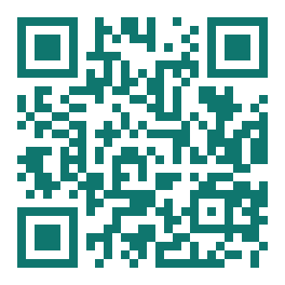
AFTER THE VISIT
The door stays open.
Doranchae is free through the end of 2026 beta — no card, ever, to try it
Start Here + Levels 1–2 are open to anyone, no account needed
24 full episodes of vocabulary, grammar, and practice, ready today
Scan to try it — doranchae.com
Doranchae · doranchae.com
9

Slide 10

Let's find 40 minutes.
I'll bring everything. You just say when.
Kate (Haeok) Yu
doranchae.com
[email] · [phone]

