Slide 1
UPLIFITING THE FARMER THROUGHT A CONNECTED ECOSYSTEM
PIP2001 Capstone Project
Review-0
Batch Number : CAI-G03
Under the Supervision of,
Dr. Akshatha Y
Assistant Professor - Senior Scale
School of Computer Science and Engineering
Presidency University
Roll Number | Student Name
20211CAI0148 | Kamini Prajapathi S
20211CAI0079 | Lavanya Ramachandra
20211CAI0165 | Mekala Sai Lakshmi
20211CAI0145 | Tejaswini K A
Name of the Program: CAI
Name of the HoD: Dr. Zafar Ali Khan
Name of the Program Project Coordinator: Dr. Afroz Pasha
Name of the School Project Coordinators: Dr. Sampath A K / Dr. Abdul Khadar A / Mr. Md Ziaur Rahman

Slide 2
Content
Problem Statement
Objective
Analysis of Problem Statement
Timeline of the Project
References

Slide 3
Problem Statement Number: PSCS59
Organization: Mahindra & Mahindra(FarmEq)
Category : Software
Problem Description : How can a farmer gain access to all the elements of his farming cycle ? one stop shop where he has access to information from different aggregators, for retailing , leasing & finally taking his produce to the nearest mandi. Application to provide a means of easy transaction for all his farming activities and his personal expenses. Agri credit should help him buy/lease Farm Machinery & have access to all the local vendors for his plantation needs including expert advice from the local university.
Difficulty Level: Complex
* The project is complex and faces challenges in real-time data integration
* Difficulty in finding machinery and taking farms for rent.
* Implementing features like weather data and mandi prices requires API integration.

Slide 4
Objective
Centralizing Information: Provide real-time access to retail, leasing, and market data from various aggregators.
Facilitating Transactions: Enable seamless transactions for farming activities and personal expenses.
Enhancing Credit Access: Offer tailored agri-credit options for purchasing or leasing machinery.
Connecting with Vendors and Experts: Link farmers to local vendors and agricultural experts for advice and support.
Streamlining Mandi Operations: Simplify the process of selling produce at local mandis.
Empowering Decision-Making: Equip farmers with data-driven insights for informed decision-making.
This platform aims to improve efficiency, productivity, and financial well-being for farmers, promoting sustainable agriculture.

Slide 5
Analysis of Problem Statement
Technology Stack Components:
Programming Language : XML- Frontend, JAVA- Backend
Database : Firebase
Toolkit : Android Studio
SDK : Android SDK

Slide 6
Analysis of Problem Statement (contd...)
Software Requirements:
Figma - To develop the UI/UX of the app
Android Studio - To develop the app
Firebase - For data storage

Slide 7
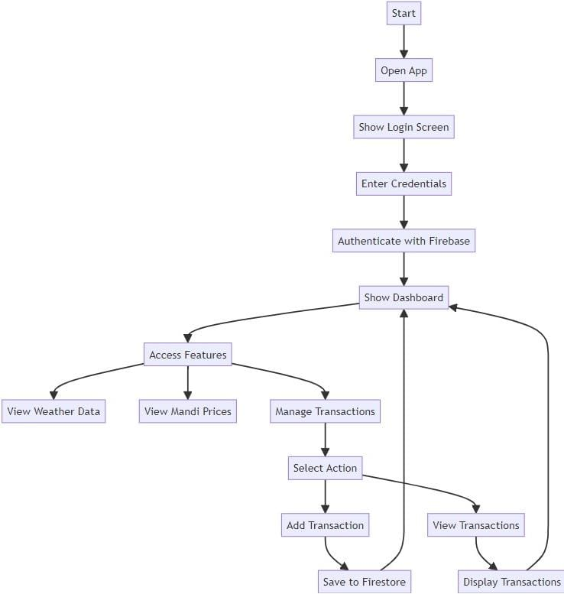
Analysis of Problem Statement (contd...)
Block Diagram for the Problem Statement :

Slide 8
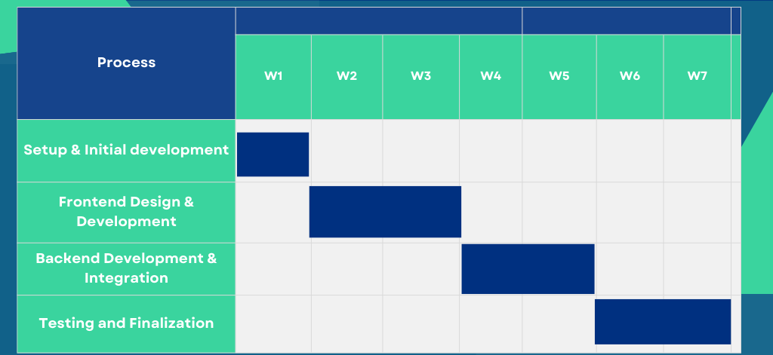
Timeline of the Project (Gantt Chart)

Slide 9
References (IEEE Paper format)
[1] Kamal, Mostafa & Bablu, Tarek. (2023). Mobile Applications Empowering Smallholder Farmers: An Analysis of the Impact on Agricultural Development. 8. 36-52.
[2] Kumar, Mr & Sahithi, Ms & Sheerin, Ms & Aakanksha, Ms & Reddy, Mr. (2022). UPLIFTING THE FARMER THROUGH CONNECTED ECOSYSTEMS. YMER Digital. 21. 537-542. 10.37896/YMER21.04/54.

Slide 10


