Slide 1
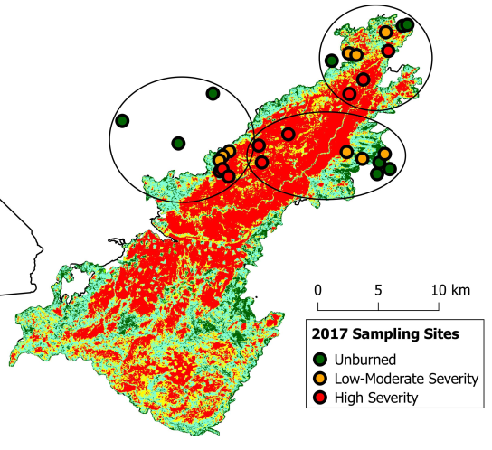
Big Fires and Small Mammals
Tab 1: The ‘King’ of mega-fires
Tab 1: Meet the mammals!
Tab 1: Measuring diversity
Sidebar with a widget
Here is a description of the King Fire!
General summary of the fire (where, what, how)
Why this project used the King Fire as a study system
Why fires are important to study
RADIO BUTTONS:
Unburned (outside the fire boundary)
Low-moderate severity
High severity
Output: map
Output: table
Output: photo
This map highlights the appropriate sites
This table displays summaries of the habitat characteristics
Metric | Value
Vegetation cover | 38%
Tree mortality | 84%
Tree diversity | Shannon index = 0.345
Tree biomass | 3.45 kg/m²
etc | etc
etc | etc
This is a photo from one of the sites

Slide 2
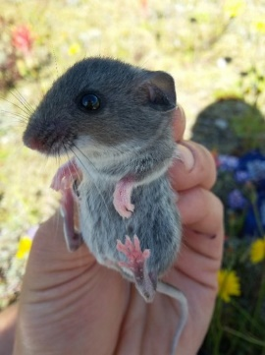
Big Fires and Small Mammals
Tab 1: The ‘King’ of mega-fires
Tab 1: Meet the mammals!
Tab 1: Measuring diversity
Sidebar with a widget
Output: table
Output: pie chart
RADIO BUTTONS:
North American deer mouse
Brush mouse
Trowbridge’s shrew
Long-eared chipmunk
Etc. etc.
This table displays a species description
Species | P. maniculatus
Activity time | nocturnal
Family | Cricetidae
Other information | Groovy facts
This pie chart displays the food preferences out of 6 categories for the selected species
Output: map
This map highlights where the species was captured
Output: bar graph
Output: photo
This is a cute photo of a smamm!
This graph displays the habitat preference for the selected species (how many individuals were found at sites across the fire severity gradient)

Slide 3
Big Fires and Small Mammals
Tab 1: The ‘King’ of mega-fires
Tab 1: Meet the mammals!
Tab 1: Measuring diversity
Sidebar with widgets
SLIDER BARS
North American deer mouse
Brush mouse
Trowbridge’s shrew
Long-eared chipmunk
Etc. etc.
ACTION BUTTONS
Unburned
Low-Moderate Severity
High Severity
Output: bar graph
Static bar graph
This graph displays three metrics of diversity depending on the abundances of the species:
Species diversity (Shannon index)
Functional diversity
Phylogenetic diversity
This graph displays the average diversity metrics for the three fire severities, for comparison.

Slide 4
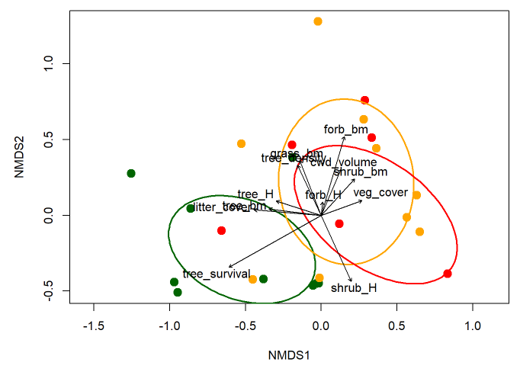
Big Fires and Small Mammals
Tab 1: The ‘King’ of mega-fires
Tab 1: Meet the mammals!
Tab 1: Measuring diversity
BONUS TAB*** Visualizing community composition
If you mouse over the points, they’ll tell you information about that site.
***can’t decide the best way to go about this and so leaving it undeveloped for now

