Slide 1
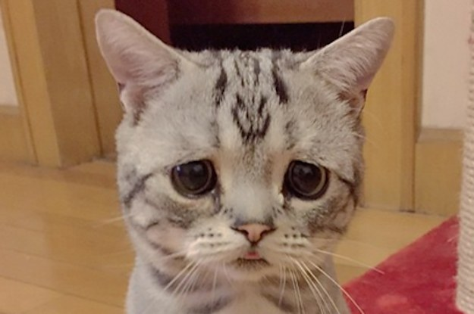
Y u no use my purrgram?
Start Microscope software?
No
LCD Screen
Yes
Raspberry Pi
Microscope control software
User starts
Stackshot
Microscope
Focused image displayed
Stackshot software
Sample
Stackshot
Captures Images
Images saved
Focused image created
Stacking software

