Slide 1
ECE 453
Embedded Microprocessor System Design
Soldering 101
Michael G. Morrow, P.E.

Slide 2
Relevant Terminology
Through-hole
  Component leads are soldered into holes (plated or unplated) in the PCB
Surface mount (SMT)
  Component electrode are soldered to copper areas (pads/lands) on the PCB surface
Restriction on Hazardous Substances
  EU directive (RoHS) banning the use of certain materials including Pb, Hg, and Cr(VI)
  Forced lead-free soldering technologies

Slide 3
Relevant Terminology
PCB (printed circuit board)
  Aka PWB (printed wiring board)
  Non-conductive substrate (i.e. FR4) with plated copper layers
    Simplest is a single substrate with one or both sides plated
    Stacked layers used to create 4+ layer PCBs
  Top/bottom coated with soldermask except on component pads
    Exposed copper is plated (HASL, ENIG, etc)
  Silkscreen layer for component names, etc.

Slide 4
What Soldering Is NOT
It is NOT welding – the materials being joined do not melt and fuse together
It is NOT a substitute for a good mechanical connection – it is a relatively weak metallic bond that will break if stressed
It will NOT make a good electrical connection to dirty/corroded compents or PCBs – the solder must wet onto the surfaces being joined

Slide 5
Types of Solder
Solders are generally alloys that are designed to achieve certain properties.
Leaded
  Sn60/Pb40 (MP=183-190C)
  Sn63/Pb37 (MP=183C) *this is what we use in the lab
Lead-free
  Sn96.5Ag3.5 (MP=221C)
  Sn96.5Ag3.0Cu0.5 (MP=217-220C)
  Sn99.3Cu0.7 (MP=227C)
  Sn100 (MP=232C)

Slide 6
Fluxes
Fluxes clean the surfaces and promote wetting
Rosin Fluxes
  RMA (rosin, mildly active) most commonly used
  Leaves sticky residue that must be cleaned with solvents (i.e. alcohols)
Water Soluble Fluxes
  Flux residue is removable with hot water
No-Clean Fluxes *this is what we use in the lab
  Flux residue can be left on board
  Inert and “visually acceptable”
Acid fluxes are for plumbers!

Slide 7
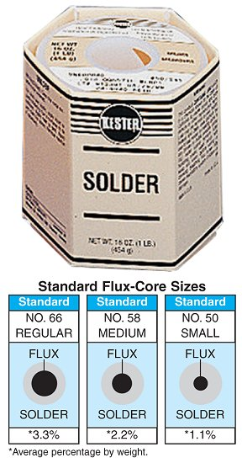
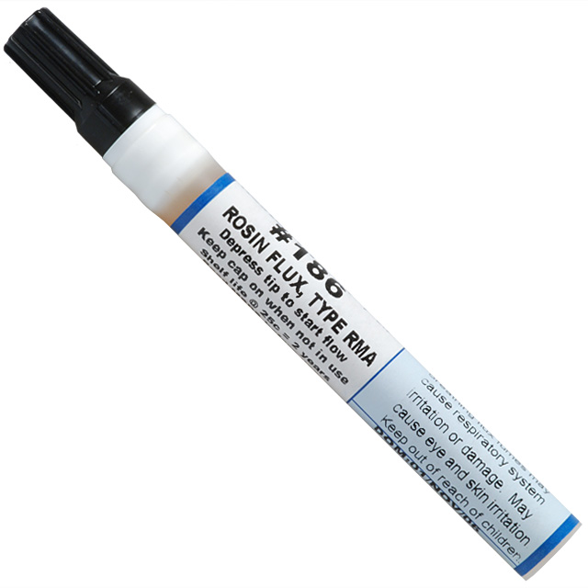
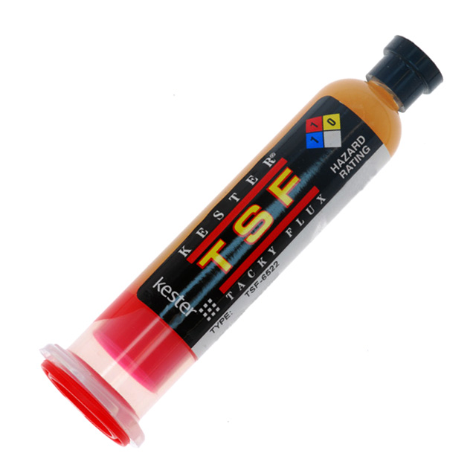
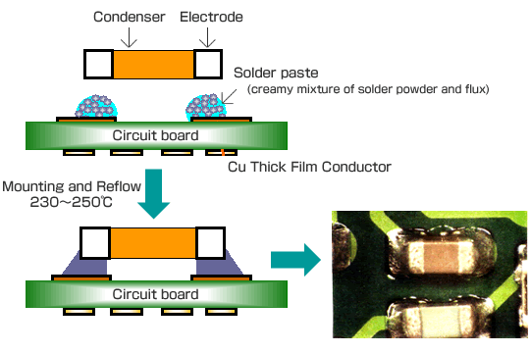
Fluxes
Flux delivery
  Flux-core solder
  Flux pens
  Tacky flux
  Solder paste

Slide 8
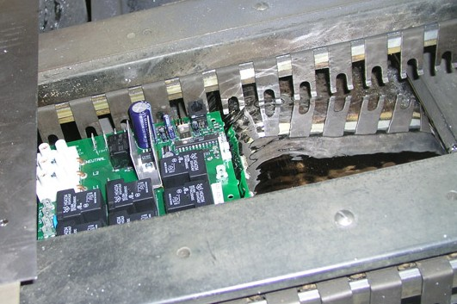
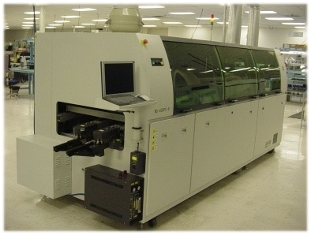
Industrial Soldering Processes
Wave Soldering
  The PCB is passed over a standing wave of molten solder
  Used for through hole and some SMT parts
  May use an inert atmosphere to reduce dross

Slide 9
Industrial Soldering Processes
Reflow Soldering
  The PCB is stenciled with solder paste where SMT component electrodes will be located
  Components are positioned on the board by a pick-and-place machine
  The board is heated in a reflow oven through a closely controlled temperature profile to melt the solder paste
  If components are on both sides, can glue the bottom components or make two passes by tight temperature control on bottom side

Slide 10
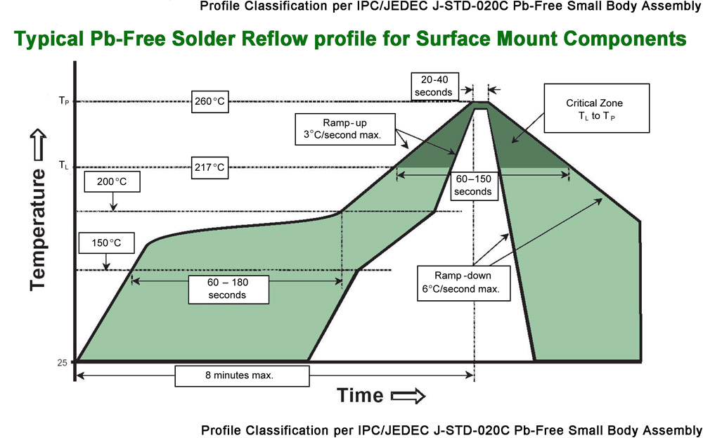
Reflow Temperature Profile

Slide 11
Leaded Solder Joints
Good
  Has a shiny appearance
  Wets onto the parts being soldered
  Concave surfaces at corners and joints
Bad
  Dull or matte texture
  Does not wet onto components
  Convex or bulging shape
The Good, The Bad, and The Ugly

Slide 12
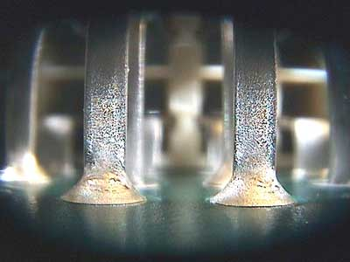
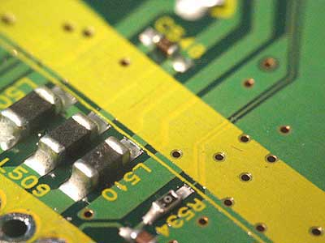
Lead-Free Solder Joints
Good
  Has a matte appearance
  Wets onto the parts being soldered
  Should be concave

Slide 13
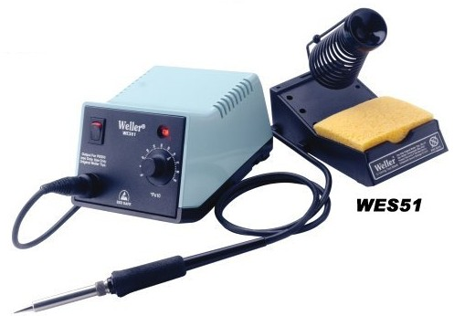
Soldering Irons
Set at 720F
Sponge is to be damp, not soaking wet
Clean the tip (if necessary) BEFORE soldering
  Do NOT clean the tip before putting back
  Ensure tip has solder on it AFTER using to protect it from oxidation

Slide 14
Hand-Soldering Techniques
Through-hole components
  Ensure component lead and PCB land are clean, and component is securely positioned
  Tip should be clean
  Gently put the tip in contact with both the lead and land
  Touch the solder to the lead and land, not the tip. Let the solder flow into the joint and through the barrel
  You may need to add a little solder to the tip to get good thermal transfer to the lead and land

Slide 15
Hand-Soldering Techniques
Surface mount components
  Put a little bit of flux on the pads
  Hold the component with tweezers, and tack one or more leads to the PCB
    Depending on the PCB, may need to put a bit of solder on the pads
  Verify placement
  Solder the remaining leads
  Resolder the lead(s) that were tacked

Slide 16
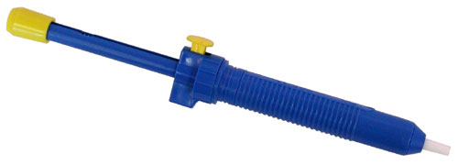
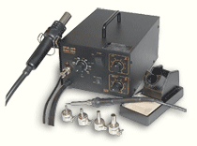
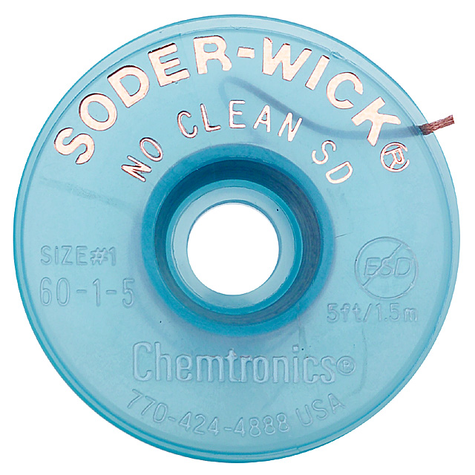
Hand-Soldering Techniques
Desoldering
  Solder wick
  Solder suckers
  Desoldering stations

Slide 17
Today’s Assignment
Obtain a small circuit board
  Mark PCB with your team number
  Solder in the following
    Solder the 1/4W resistor somewhere in J5
    Solder the 0805 resistor as R2
    Solder the SOT-23 transistor as Q2
    Solder the SOIC-14 as U1
      Use tacky flux (sparingly!) on pins 1-7 only, solder 8-14 without using added flux
      Match the part orientation shown on the silkscreen
Turn PCB into Dan when complete

Slide 18
Soldering 101
Who cares about soldering?
  Knowing how to solder correctly is a very useful skill for an engineer, both to be able to do it yourself and to know if others are doing it correctly
  The soldering process affects how a design will handle environmental stresses
    Device packages are more or less able to handle environmental stresses (i.e. BGA versus leaded packages)
That’s a wrap!

Slide 19
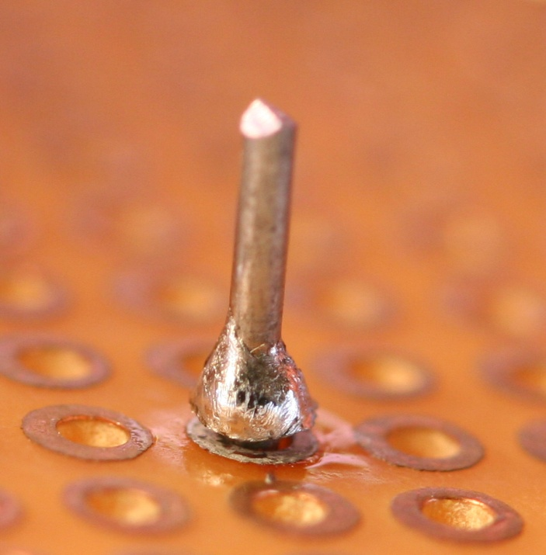
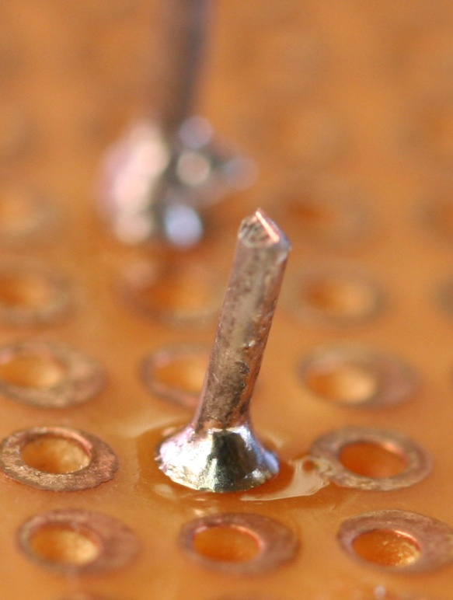
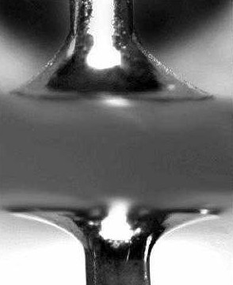
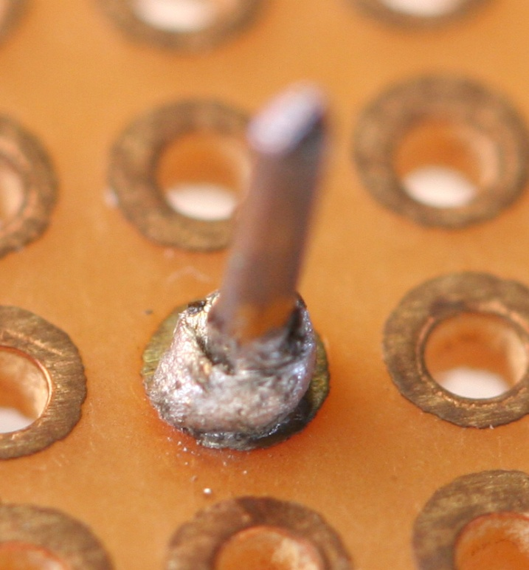
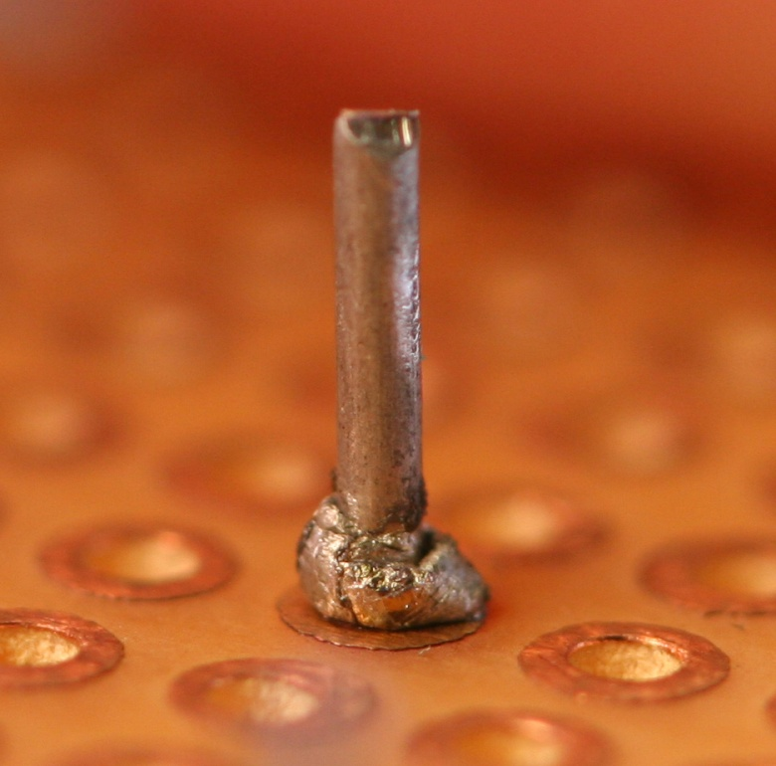
Solder Joints

