Slide 1
The Salmon Crisis
12/2/2019
Katelyn Morrison
ENGR 1905

Slide 2
The Challenge: Genetic Diversity
each year, only 2,000 adults will return out of the 400,000 salmon smolts they release.
Domestication and man-made structures are a huge component in the decimation of wild fish populations and their ability to maintain a healthy population

Slide 3
Adult Holding Pond
Spawning Shed
Hatchery Incubation Building
Fish ladders
Pacific Ocean
Raceways
Local rivers
The Salmon Lifecycle

Slide 4
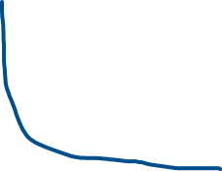
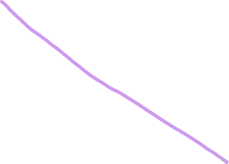
Consumer Theory Example
Budget = $1000
Price of Chicken = $10/pound
Price of Salmon = $20/pound
Price of Salmon after wild population can sustain themselves = $5/pound

Slide 5
Solutions
Create subsidies for hatcheries that follow the “stepping-stone” model for breeding practices.
Create taxes for counties or townships that build dams on major rivers that feed into a hatchery upstream.
Make it easier for hatcheries to have access to a wild population to breed from.
Strengthen the data collection process on the salmon
Automate it; use machine learning to predict domestication of breed in future.

