Slide 1
What Actually Explains
Life Expectancy
A Global Health Data Story · 215 countries and territories, 2000-2023
Katelyn Rakonjac | 17:610:554 Information Visualization & Presentation | Term Project

Slide 2
THE QUESTION
Which variables actually move life expectancy,
and which just ride along with wealth?
Life expectancy is the number news stories use to sum up a country's health. But it's really the output of a bunch of quieter variables working together: healthcare spending, physician supply, national wealth, chronic disease, tobacco use, urbanization, connectivity, and more. This project tests each one against real data instead of assuming which ones matter.
215
countries & territories
24
years of data (2000-2023)
11
independent variables tested

Slide 3
APPROACH TAKEN
Design choices behind the analysis
Diverging color, not sequential
Animated by year
1
Map recolored: orange–blue diverging palette, custom midpoint at 70 years.
2
Added Year to the map's Pages shelf so it plays 2000 → 2023, like the motion charts.
A third variable, tested first
One trend line, not seven
3
Tried a few candidates with a trend line, then added Physicians per 1,000, the tightest fit of the group.
4
Unchecked Region as a trend-line factor so each chart shows one overall line.
Three dashboards, cross-highlighted
5
Map + charts paired with Highlight Actions set to All Fields.

Slide 4
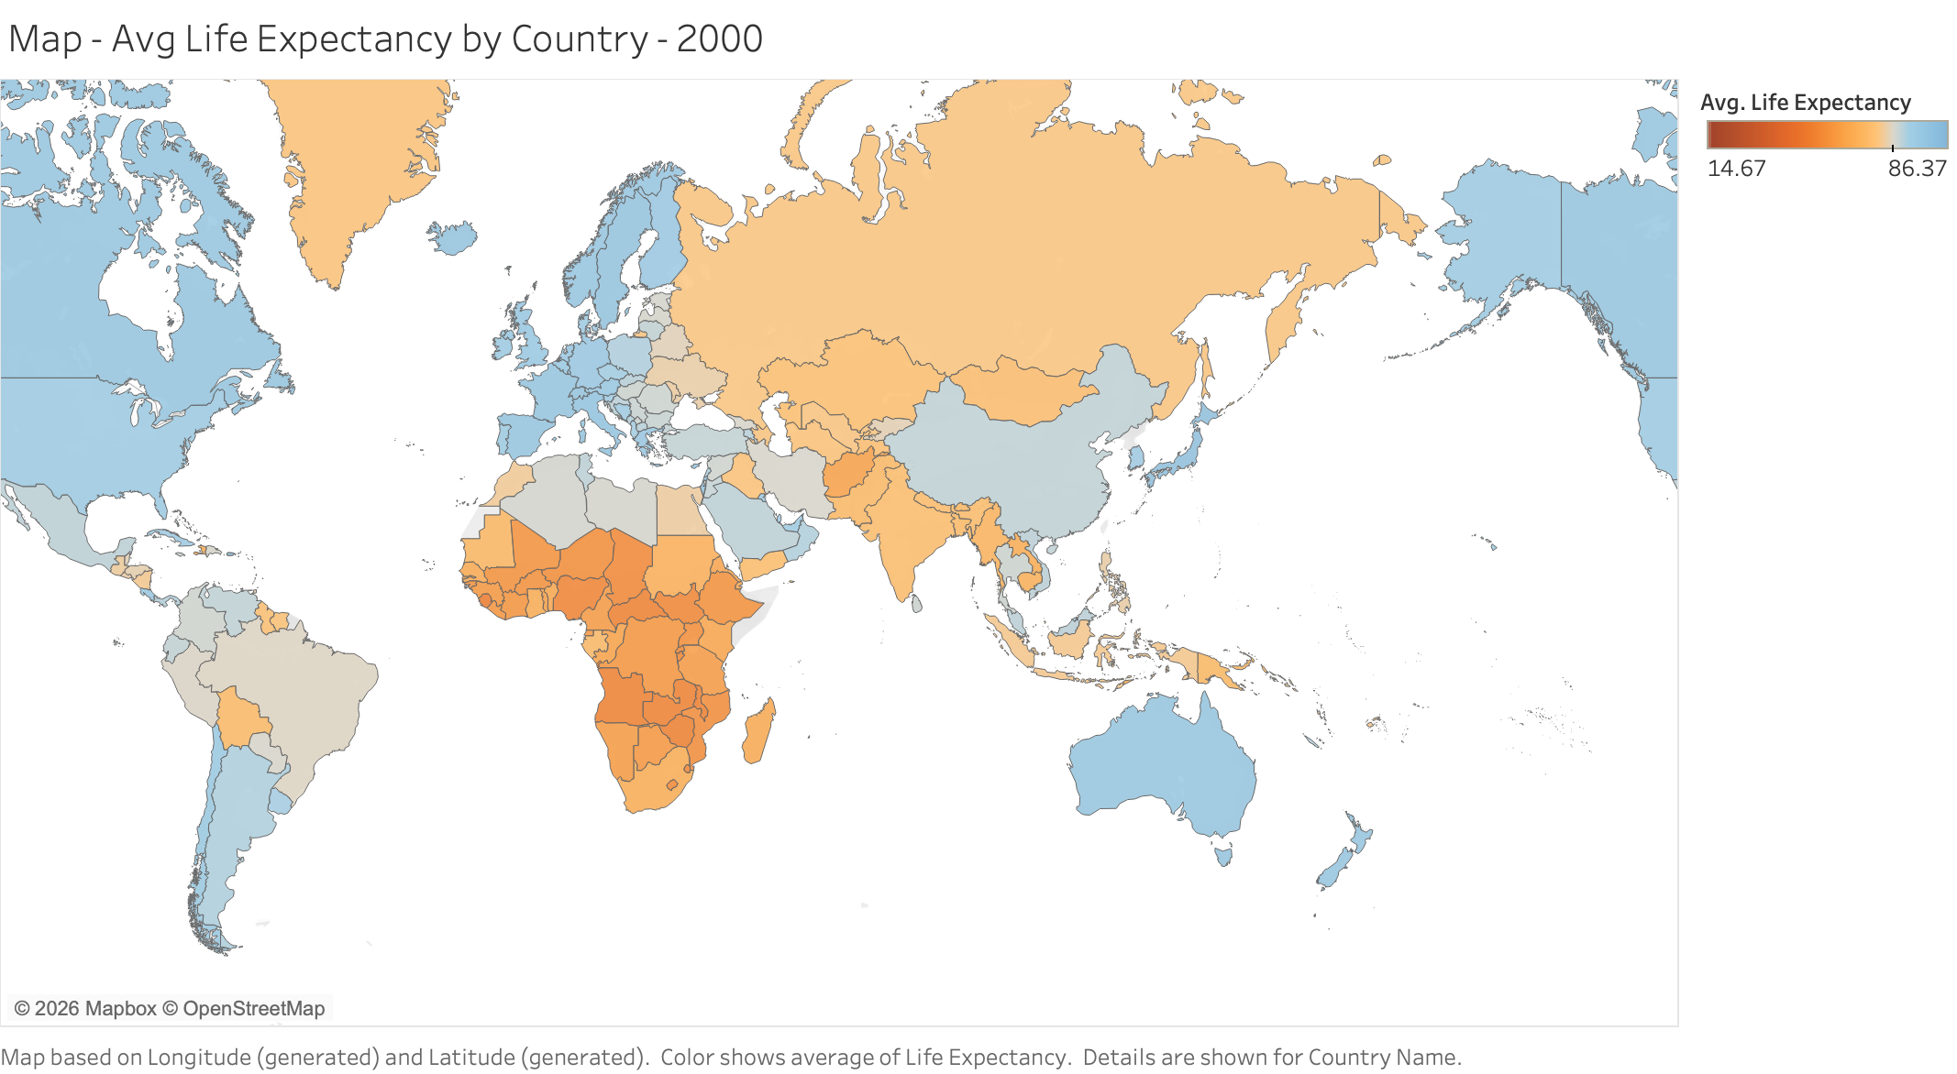
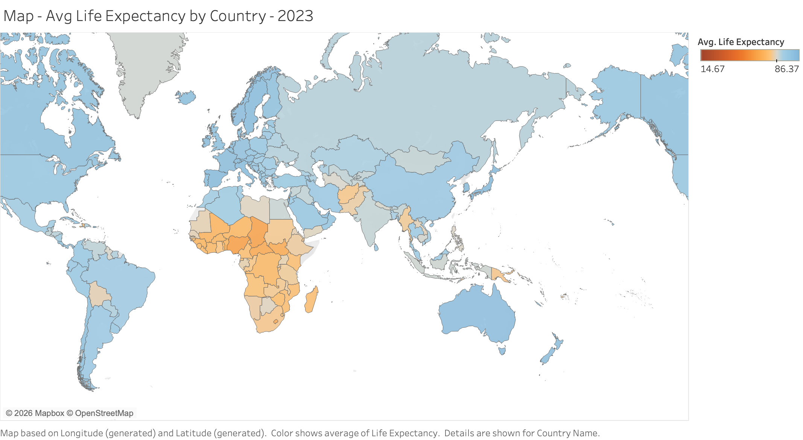
VARIABLE 1 · THE MAP
A 23-year gap that's slowly closing
2000
2023
READING THE MAP
Orange is below the 70-year midpoint, blue is above it. Most of South and Southeast Asia crosses into blue by 2023. Sub-Saharan Africa is the one region that mostly hasn't. A sequential scale would have hidden this; it would just look like a lighter shade of the same color.

Slide 5
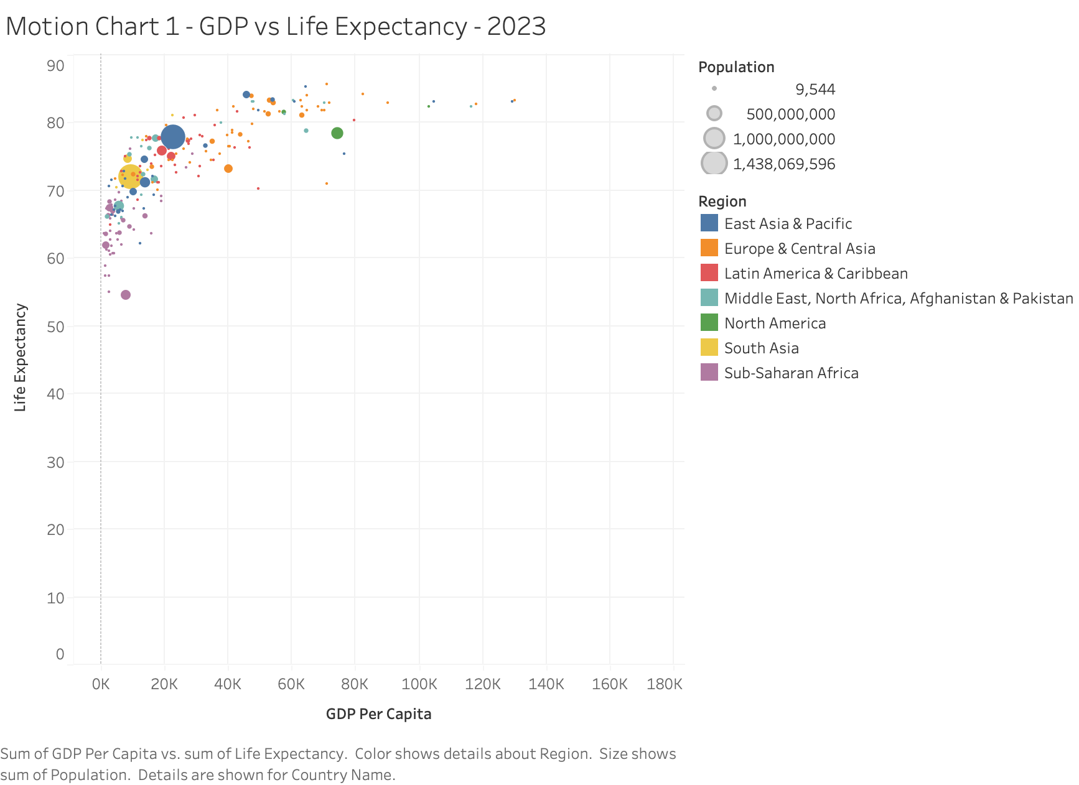
VARIABLE 2 · MOTION CHART
GDP per capita: strong, but not a straight line
THE PATTERN
GDP per capita and life expectancy clearly move together, but not in a straight line. The scatter curves, it doesn't run straight.
WHAT IT MEANS
Life expectancy climbs steeply from $0 to $20K per capita, then flattens. Nations above roughly $40K cluster near 80 to 85 years no matter how much richer they get from there. Classic diminishing returns.

Slide 6
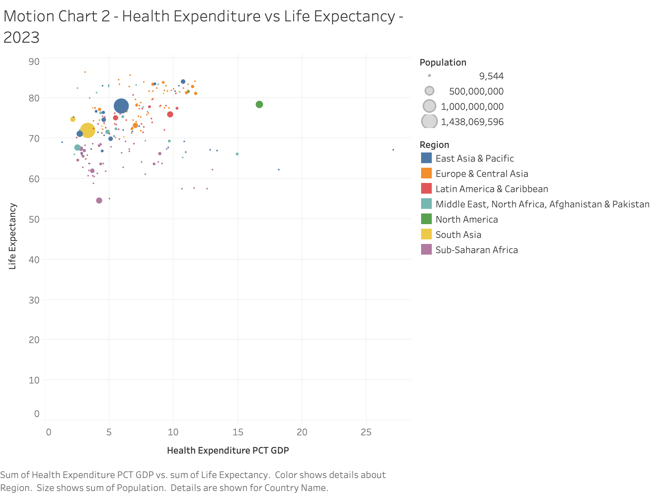
VARIABLE 3 · MOTION CHART
Health spending share: necessary, not sufficient
THE PATTERN
The messiest relationship of everything I looked at, barely any consistent pattern.
WHAT IT MEANS
Some countries spend 15 to 20% of GDP on health and still sit in the 60s and 70s. Others spend under 5% and land above 75. Spending share alone doesn't say whether that money is spent well.

Slide 7
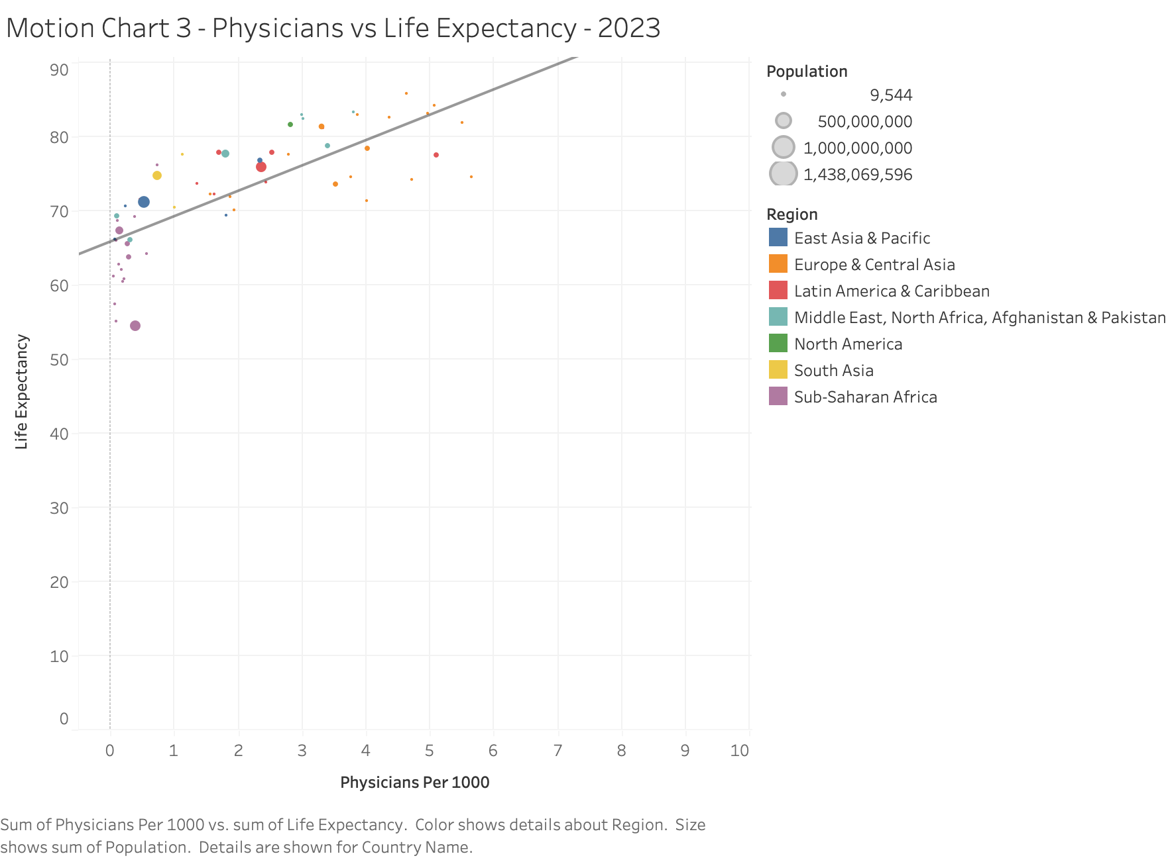
VARIABLE 4 · MOTION CHART
Physicians per 1,000: the stronger, quieter driver
THE PATTERN
Tracks life expectancy far more closely than health-expenditure share does. Points sit much tighter around the trend line than they did on the spending chart.
WHY IT MATTERS
Chosen after testing candidates instead of guessing. Next to the spending-share slide, it suggests how a country spends on healthcare, building out its physician workforce, matters more than how much it spends as a percent of GDP.

Slide 8
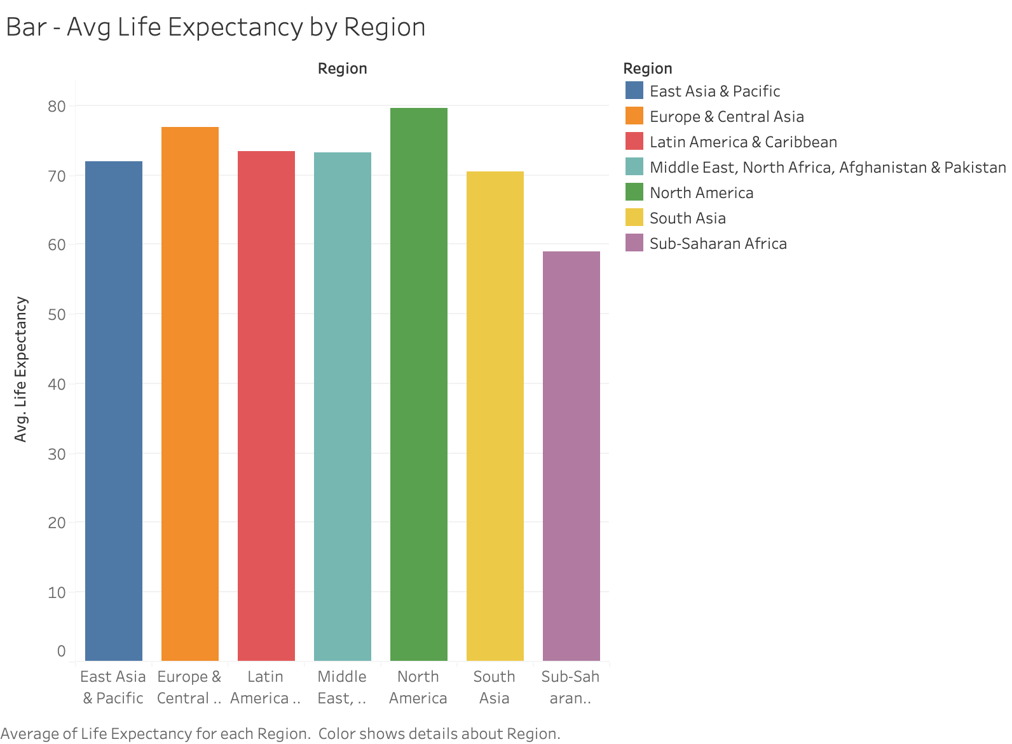
VARIABLE 5 · REGIONAL COMPARISON
The regional gap, in one bar chart
58.97
Sub-Saharan Africa (lowest)
79.63
North America (highest)
20.7 yrs
gap between them
At the country level in 2023: Monaco (86.4), San Marino (85.7) and Hong Kong (85.2) lead; Nigeria (54.5), Chad (55.1) and Lesotho (57.4) trail. That's a spread of about 32 years in a single year.

Slide 9
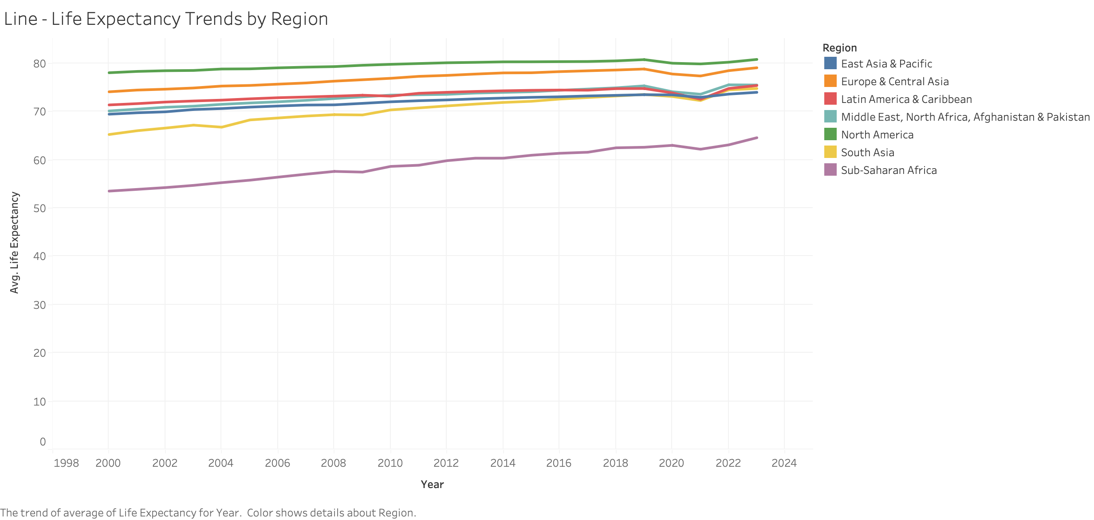
VARIABLE 6 · TREND OVER TIME
Steady progress, then a visible dip
READING THE TREND
Global average life expectancy rose from 67.6 years in 2000 to 73.8 in 2023. It's not a straight climb though. Nearly every region dips between 2019 and 2021 (global average fell from 73.0 to 71.8) before recovering by 2022 and 2023, timing that lines up with COVID.

Slide 10
FURTHER ANALYSIS
Five more variables worth testing
Beyond physicians per 1,000, I pulled five indicators from the World Bank's World Development Indicators. Variables 1 through 6 came from a dataset I'd already worked with; these five didn't, and full year-by-year coverage isn't available for them the way it is for GDP, health expenditure, and physicians. So each is tested as a single scatter against life expectancy using the most recent year available per country, for the same 215 countries and territories.
1
Urban population (% of total)
2
Internet users (% of population)
3
Unemployment (% of labor force)
4
Access to electricity (% of population)
5
Population density (people per sq. km)

Slide 11
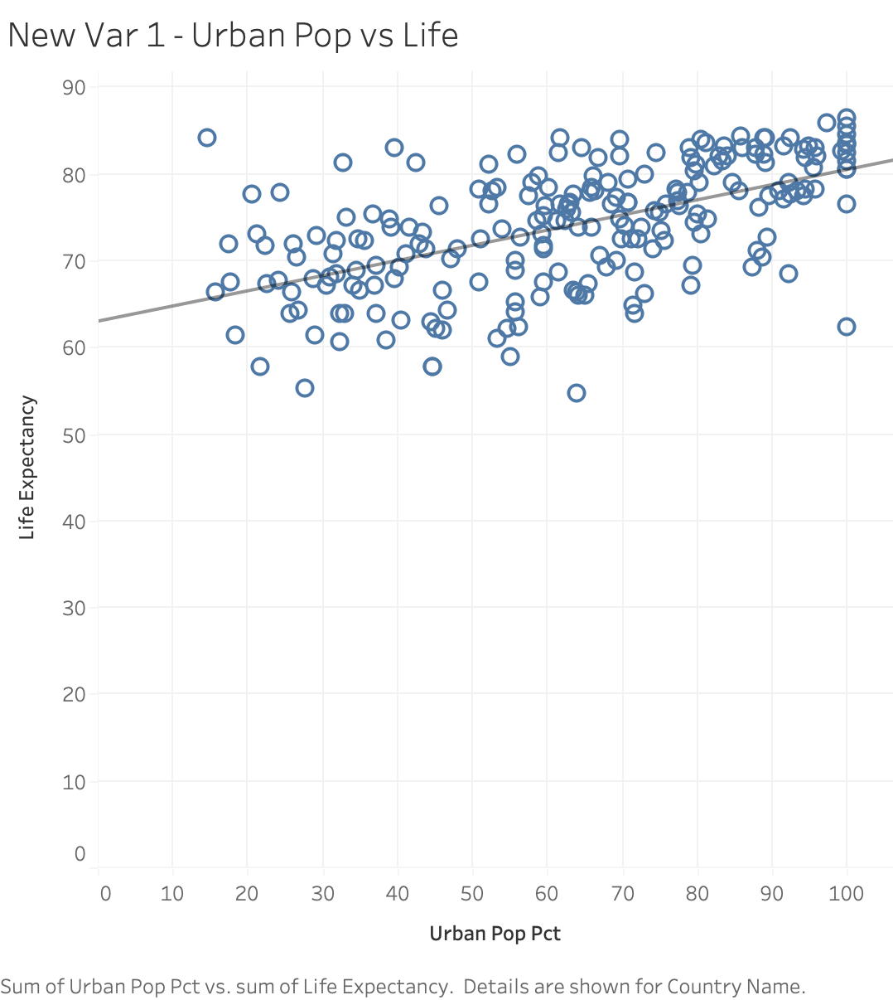
VARIABLE 7
Urban population: a looser version of the GDP pattern
THE PATTERN
Countries with a larger urbanized share tend to have higher life expectancy, though looser than GDP's relationship.
WHAT IT MEANS
Mostly rural countries cluster in the 60s. Highly urbanized countries spread from the high 60s to the mid-80s. Urbanization tracks with development generally, but it's a real, independent pattern here.

Slide 12
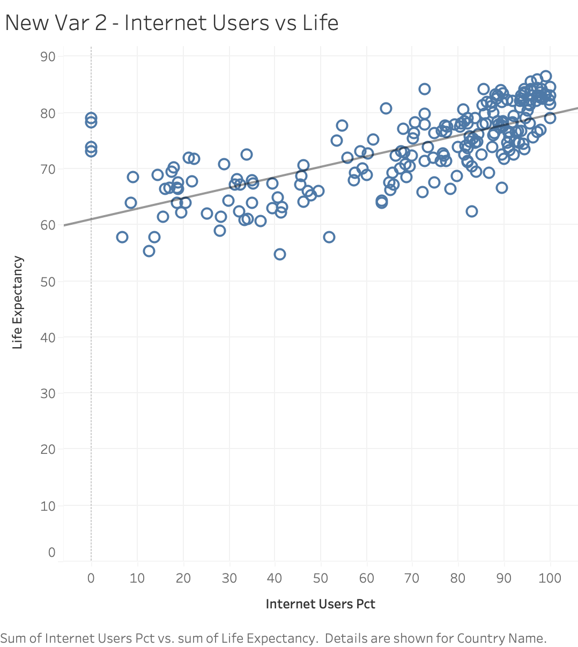
VARIABLE 8
Internet use: the tightest of the five new variables
THE PATTERN
The cleanest relationship of the five. Low-internet countries sit mostly in the 55-to-70 range; life expectancy climbs steadily as internet use rises.
WHAT IT MEANS
Likely stands in for overall development and infrastructure rather than internet access itself doing the work, but it's the closest fit of anything tested besides GDP.

Slide 13
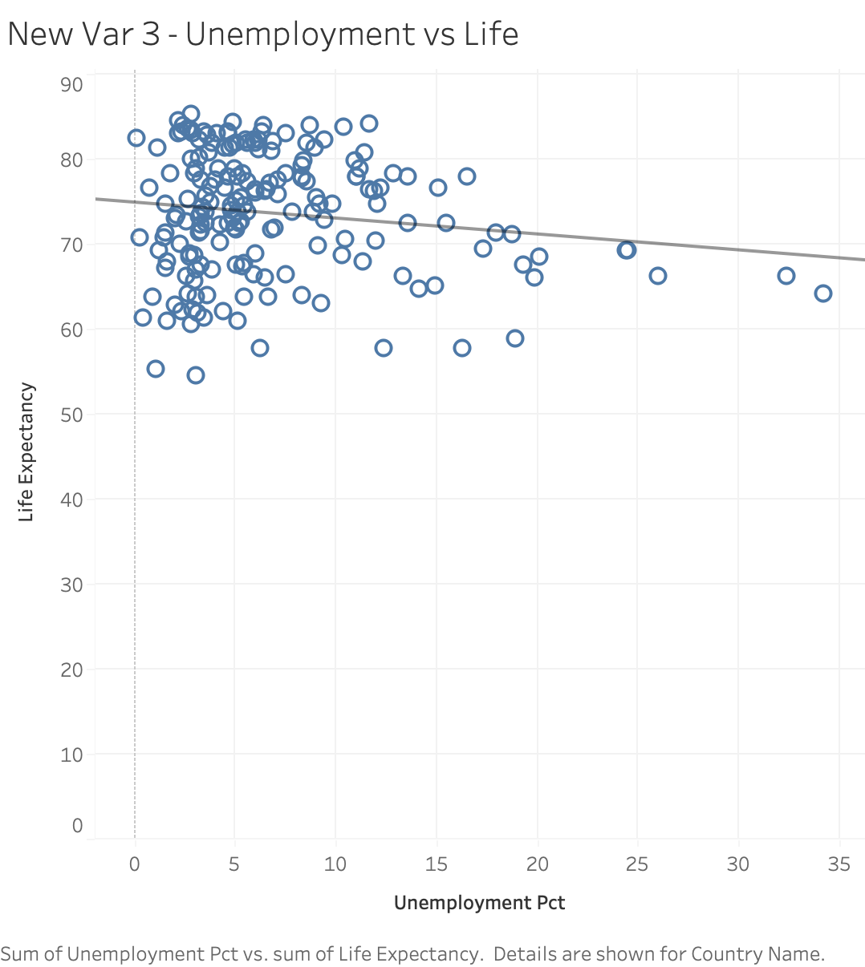
VARIABLE 9
Unemployment: no real pattern
THE PATTERN
The weakest of the five. Points scatter fairly evenly across the low-to-middle unemployment range regardless of life expectancy.
WHAT IT MEANS
My guess: official unemployment counts formal job-seekers, so it under-counts joblessness where informal economies are large, and reads as normal background noise in wealthy countries with strong safety nets. It's also a one-year snapshot tied to the business cycle, while life expectancy reflects decades of infrastructure. Different timescales, different economies, same number.

Slide 14
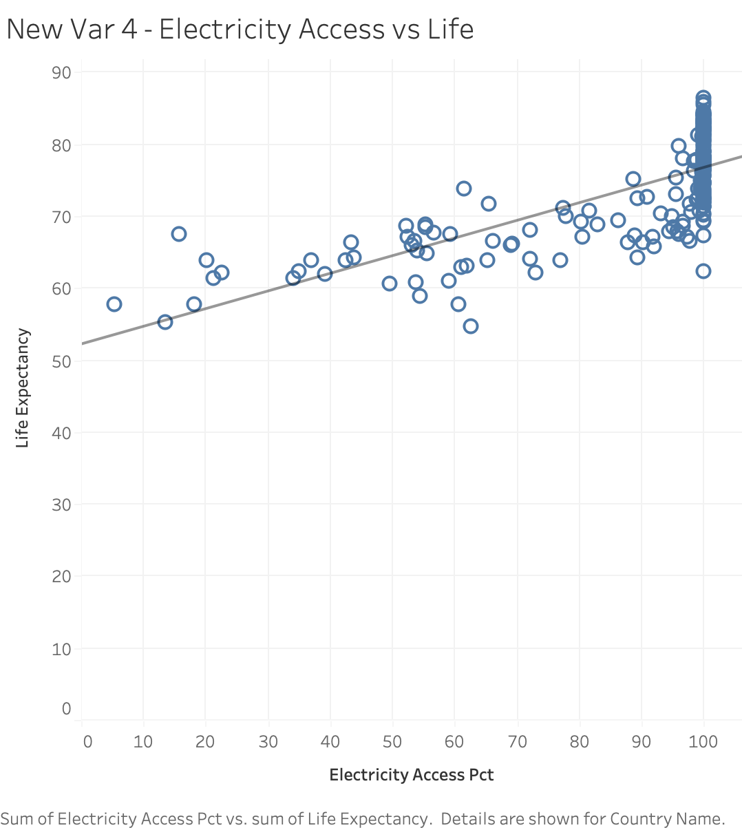
VARIABLE 10
Electricity access: strong, but with a ceiling effect
THE PATTERN
Most countries already have universal or near-universal access, so variation is packed into the lower end of the scale.
WHAT IT MEANS
Where access is incomplete, life expectancy is consistently lower. But countries clustered at 100% access still span a wide range, from the 60s to the high 80s: a floor, not a predictor, once cleared.

Slide 15
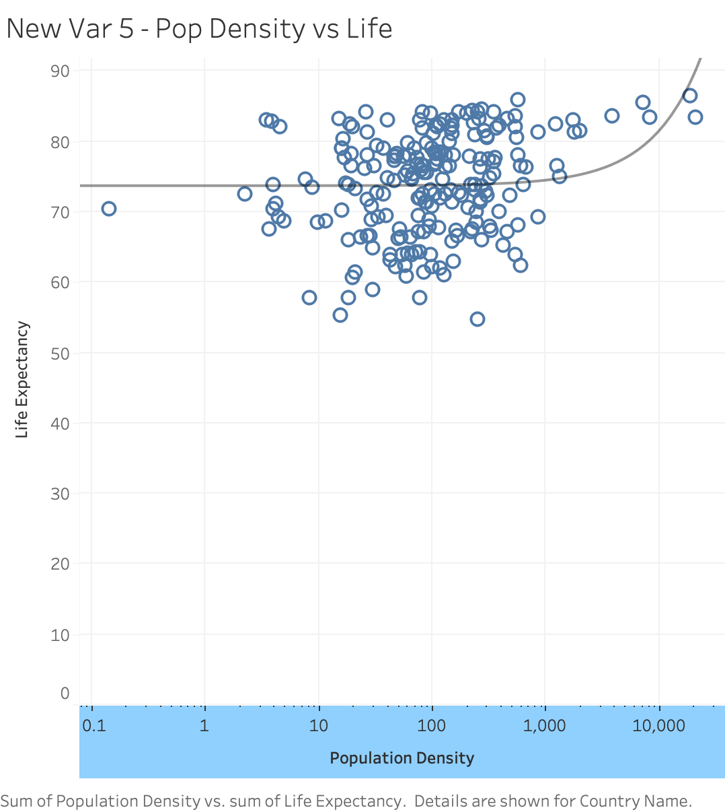
VARIABLE 11
Population density: weaker once the scale is fixed
THE PATTERN
A few outliers (Monaco, Singapore) are so much denser than everywhere else that the chart is unreadable without a log scale, so density is plotted logarithmically here.
WHAT IT MEANS
My guess: density is measuring two different things here. Tiny wealthy city-states (Monaco, Singapore) are dense purely for lacking land area, unrelated to health, while dense poor urban areas can carry real health costs. Much of this chart is really land area, a geographic accident, not a development signal.

Slide 16
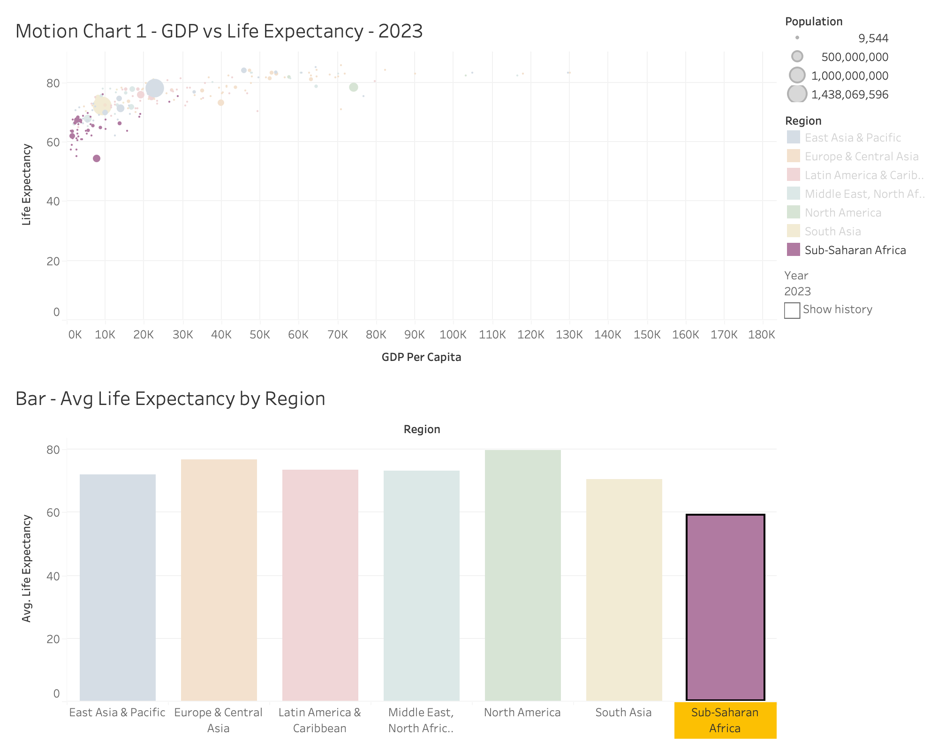
DASHBOARD 1
Wealth and Regional Comparison
HOW IT'S USED
Motion Chart 1 (GDP vs. life expectancy) paired with the regional bar chart. Press play on the Year control and the bubble cloud sweeps upward and right over 23 years.
Click any bubble and its region highlights in the bar chart below. Highlighting is set to All Fields, so the link between one country and its regional average is one click away.

Slide 17
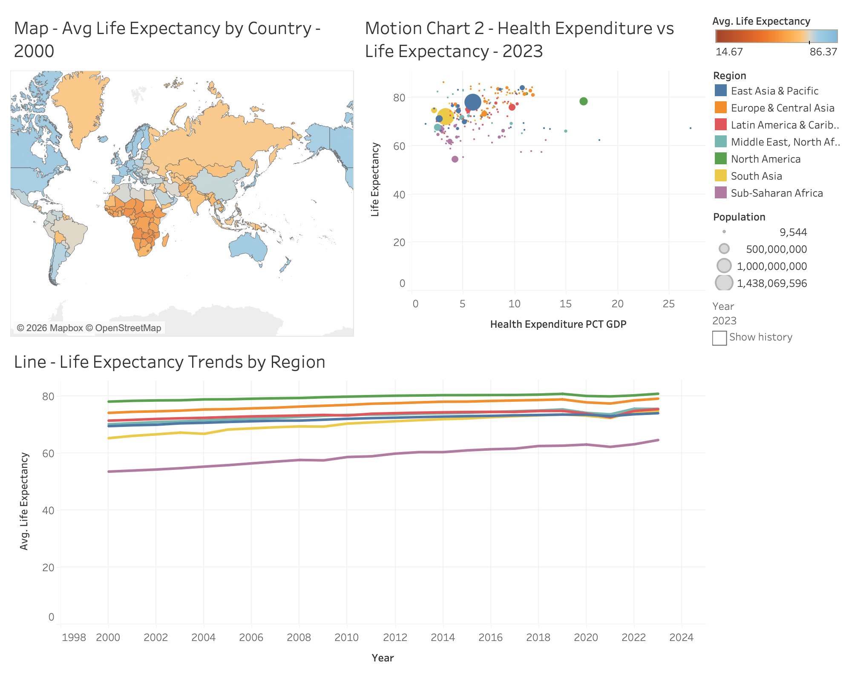
DASHBOARD 2
Geography, Spending, and Time
READING THE VIEW
The map, the health-expenditure motion chart, and the 23-year trend line, cross-highlighted together.
Click a country on the map to see how its spending compares to neighbors and where its region's trend line sits. Each view keeps its own Year control, since Tableau animates the Pages shelf per worksheet, but one click still ties all three together.

Slide 18
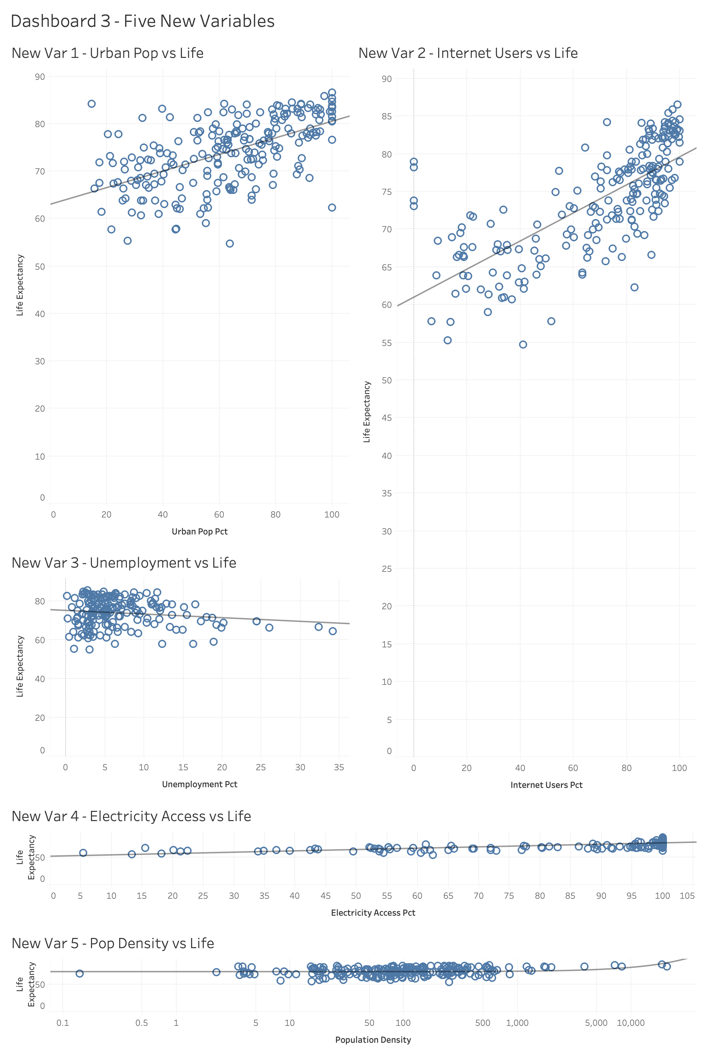
DASHBOARD 3
Development, Access, and Density
HOW IT'S USED
All five newer variables, urban population, internet use, unemployment, electricity access, and population density, linked in one dashboard. None of them have a time dimension to animate, so unlike Dashboards 1 and 2, there's no Year control here.
Selecting a country on any one scatter highlights it across all five, so a country that stands out on internet use is easy to trace across urbanization, unemployment, electricity access, and density in the same click.

Slide 19
INSIGHTS GAINED
What the dashboards changed about the conclusions
Relationships
Outliers
Physicians per 1,000 and GDP per capita both tracked life expectancy closely across the motion charts. Health-expenditure share was the weakest link of the three, even though it's the one that comes up most in policy debates.
A handful of high-population, mid-expectancy countries pull the global picture toward the middle even while smaller wealthy nations cluster near the top.
Trends
Geography
Progress isn't a straight line up. The 2019-2021 dip across nearly every region is a reminder that a decades-long upward trend can still carry a real reversal.
The animated, diverging map makes Sub-Saharan Africa's stall obvious in a way the regional average (58.97 years) alone doesn't really convey.
ON THE FIVE NEWER VARIABLES
Internet use tracked life expectancy about as closely as GDP did, and urban population share and electricity access weren't far behind. Unemployment and population density were the weakest of everything tested in this project, new or original.

Slide 20
CONCLUSION
No single variable explains life expectancy,
but the data does rank the candidates.
Healthcare workforce capacity and overall wealth matter more than raw spending share. Geography still tracks pretty closely with income twenty years into the century. And a clear long-term upward trend can still carry a real dip inside it. Building this as three linked dashboards instead of eleven separate charts is what made comparisons like GDP against expenditure, or one region against another, something I could actually click through rather than just describe.

