Slide 1
Statistical Analysis of Global Terrorism Patterns
Katelyn McCullough

Slide 2
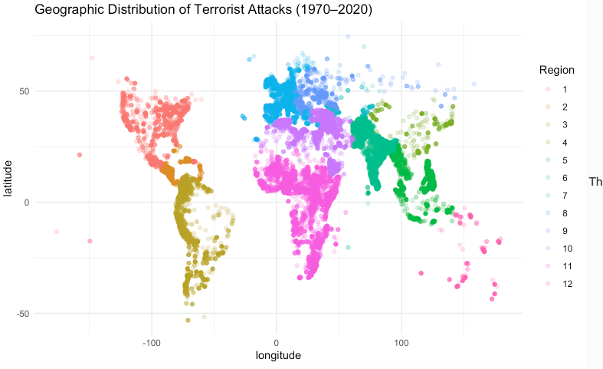
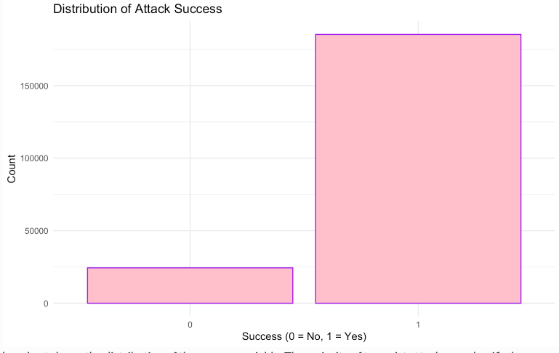
Dataset & Exploratory Analysis
Dataset:
Global Terrorism Database (1970–2020)
209,706 observations
Reduced from 135 → 45 variables
Target variable: Attack Success (0/1)
Challenges:
Missing values (-99 placeholders)
Severe class imbalance
  88% successful attacks
  12% unsuccessful attacks

Slide 3
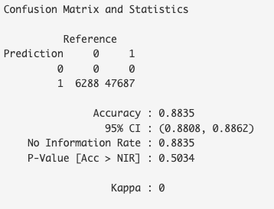
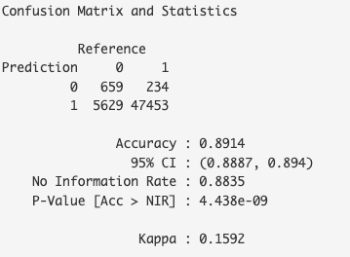
Logistic Regression:
Baseline classification model
Accuracy: 88.35%
Predicted only majority class
Failed minority detection
Misleading high accuracy
Random Forest:
Ensemble tree model
Accuracy: 89.14%
Better than logistic regression
Some minority class detection
Better overall performance

Slide 4
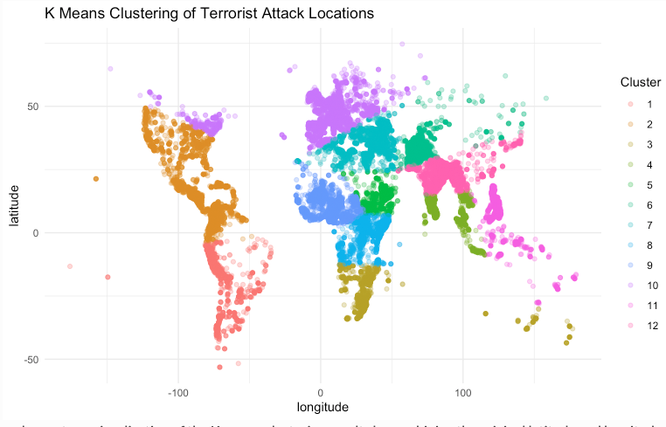
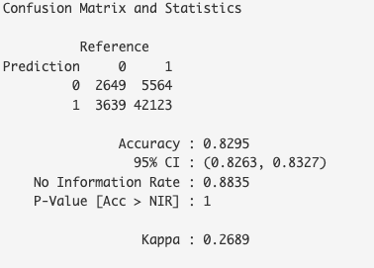
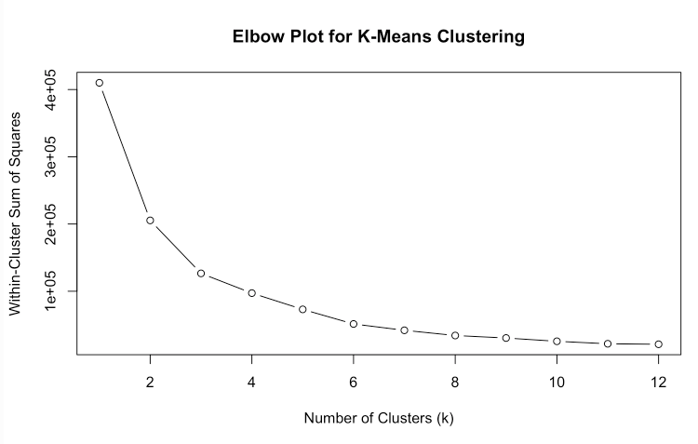
Balanced Random Forest:
Used up-sampling to fix imbalance
Accuracy: 82.95%
Sensitivity improved to 42%
Best balanced performance
Best model
K-Means Clustering:
Unsupervised learning
Used latitude + longitude
Found geographic clusters of attacks
Confirmed strong location patterns
Terrorism events cluster spatially

Slide 5
Results Comparision
Model | Accuracy | Minority Detection | Overall
Logistic Regression | 88.35% | Poor | Weak
Random Forest | 89.14% | Low | Good
Balanced RF | 82.95% | Best | Best
XGBoost | 30.18% | Poor | Failed

Slide 6

Conclusion
Class imbalance was the biggest challenge
More complex models were not always better
Balanced Random Forest performed best
Geographic location strongly influences attack patterns
Geographic location strongly influences attack patterns

