Slide 1

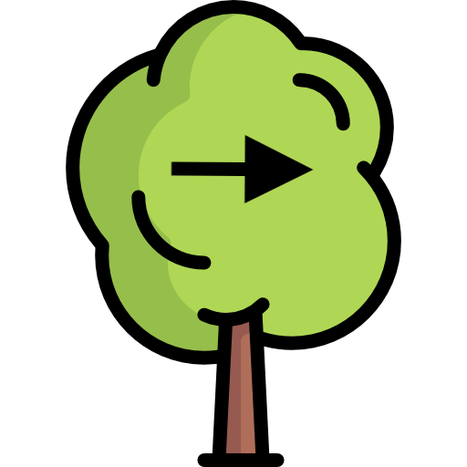

Welcome to the fruit-picking game!
Notes:
Welcome to the fruit-picking game! This is an interactive task where you'll engage in a series of trials involving selecting fruit from different trees. The game is designed to be both fun and insightful, helping us understand decision-making processes of our regretful experiences.

Slide 2
In this game, you will go through 60 trials of picking fruit from the trees shown above.
Each tree has a slightly different shape and color. The shapes and colors are there just to help you tell the trees apart—they don't have any special meaning other than that.
Notes:
You will complete 60 trials where you pick fruit from trees that differ slightly in shape and color. These visual differences help you distinguish between the trees but don't carry any special meaning or influence the outcome. Focus on making your choices based on your strategy rather than the appearance of the trees.

Slide 3
Left Up Right
On each trial you will choose which one you want to pick fruit from. You can make your choice using the left, up,
and right arrow keys that correspond to the arrows on the trees.
Notes:
On each trial, you will select one of three trees using the left, up, and right arrow keys on your keyboard. These keys correspond to the positions of the trees displayed on the screen. This setup allows for quick and intuitive choices during the game.

Slide 4
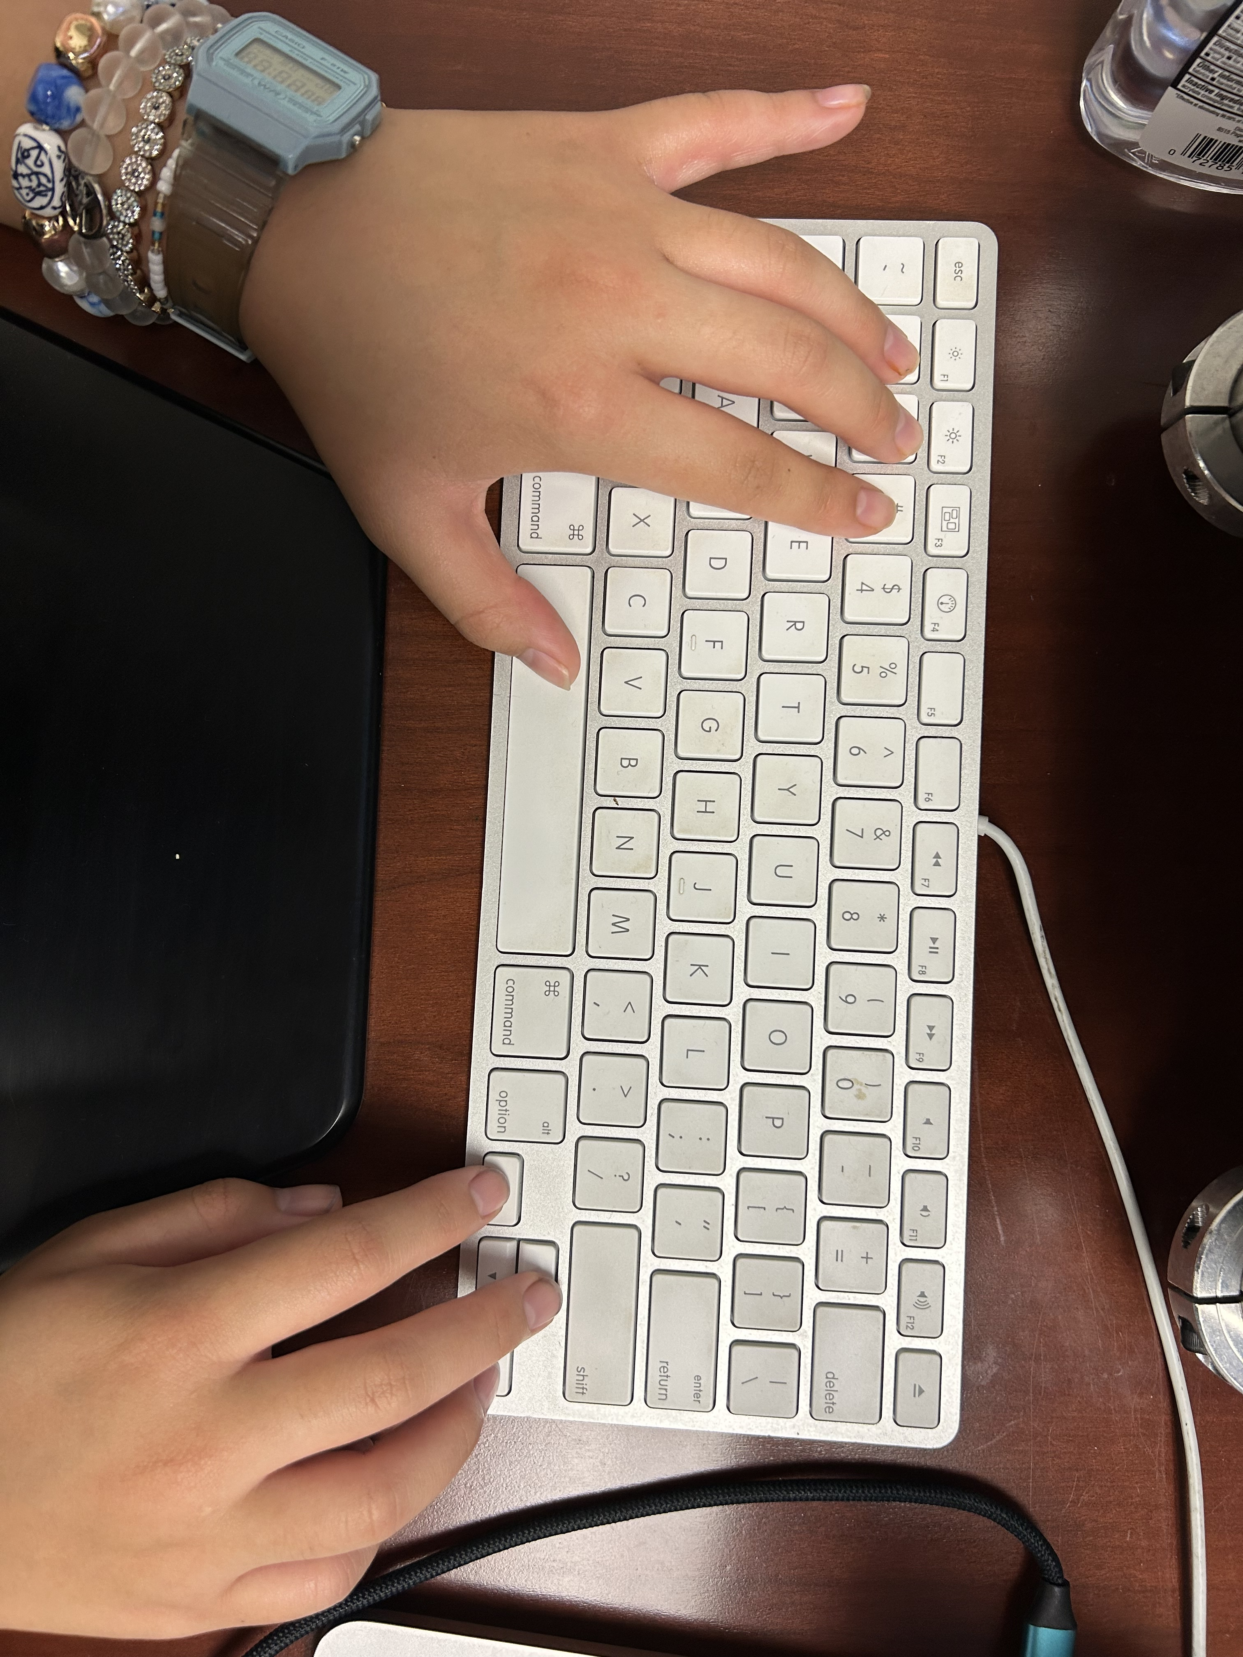
Please keep the index, middle, and fourth fingers of your right hand on the left, up, and right arrow keys as shown above throughout the entire experiment. You will use these keys to select trees on each trial.
Notes:
Please keep your right hand's index, middle, and fourth fingers positioned on the left, up, and right arrow keys throughout the experiment. This positioning will help you respond quickly and accurately when selecting trees during each trial.

Slide 5


When you pick fruit, it can turn out to be either ripe or rotten. Your goal is to pick as much ripe fruit as you can!
Notes:
When you pick fruit from a tree, it can either be ripe or rotten. Your objective is to maximize the number of ripe fruits you collect. This means you should try to learn which trees are more likely to yield ripe fruit and avoid those that often produce rotten fruit.

Slide 6
Following your choice, you will see the fruit you got displayed above the tree you chose. For example, you will see a screen like this after selecting the middle tree and getting a ripe fruit…
Notes:
After making your choice, the fruit you receive will be displayed above the tree you selected. For example, if you pick from the middle tree and get a ripe fruit, you will see a visual confirmation on the screen. This feedback helps you track your progress and adjust your choices accordingly.

Slide 7
… or a screen like this after selecting the left tree and getting a rotten fruit
Notes:
Similarly, if you pick from the left tree and receive a rotten fruit, the screen will show this outcome above the chosen tree. This immediate feedback is crucial for learning which trees to avoid in future trials.

Slide 8
How much do you regret this choice? Please enter a number between 1 and 3 to rate the intensity of your regret on the scale below
1
Not at all
2
Moderately
3
A lot
Finally, on some trials, each time you get a rotten fruit, you will be asked to rate how much you regret your choice of tree using a 3-point scale.
Notes:
During the first 30 trials, whenever you get a rotten fruit, you will be asked to rate how much you regret your choice on a scale from 1 to 3, where 1 means 'Not at all,' 2 means 'Moderately,' and 3 means 'A lot.' This helps us understand your emotional response to the outcomes.

Slide 9
Please keep the fourth, middle, and index fingers of your left hand on numbers 1, 2, and 3 as shown above throughout the experiment. You will use these keys to rate your feelings of regret.
Notes:
To rate your regret, please keep your left hand's fourth, middle, and index fingers on the number keys 1, 2, and 3 respectively. This will allow you to quickly and easily input your regret rating after receiving a rotten fruit.

Slide 10
+
Between the trials, you will see a cross in the middle of the screen. Please look at the cross as soon as you see it and until the next trial begins.
Notes:
Between each trial, a fixation cross will appear in the center of the screen. Please focus your gaze on this cross until the next trial begins. This helps maintain your attention and prepares you for the upcoming choice.

Slide 11
You are now ready to begin the game.
Remember, your goal is to earn as many points as you can by picking more ripe fruit and avoiding rotten fruit.
Happy fruit-picking!
Notes:
You are now ready to start the fruit-picking game. Remember, your goal is to earn as many points as possible by selecting trees that yield ripe fruit and avoiding those with rotten fruit. Good luck and enjoy the game!

