Slide 1



Welcome to the fruit-picking game!
We will now give you some instructions on how to play the game. Use
the buttons below (or the arrow keys) to navigate the instructions.

Slide 2
In the fruit-picking game, there are three trees you can pick fruit from.
Each tree has a slightly different shape and color. The shapes and colors are there just to help you tell the trees apart - they don't have any special meaning other than that.

Slide 3
Left Up Right
On each turn you will be shown three trees, and you will
choose which one you want to pick fruit from.
You can make your choice using the left, up,
and right arrow keys that correspond to the arrows on the trees.

Slide 4


Ripe
+1
Rotten
0
When you pick fruit, it can turn out to be either ripe or rotten. You will receive points for ripe fruit. You will not get points for rotten fruit.
Your goal is to earn as many points as you can!

Slide 5
Total points: 4
You will be able to see the total number of points you’ve earned so far in the game in the upper right corner of your screen.

Slide 6
Some trees are better than others.
You are more likely to pick ripe fruit from some trees (though you will still sometimes pick rotten fruit); and you are more likely to pick rotten fruit from other trees (though you will still sometimes pick ripe fruit).

Slide 7
Your goal is to figure out which tree(s) are most likely to give you ripe fruit, so that you can earn as many points as you can.

Slide 8
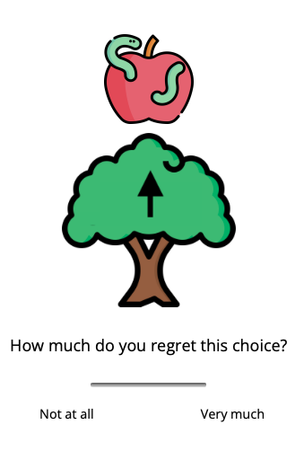
Finally, every time you get a rotten fruit, we will ask you to rate how much you regret your tree choice. Use your mouse to record your answer and press “Continue” to proceed to the next trial.
Please report your feelings openly and honestly regardless of how strong or weak they are!

Slide 9
Finally, in the first half of the task, every time you get a rotten fruit, we will ask you to rate how much you regret your tree choice. Use your mouse to record your answer and press “Continue” to proceed to the next trial.
Please report your feelings openly and honestly regardless of how strong or weak they are!

Slide 10
Finally, in the second half of the task, every time you get a rotten fruit, we will ask you to rate how much you regret your tree choice. Use your mouse to record your answer and press “Continue” to proceed to the next trial.
Please report your feelings openly and honestly regardless of how strong or weak they are!

Slide 11
You are now ready to begin the game. Remember, your goal is to earn as many points as you can by picking more ripe fruit and avoiding rotten fruit.
Happy fruit-picking!

