Slide 1


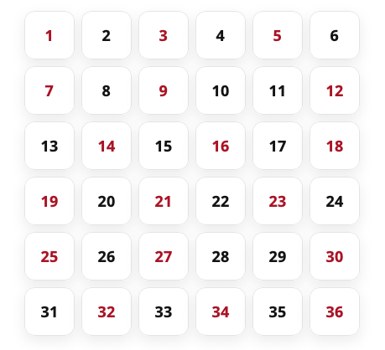
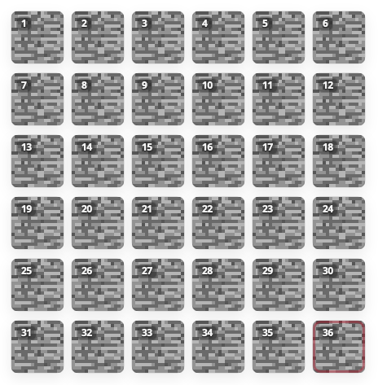
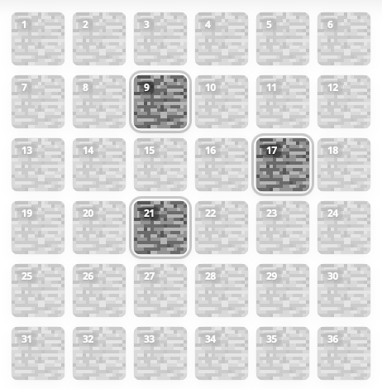
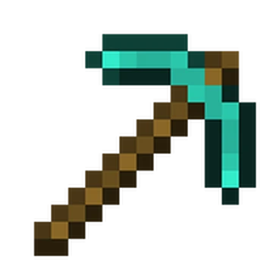



A. Study 1 (a and b)
B. Study 2
HOT: 9, 25, 35
Loss
How much do you regret choosing 25?
Choose 3 blocks to consider
Choose 1 block to mine
Loss
How much do you regret choosing 9?
How much do you regret NOT choosing 9?
Win
Win
How much do you regret NOT choosing 21?

