Slide 1
Data-oriented Programming Paradigms
Exercise 2
Group 31
Avakian Valeriia 12432869
Dobrynina Ekaterina 12332276
Ellamey Mazen 12347687
Shahin Eman 12432813
VU Data-oriented Programming Paradigms
WS2024
TU Wien, Austria

Slide 2
Project: Airbnb
Main questions:
What features contribute the most to the popularity of AirBnB listings?
How can we predict the revenue potential of an Airbnb listing in Vienna based on its location relative to public transport, POIs, and the overall tourism trend in the city?
If I plan to open one more accommodation, based on current Airbnb performance data, can we predict which neighborhoods in Vienna will see a rise in Airbnb demand in the future?
Work plan:
Data engineering (Dobrynina Ekaterina, Shahin Eman)
Data analytics and preparation (Valeriia Avakian)
Modeling and Interpretation (Ellamey Mazen)

Slide 3
Understanding the Data
Datasets Chosen:
Airbnb Listings: Data about Airbnb accommodations in Vienna, including amenities, reviews and location
Airbnb Calendar: Availability and pricing data over time
Points of Interest (POI): Locations of nearby attractions and services in Vienna
Public Transport Stops: Data on public transport stops in Vienna

Slide 4
Data Fetching
Data fetched via HTTP requests using custom functions.
CSV files are downloaded and validated before processing.
Challenges include network issues and data consistency.
Pandas is used for reading and initial cleaning.

Slide 5
Data Exploration
Number of rows: 398,943
Number of columns: 84
Data types: numeric (22 columns), categorical (35 columns)
Number of Missing Values:
bathrooms: 188,867 missing values
bedrooms: 75,580 missing values
review_scores_rating: 73,366 missing values
host_response_rate: 167,117 missing values
Statistical information:
Average price: 141.55 EUR
Minimum price: 9 EUR, Maximum price: 21,000 EUR
Minimum number of nights: 1, maximum — 1,125.

Slide 6
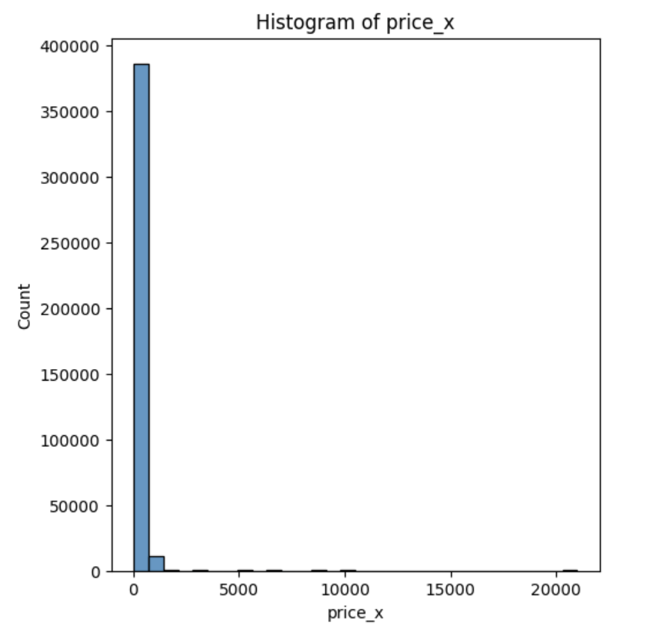
Data Exploration: Numerical Features
Distribution:
Price:
Most properties are in the low price range
Outliers at > 1,000 EUR
Minimum number of nights:
Most properties allow booking for 1-2 nights
Outliers for values ​​> 100 nights
Ratings:
Average rating: 4.81
Most properties have high ratings (close to 5)

Slide 7
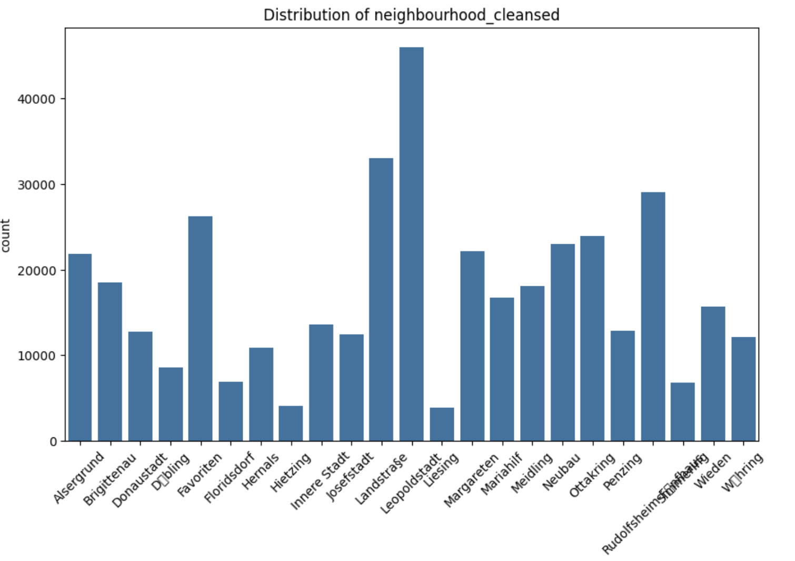
Data Exploration: Categorical Features
Districts:
Total: 23 districts
Most popular: Leopoldstadt, Favoriten
Property types:
Total: 54 types
Most popular: Entire rental unit, Private room in rental unit
Nearest POIs:
education, transport_and_infrastructure, supermarket, cafe_restaurant, entertainment_leisure, shops_and_retail, park

Slide 8
Preprocessing
Missing Values:
Dropped rows with null values in review columns and leaving review_scores_rating and reviews_per_month as most representative for our analytics (before the split)
Filled host_response_rate, host_acceptance_rate, bathrooms, bedrooms with k-nearest KNNImputer(n_neighbors=5, weights="distance") (after the split)
Outliers:
Used the Interquartile Range (IQR) to remove outliers in numerical columns (after the split)
Transformation:
Aggregated categorical variables with high cardinality (‘amenities’, ‘POIs’, ‘property_type’)
Removed irrelevant or redundant columns
Changed data types (converted price strings to numeric values, etc.)
Encoding:
Encoded categorical variables using one-hot encoding
Feature Scaling (after the split)

Slide 9
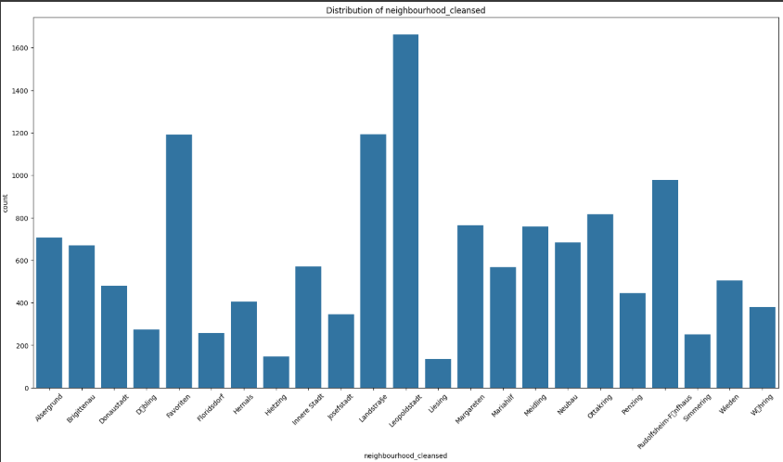
Insights
Listings situated near public transport hubs and Points of Interest (POIs), show higher booking rates.
Listings are highly concentrated in central neighborhoods such as Leopoldstadt and Favoriten, which may indicate higher demand in these areas.

Slide 10
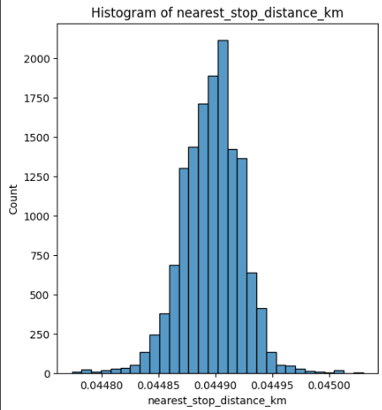
Insights
The distribution is highly concentrated around 0.04490 km, indicating that most Airbnb properties are located very close to public transport stops.
The data exhibits a normal distribution, suggesting consistent proximity of listings to transport hubs without significant outliers.
The slight variation in distance suggests that public transport accessibility is uniform across most listings.

Slide 11
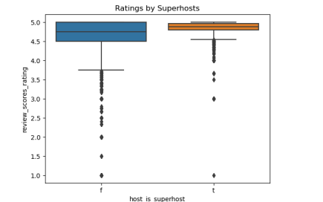
Insights
Superhosts consistently receive higher ratings with less variability, indicating better guest satisfaction and trust. Achieving Superhost status can enhance credibility and increase bookings.

Slide 12
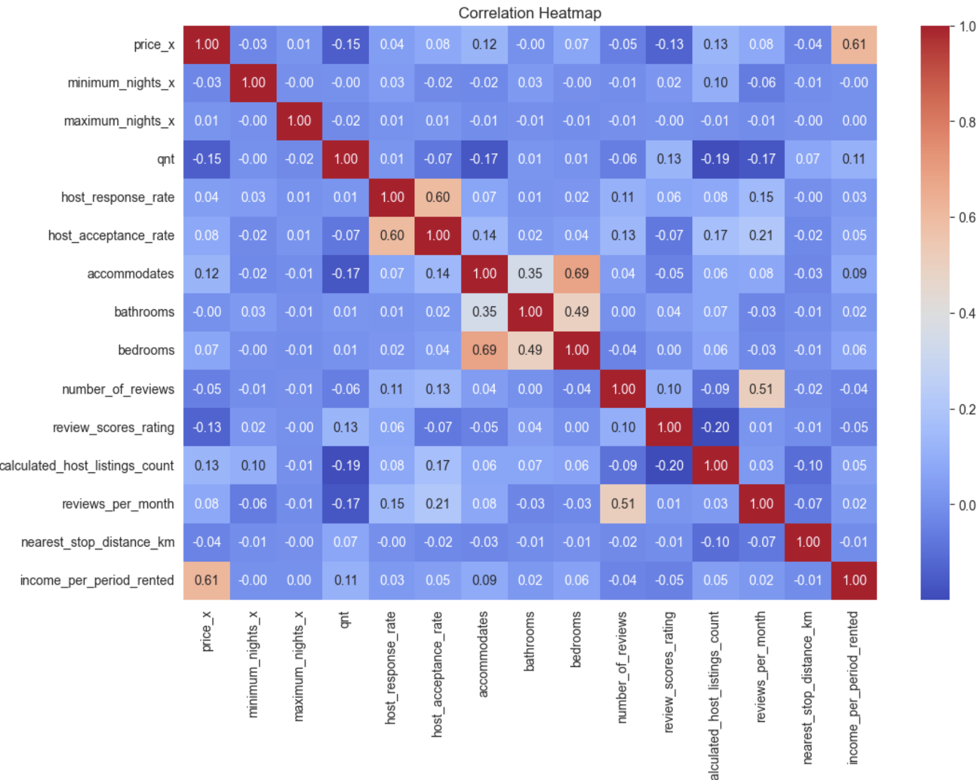
Insights: Correlation
The correlation heatmap reveals a strong relationship between price and income per booked period (0.61), but other features, such as amenities and location, show weak correlations with revenue. This suggests that external factors might play a bigger role in influencing earnings.

Slide 13
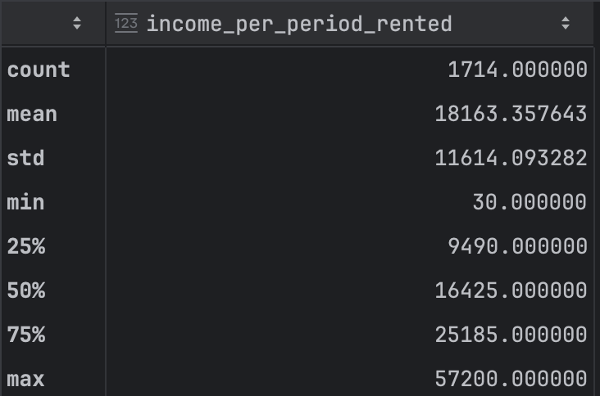
Target Variable
We added the target variable income_per_period_rented
Formula: price per night * calendar_days_rented for each listing
This variable represents the popularity and profit if each listing.

Slide 14
Data Manipulation
Aggregating the data by each listing
Every Listing has the total income per period it was rented
Having Data Leakage was prevented by preprocessing train, test and validation data separately and training scaler and KNNImputer on train dataset only

Slide 15
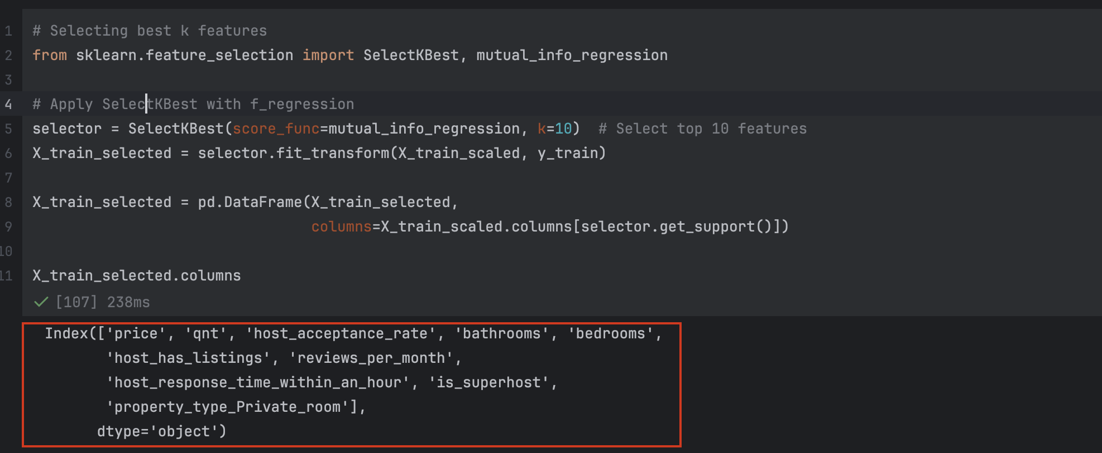
Top Variables Selection
Selecting Top Variables
Using F-Statistic to calculate Relevance between Variables and Target

Slide 16
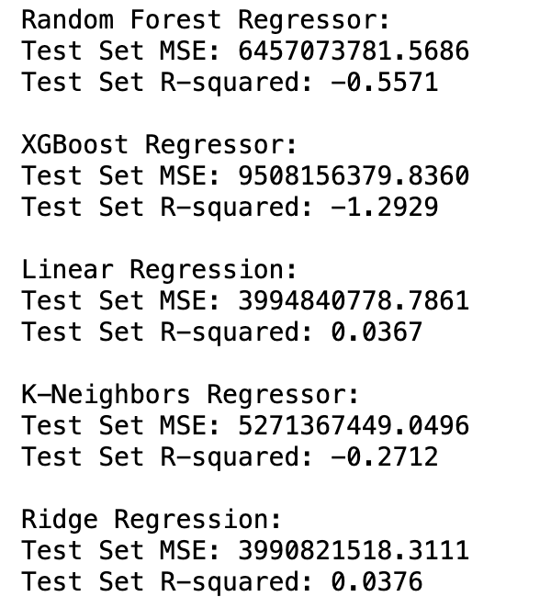
Models
RF, XG and KNN Regressors Models
Overfits
Linear and Ridge Regression has very
poor Accuracy.

Slide 17
Conclusion
The project analyzes factors that affect Airbnb success in Vienna, like location and pricing.
Data was cleaned and processed to fix missing values and remove outliers.
Different models, such as Random Forest and XGBoost, were used to predict revenue and demand. However this question cannot be answered through the selected method as time series analytics should be performed instead.

