Slide 1

Bitcoin Price Prediction
Team K
Katerina Tsilingiri, 2806
Chrysa Noli, 2780
Panos Petropoulos, 2610

Slide 2
Steps of Final Project
01
Exploratory Data Analysis
02
Pre-Process
Monthly and Yearly analysis of the Bitcoin price
Check and Scale the data before step 3
03
Application of Models
04
Conclusions
Try different models and try to predict with high accuracy the Bitcoin price for the future
Evaluate the models and find the best

Slide 3
Exploratory Data Analysis
01

Slide 4
Information about our data
Our dataset contains information about the bitcoin price from 17 November 2017 until 15 June 2022.
The columns of our dataset are :
unix
date
symbol
open
high
low
close
Volume EUR
Volume BTC
Our yearly analysis begins from 01 January 2018 until the present
We have as main goal to predict the price of Bitcoin during 2022

Slide 5
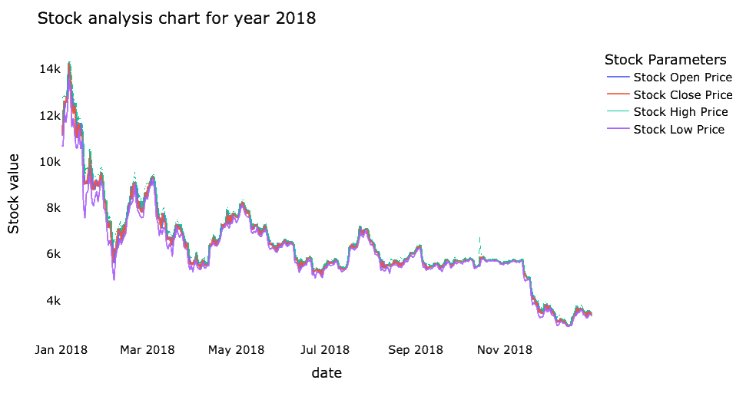
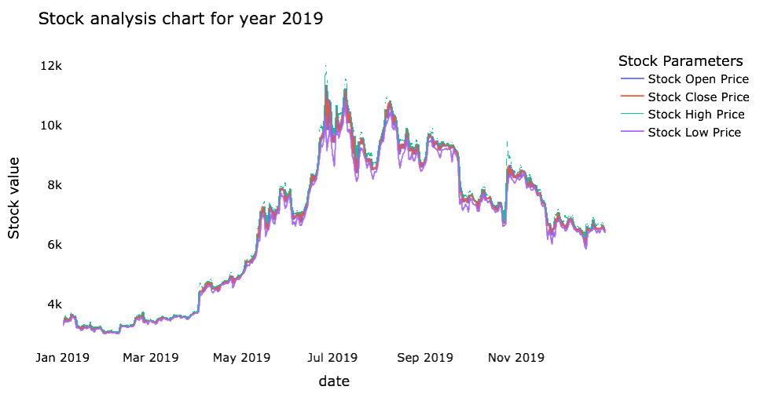
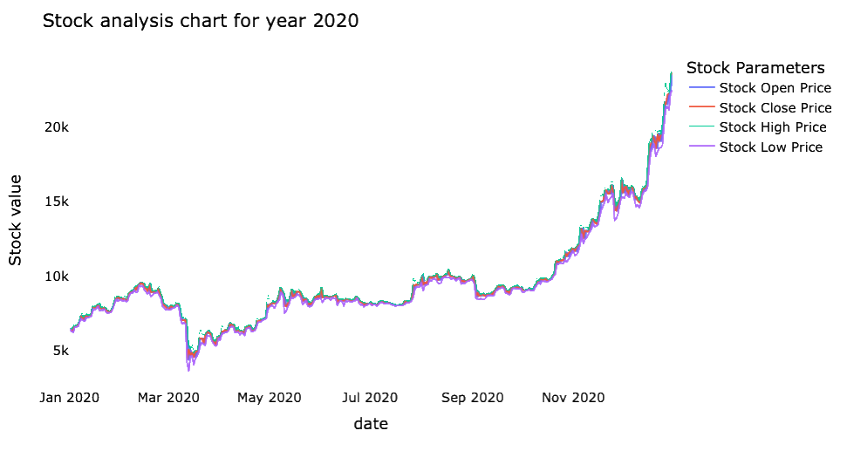
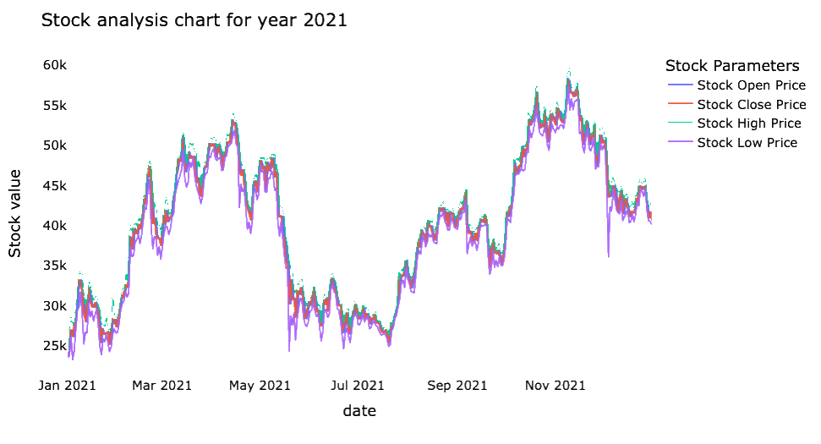
Yearly analysis of stock BTC price

Slide 6
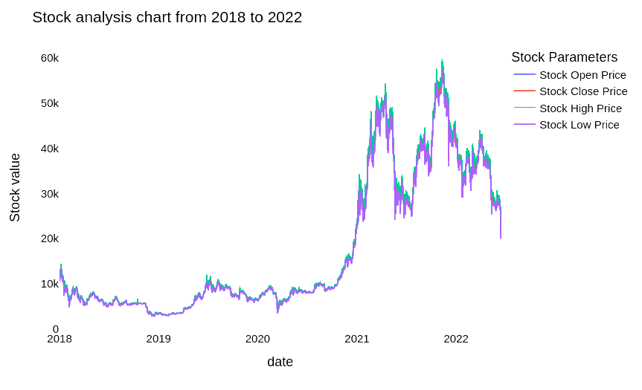

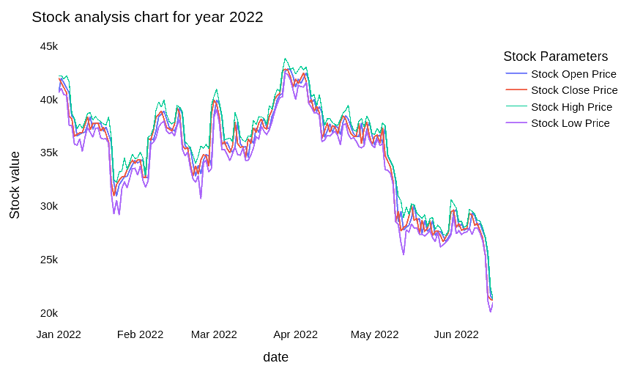
Overall years Stock analysis of BTC price
what we want to predict:

Slide 7
Pre-Process
02

Slide 8
Pre-Process Steps
”Break down” the date column of the dataset into more columns
Day, Day of week, Day of year,
Is month end, Is month start,
Is quarter end, Is quarter start,
Is year end, Is year start
because we the ”date” column was not a valid input for the models
Drop unnecessary columns
Such as time (same in all days)
Unix
Separate the initial dataset into X and Y
Scale using MinMaxScaler both X and Y
Train Test Split the X and Y in order to use them for the models
Test size 0.1
Shuffle= false (!)
The train set contains the dates from 21/11/2017 until 31/12/2021 and the test set from 01/01/2022 until 15/06/2022

Slide 9
Application of Models
03

Slide 10
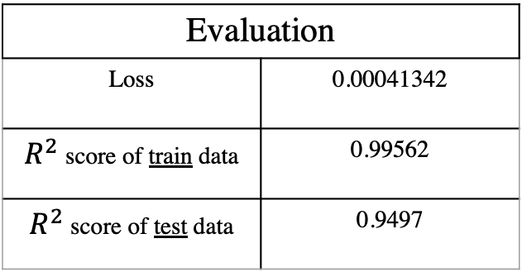
LSTM Neural Network
Model Architecture
10 LSTM Layers
ReLU as activation function
1 Dense Layer
200 Epochs
Batch size 32
Evaluation
Loss | 0.00041342
$R^{2}$ score of train data | 0.99562
$R^{2}$ score of test data | 0.9497

Slide 11
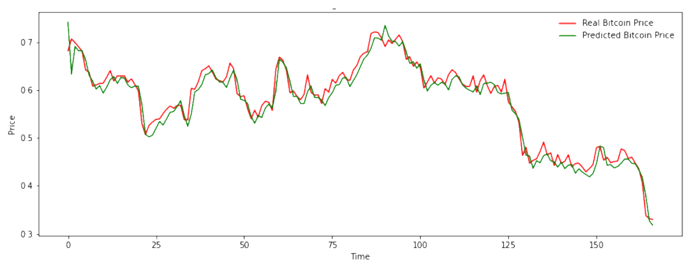
LSTM Neural Network_{continued}
Bitcoin price prediction using LSTM from 01/01/2022 to 15/06/2022
Notes:
make it transparent png

Slide 12
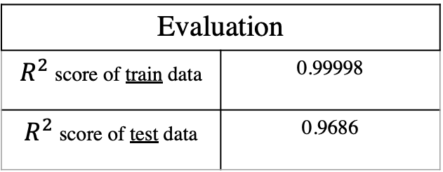
XGBoost
General model information
Gradient tree boosting algorithm
Tree are built parallel
Tries to estimate the quality of the splits at every split in the training data searching the computed gradients
Evaluation
$R^{2}$ score of train data | 0.99998
$R^{2}$ score of test data | 0.9686
Model Architecture
1000 estimators
Learning rate 0.3

Slide 13
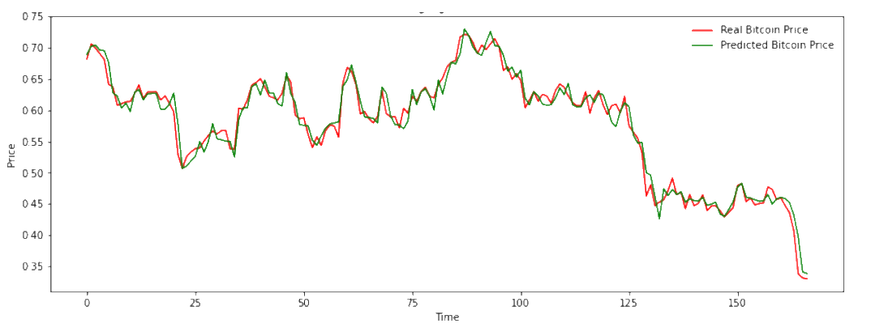
XGBoost_{continued}
Bitcoin price prediction using XGBoost from 01/01/2022 to 15/06/2022

Slide 14
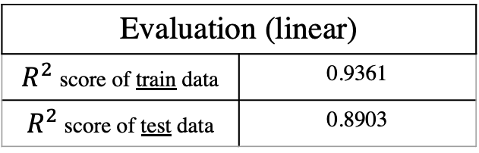
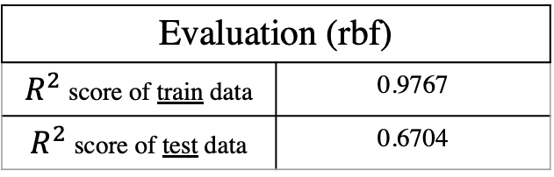
SVM
Used 2 different kernels
Linear
Radial Basis Function (RBF)
Evaluation (linear)
$R^{2}$ score of train data | 0.9361
$R^{2}$ score of test data | 0.8903
Evaluation (rbf)
$R^{2}$ score of train data | 0.9767
$R^{2}$ score of test data | 0.6704

Slide 15
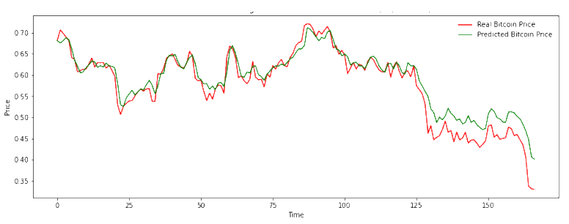
SVM – linear kernel
Bitcoin price prediction using SVM (linear) from 01/01/2022 to 15/06/2022
different value of price
but same slope

Slide 16
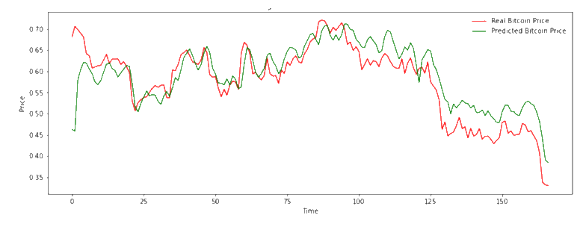
SVM – rbf kernel
Bitcoin price prediction using SVM (rbf) from 01/01/2022 to 15/06/2022
maybe the model needs more iteartions
the same behavior as linear kernel

Slide 17
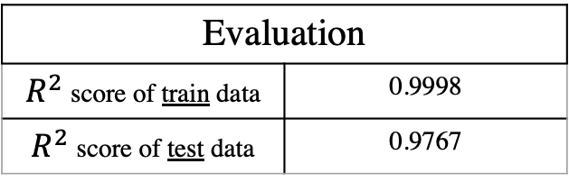
Random Forest
General model information ​
Consists of many decision trees
Predicts by taking the average or mean of the output from the already constructed trees
Evaluation
$R^{2}$ score of train data | 0.9998
$R^{2}$ score of test data | 0.9767
Model Architecture​
100 trees in the forest
Trained through bootstrap aggregating (bagging)

Slide 18
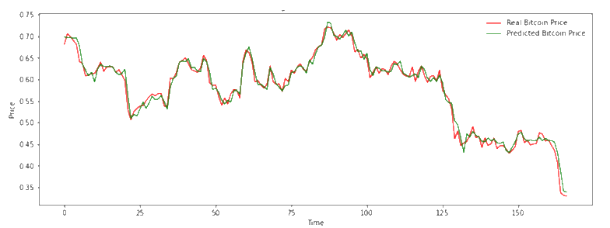
Random Forest_{continued}
Bitcoin price prediction using Random Forest from 01/01/2022 to 15/06/2022

Slide 19
AutoML – AutoTS
Input
Train data set with "date" column included
Best model
Seasonal Naïve
Output
Log difference of close price
Seasonal Naïve
Very similar to Simple Naïve
In order to predict a new value, uses the the value of the same period a season ago
Forecasting
Number of days to forecast (165)

Slide 20
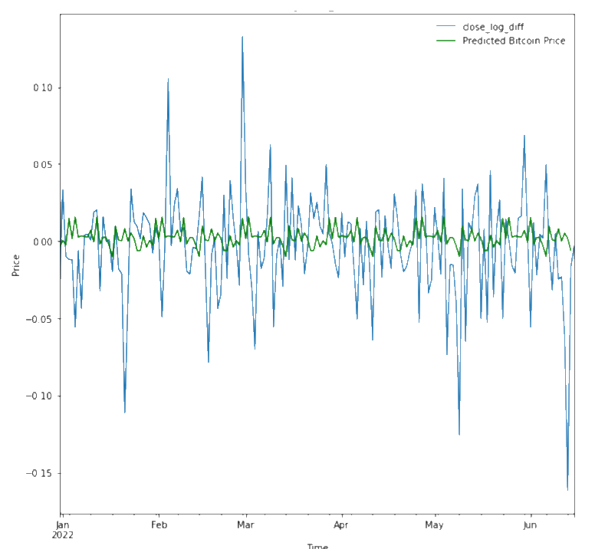
AutoML – AutoTS (II)
Again, the predicted Bitcoin price is not the same as the real, but the increases/decreases happen at the same time

Slide 21
Conclusions
04

Slide 22
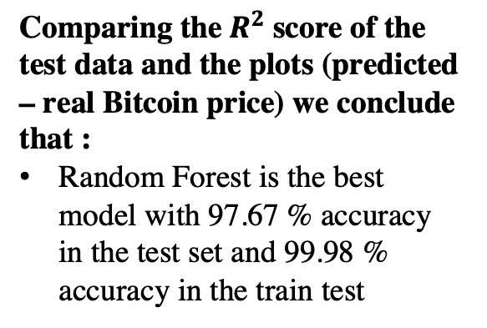
Comparisons / Observations
Comparing the${ R}^{2}$score of the test data and the plots (predicted – real Bitcoin price) we conclude that :
Random Forest is the best model with 97.67 % accuracy in the test set and 99.98 % accuracy in the train test
Some models, even though predicted correctly the periods that the Bitcoin price increased/decreased, could not predict with high accuracy the price.
SVM (both linear and rbf kernel)
Seasonal Naïve
The main reason may be the randomness and the lack of patterns in the change of price

Slide 23
Thank you

