Slide 1
Debit Card Transaction Analysis
Faith Dwyer, George, Katerine

Slide 2
Our Partner:
Their Problem:
Vantage Point Benefit Administrators
Small employee benefits firm located in Long Island, NY
Analyze debit card transactions to uncover trends and aid in improving our employee benefit plans

Slide 3
Motivating Question
How does spending vary over time yearly vs monthly?
1/4

Slide 4
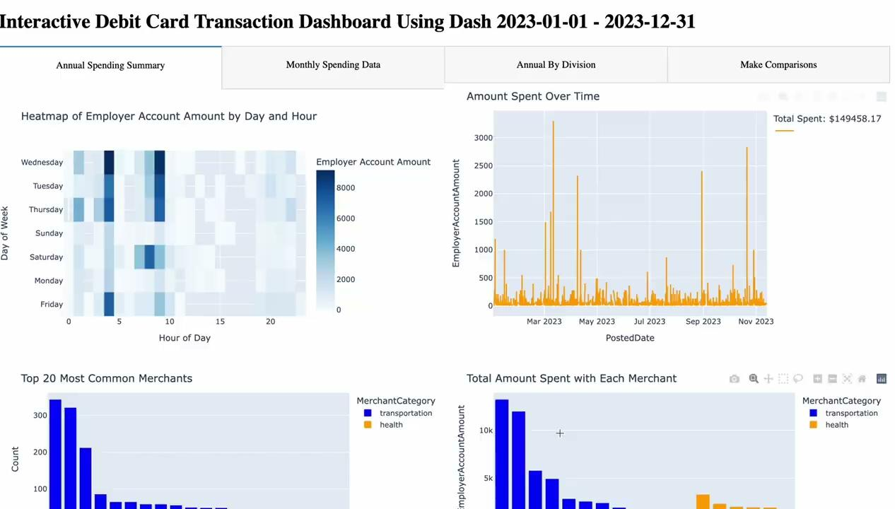
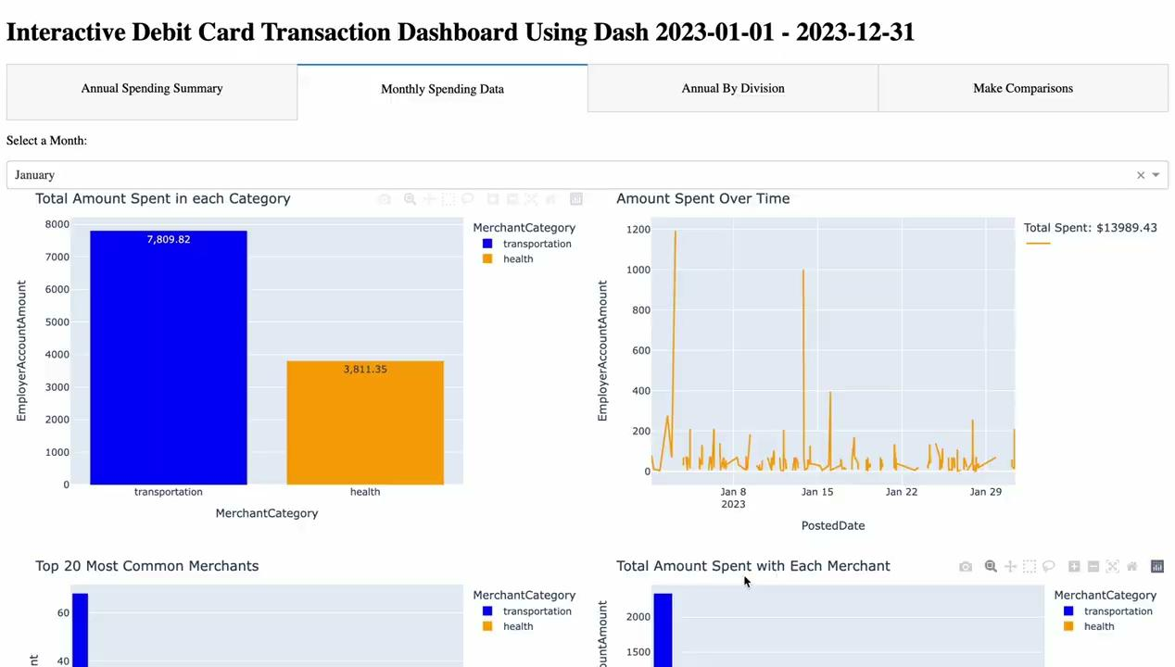
Our Solution (1/4)
Spending trends over time for most commonly merchants
Notes:
Katerine

Slide 5
Motivating Question
2. Is the card being used appropriately?
Ie. are people charging their food or clothing shopping to the card?
2/4

Slide 6
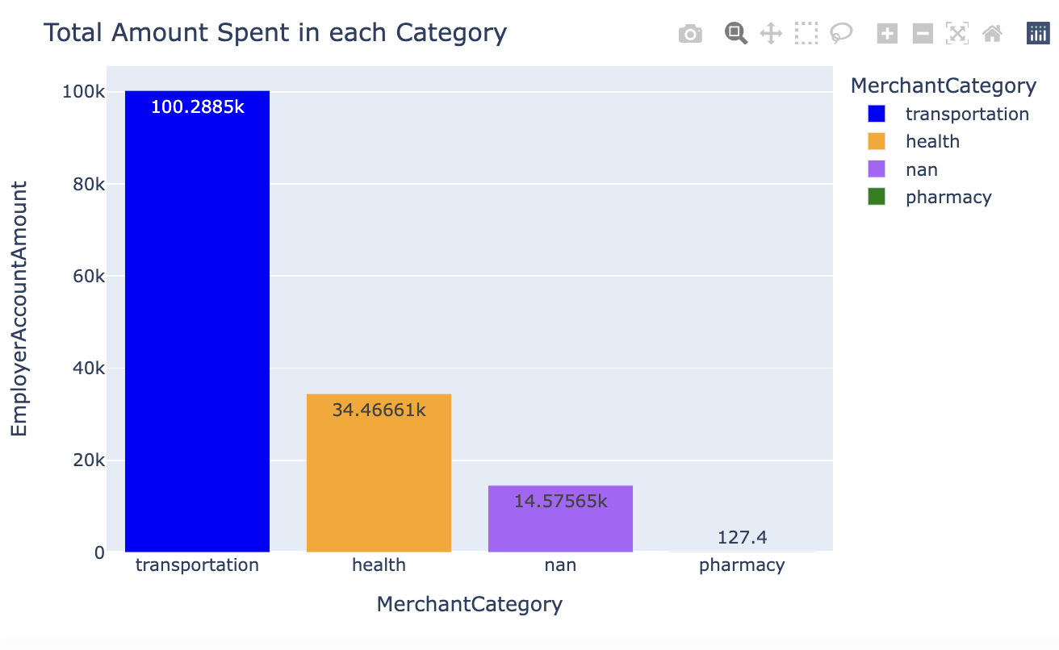
Our Solution (2/4)
By categorizing each purchase, we can make predictions about what the money is being used for
Notes:
Faith

Slide 7
Motivating Question
3. How does spending vary across divisions?
3/4

Slide 8
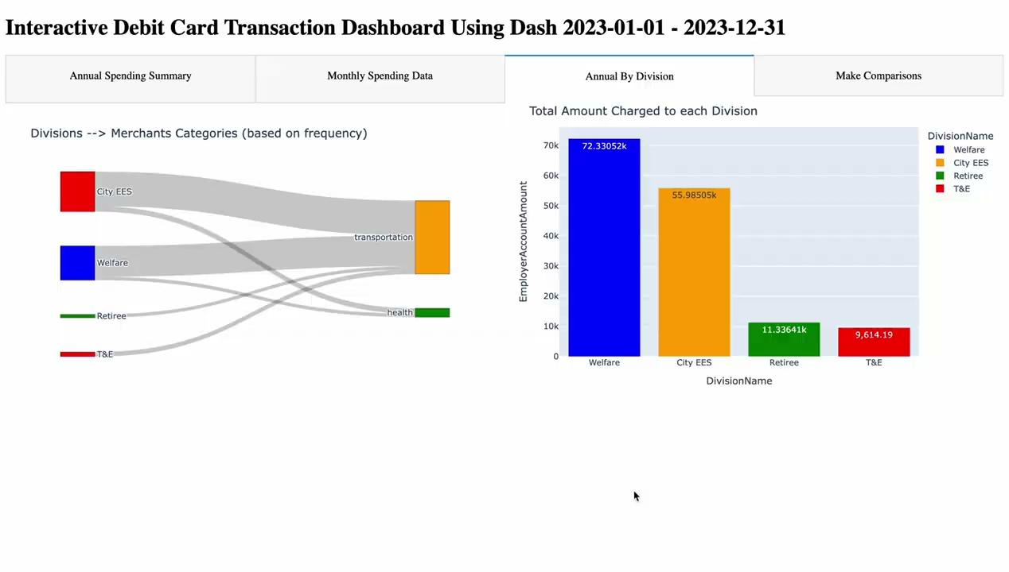
Our Solution (3/4)
The ‘By Division’ tab on the dashboard offers insights into how money is spent in each division and how much of it
Notes:
Faith

Slide 9
Motivating Question
4. How can we compare spending over time?
4/4

Slide 10
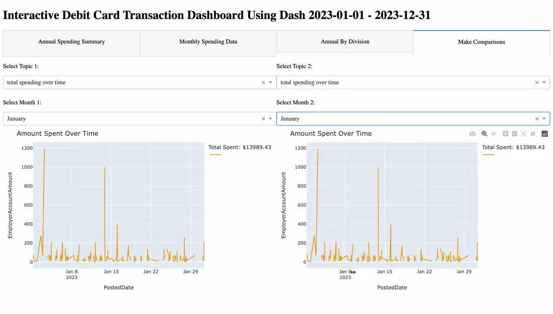
Our Solution (4/4)
The final tab allows you to make direct comparisons between different visuals/dates
Notes:
George

Slide 11
Conclusions/Takeaways
Conclusions
Dominant merchant category = transportation
Peaks in spending = Mar, Apr, Sep, Oct
Division Spending = Highest (Welfare/City EES) and Lowest(T&E/Retiree)
Card Usage by category= very few non-health/transportation charges
Improvements to benefit plan
Allot more money toward transportation
Monitor transactions more closely during peak months
Consider marketing T&E more
Future considerations
Reusability
Increase amount of data used

