Slide 1

Product Metrics Analysis
Final Project for the ‘Data Analyst’ Course, Kateryna Mayatska

Slide 2
The idea of the project
Create a dashboard for a product
manager with the goal of analyzing
revenue from the project,
tracking its dynamics,
and performing high-level
analysis of changes.

Slide 3
Project Data
For the analysis, data from a SQL database were used: project.games_payments and project.games_paid_users.
Domain: gaming
Period: 2022

Slide 4



Project Description
Duration: 5 days
Technologies used: DBeaver (PostgreSQL), Tableau
Applied functionality:
  The project includes SQL queries for data selection, transformation, and preparation
  Dashboard for interactive visualization and analysis of metrics

Slide 5
Metrics for Analysis
MRR
Paid Users
New MRR
Churned MRR
Returning MRR
Expansion MRR
Contraction MRR
New paid Users
Churned Users
Returnig Users
LT
LTV
ARPPU
Churned Users Rate
Churned MRR Rate

Slide 6
Challenges Faced
Determine which metrics are appropriate and convenient to calculate in SQL, and which should be aggregated and calculated directly in Tableau.
Decide which indicators to group together and which data to display on the dashboard so that it is not overloaded, yet remains as informative as possible.
Verify data completeness in visualizations. During the first attempt to build the MRR components chart, it was noticed that the data were incomplete and did not provide a full picture because revenue from returning users was not taken into account.

Slide 7
Proposed Solutions
It was decided that aggregations and ratio calculations would be performed in Tableau, as this ensures correct results display when using interactive filters.
For a deeper analysis of the relationship between key metrics and their impact on management decisions and project profitability, additional informational resources were used.
To form a complete picture of revenue dynamics and user activity, the metrics Returning MRRand Returning Userswere added.

Slide 8
Project Stages
01
03
Familiarization with the available data and determination of which data transformations are necessary for further visualization, as well as which metrics are appropriate to calculate using SQL queries.
The resulting file with transformed and prepared data is loaded into Tableau for visualization.
02
04
Writing the SQL-Query. The query was implemented as a CTE using window functions. The following metrics were calculated: MRR, New MRR, New Paid Users, Churned MRR, Churned Users, Expansion MRR, Contraction MRR, Returning MRR, Returning Users.
Calculation in Tableau of the remaining metrics: ARPPU, LT, LTV, Paid Users, Churned Users Rate, Churned MRR Rate. Visualization of the results on the dashboard with added filters for month, user age, and user language.

Slide 9
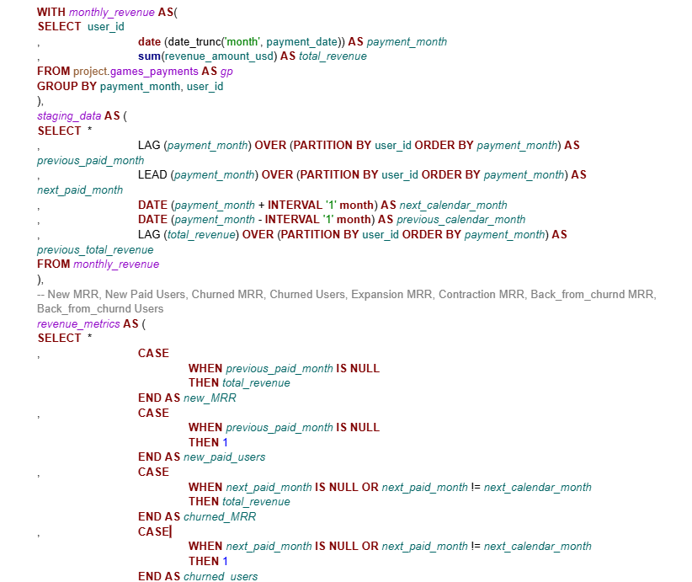
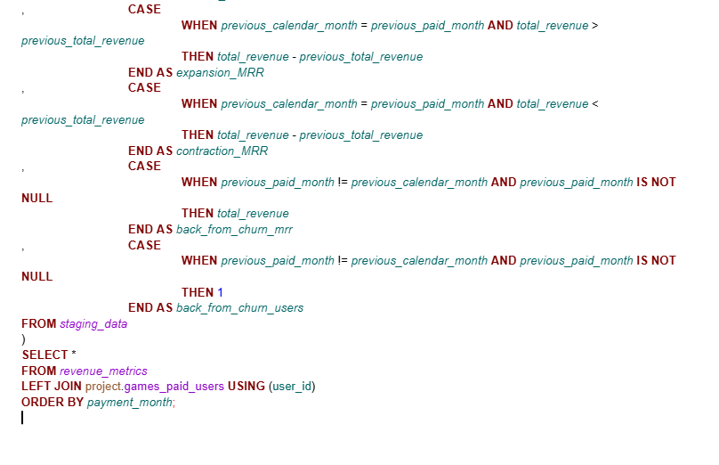
SQL - query

Slide 10
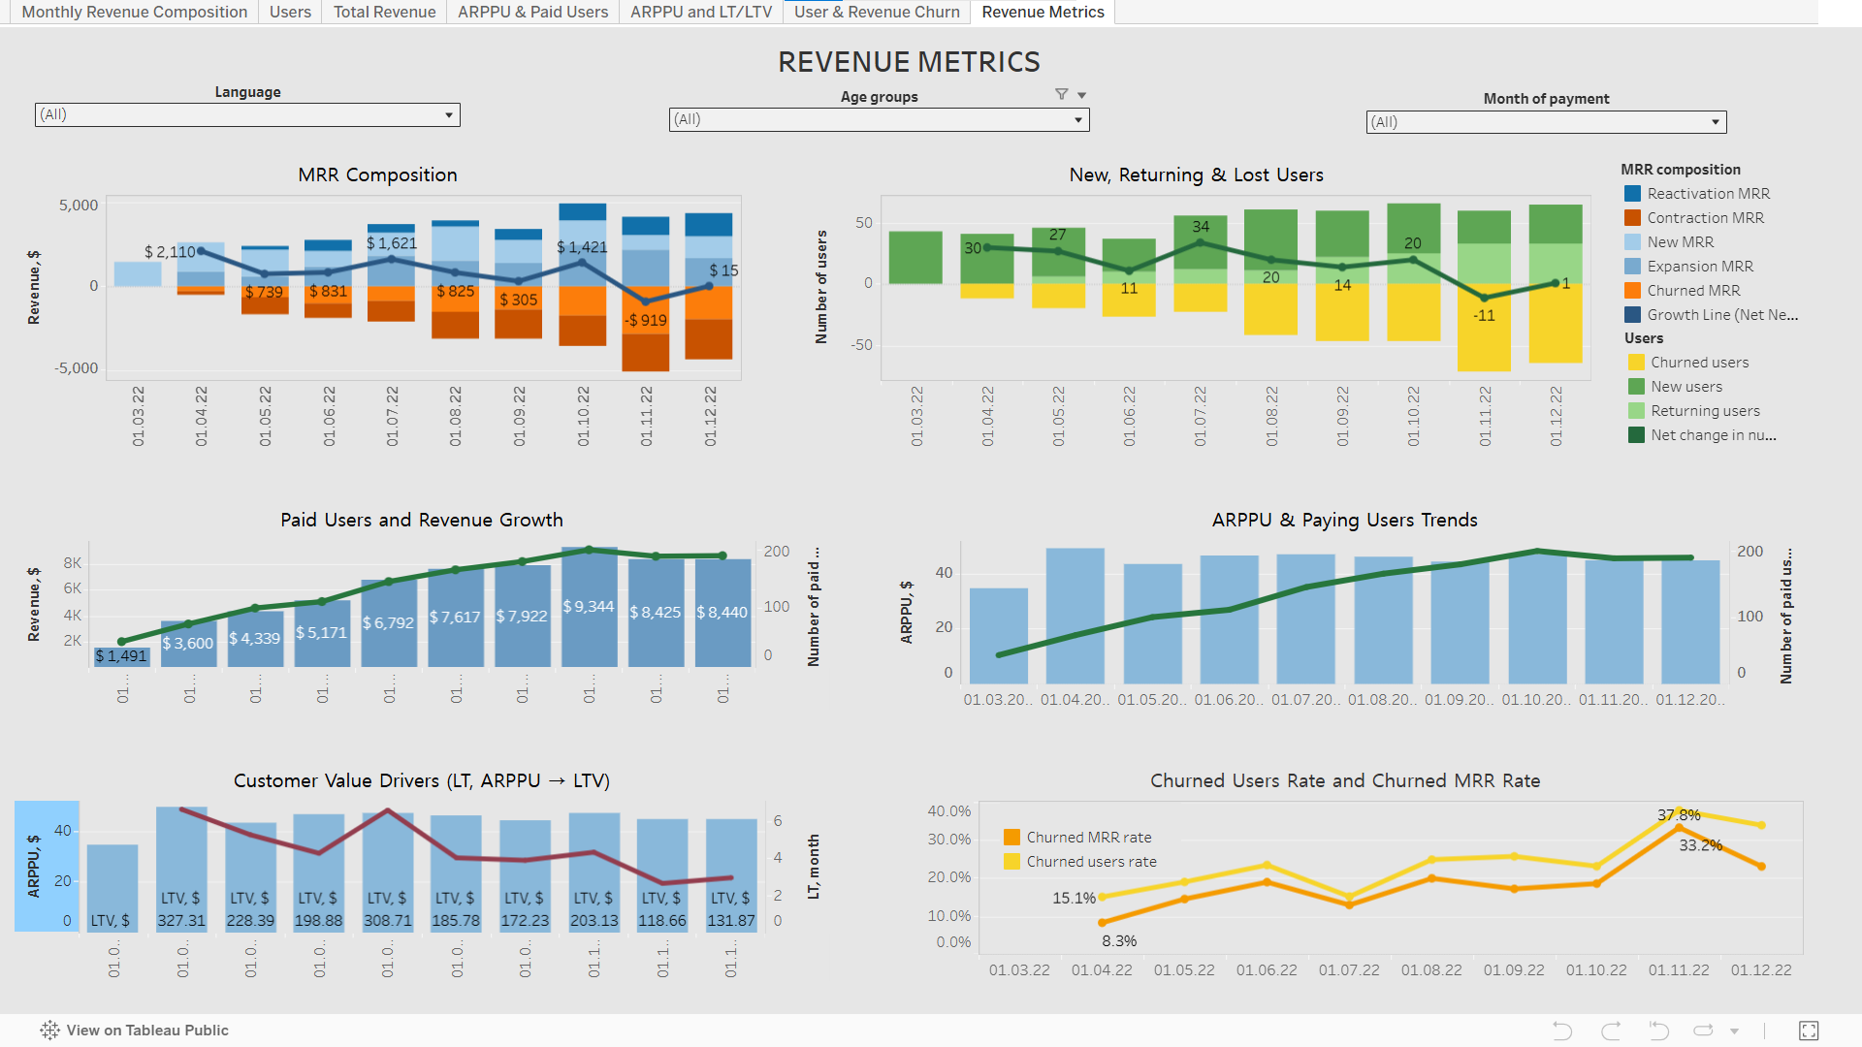

Slide 11

Conclusions
The dashboard allows the manager to immediately see all key metrics and their interrelationships. Using analytics tools made it possible to identify patterns and critical points:
    The business model is extensive, so acquiring new clients and retaining existing ones is critically important.
    Customer churn remains fairly high (over 20%), which is significant even for the gaming industry. The highest risk is observed among users under 30 years old, where churn shows an increasing trend. The 30+ segment demonstrates a wave-like dynamic. This indicates the need for a separate analysis of factors affecting the choices of different age groups to improve retention.
    Overall, the model is profitable, except for one month, which requires a deeper assessment of the factors that led to this outcome.
    Since users are currently not ready to increase their average spend, it is recommended to focus on analyzing their needs and finding creative solutions to increase the product’s value.
  The project demonstrated that a systematic approach to collecting, visualizing, and interpreting product metrics is an effective tool for decision-making, enabling improved business process performance and identifying pathways for development.

Slide 12

A big thank you to the instructors for the structured presentation of the material and to the mentor for guidance throughout all stages of the course and the final project.
Thank you for your attention!

