Slide 1
Unit No: 2
Object Oriented Programming Concepts:

Slide 2
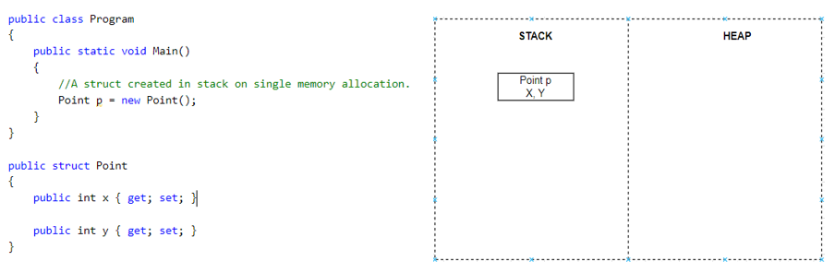
Value Type and Reference Type
Value Type
A data type is a value type if it holds a data value within its own memory space. It means the variables of these data types directly contain values.
For example, consider integer variable int i = 100;
The system stores 100 in the memory space allocated for the variable i.

Slide 3
Example
struct Employee
{
public int salary;
public int age;
}
Class Program
{
static void Main(string[] args)
{
Employee e=new Employee();
e.salary=5000;
e.age=23;
Employee e1=e;
Employee e2=e;
e.age=25;
Console.WriteLine(e1.age);
Console.WriteLine(e2.age);
Console.ReadKey();
}
}
STACK | HEAP
e2
Salary 5000 | Age 23
e1
Salary 5000 | Age 23
Salary 5000 | Age 23
e

Slide 4
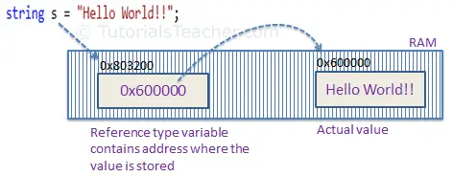
Reference Type
A reference type doesn't store its value directly. Instead, it stores the address where the value is being stored. In other words, a reference type contains a pointer to another memory location that holds the data.
For example, consider the following string variable:
string s = "Hello World!!";
Memory Allocation of Reference Type Variable
The system selects a random location in memory (0x803200) for the variable s. The value of a variable s is 0x600000, which is the memory address of the actual data value. Thus, reference type stores the address of the location where the actual value is stored instead of the value itself.

Slide 5
Example
class Employee
{
Public int salary;
public int age;
}
Class Program
{
Static void Main(string[] args)
{
Employee e=new Employee();
e.salary=5000;
e.age=23;
Employee e1=e;
Employee e2=e;
e.age=25;
Console.WriteLine(e1.age);
Console.WriteLine(e2.age);
Console.ReadKey();
}
}
STACK | HEAP
Salary 5000 | Age 23
e2
Ox3453
Ox3453
e1
Ox3453
e
Ox3453

Slide 6
Difference Between Value Type and Reference Type?
Value Type vs Reference Type
A value type holds a data value within its own memory space. | A reference type holds a pointer to another memory location that holds the data.
Assignment
In value type, the value is copied to the new location, so there are two identical copies of the same value in the memory. | In reference type, the reference is copied while the actual value remains the same.
Stored Location
A value type is stored in the stack. | A reference type is stored on the heap.
Examples
The int, float, double, struct, enum are some examples of value types. | The class, array, interface are some examples of reference types.

Slide 7
C# Class:
A class is a user-defined blueprint or prototype from which objects are created. It represents the set of properties or methods that are common to all objects of one type.
It will combine various types of data members such as fields,properties, and member functions.
Declaring a class :- Class are decalred by using Class keywords.
public class users
{
public int a, b; // field or data members
// member function or method
public void display()
{
Console.WriteLine(“Class & Objects in C#”);
}
}

Slide 8
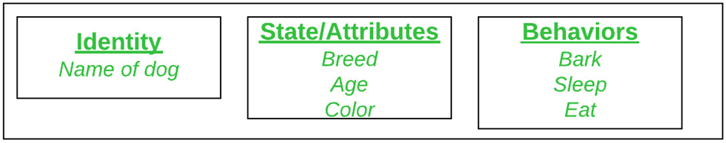
C# Object:-
1)Object is an instance of a class & that can be used to access the data members & member function of a class.
An object consists of :
State: It is represented by attributes of an object. It also reflects the properties of an object.
Behavior: It is represented by the methods of an object. It also reflects the response of an object with other objects.
Identity: It gives a unique name to an object and enables one object to interact with other objects.
Objects correspond to things found in the real world. For example, a graphics program may have objects such as “circle”, “square”, “menu”. An online shopping system might have objects such as “shopping cart”, “customer”, and “product”.
Object is a runtime entity, it is created at runtime.
Object is an instance of a class. All the members of the class can be accessed through object.
We can create objects by using a “new” keyword followed by the name of the class.
Users user=new Users();

Slide 9
using System;
public class BankAccount
{
private string accountNumber;
private decimal balance;
public string AccountNumber
{
get { return accountNumber; }
set { accountNumber = value; }
}
public decimal Balance
{
get { return balance; }
private set { balance = value; }
}
public void Deposit(decimal amount)
{
balance += amount;
}
public void Withdraw(decimal amount)
{
if (amount <= balance)
balance -= amount;
}
}
public class Program
{
public static void Main()
{
BankAccount myAccount = new BankAccount();
myAccount.AccountNumber = "123456789";
myAccount.Deposit(1000);
myAccount.Withdraw(500);
Console.WriteLine("Account Number: " + myAccount.AccountNumber);
Console.WriteLine("Balance: $" + myAccount.Balance);
}
}

Slide 10
Constructors
A constructor is a special method of the class which gets automatically invoked whenever an instance of the class is created.
Syntax:
class ABC
{
// Constructor
public ABC() {}
}
// an object is created of Geek class,
So above constructor is called
ABC obj = new ABC();
There can be two types of constructors
1)Default constructor
2)Parameterized constructor
Important points to Remember About Constructors
Constructor of a class must have the same name as the class name in which it resides.
A constructor can not be abstract, final, and Synchronized.
Within a class, you can create only one static constructor.
A constructor doesn’t have any return type, not even void.
A static constructor cannot be a parameterized constructor.
A class can have any number of constructors.
Access modifiers can be used in constructor declaration to control its access i.e which other class can call the constructor.

Slide 11
C# Default Constructor
A constructor which has no argument is known as default constructor. It is invoked at the time of creating object.
C# Default Constructor Example: Having Main() in another class
using System;
public class Employee
{
public Employee()
{
Console.WriteLine("Default Constructor Invoked");
}
public static void Main(string[] args)
{
Employee e1 = new Employee();
Employee e2 = new Employee();
}
}
using System;
public class Employee
{
public Employee()
{
Console.WriteLine("Default Constructor Invoked");
}
}
class TestEmployee{
public static void Main(string[] args)
{
Employee e1 = new Employee();
Employee e2 = new Employee();
}
}

Slide 12
C# Parameterized Constructor
A constructor which has parameters is called parameterized constructor. It is used to provide different values to distinct objects.
using System;
public class Employee
{
public int id;
public String name;
public float salary;
public Employee(int i, String n,float s)
{
id = i;
name = n;
salary = s;
}
public void display()
{
Console.WriteLine(id + " " + name+" "+salary);
}
}
class TestEmployee{
public static void Main(string[] args)
{
Employee e1 = new Employee(101, "Sonoo", 890000f);
Employee e2 = new Employee(102, "Mahesh", 490000f);
e1.display();
e2.display();
}
}
Output:
101 Sonoo 890000
102 Mahesh 490000

Slide 13
C# this
The “this” keyword in C# is used to refer to the current instance of the class. It is also used to differentiate between the method parameters and class fields if they both have the same name.
Another usage of “this” keyword is to call another constructor from a constructor in the same class.
example, we are showing a record of Students i.e: id, Name, Age, and Subject. To refer to the fields of the current class, we have used the “this” keyword in C#

Slide 14
using System.IO;
using System;
class Student {
public int id, age;
public String name, subject;
public Student(int id, String name, int age, String subject) {
this.id = id;
this.name = name;
this.subject = subject;
this.age = age;
}
public void showInfo() {
Console.WriteLine(id + " " + name+" "+age+ " "+subject);
}
}
class StudentDetails {
public static void Main(string[] args) {
Student std1 = new Student(001, "Jack", 23, "Maths");
Student std2 = new Student(002, "Harry", 27, "Science");
Student std3 = new Student(003, "Steve", 23, "Programming");
Student std4 = new Student(004, "David", 27, "English");
std1.showInfo();
std2.showInfo();
std3.showInfo();
std4.showInfo();
}
}

Slide 15
static keyword in C#
static is a modifier in C# which is applicable for the following:
Classes
Variables
Methods
Constructor
It is also applicable to properties, event, and operators. To create a static member(class, variable, methods, constructor), precede its declaration with the keyword static. When a member is declared static, it can be accessed with the name of its class directly.
Static Class
A static class is declared with the help of static keyword.
A static class can only contain static data members, static methods, and a static constructor.
It is not allowed to create objects of the static class.
Static classes are sealed, means one cannot inherit a static class from another class.

Slide 16
// C# program to illustrate the
// concept of a static class
using System;
// Creating static class
// Using static keyword
static class Tutorial {
// Static data members of Tutorial
public static string Topic = "Static class";
}
// Driver Class
public class GFG {
// Main Method
static public void Main()
{
// Accessing the static data members of Tutorial
Console.WriteLine("Topic name is : {0} ", Tutorial.Topic);
}
}
Output:
Topic name is : Static class

Slide 17
Static Variable
A static variable is declared with the help of static keyword.
When a variable is declared as static, then a single copy of the variable is created and shared among all objects at the class level.
Static variables are accessed with the name of the class, they do not require any object for access.
// C# program to illustrate the
// concept of static variable
using System;
class Vehicle {
// Creating static variable
// Using static keyword
public static string Model_color = "Black";
}
// Driver Class
public class GFG {
// Main Method
static public void Main()
{
// Accessing the static variable
// using its class name
Console.WriteLine("Color of XY model is : {0} ",
Vehicle.Model_color);
}
}
Output:
Color of XY model is : Black

Slide 18
Static Method
-A static method is declared with the help of static keyword.
-Static methods are accessed with the name of the class.
-A static method can access static and non-static fields, static fields are directly accessed by the static method without class name whereas non-static fields require objects.
// C# program to illustrate the
// concept of static method
using System;
class Nparks {
static public int t = 104;
// Creating static method
// Using static keyword
public static void total()
{
Console.WriteLine("Total number of national parks"+
" present in India is :{0}", t);
}
}
// Driver Class
public class GFG {
// Main Method
static public void Main()
{
// Accessing the static method
// using its class name
Nparks.total();
}
}
Output:
Total number of national parks present in India is :104

Slide 19
Static Constructor
A static constructor is declared with the help of static keyword.
Static Constructor has to be invoked only once in the class and it has been invoked during the creation of the first reference to a static member in the class.
Points To Remember:
It can’t be called directly.
When it is executing, then the user has no control.
It does not take access modifiers or any parameters.
It is called automatically to initialize the class before the first instance created.

Slide 20
// Instance method.
public string g1_detail(string name, string branch)
{
return "Name: " + name + " Branch: " + branch;
}
// Main Method
public static void Main()
{
// Here Both Static and instance
// constructors are invoked for
// first instance
G1 obj = new G1(1);
Console.WriteLine(obj.g1_detail("Sunil", "CSE"));
// Here only instance constructor
// will be invoked
G1 ob = new G1(2);
Console.WriteLine(ob.g1_detail("Sweta", "ECE"));
}
}
// C# Program to illustrate calling
// a Static constructor
using System;
class G1 {
// It is invoked before the first
// instance constructor is run.
static G1()
{
// The following statement produces
// the first line of output,
// and the line occurs only once.
Console.WriteLine("Example of Static Constructor");
}
// Instance constructor.
public G1(int j)
{
Console.WriteLine("Instance Constructor " + j);
}

Slide 21
Output:
Example of Static Constructor
Instance Constructor 1
Name: Sunil Branch: CSE
Instance Constructor 2
Name: Sweta Branch: ECE

Slide 22
C# Inheritance
1) C#, inheritance is a process in which one object acquires all the properties and behaviors of its parent object automatically.
2) you can reuse, extend or modify the attributes and behaviors which is defined in other class.
3) The class which inherits the members of another class is called derived class and the class whose members are inherited is called base class.
4) In C#, use the : symbol to inherit a class from another class.
Inheritance Syntax
<access_modifier> class <base_class_name> { // Base class Implementation } <access_modifier> class <derived_class_name> : <base_class_name> { // Derived class implementation }

Slide 23
In the real world example, a customer is a person.
In the same way, a student is a person and an employee is also a person.
They all have some common things, for example, they all have a first name, middle name, and last name.
So to translate this into object-oriented programming, we can create the Person class with first name, middle name, and last name properties and inherit the Customer, Student, and Employee classes from the Person class.
That way we don't need to create the same properties in all classes and avoid the violation

Slide 24
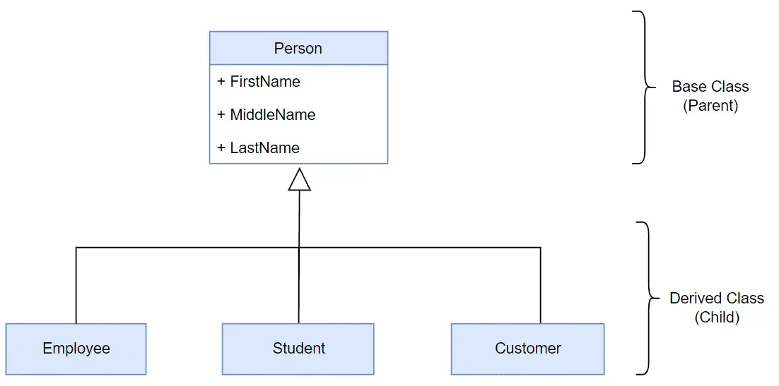

Slide 25
class Vehicle {
// attributes and methods
}
// Car inherits from Vehicle
class Car : Vehicle {
// attributes and methods of Vehicle
// attributes and methods of Car
}
// Truck inherits from Vehicle
class Truck : Vehicle {
// attributes and methods of Vehicle
// attributes and methods of Truck
}
there are three classes - Vehicle, Car, and Truck. The Vehicle class is a base class whereas the other two are the derived classes that inherit the properties of the base class Vehicle.

Slide 26
using System;
namespace Inheritance {
// base class
class Vehicle {
public string name;
public void engine() {
Console.WriteLine("This is the engine of the vehicle");
}
}
// derived class of Vehicle
class Car : Vehicle {
public void display() {
Console.WriteLine("This car is" + name);
}
}
class Program {
static void Main(string[] args) {
// object of derived class
Car c = new Car();
c.name = "Tiago";
// method of base class
c.engine();
// method from own class
c.display();
}
}
}
Output:
This is the engine of the vehicle
This car is Toyota

Slide 27
In the above example, we have inherited a class Car from the Vehicle class.
You can see that using an object c of the Car class, we are accessing the members of the Vehicle class such as the name field and the engine() method.
All this is possible because of the inheritance relationship that exists between the parent class "Vehicle" and the child class "Car".
C# Inheritance Protected Members
Protected is an access specifier that is used with classes, methods, or variables to restrict their usage on various parts of the program.
When we use a protected keyword with a variable or a method, it can only be accessed within the class or its derived class.

Slide 28
using System;
namespace Inheritance {
class Vehicle {
protected void run() {
Console.WriteLine("The vehicle will run");
}
}
class Truck : Vehicle {
static void Main(string[] args) {
Truck t = new Truck();
// accessing protected methods from the base class
t.run();
}
}
}
Output:
The vehicle will run

Slide 29
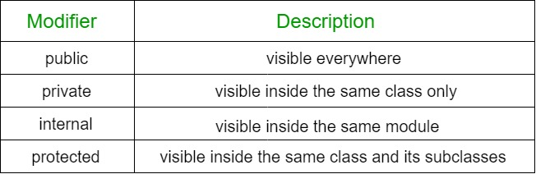

Slide 30
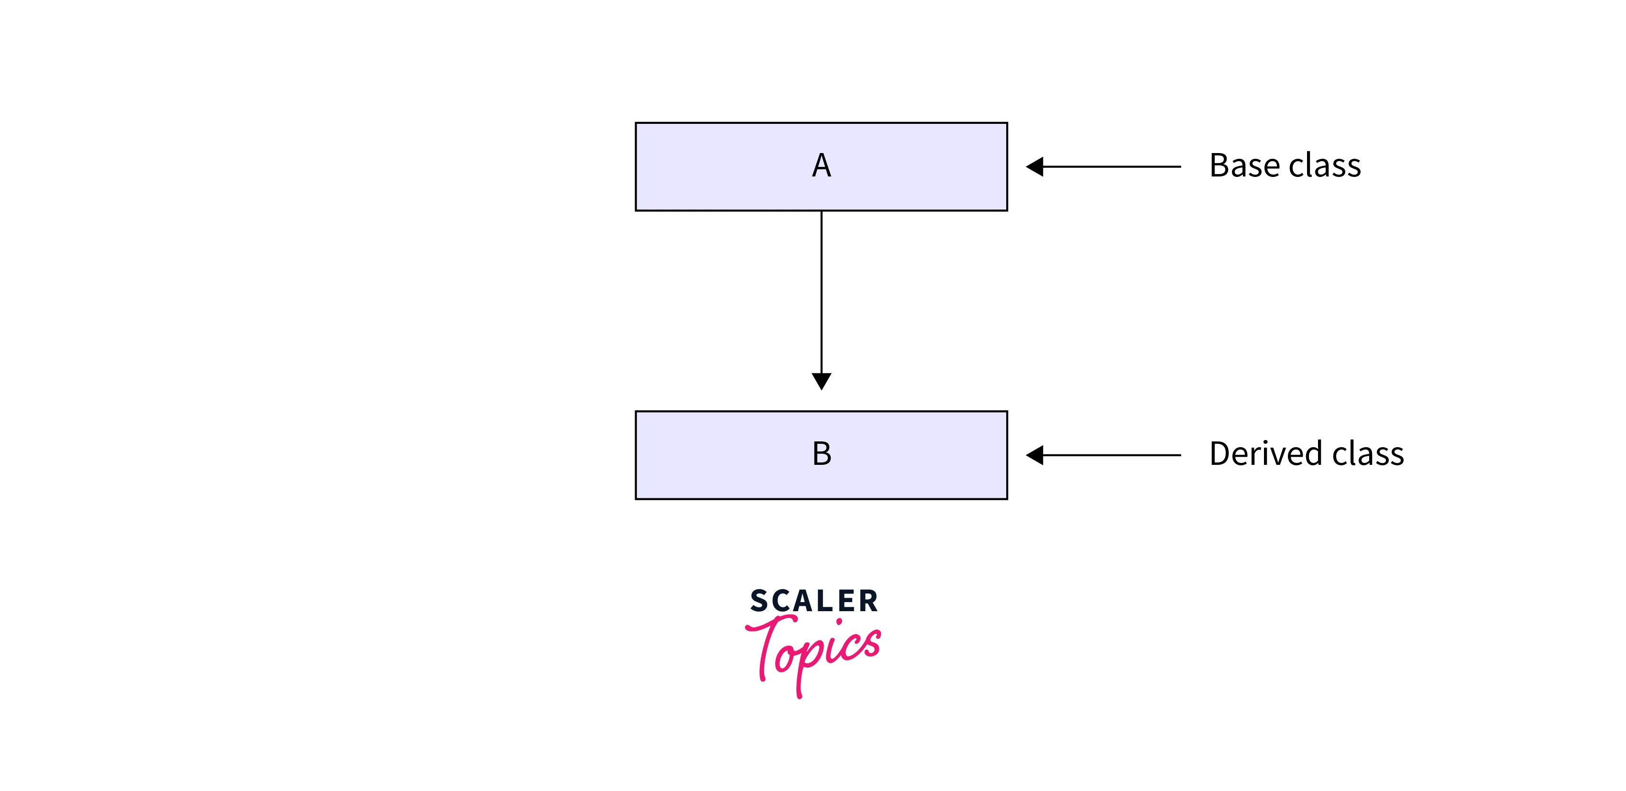
Types of Inheritance in C#
Single Inheritance:
In single inheritance, a derived class inherits the properties of only one base class.

Slide 31
using System;
class Vehicle {
public void Engine() {
Console.WriteLine("A vehicle has an engine.");
}
}
class Car : Vehicle {
public void run() {
Console.WriteLine("Car is running.");
}
}
class Example {
static void Main(string[] args) {
Car c = new Car();
c.Engine();
c.run();
}
}
A vehicle has an engine.
Car is running.
the Car class is only inherited from the Vehicle class. Therefore, it is an example of single inheritance as only one derived class is inherited from one base class.

Slide 32
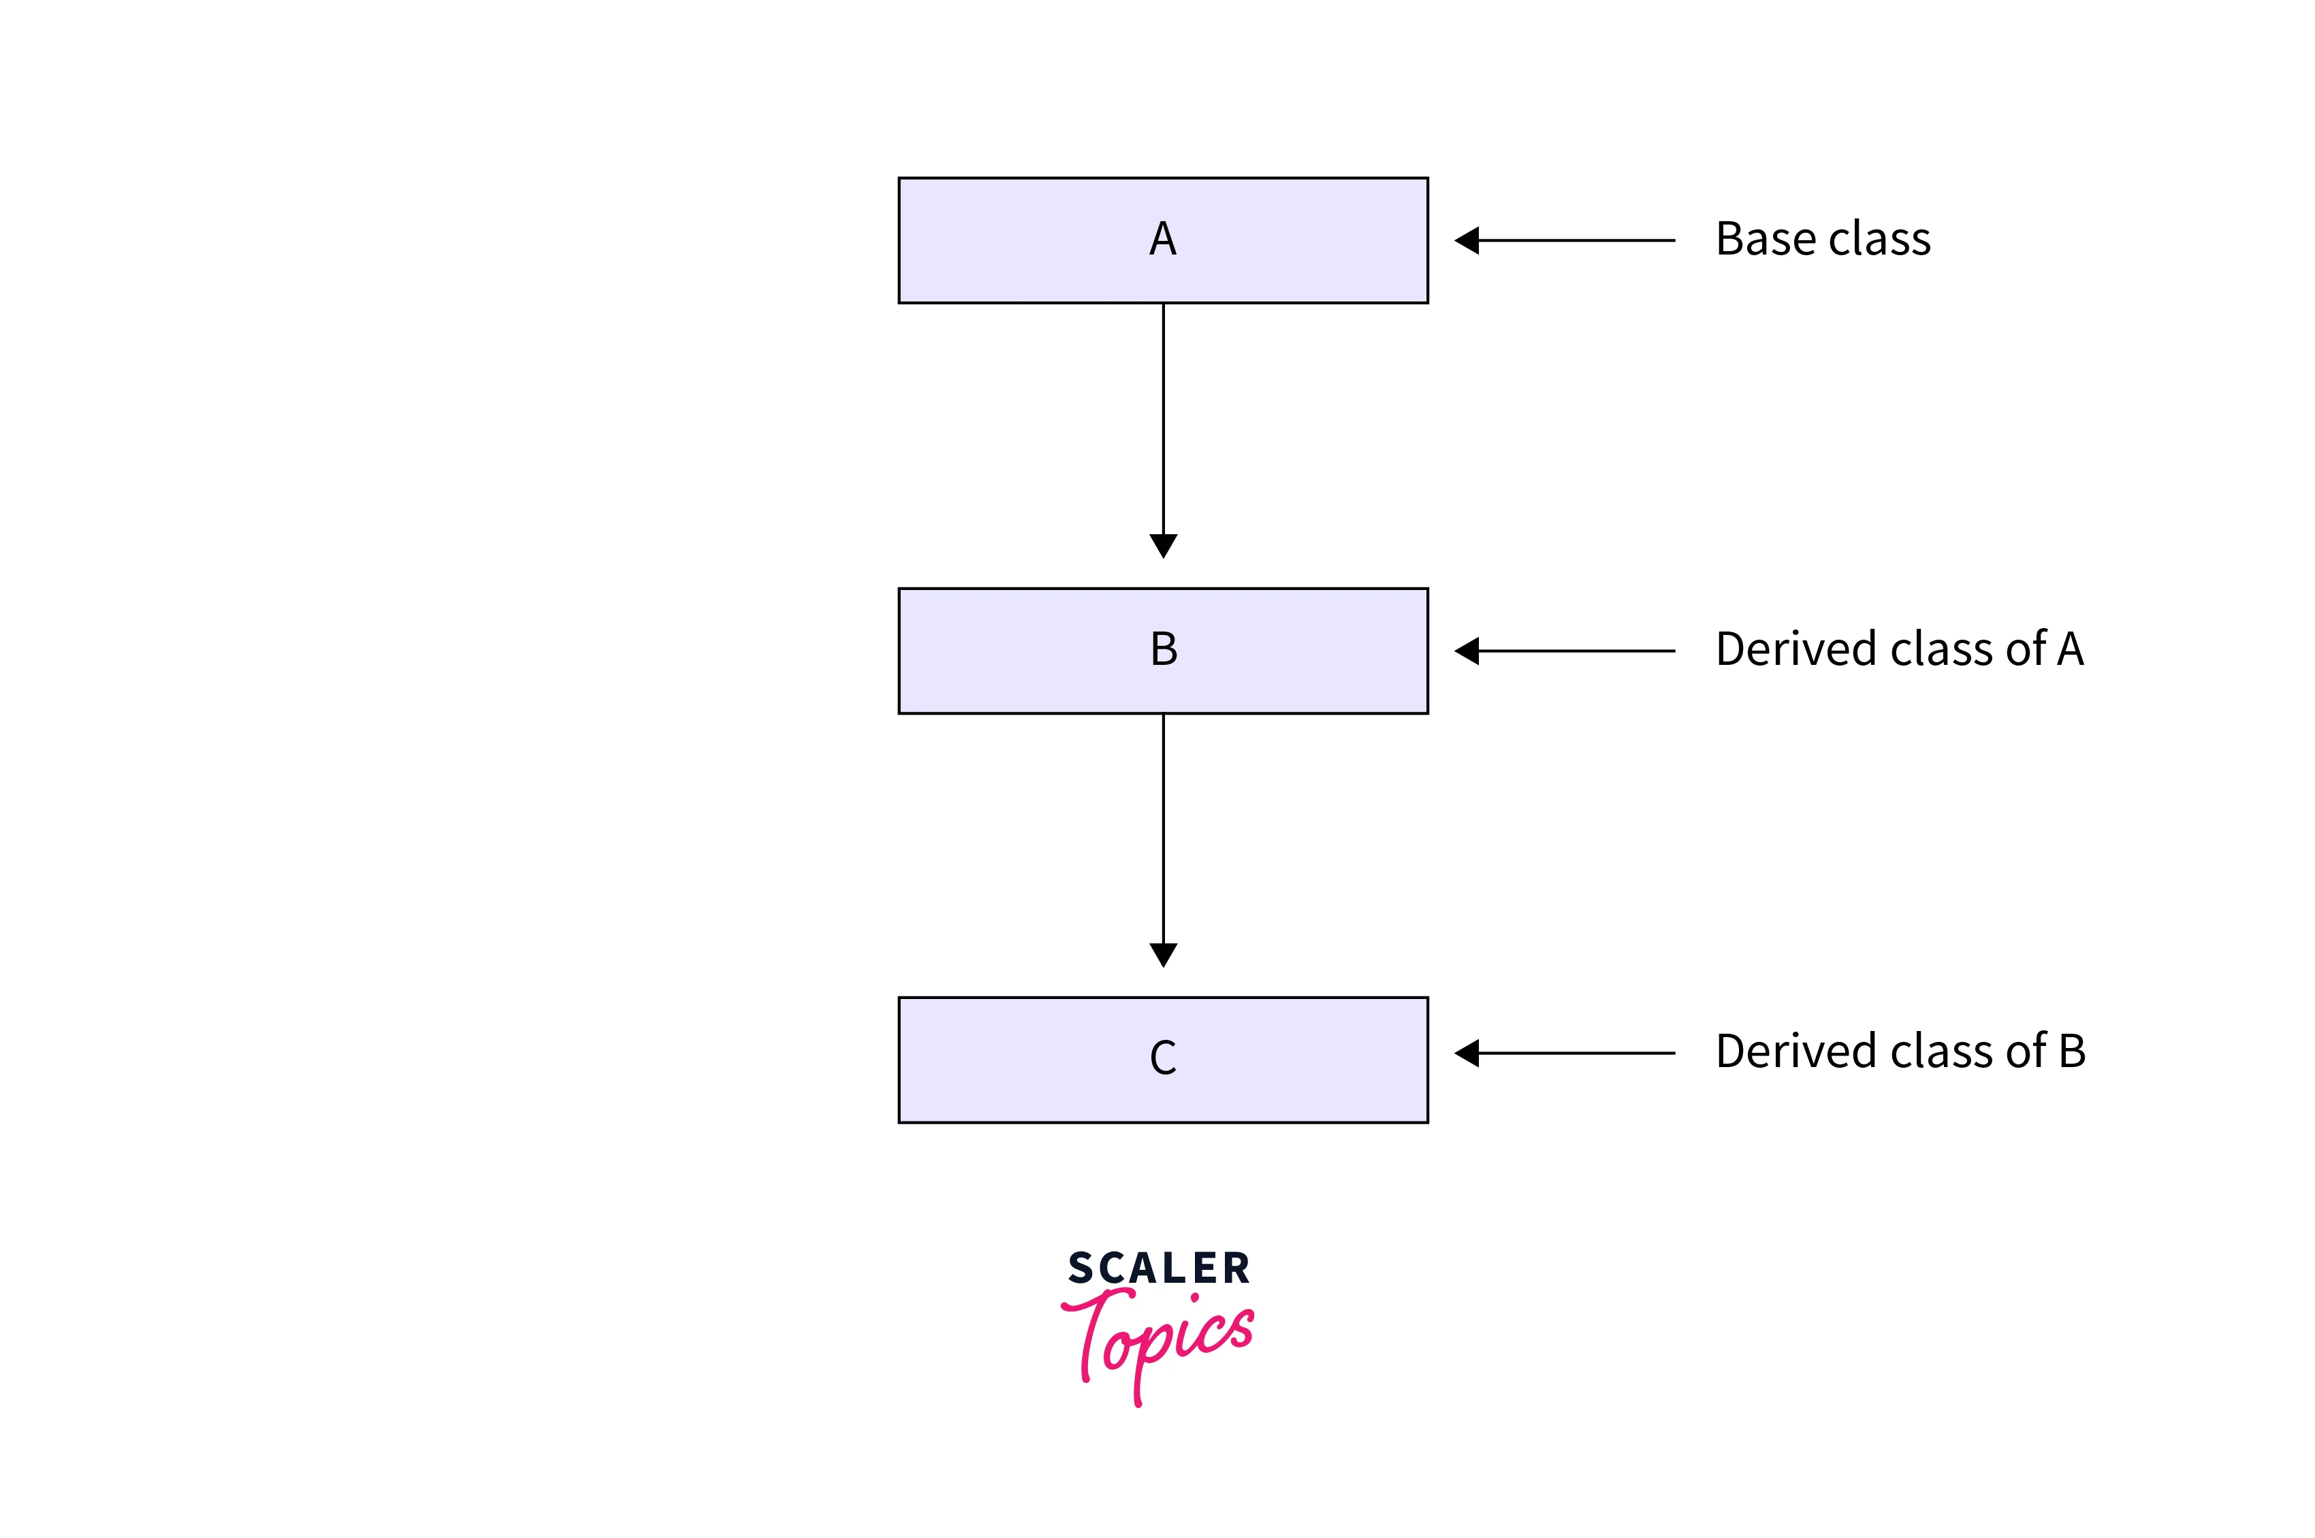
C# Multi Level Inheritance Example
When one class inherits another class which is further inherited by another class, it is known as multi level inheritance in C#.
Inheritance is transitive so the last derived class acquires all the members of all its base classes.

Slide 33
using System;
class GrandFather {
public void write() {
Console.WriteLine("GrandFather");
}
}
class Father : GrandFather {
public void wrote() {
Console.WriteLine("Father");
}
}
class Son : Father {
public void written() {
Console.WriteLine("Son");
}
}
class Example {
static void Main(string[] args) {
Son s = new Son();
s.write();
s.wrote();
s.written();
}
}
OUTPUT:
GrandFather
Father
Son

Slide 34
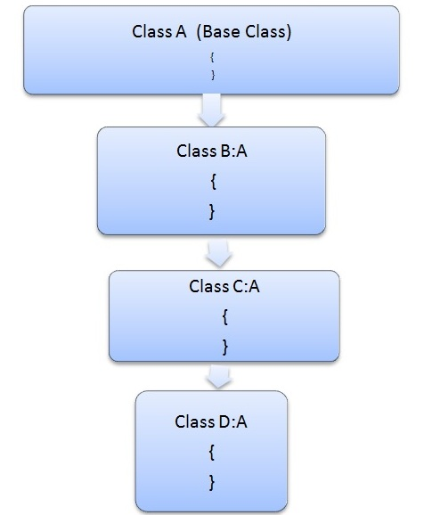
Hierarchical inheritance in C#
This is the type of inheritance in which there are multiple classes derived from one base class. This type of inheritance is used when there is a requirement of one class feature that is needed in multiple classes.

Slide 35
using System;
namespace Studytonight
{
public class Parent
{
public void DisplayParentsAB()
{
Console.WriteLine("A and B are my parents");
}
}
public class ChildC: Parent
{
public void DisplayChildC()
{
Console.WriteLine("I am the child C");
}
}
public class ChildD: Parent
{
public void DisplayChildD()
{
Console.WriteLine("I am the child D");
}
}
public class Program
{
public static void Main(string[] args)
{
ChildC cc = new ChildC();
ChildD cd = new ChildD();
cc.DisplayChildC();
cc.DisplayParentsAB(); // accessing parent class
cd.DisplayChildD();
cd.DisplayParentsAB(); // accessing parent class
}
}
}
Output:
I am the child C
A and B are my parents
I am the child D
A and B are my parents

Slide 36
Abstraction in C#
Abstraction is an important part of object oriented programming. It means that only the required information is visible to the user and the rest of the information is hidden.
Abstraction can be implemented using abstract classes in C#. Abstract classes are base classes with partial implementation. These classes contain abstract methods that are inherited by other classes that provide more functionality.
In C# we can achieve the abstraction with the help of abstract class
We can declare the abstract class with the keyword of abstract
It is not allowed to create abstract class objects in C #. Or in other words, you can not use the abstract class directly with the new operator.
The class that contains the abstract keyword along with some of the methods (not all abstract methods) is known as the abstract base class.
The class that contains the abstract keyword with all its methods is called a pure abstract base class.
You cannot explain abstract methods outside the abstract class.
You cannot declare an abstract class as a sealed class.
Some of the salient points about abstract classes are as follows:
The abstract class is created using the keyword abstract and some of the methods of the abstract class also contain the keyword abstract.
No object can be created of the abstract class i.e.it cannot be instantiated.
The abstract methods in the abstract class are implemented actually only in the derived classes.
If all the methods in the abstract class contain the keyword abstract, then that class is known as pure Abstract class.

Slide 37
Another real-time example is an ATM machine. We all use ATM machines for cash withdrawals, money transfers, retrieving min-statements, etc. in our daily lives.
But we don’t know internally what things are happening inside an ATM machine when we insert an ATM card for performing different kinds of operations.
Information like where the server is, where the database server is, what programming language they use to write the logic, how they are validating the data, how they are implementing logic for various kinds of operations, and what SQL statements get executed on the database when we perform any operations, all these things are hidden from us.
What they provide as part of the ATM machine is services (cash withdrawal, money transfer, retrieving min-statement, etc), but how these services are implemented is abstracted to us.

Slide 38
There are a few rules to follow when using abstraction in C#:
-Abstract classes must be marked with the abstract keyword.
-Abstract classes can contain both abstract and non-abstract members.
-Abstract methods do not have an implementation, and must be implemented in a derived class.
-Derived classes that implement abstract methods must use the override keyword.
-Abstract classes cannot be instantiated, and must be inherited by a derived class in order to be used.
-If a class contains any abstract members, it must also be marked as abstract.
-A derived class that implements all of the abstract members of its base class is considered to be a concrete class, and can be instantiated.

Slide 39
using System;
namespace abstraction
{
//abstract class
abstract class Shape
{
//abstract methods
public abstract double calculateArea();
public abstract void displayDetails(double area);
}
//Rectangle class inheriting Shape class
class Rectangle : Shape
{
//private data members
private double length;
private double breadth;
public Rectangle(double length, double breadth)
{
this.length = length;
this.breadth = breadth;
}
//overriding abstract methods of Shape class using 'override’ keyword
public override double calculateArea()
{
return (length * breadth);
}
public override void displayDetails(double area)
{
Console.Write("Length of rectangle: "+length);
Console.Write("\nBreadth of rectangle: "+breadth);
Console.Write("\nArea of rectangle: "+area);
}
}
//Square class inheriting Shape class
class Square : Shape{
//private data members
private double side;
public Square(double side)
{
this.side = side;
}
//overriding abstract methods of Shape class using 'override' keyword
public override double calculateArea()
{
return (side * side);
} public override void displayDetails(double area)
{
Console.Write("Length of a side of square: "+side);
Console.Write("\nArea of square: "+area);
}
}
public class AbstractionDemo
{
public static void Main(string[] args)
{
double area;
//creating reference of Shape class using Rectangle class
Shape shapeRec = new Rectangle(5,6);
area = shapeRec.calculateArea();
shapeRec.displayDetails(area);
Console.WriteLine("\n");
//creating reference of Shape class using Square class
Shape shapeSquare = new Square(4);
area = shapeSquare.calculateArea();
shapeSquare.displayDetails(area);
}
}
}

Slide 40
Polymorphism in C#
Polymorphism is a Greek word meaning "one name many forms."
one object has many forms or has one name with multiple functionalities.
Polymorphism allows a class to have multiple implementations with the same name.
Types of Polymorphism
There are two types of polymorphism in C#:
1) Static / Compile Time Polymorphism
2) Dynamic / Runtime Polymorphism
Static or compile-time polymorphism
Method overloading is an example of Static polymorphism.
Overloading is the concept in which method names are the same with different parameters.
The method/function has the same name but different signatures in overloading.
It is also known as Early binding.
It is also known as compile-time polymorphism because the decision of which method is to be called is made at compile time.
C# compiler checks the number of parameters passed, and the parameter type decides which method to call and throws an error if no matching method is found.

Slide 41
public class TestData
{
public int Add(int a, int b, int c)
{
return a + b + c;
}
public int Add(int a, int b)
{
return a + b;
}
}
class Program
{
static void Main(string[] args)
{
TestData dataClass = new TestData();
int add2 = dataClass.Add(45, 34, 67);
int add1 = dataClass.Add(23, 34);
}
}

Slide 42
Dynamic / Runtime Polymorphism:-
This type of polymorphism is also referred to as run-time or late binding polymorphism because of the decision about which method is to be called is made at run-time.
In dynamic polymorphism, we override the base class method in the derived class using inheritance, and this can be achieved using override and virtual keywords.
Now we will see the example of method overriding where we will give the same method name and signature (same number of parameters and type but with different definitions) too in parent and child classes.

Slide 43
using System;
namespace polymorphisamOverriding
{
public class Interest
{
public virtual double TrueBank(double amount, double rate)
{
return amount + (amount * rate);
}
}
// first child class
public class SimpleInterest: Interest
{
public override double TrueBank(double amount, double rate)
{
return amount + (amount * rate) + 1000;
}
}
// second child class
public class FixedInterest: Interest
{
public override double TrueBank(double amount, double rate)
{
return amount + (amount * rate) + 1500;
}
}
public class Program
{
public static void Main(string[] args)
{
Interest i = new Interest();
double finalamount = i.TrueBank(5000.00,0.1);
Console.WriteLine("Normal interest for a holder "+finalamount);
i = new SimpleInterest();
finalamount = i.TrueBank(5000.00,0.1);
Console.WriteLine("Simple interest for a holder "+finalamount);
i = new FixedInterest();
finalamount = i.TrueBank(5000.00,0.1);
Console.WriteLine("Fixed interest for a holder "+finalamount);
}
}
}
OUTPUT:-
Normal interest for a holder 5500
Simple interest for a holder 6500
Fixed interest for a holder 7000

Slide 44
In the above example, we have created a base class named Interest, and two derived classes that is SimpleInterest and FixedInterest.
In the base class, we used the virtual keyword with the method so that it can overriden in the derived class using the override keyword.
Here, we have given the same method name that is TrueBank and the same signature (number and type parameters) but different method definitions in the derived/child classes.
The we created the object of the Interest class and provided the parameter list.
If you closely observe the above parameter list, you will find the same parameters have been provided for each method call.
Here the compiler only requires TrueBank() method to compile successfully and at the run-time desired methods get called respectively, based on which class's object is calling it.

Slide 45
C# | Encapsulation
Encapsulation is defined as the grouping of data into a single unit.
encapsulation is achieved by defining the class's fields as private or protected, which means that they are not directly accessible from outside the class.
Access to the class's fields is provided through methods, which are called "accessors" or "getters" and "mutators" or "setters".
Use properties:
In C#, you can use properties to encapsulate fields and provide access to their values.
Properties are special methods that allow you to get or set the value of a field while controlling access to it.

Slide 46
using System;
public class Person
{
private string name;
private int age;
public string Name
{
get { return name; }
set { name = value; }
}
public int Age
{
get { return age; }
set { age = value; }
}
}
class Program
{
static void Main(string[] args)
{
Person person = new Person();
person.Name = "John";
person.Age = 30;
Console.WriteLine("Name: " + person.Name);
Console.WriteLine("Age: " + person.Age);
}
}
Output:
Name: John
Age: 30

Slide 47
// C# program to calculate the area
// of a square using the concept of
// data abstraction
using System;
namespace Demoabstraction {
// abstract class
abstract class Shape {
// abstract method
public abstract int area();
}
// square class inheriting the Shape class
class Square : Shape {
// private data member
private int side;
// method of square class
public Square(int x = 0)
{
side = x;
}
// overriding of the abstract method of Shape
// class using the override keyword
public override int area()
{
Console.Write("Area of Square: ");
return (side * side);
}
}
// Driver Class
class GFG {
// Main Method
static void Main(string[] args)
{
// creating reference of Shape class
// which refer to Square class instance
Shape sh = new Square(4);
// calling the method
double result = sh.area();
Console.Write("{0}", result);
}
}
}

Slide 48
What is an Interface in C#?
The Interface in C# is a Fully Unimplemented Class used for declaring a set of operations/methods of an object.
So, we can define an interface as a pure abstract class, which allows us to define only abstract methods.
The abstract method means a method without a body or implementation.
It is used to achieve multiple inheritances, which the class can’t achieve.
It is used to achieve full abstraction because it cannot have a method body.
Note:
An interface can contain declarations of methods, properties, indexers, and events.
Default interface methods with implementation body are supported from C# 8.0.
An interface cannot contain constructors and fields.
Interface members are by default abstract and public.
You cannot apply access modifiers to interface members.
Although, C# 8.0 onwards, you may use private, protected, internal, public, virtual, abstract, sealed, static, extern, and partial modifiers on certain conditions.

Slide 49
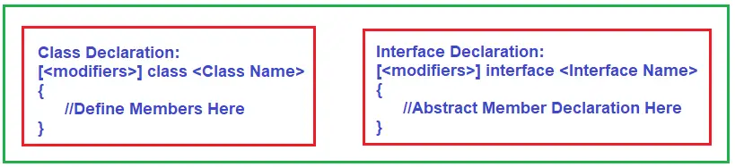
Differences Between Concrete Class, Abstract Class, and Interface in C#:
A Concrete Class can contain only the methods that contain the method body.
Do we have a method without the body? Yes, we have methods without a body, called abstract methods.
So, we can say class contains a method with a method body, or you can say non-abstract methods. Abstract class contains abstract and non-abstract methods, and the interface contains only abstract methods.
Class: Contains only the Non-Abstract Methods (Methods with Method Body).
Abstract Class: Contains both Non-Abstract Methods (Methods with Method Body) and Abstract Methods (Methods without Method Body).
Interface: Contain only Abstract Methods (Methods without Method Body).
How to Define an Interface in C#?
The way we define a class in the same way we need to define an interface in C#. In a class declaration, we need to use the class keyword, whereas in an interface declaration, we need to use the interface keyword. Moreover, in an interface, we can only declare abstract members.

Slide 50
using System;
namespace CsharpInterface {
interface IPolygon {
// method without body
void calculateArea(int l, int b);
}
class Rectangle : IPolygon {
// implementation of methods inside interface
public void calculateArea(int l, int b) {
int area = l * b;
Console.WriteLine("Area of Rectangle: " + area);
}
}
class Program {
static void Main (string [] args) {
Rectangle r1 = new Rectangle();
r1.calculateArea(100, 200);
}
}
}
OUTPUT:-
Area of Rectangle: 20000

Slide 51
class Square : IPolygon {
// implementation of IPolygon interface
public void calculateArea()
{
int l = 30;
int area = l * l;
Console.WriteLine("Area of Square: " + area);
}
}
class Program {
static void Main (string [] args) {
Rectangle r1 = new Rectangle();
r1.calculateArea();
Square s1 = new Square();
s1.calculateArea();
}
}
}
Output
Area of Rectangle: 2700
Area of Square: 900
using System;
namespace CsharpInterface {
interface IPolygon {
// method without body
void calculateArea();
}
// implements interface
class Rectangle : IPolygon {
// implementation of IPolygon interface
public void calculateArea() {
int l = 30;
int b = 90;
int area = l * b;
Console.WriteLine("Area of Rectangle: " + area);
}
}

Slide 52
Explicit Interface Implementation
In C#, we use explicit interface implementation to explicitly implement an interface member to avoid ambiguity when a class implements multiple interfaces having a member with the same name and signature.
By using explicit implementation, we can resolve the ambiguity between the members with the same name. The class must explicitly specify which interface member it is implementing.

Slide 53
using System;
public interface IShape {
void Draw();
}
public interface ICircle {
void Draw();
}
public class Shape : IShape, ICircle {
void IShape.Draw() {
Console.WriteLine("Drawing a shape");
}
void ICircle.Draw() {
Console.WriteLine("Drawing a circle");
}
}
class Program {
static void Main(string[] args) {
IShape shape = new Shape();
ICircle circle = new Shape();
shape.Draw(); // Outputs "Drawing a shape"
circle.Draw(); // Outputs "Drawing a circle"
}
}

