Slide 1


Slide 2
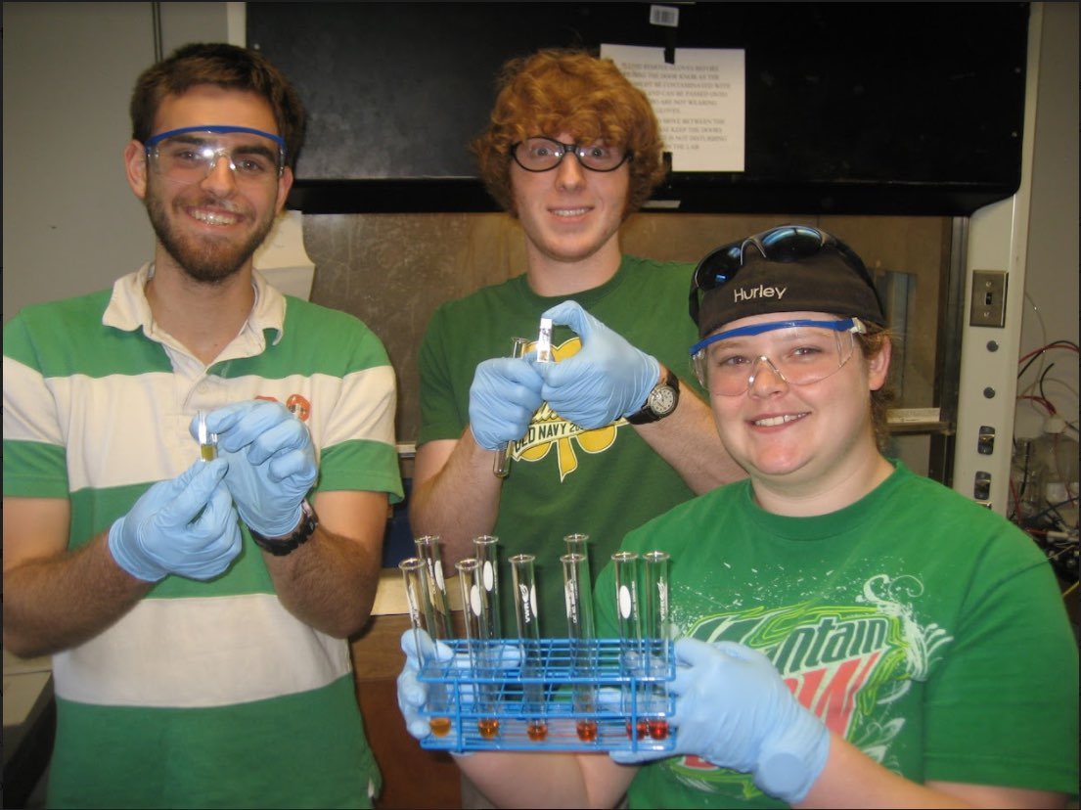
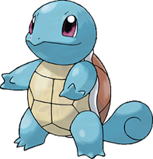
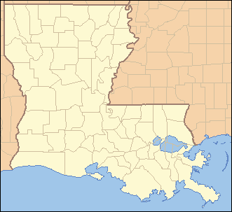
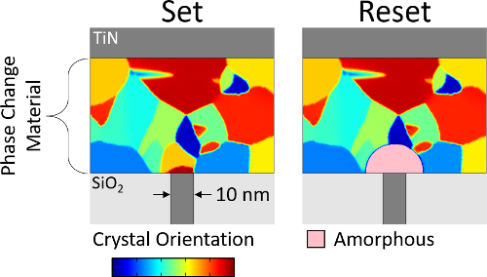
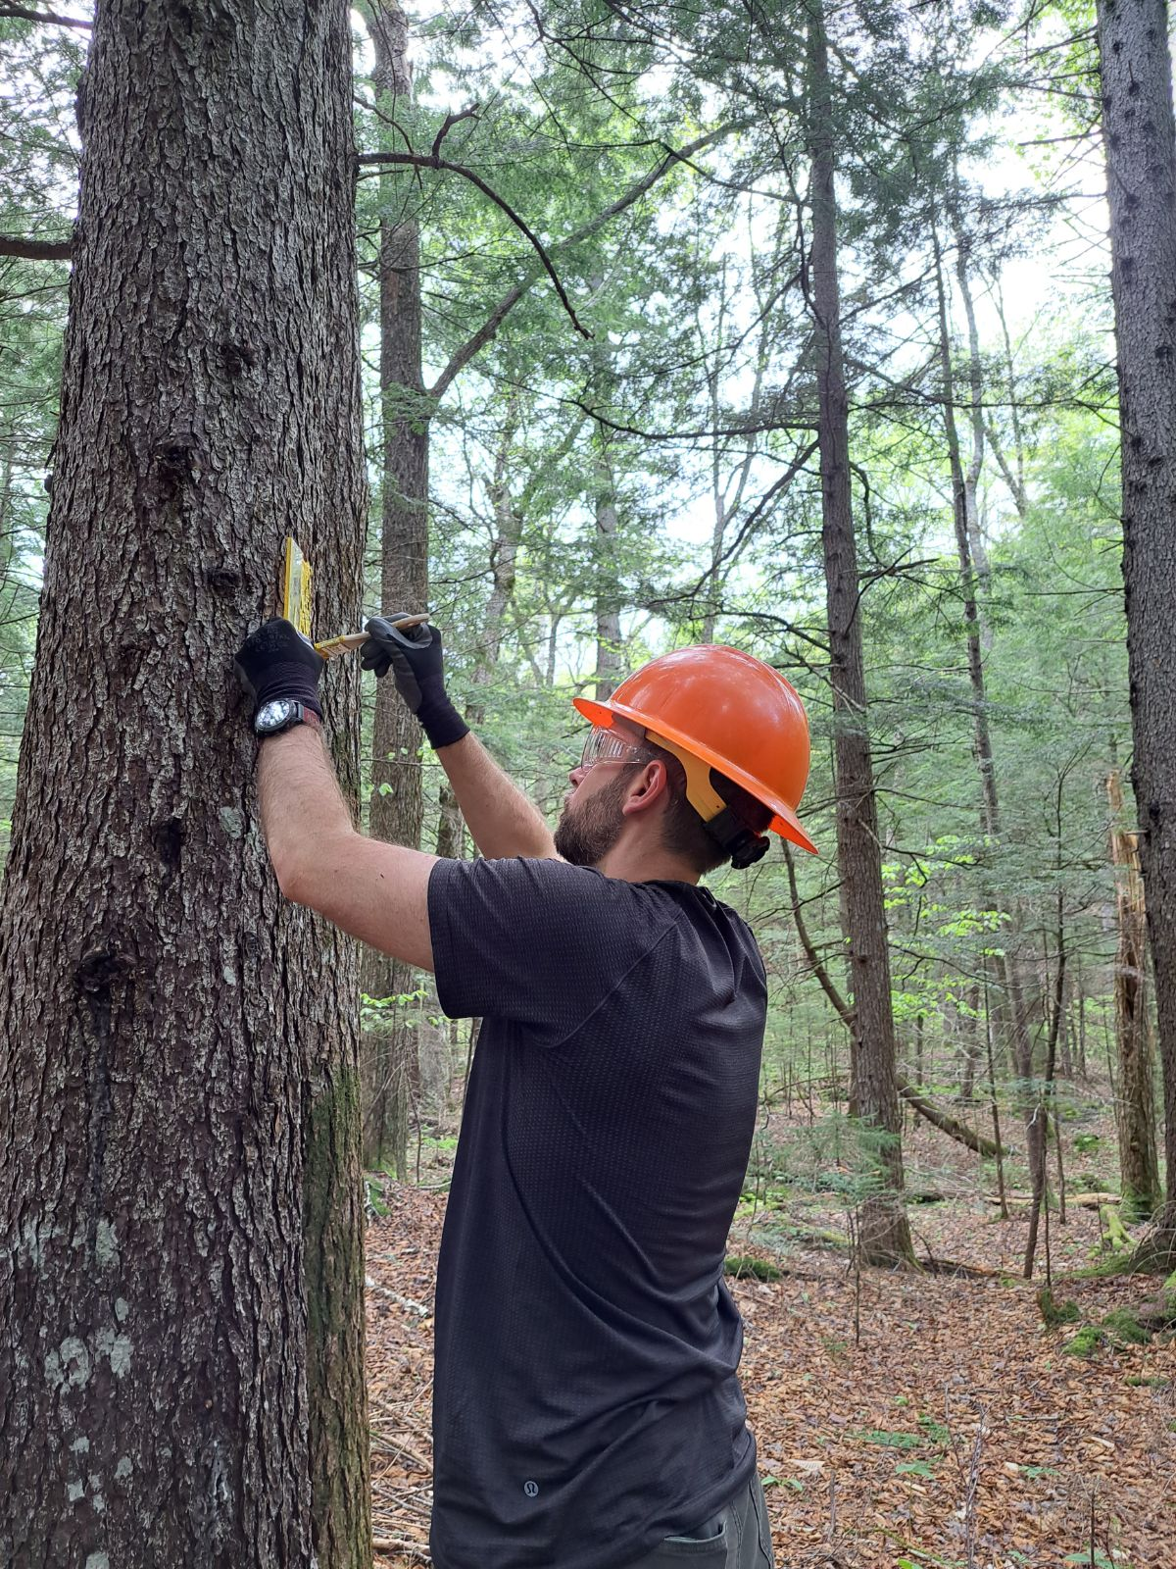
About Me
From Louisiana (hey y'all!)
Studied Nanosystems & Electrical Engineering
Interests – Games and Hiking

Slide 3
Rapid Overview
Join the Discord, update your name to FirstName LastName
Weekly labs (starting this week) due Fridays
Weekly homework (starting this week) due Tuesdays
Week 1- office hours from 5-6 PM in FSB 202
Start homework, and come by if you're struggling
Or just come by to chat
Participation is graded in lectures and labs
Lectures – answer at least 1 poll during lecture
Labs – Be on time, work with a partner throughout
These slides are available! Find this and other material in the Discord #quick-links channel.

Slide 4
UConn CS Overview
CSE 1010/AP Computer Science
CSE 2050 – Data Structures & Object-Oriented Programming
CSE 2500 – Discrete Math
CSE 3100 – Systems Programming
CSE 3140 – Cyber Security
CSE 3500 - Algorithms
CSE 3504 – Probabilistic Analysis
CSE 3666 - Architecture
CSE 3150 (C++) or CSE 3160 (Functional Programming)

Slide 5
CSE 2050 Overview – Data Structures and Object-Oriented Programming

Slide 6
CSE 2050 Overview
Data Structures
How we store information in a computer
Common examples:
array (in Python, a "list")
string
tuple
linked lists
hash table (sets)
hash mapping (dictionaries)
trees
heaps
graphs
"a"
"b"
(1, 2, 3)
"c"
"h"
"e"
"l"
"l"
"o"
"a"
"b"
(1, 2, 3)
"c"
Mod 4
"a"
link
"c"
link
"b"
link
Mod 8
Mod 9
Mod 10
Mods 11, 12

Slide 7
CSE 2050 Overview: Object-Oriented Programming
Let's run some statements in the interactive shell (open up a terminal, type "python", and press enter)
C:\Users\jjscoggin\$ python
Python 3.11.4 (tags/v3.11.4:d2340ef, Jun 7 2023, 05:45:37) [MSC v.1934 64 bit (AMD64)] on win32
>>>

Slide 8
CSE 2050 Overview: Object-Oriented Programming
Let's run some statements in the interactive shell (open up a terminal, type "python", and press enter)
C:\Users\jjscoggin\$ python
Python 3.11.4 (tags/v3.11.4:d2340ef, Jun 7 2023, 05:45:37) [MSC v.1934 64 bit (AMD64)] on win32
>>> radius = 4
>>> pi = 3.14159
>>> area = pi * radius**2
>>> area
50.26544
Rules for variable names:
Must start with a letter or underscore (_)
Can only contain alpha-numeric characters and underscores
Case-sensitive
Should not be any of the restricted python keywords
Should not begin and end with 2 underscores (e.g. __x__)

Slide 9
CSE 2050 Overview: Object-Oriented Programming
id
139647893651792
Variable names map to objects
radius
type
int
value
42
C:\Users\jjscoggin\$ python
Python 3.11.4 (tags/v3.11.4:d2340ef, Jun 7 2023, 05:45:37) [MSC v.1934 64 bit (AMD64)] on win32
>>> radius = 4
>>> pi = 3.14159
>>> area = pi * radius**2
>>> area
50.26544
id
139647892197520
pi
type
float
value
3.14159
id
139647892196624
area
type
float
value
50.26544

Slide 10
CSE 2050 Overview: Object-Oriented Programming
>>> x = 300
>>> id(x)
139647870797008
>>> y = 300
>>> id(y)
139647870797456
>>> x is y
???
>>> x == y
???
is checks identity (do these two variables point to the same object?)
== checks equality (do these two variables point to objects with equal values?)

Slide 12
CSE 2050 Overview: Object-Oriented Programming
>>> x = 300
>>> id(x)
139647870797008
>>> y = 300
>>> id(y)
139647870797456
>>> x is y
False
>>> x == y
True
id
139647870797008
x
type
int
is checks identity (do these two variables point to the same object?)
value
300
id
139647870797456
== checks equality (do these two variables point to objects with equal values?)
y
type
int
value
300

Slide 13
CSE 2050 Overview: Object-Oriented Programming
>>> x = 300
>>> y = x
>>> x is y
???
>>> x == y
???
is checks identity (do these two variables point to the same object?)
== checks equality (do these two variables point to objects with equal values?)

Slide 15
CSE 2050 Overview: Object-Oriented Programming
>>> x = 300
>>> y = x
>>> x is y
True
>>> x == y
True
is checks identity (do these two variables point to the same object?)
id
139647870797008
x
type
int
y
value
== checks equality (do these two variables point to objects with equal values?)
300

Slide 16
CSE 2050 Overview: Object-Oriented Programming
>>> x = 300
>>> y = x
>>> x is y
True
>>> x == y
True
>>> x = 27
>>> print(y)
???
is checks identity (do these two variables point to the same object?)
id
139647870797008
x
type
int
y
value
== checks equality (do these two variables point to objects with equal values?)
300

Slide 17
CSE 2050 Overview: Object-Oriented Programming
>>> x = 300
>>> y = x
>>> x is y
True
>>> x == y
True
>>> x = 27
>>> print(y)
300
is checks identity (do these two variables point to the same object?)
id
139647870797008
x
type
int
y
value
== checks equality (do these two variables point to objects with equal values?)
300
id
139647893652528
The id and type of an object never changes
The value of some objects can change:
lists
sets
dictionaries
type
int
value
27
mutables

Slide 18
This week
Read chapters 1 and 2 in the textbook
Lab on Thursday (due Friday)
Homework 1 is live
Start now
Come to office hours: M-F, 5-6PM, FSB 202

Slide 19
Wednesday Start
Discuss with a neighbor 1 thing we covered last class.
id
139647870797008
>>> x = 300
>>> y = 300
>>> x is y
False
>>> x == y
True
x
type
int
value
300
id
139647870797456
y
type
int
value
300
>>> x = 300
>>> y = x
>>> x is y
True
>>> x == y
True
id
139647870797008
x
type
int
y
value
300

Slide 20
An array ("list" in python) is an object which we think of as "containing" other objects
id
139647871153024
L
type
list
>>> L = ['a', 'b', 'c']
>>> id(L)
139647871153024
>>> len(L)
3
>>> id(L[0])
139647892586864
>>> id(L[1])
139647892358128
>>> id(L[2])
139647892261040
len
3
value
[addr1, addr2, addr3]
id
139647892586864
id
139647892358128
id
139647892261040
type
str
type
str
type
str
value
"a"
value
"b"
value
"c"

Slide 21
Python lists store addresses, which lets us:
mix-and-match types in a list
L = ['a', (1, 2, 3), {'name':'jake'}]
Quickly overwrite items
huge_list = [i for i in range(100000)]
L[0] = huge_list
Downsides?
More memory
Slower lookups
id
139647871153024
L
type
list
len
3
value
[addr1, addr2, addr3]
id
139647892586864
id
139647892586864
id
139647892586864
type
str
type
str
type
str
value
"a"
value
"b"
value
"c"

Slide 22
For this class – Python abstracts all this away. We will think of a list as a "list of values," and try not to think too hard about pointers.
id
139647871153024
L
type
list
len
3
>>> L = ['a', 'b', 'c']
value
["a", "b", "c"]

Slide 24
Mod 01 – Foundations of Python
Built-in types
atomic
ints
floats
bools
None
collections
strings
lists
tuples
sets
dictionaries
Indexing (L[0])
Slicing (L[start:stop:step])
Comprehensions
Statements and Operators
+ - * / // % **
==, <, >, <=, >=, !=
not, and, or
Functions
foo(x)
default parameters
Scope (LEGB)
Variables
type(x)
is vs ==
mutable vs immutable
Imports
built-in and custom modules
Scope (LEGB)
Control flow
if/elif/else statements
for loops
while loops

Slide 26
Friday Start
Discuss with a neighbor 1 thing we covered last class, or 1 question about homework/lab.
id
139647870797008
>>> x = 300
>>> y = 300
>>> x is y
False
>>> x == y
True
x
type
int
value
300
id
139647870797456
y
type
int
value
300
>>> x = 300
>>> y = x
>>> x is y
True
>>> x == y
True
id
139647870797008
x
type
int
y
value
300

Slide 27
Your Turn
Class Exercise
Create a random number game:
Generate a random number
Until user gets correct number:
Prompt for a guess
Tell them “too high” or “too low”
Tell user how many tries it took
Enter a number between 1 and 100: 50
Too high!
Enter a number between 1 and 100: 25
Too high!
Enter a number between 1 and 100: 12
Too high!
Enter a number between 1 and 100: 6
You got it in 4 tries

Slide 28
if
Tips
Empty collections evaluate as False
if []: # equivalent to if False
If code block is one line, you can use just 1 line
if a>b: print("hello!")
elif b>c: print("b is big!")
else: print("c is big!")
Normal Usage
if condition1:
# do this
# block
elif condition2:
# do this
# instead
... # (more elifs allowed)
else:
# do this
# if no conditions were
# True
Antipattern (avoid)
if a == b:
return True
else:
return False
Instead, use this:
return a == b
Better readability
Faster

Slide 29
for
Tips
range to get indices
for i in range(len(L)):
print(L[i])
enumerate to get indices and items
for i, item in enumerate(L):
print(i, item)
Dictionary tricks:
for key in D:
for key, value in D.items():
for value in D.values():
Normal Usage
for item in collection:
# do this
Works with any collection:
for num in [1, 2, 3]:
for num in (1, 2, 3):
for char in "abcd":
for element in {1, 2, 3}:
for key in {'a':1, 'b':3}:
Antipatterns
Unhelpful loop variable names
for i in L:
Okay for indices only
for i in range(len(L)):

Slide 30
while
Tips
Use True for infinite loop
Use break to exit
while True:
# do this forever
if cond2: break
Non-empty collections evaluate as True
# runs until L is empty
while L:
print(L.pop())
Normal Usage
while condition:
# do this

Slide 31
Your Turn
Class Exercise
Write a function unique_string(str_in) that returns true if and only if (in math speak, we say “iff”) str_in contains no duplicate characters
>>> unique_string("abcd")
True
>>> unique_string("abcdc")
False

Slide 32
Your Turn
Class Exercise
Write a function is_first_digit(num, target) that returns true iff the first digit in num is target.
Hint – if you divide a number by 10, the remainder is the first digit in that number.
>>> is_first_digit(482, 1)
False
>>> is_first_digit(482, 2)
True
>>> is_first_digit(482, 3)
False

Slide 33
scope_example.py
Namespaces
Namespace - a collection of variable names
Multiple namespaces exist in a program:
Each functions gets its own namespace (“local”)
Nested functions can see their parent functions’ namespaces (“enclosing”)
Variables and functions defined outside any other functions are called “global”
Python “built-ins” (e.g int, set) get their own namespace
# Global Scope
x = 'global'
y = 'global'
z = 'global'
def outer_func():
# Enclosing Scope
x = 'enclosing'
y = 'enclosing'
def inner_func():
# Local Scope
x = 'local'
print(f"x={x}")
print(f"y={y}")
print(f"z={z}")
inner_func()
outer_func()
$ python ./scope_example.py

Slide 35
scope_example.py
Namespaces
Namespace - a collection of variable names
Multiple namespaces exist in a program:
Each functions gets its own namespace (“local”)
Nested functions can see their parent functions’ namespaces (“enclosing”)
Variables and functions defined outside any other functions are called “global”
Python “built-ins” (e.g int, set) get their own namespace
# Global Scope
x = 'global'
y = 'global'
z = 'global'
def outer_func():
# Enclosing Scope
x = 'enclosing'
y = 'enclosing'
def inner_func():
# Local Scope
x = 'local'
print(f"x={x}")
print(f"y={y}")
print(f"z={z}")
inner_func()
outer_func()
$ python ./scope_example.py
x=local
y=enclosing
z=global

Slide 36
import
Normal Usage
import module
import module as alias
from module import attribute
from module import attribute as alias
Notes
from module import * adds all attributes from module to current namespace
AVOID THIS. Too easy to get name collisions.
Importing executes every line in a file, including any print statements or test cases. To avoid, use
if __name__ == '__main__':
>>> import math
>>> math.pi
3.141592653589793
>>> import math as m
>>> m.pi
3.141592653589793
>>> from math import pi
>>> pi
3.141592653589793
>>> from math import pi as p
>>> p
3.141592653589793

Slide 37
helpers.py
def is_first_digit(number, target):
"""Returns True iff ("If and only if") the first
digit of number is target.
""" return number%10 == target
# Debugging checks
print(f"About to start tests. Namespace: {__name__}")
for digit in range(10):
print(f"is_first_digit(234, {digit}) = {is_first_digit(234, digit)}")
$ python ./helpers.py
About to start tests. Namespace: __main__
is_first_digit(234, 0) = False
is_first_digit(234, 1) = False
is_first_digit(234, 2) = False
is_first_digit(234, 3) = False
is_first_digit(234, 4) = True
is_first_digit(234, 5) = False
is_first_digit(234, 6) = False
is_first_digit(234, 7) = False
is_first_digit(234, 8) = False
is_first_digit(234, 9) = False
The namespace of the file I am executing is called __main__

Slide 38
hw1.py
import helpers
def fizz_buzz(start, finish):
pass
$ python ./hw1.py
About to start tests. Namespace: helpers
is_first_digit(234, 0) = False
is_first_digit(234, 1) = False
is_first_digit(234, 2) = False
is_first_digit(234, 3) = False
is_first_digit(234, 4) = True
is_first_digit(234, 5) = False
is_first_digit(234, 6) = False
is_first_digit(234, 7) = False
is_first_digit(234, 8) = False
is_first_digit(234, 9) = False
Imported modules get their own namespace
The namespace of the file I am executing is called __main__
Use if __name__ == '__main__': for code that shouldn’t be run when a file is imported, e.g. tests.

Slide 39
helpers.py
def is_first_digit(number, target):
"""Returns True iff ("If and only if") the first
digit of number is target.
""" return number%10 == target
if __name__ == '__main__':
# Debugging checks
print(f"About to start tests. Namespace: {__name__}")
for digit in range(10):
print(f"is_first_digit(234, {digit}) = {is_first_digit(234, digit)}")
$ python ./helpers.py
About to start tests. Namespace: __main__
is_first_digit(234, 0) = False
is_first_digit(234, 1) = False
is_first_digit(234, 2) = False
is_first_digit(234, 3) = False
is_first_digit(234, 4) = True
is_first_digit(234, 5) = False
is_first_digit(234, 6) = False
is_first_digit(234, 7) = False
is_first_digit(234, 8) = False
is_first_digit(234, 9) = False
$ python ./hw1.py
$

Slide 41
Mod 01 – Foundations of Python
Built-in types
atomic
ints
floats
bools
None
collections
strings
lists
tuples
sets
dictionaries
Indexing (L[0])
Slicing (L[start:stop:step])
Comprehensions
Statements and Operators
+ - * / // % **
==, <, >, <=, >=, !=
not, and, or
Functions
foo(x)
default parameters
Scope (LEGB)
Variables
type(x)
is vs ==
mutable vs immutable
Imports
built-in and custom modules
if __name__ == '__main__':
Control flow
if/elif/else
for
while

Slide 42
print(f"Namespace: {__name__}")
helpers.py
import helpers
hw1.py
$ python ./helpers.py
terminal
print(f"Namespace: {__name__}")
helpers.py
import helpers
hw1.py
$ python ./hw1.py
terminal

