Slide 1
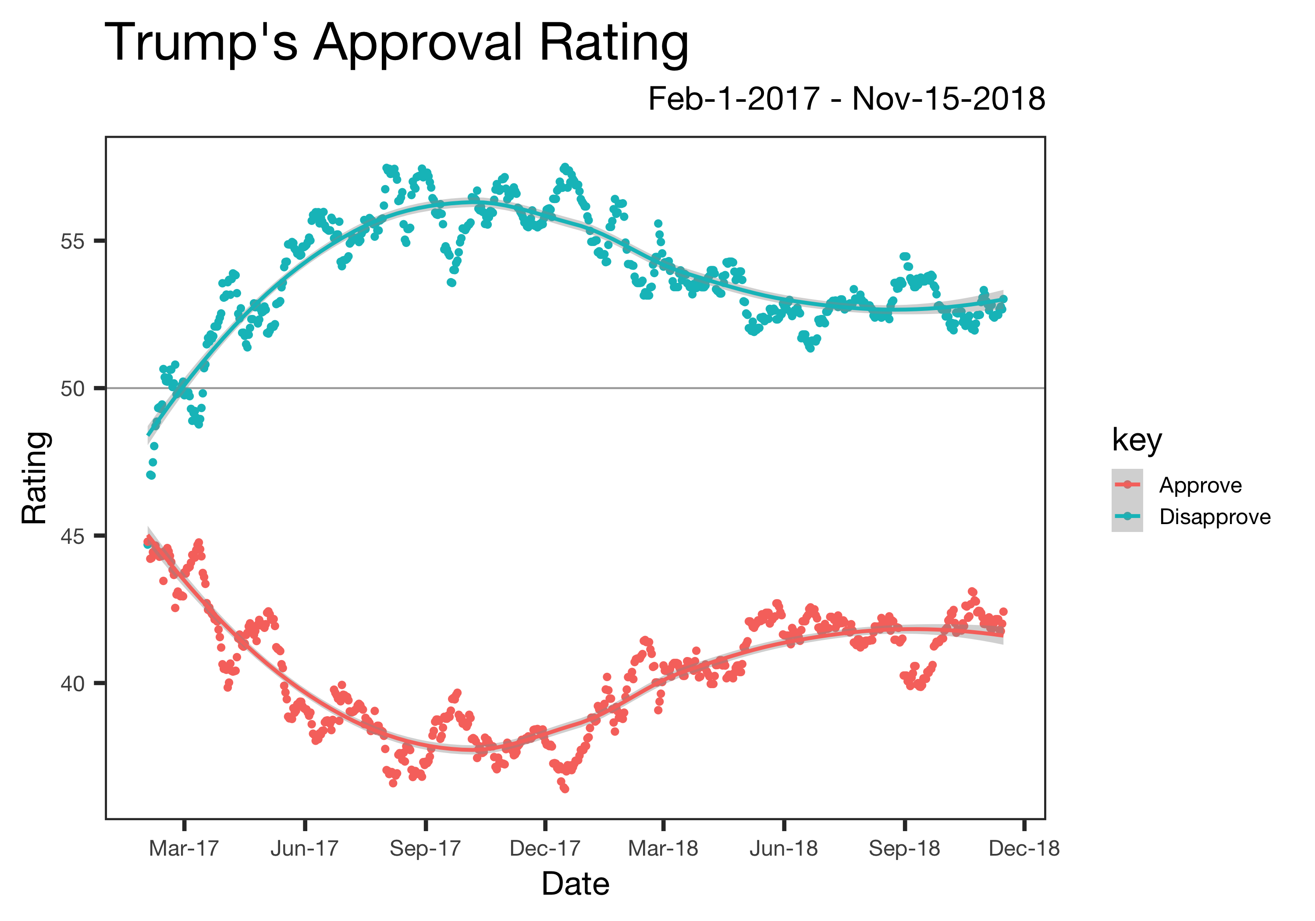
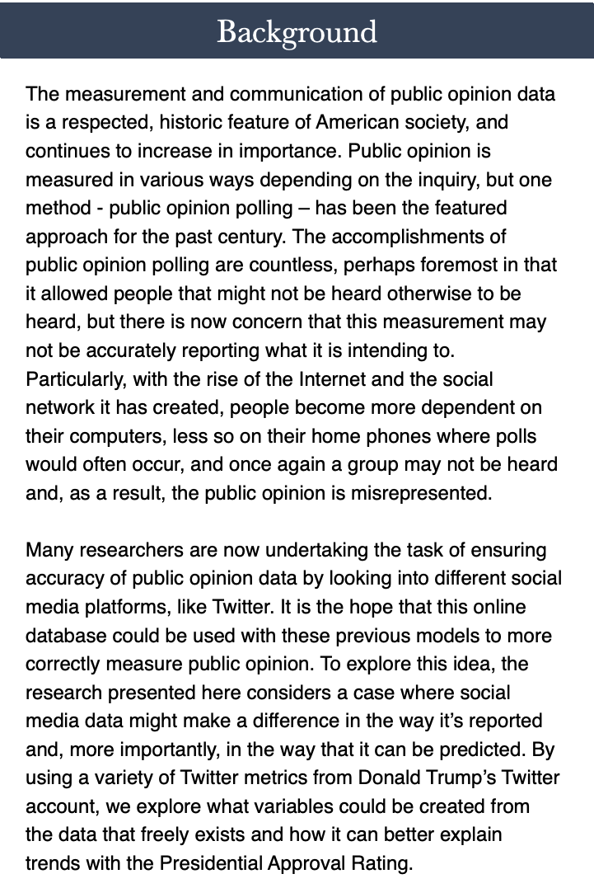
Trump, Twitter & Popularity –
The Relationship Between Approval Rating and Tweets
Kate Coulter
Duke University – IDS 702, Fall 2018
We also wanted to get a sense of how his tweets were received, what the online response was to these tweets and which tweets of his were most popular. We used the RT value and favorite value provided in the dataset to find basic summations and averages for this response. To find which tweets were uniquely popular we created a response metric that combined RTs with favorites for each tweet, and then looked at the distribution of this response for each tweet across the entire tweet dataset, as well as how it measured across time.
Model Summary for Change in Rating – ”change in rating” or “y” – the difference between prior week’s average rating and current week’s
Variable | Estimate
Intercept | -13.409
count - Weekly Count of Tweets | -0.002
response – Average of All RTs and Favorites in Week | 0.000
emote.11 – Yes if at least one day of that week has their primary emotion in category 1 (no emotion), no otherwise | 2.720
emote.21 – Yes if at least one day of that week has their primary emotion in category 2 (anger, sadness, trust), no otherwise | -5.963
Finally, we performed text analysis on these tweets so that they were ”clean” to perform further analysis on. A sentiment score for each tweet was found using the method created by Syuzhet. The sentiment score is on a scale from -1 to 1 (negative to positive), but to gain even more insight into each tweet we created a variable measuring the primary emotion of each tweet. For this variable, we used the dictionaries created by NRC that measure the following 10 emotions: "anger", "anticipation", "disgust", "fear", "joy", "sadness", "surprise", "trust", "negative", "positive”.
Results
During our initial exploratory analysis, we noticed a relationship between emotion and response. The plot between the initial emotion variable created also did seem to show some sort of relationship between emotion and rating, which we decided to further explore by collapsing emotion further into the 3 related categories. Plots for the final interaction between the emote variable, response variable, and change are included below. Interestingly, we also believe that emotion directly relates to if a tweet goes viral or not, but further research and more data would be needed to say if that is the case.
emote.31 – Yes if at least one day of that week has their primary emotion in category 3 (anticipation, fear), no otherwise | -0.780
sent – Sum of sentiment score for each day in week | 9.778
response:emote.11 – Interaction | 0.000
response:emote.21 – Interaction | 0.000
response:emote.31 – Interaction | 0.000
response:sent – Interaction | 0.000
This model is pointless to interpret for each variable, but it does seem to imply a few things. For example, as sentiment increases by one unit, his approval rating will change in a negative way as compared to where his approval rating was. Despite our model saying otherwise, there still does seem to be a relationship between tweets and his approval rating and should be explored.
Instead, our final model is a multiple regression that considered over 100 unique variables including 6 outcome measurements for approval. Assumptions for linear regression were checked for each model and variable, and thus appeared to be a good fit for our data.
We analyzed the tweets in different ways, and then summarized these variables by unit of time. From the tweets alone we found how many times Trump tweeted each day and week as well as what times he tweeted. We also wanted to get a sense of how his tweets were received, what the online response was to these tweets and which tweets of his were most popular. We used the RT value and favorite value provided in the dataset to find basic summations and averages for this response. To find which tweets were uniquely popular we created a response metric that combined RTs with favorites for each tweet, and then looked at the distribution of this response for each tweet across the entire tweet dataset, as well as how it measured across time
Conclusion
Based on our analyses, you cannot find a model of any sort of quality that predicts approval rating based on this data alone. However, that was also our assumption coming into this project, and doesn’t not necessarily mean social media data should be ignored for public opinion surveys. From our research, it seems like there is a relationship between President Trump’s Tweets and his approval rating – at least probably. We cannot conclude from this dataset or model what that relationship is, but the interaction between viralness and emotion as well as emotion and approval should be at least considered as we continue to observe his presidency.
Our model is shown below, as well as the summary statistics for each variable. The residual standard error is 3.905 on 84 degrees of freedom, and the R-Squared value is 0.138. None of the individual variables are marked with strong p-values and the overall residuals have a minimum of -6.2659, median of -0.1752, and max of 8.5204.

