Slide 1
Compliant
Partially compliant
Non-compliant
Ensure safety and productivity of roads and maritime | Status
Ensure that change is based on requirements
Reuse before buy before build
Ensure technical diversity and currency
Ensure information systems interoperability
Manage data as an asset
Ensure security and privacy
Ensure reliability, scalability, availability and manageability
RDS IT Portfolio Design Authority
Title: Test Booking System
Architecture Deliverable: MDD/SAD/Solution Brief
Purpose: Seeking Endorsement
Forum Date: 28/10/2021
Author: Maheswaran SP |  | Project ID:
Portfolio: |  | Project Name: | TBS
Register number: | ARB00…. If new item, N/A | Version:
Action Update
Guidance/ Information
Endorsement

Slide 2
Action Update
Use for ACTIONS UPDATE Remove slide otherwise
Date Action raised: |  | Action Owner:
Action | Update
Discuss with Dev for the www.Myrta.com DNS migration Discuss on the solution of using S3, EFS for Teamsite Integration | www.Myrta.com would be migrated to HC EFS would be a better option than S3

Slide 3
Executive Summary
Background
Test Booking System is a myRTA portal application that is used by public customers to book and manage driving test and computer based tests. Users can book a slot for a test or they can cancel or reschedule the test for later. Book a Test Change or Cancel a Test
Endorsement/ Guidance / Info only (select one)
List business outcomes delivered by this solution in terms of value added or requirements met partially, fully or exceedingly. Include all expected tactical achievements and steps towards strategic objectives. Example: Business scenario XYZ will be flow through automated by providing mobile self-service capability in 80% of cases. Activity will also be completed in < ZZ minutes in 75% of business events, improving average inspection time by 12%
Mandatory task before build
Project phase
iServer App catalogue update
API register update

Slide 4
Business Context
Business Drivers
Migrate TBS Portlet to Hybrid Cloud as part of BAHS migration
Business Outcomes
List business outcomes delivered by this solution in terms of value added or requirements met partially, fully or exceedingly. Include all expected tactical achievements and steps towards strategic objectives. Example: Business scenario XYZ will be flow through automated by providing mobile self-service capability in 80% of cases. Activity will also be completed in < ZZ minutes in 75% of business events, improving average inspection time by 12%

Slide 5
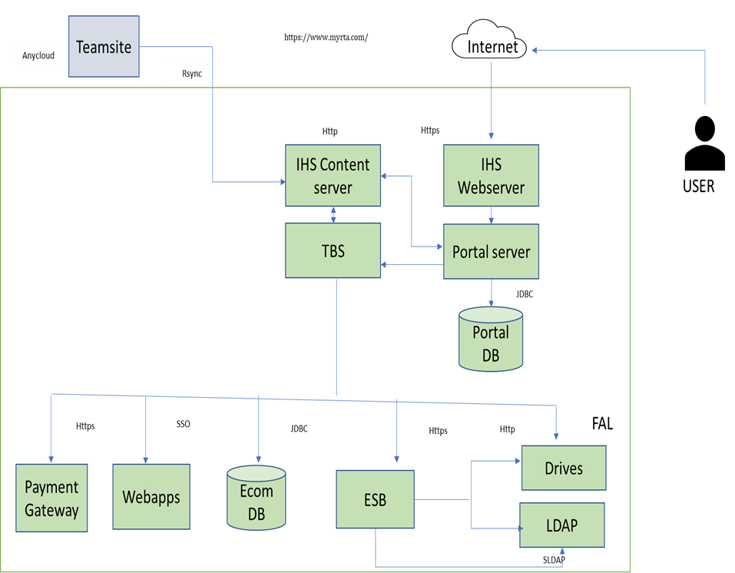
Contextual Diagram – Current State
Description:
TBS has the below transactional flows Book/Cance/Reschdule: Book a Test Change or Cancel a Test .

Slide 6
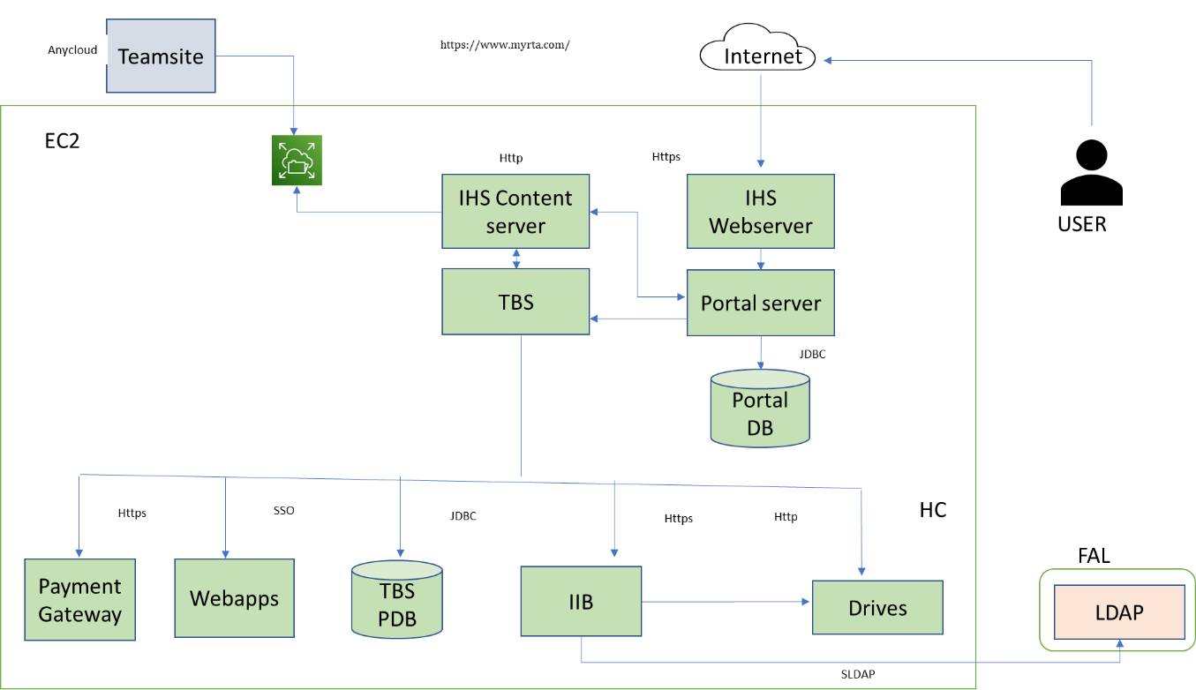
Intermediate/Target State - Hybrid Cloud
Description:
Migrate TBS Application to Hybrid Cloud with higher version of Websphere Portal Server 8.0 Patch would be deployed to upgrade the Websphere portal to 9.5V Portal DB would be migrated from Oracle 11g to Oracle 19c in Hybrid Cloud TBS ECOM DB would be migrated from Oracle 11g to Oracle 19c in Hybrid Cloud IHS would be used for the revers proxy and for the integration with Teamsite for Content
1
Name

Slide 7
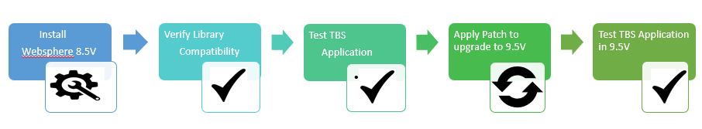
Portal Migration Strategy

Slide 8
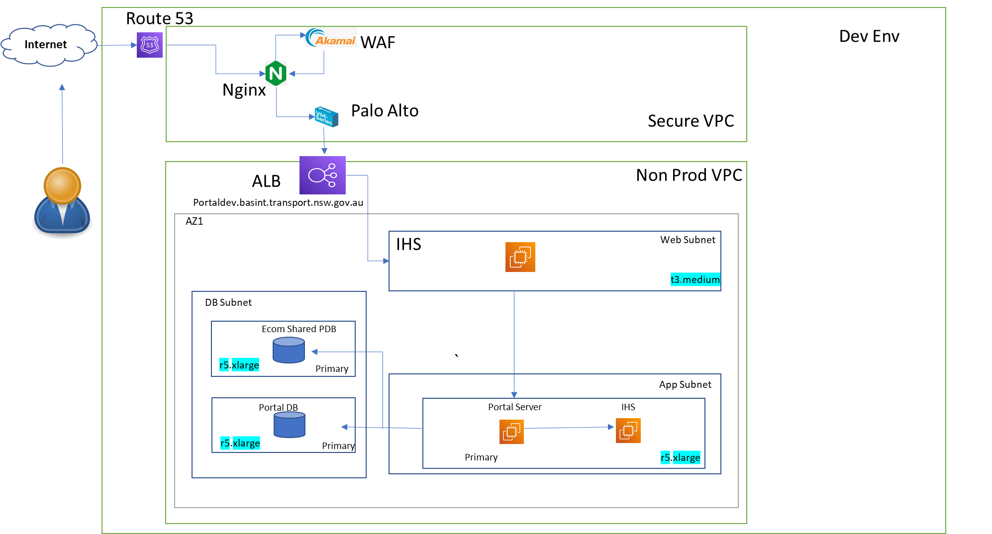
Deployment Model

Slide 9
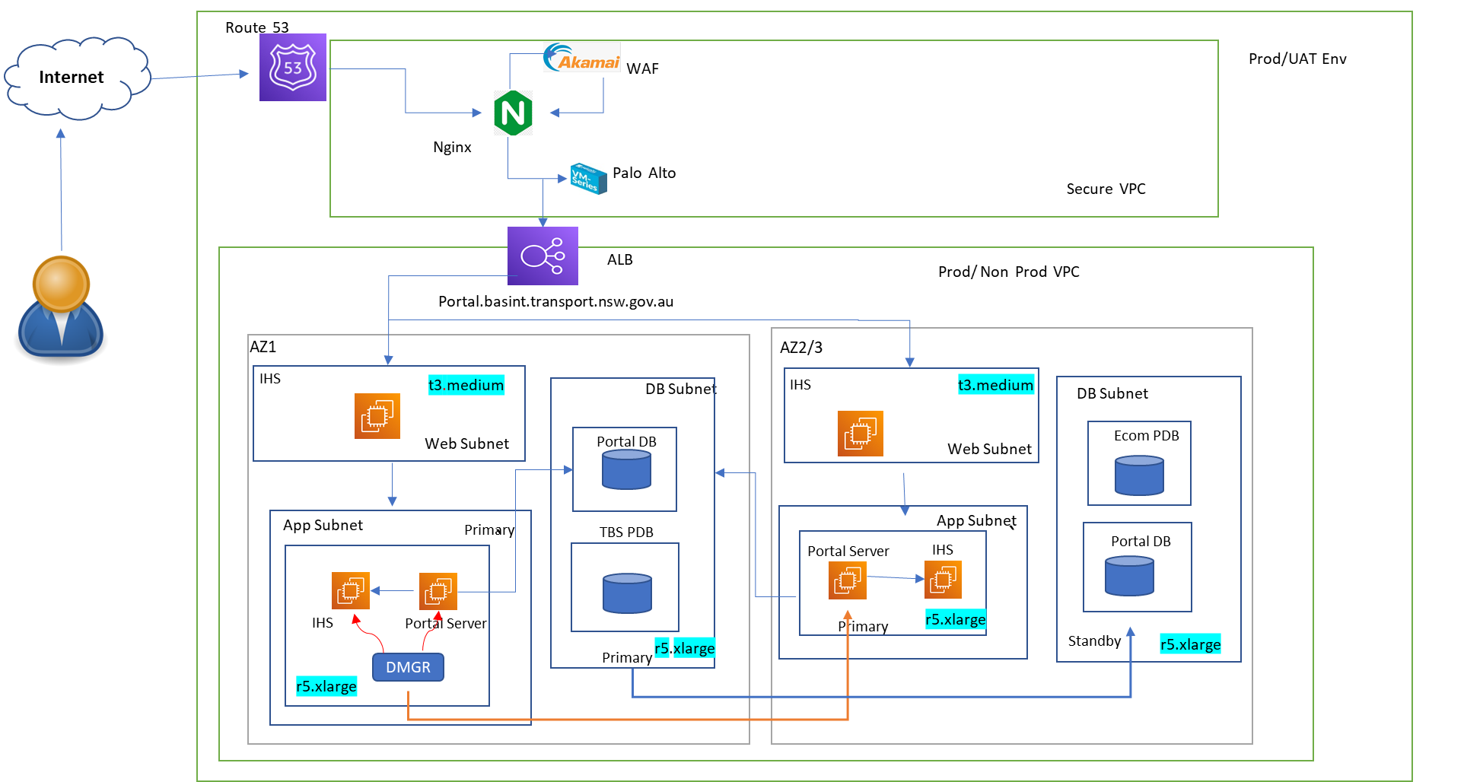
Deployment Model

Slide 10
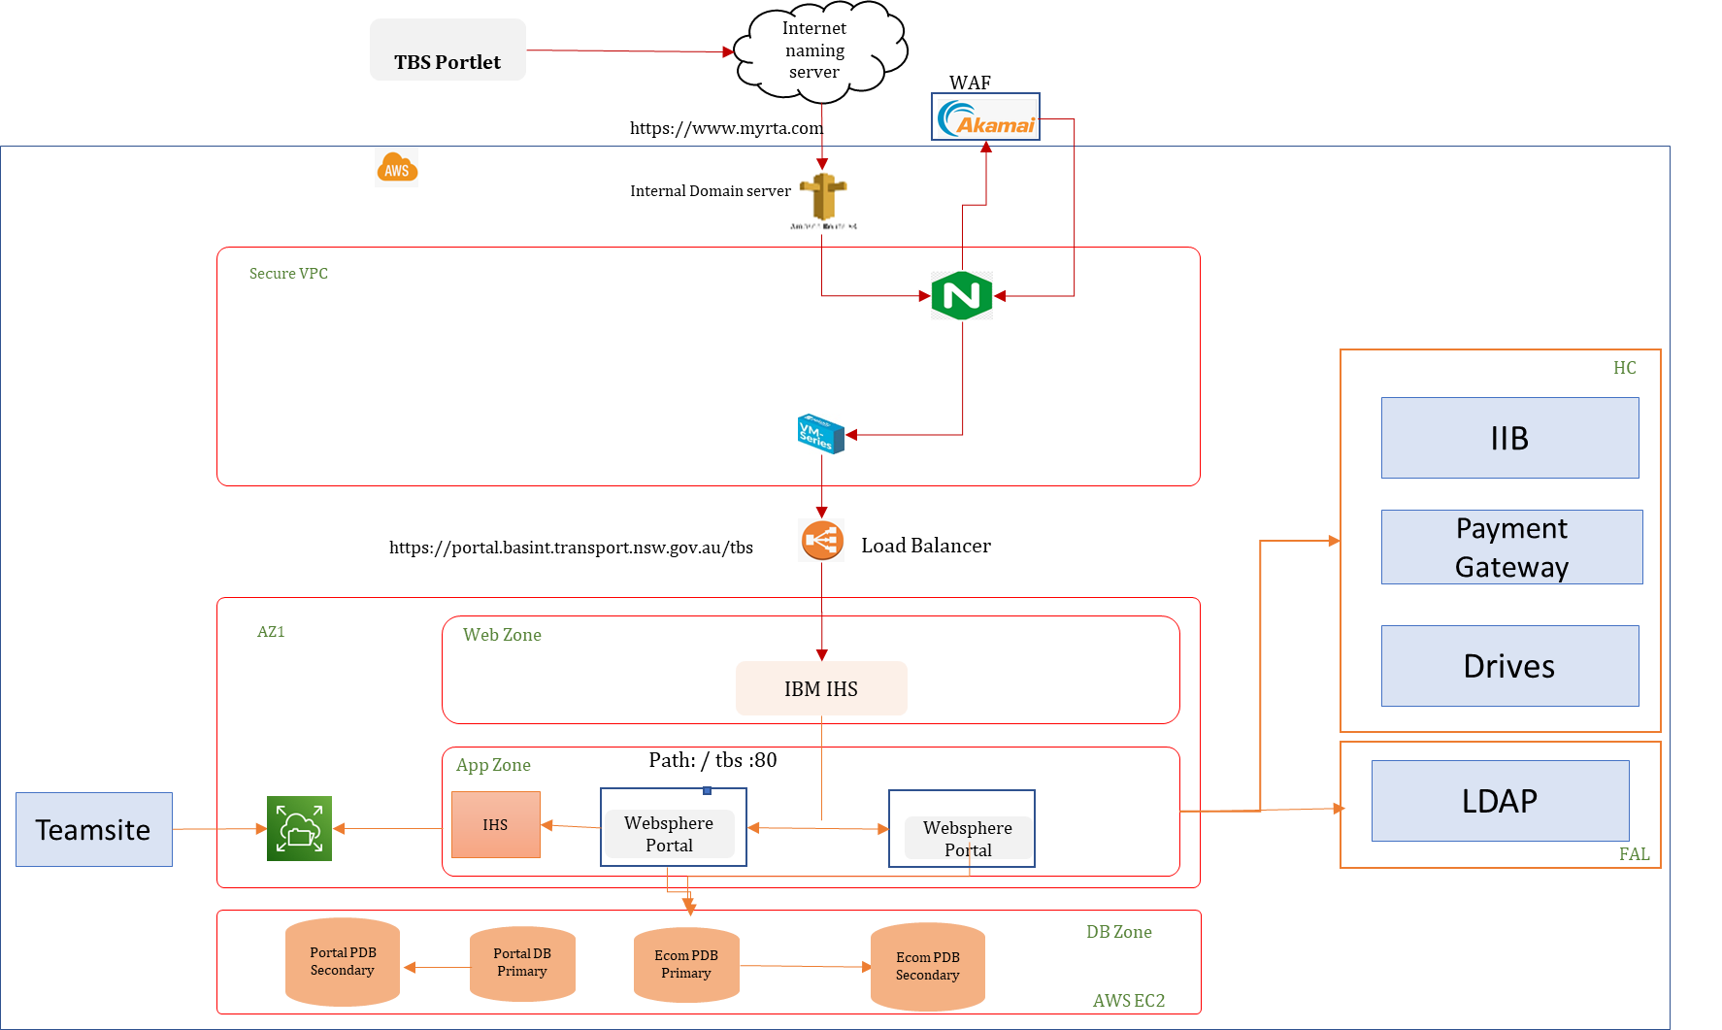
Network Diagram

Slide 11
Business Solution Alignment
Provide a summary of key business requirements (refer to Business Drivers and Outcomes) and highlight non or partial compliance
During presentation emphasis only on non- compliant or partially compliant outcomes, include security requirement and compliance level.
Business Outcome | Status (Compliant/ Not Compliant / Partially Compliant) | Comment

Slide 12
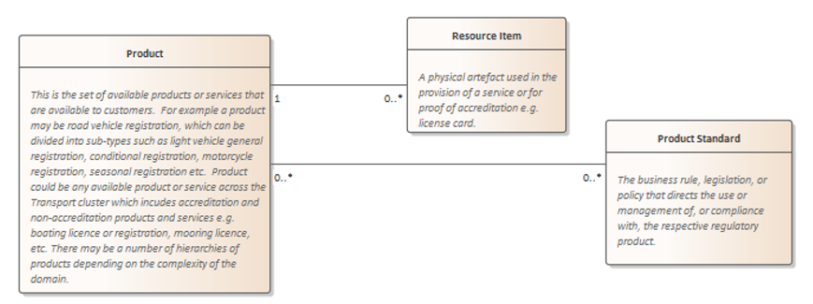
Information Architecture – Data Model
Conceptual data model
Guidelines:
Create Conceptual data model based on the topic/user stories. Refer Conceptual data model standards and guidelines.
https://objective.transport.nsw.gov.au/id:A34794785/document/versions/published
Align the Conceptual data model with the Enterprise Information Model.
Refer: https://km.rms.nsw.gov.au/confluence/display/ESAG/RDS+Enterprise+Conceptual+Business+Information+Model
Project Subject Area | Business entity | Business entity Definition | Enterprise Information Entity | Enterprise Subject Area
Customer | Customer | An organisation, organisation unit, person or household of interest to the organisation. | Customer Profile & Demographics | Customer
Information Classification & Labelling
Conceptual Business Entity with Description | Information Classification | DLM (Labelling)

Slide 13
Security Controls & Risks
Endorsement Status: Not Endorsed
Describe how business and privilege users are authenticated with an application?
All users are authenticated against LDAP
Describe privilege and business user authorization roles? Whether user access review is externally audited?
There are 4 types of Roles defined in LDAP.
External Users
Internal Users
System Admin
Content Admin
What is the current and target state encryption method used for data in-transit and at-rest?
For LDAP, DRIVES and for the PAYMENT Gateway integration, TLS is enabled while in transit
At-rest will be available once the UAT environment is available
What are the current vulnerability associated with source code? Provide security posture details
This will be accessed once the codebase is available

Slide 14
Security Risks / Issues
Risk | Impact | Severity | Mitigation
Unencrypted channel between HCE and FAL/GovDC | The communication link between HCE (AWS) and FAL & GovDC is not encrypted (point-to-point connection using DirectConnect) which could lead data exposure and lateral movement increase the risk to exfiltrate other sensitive information | Existing High risk | Enable encrypted channel between FAL & HCE (1003343)
Security Testing not completed and review of High/Critical vulnerabilities not remediated | Security Testing (SAST, DAST, Pen-Testing) not completed which could increase the chances of potential High/Critical vulnerabilities | Medium | UAT environment with valid test data should be available Security testing report and associated Jira tickets should be reviewed Raise risk if there are High/Critical defects
Payment Gateway progress is unknown | Secure Payment Gateway project is setup to ensure we have encryption in-transit configured between Hybrid cloud and Quest. Details are not consistent in MDD and progress details not available. | Medium | Quest details should be updated in MDD Required security controls as per Guardrails should be reviewed and artefacts should be available
Teamsite communication with AnyCloud is not documented in MDD | Teamsite communicates with TBS over RSYNC, but details are not available for review which will not allow us to complete the security assessment | Medium | Teamsite details (interface, data type, upload/download etc) should be available in MDD Applicable security guardrails controls should be updated in MDD

Slide 15
Socialisation (Mandatory)
This information has been socialised with the following:
Manager Solution Design
Team/Person | Date Reviewed | Outcome
Technology Program/ Project Manager
Team/Person | Date Reviewed
Business Stakeholders
Team/Person | Date Reviewed
Enterprise Architects (Mandatory engagement)
Team/Person | Date Reviewed
Technology Engagement
Team/Person | Date Reviewed
Agency System
Team/Person | Date Reviewed
Testing
Team/Person | Date Reviewed
Peer review including security architect (Mandatory security engagement)
Team/Person | Date Reviewed
15

Slide 16
Socialisation (External + Inter Agencies)
This information has been socialised with the following:
Team/Person | Date Reviewed | Outcome
Program/ Project Manager
Team/Person | Date Reviewed
Business Stakeholders
Team/Person | Date Reviewed
Architects
Team/Person | Date Reviewed
Technology Engagement
Team/Person | Date Reviewed
Agency System
Team/Person | Date Reviewed
Delete Slide if not relevant
16

Slide 17
Decision Section
Repeat for each major decision
7
Create a copy of the following section for each decision

Slide 18
Decision <1…n>: <Decision Name> - Context
Create 1 or more diagrams (business, application, technology, security, operations, etc.) to set the context for review of each decision in this area.
Depending on the initiative, some alignment to EA models is mandatory.
New apps should show alignment to the EBCM
New technology should show alignment to the TRM
New information usages should show alignment to the EIM
When an initiative is delivering in multiple stages, or is large/complex, a roadmap should be provided
8
9
10
Diagram Summary
<Explanation of the context, e.g. detail => [logical | physical], layer => [business | app | tech | security | operations ], what’s it showing => [ flows | dependencies ] etc.
Context Summary | <Set the scene for discussing this decision> <Provide root cause analysis if useful> Dimension of the problem or opportunity: <People / Organisation, Process, Application, Information, Infrastructure, Security, Operations>
Problem/Opportunity/Key Issues | <If current situation and main pain points to be improved. If relevant, include a context diagram>
Architecture Model Component | Reference Architecture Model: <e.g. EBCM, TRM, EIM> Model Component Category: <e.g. Category: Hosting> Model Component Type: <Application, Platform, Service… e.g. Cloud Platform> Model Component Name: <e.g. AWS>

Slide 19
Decision <1…n>: <Decision Name> -Options
Make it clear what the recommended option is and why
Repeat this slide for each Decision within a Decision Area
Green | Fully aligns, compliant or good feasibility
Amber | Partially aligns, compliant or average feasibility
Red | Not aligned, compliant or low feasibility
No colour | N/A
Colour code and indicate in a short statement your assessment of the option’s alignment, compliance or feasibility. Refer to the PSA or SAD template for more details on the assessment criteria.
11
Make sure you have socialised and consulted with the relevant teams to have their viewpoint represented, e.g. Service Ops/ITSM, Business, IT IS, EA, Cyber, etc.
 | Option 1: <Option Name> |  | Option 2: <Option Name>
Operational Feasibility
Business Requirement Alignment
Technical Feasibility
Enterprise Architecture Alignment |  | <incl. WoG> |  | <incl. WoG>
Economic Feasibility
Schedule Feasibility
Security & Privacy Compliance
Please fill in all feasibility/alignment cells. If N/A then put “N/A - <reason>”

Slide 20
Decision <1…n>: <Decision Name> - Recommendation
Repeat this slide for each Decision within a Decision Area
12
All fields are mandatory. Please explicitly enter ‘None’ or ‘N/A’ if a field does not apply for your initiative / phase
Preferred Option / Recommendation | <Indicate the recommended option>
Recommendation Rationale | <High level justification for the recommendation>
Key Risks | Risk: <e.g. Vendor located overseas>
Key Issues | Issue: <e.g. Costing not completed>
Key Dependencies | Dependency: <e.g. Vendor to establish local presence>
Key Assumptions | Assumption: <e.g. Point-to-point integration should not be considered>
Key Constraints | Constraint: <e.g. Limited timeframe for decision due to Evolving Transport>
Key Business Implications | Implications, e.g. “The previous manual approach is no longer valid - business users must be trained in the new approach so that information is managed properly”, or “Increased/Decreased OPEX
Key Technology Implications | Implications e.g. “All future initiatives must support SSO” i.e. as a result of standing up an IDAM platform”, or “tech debt XYZ created”.
Tech Debt | <Longer-term consequences of architectural decisions ​which produce an easier and/or quicker solution but necessitate additional work and cost in the future to be remediated> <link to the Tech Debt Register entry>
Tech Debt Mitigation and Remediation | <Future actions to mitigate or remediate the recommendation tech debt>
Comms Plan for Decision | <Comms plan for the decision to be made: who to be informed of the decision, why and how>
13
14
Extend this content over 2 slides if more space is required

Slide 21
Addendums

Slide 22
DRB Specific
Delete Slide if not relevant

Slide 23
Architectural Decisions
The following decisions are being made by the [Program or Project or Team]…
ID | Domain | Decision (with Options – if applicable)
AD-001 | TEC | Describe the What Describe the How Option 1 – . Option 2 –. Preferred Option: Rational
Domain refers to the Architectural being
BU = Business, AP = Application, INF = Information, INT = Integration, IFR = Infrastructure & SC = Security, TEC = technology

Slide 24
Appendices
Delete Slide if not relevant

Slide 25
Enterprise Debt and Exemptions
The following technical debt has been identified which needs to be tracked
ID | Domain | Description | Confluence/ JIRA link | Impact/ Comment
NA | NA | NA
Technical Debt Register is mastered Confluence :
Link: TBA

Slide 26
Solution Options (if applicable)
For Concept phase only (if seeking guidance ) else delete

Slide 27
Data/ Information Architecture

Slide 28
Data Scope
Data touch points | Project scope (Y/N) | Comment
Data ingestion and integration Data migration; Data conversion/ translation / sanitation(ETL) Data retention period; Archiving/ Purging/Historical Data Reporting/ Analytics Decommissioning Data Audit Logs

Slide 29
Conceptual Data Models / Data Lifecycle – Target State
Data lifecycle checklist
Data ingestion and integration
Data migration; Data conversion/ translation / sanitation(ETL)
Data retention period; Archiving/ Purging/ Historical Data
Reporting/ Analytics
Decommissioning
Data Audit Logs
Delete Slide if not relevant

Slide 30
Conceptual Data Definition – Target State (if applicable)
Delete Slide if not relevant

Slide 31
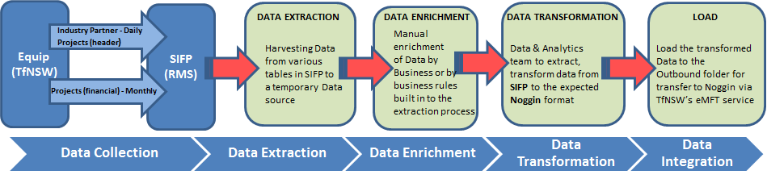
Conceptual Data Integration - ETL (if applicable)
Supporting Information Services are required for the solution
Integration Data Flows
Delete Slide if not relevant

Slide 32
Identity and Access Management (IAM)

Slide 33
Identity and Access Management (IAM)
Checklist
Identity life cycle
Authentication
Authorisation
Auditing

Slide 34
Data Encryption

Slide 35
Data Encryption
Checklist
Encryption at-rest
Encryption in-transit
Secrets management
Key management

Slide 36
Application Security Testing

Slide 37
Application Security Testing – Vulnerability Assessment
Checklist
Secure code testing
Penetration Testing
Infrastructure and OS vulnerability testing

Slide 38
Release Management
Checklist
Program phases
Roll out approach (Progressive and Big Bang)
Decommissioning Strategy

Slide 39
Total Cost of Ownership
Include Capex (Project Estimate) and Opex (recurring cost to business) if known

Slide 40
Non Functional Requirements
Checklist
Volume
Data Storage
System criticality
Security

Slide 41
Questions and Decision
This is when the forum is open for further questioning, before concluding Item is to be endorsed.

Slide 42
Icons

Slide 43
Icons

