Slide 1
Loadable Kernel Module (LKM)
By:
Kathan V. Adhyaru(121022)

Slide 2
What is LKM?
To add a new code to a Linux kernel, it is necessary to add some source files to kernel source tree and recompile the kernel. But you can also add code to the Linux kernel while it is running. A chunk of code added in such way is called a loadable kernel module
Types of modules:
(i)device drivers, (ii)file system drivers, (iii)system calls
Build working base kernel, that include anything that is necessary to get the system up, everything else can be built as modules
Modules are stored in the file system as ELF object files
The kernel keeps track of the use of modules, so that no modules is unloaded while another module or kernel is using it (/proc/modules)

Slide 3
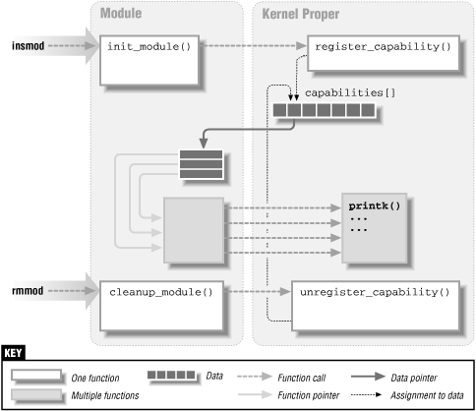
Linking and Unlinking the module
Codes used
insmod
reads from the name of the module to be linked
ismod
reads /proc/modules
rmmod
From reads the name of the module to be unlinked.
Invokes the query_module( )
Invokes the delete_module( ) system call, with the QM_REFS subcommand several times, to retrieve dependency information on the linked modules.
modprobe
takes care of possible complications due to module dependencies, uses depmod program and /etc/modules.conf file

Slide 4
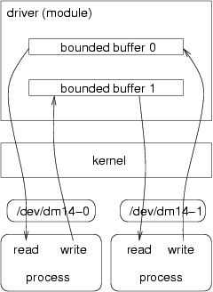
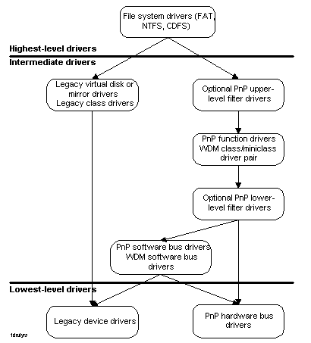
Device Drivers
There are two major ways for a kernel module to talk to processes:
To use the proc file system (/proc directory)
Through device files (/dev directory)
Device driver sits between some hardware and the kernel I/O subsystem. Its purpose is to give the kernel a consistent interface to the type of hardware it "drives".

Slide 5
Advantages
There is no necessity to rebuild the kernel, when a new kernel option is added
Modules help find system problems (if system problem caused a module just don't load it)
Modules save memory
Modules are much faster to maintain and debug
Modules once loaded are inasmuch fast as kernel
Limitations with Current Models
Generic driver model (WDM) is too complex
Focuses on very advanced drivers which punishes simple ones
Many drivers must be written in kernel mode
Even though much functionality could be user mode
Developers spend too much time driving our software
Cannot concentrate on driving their hardware
Driver quality suffers as a result
Do not allow extension and future growth

Slide 6
References
http://unix.stackexchange.com/questions/1605/benefit-of-kernel-module-compiled-inside-kernel
http://en.wikipedia.org/wiki/Loadable_kernel_module
http://www.tldp.org/LDP/lkmpg/2.6/lkmpg.pdf
http://h21007.www2.hp.com/portal/download/files/unprot/drivers/docs/refs/ddguide/Chap10.pdf
http://www.webalice.it/roberto.farina/teaching/embsys/Modules.pdf

Slide 7
Thank You

