Slide 1
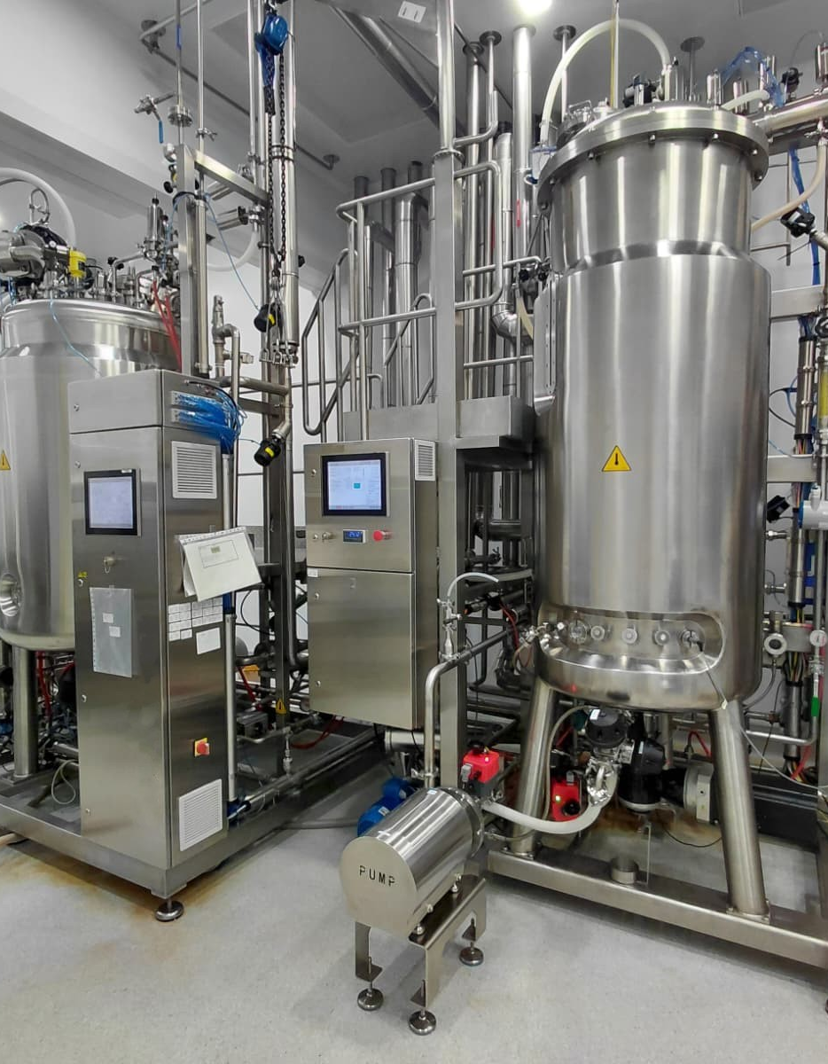
CORPORATE IDENTITY
Axion
Process OS
One coherent visual system for bioprocess engineering software, reports, presentations, and partners.
BIOPROCESS ENGINEERING, CONNECTED.
AXION PROCESS OS · CORPORATE IDENTITY · 2026
01

Slide 2
BRAND IDEA
Biology in controlled flow.
Axion makes complex production systems legible without making them generic or ornamental.
01
02
03
Organic
Exact
Operational
Living systems, adaptation, directional movement.
Restrained grids and explicit hierarchy.
Motion explains flow, state, and sequence.
AXION PROCESS OS · CORPORATE IDENTITY · 2026
02

Slide 3
PRIMARY MARK
The aquatic Axion signature.
Use the organic side-profile axolotl in navy and white by default. Keep its silhouette unchanged.
DARK SURFACE
LIGHT SURFACE
AXION PROCESS OS · CORPORATE IDENTITY · 2026
03

Slide 4
COLOR SYSTEM
Navy leads. Cobalt moves. Amber focuses.
Turquoise is not part of the corporate palette. Every color has one engineering role.
AXION NAVY
SIGNAL COBALT
PROCESS STEEL
REACTOR AMBER
SAFETY CORAL
ICE
#071D33
#316BFF
#6F8FB0
#F2B441
#D95D58
#EEF3F8
Foundation
Interaction
Infrastructure
Review
Critical
Canvas
AXION PROCESS OS · CORPORATE IDENTITY · 2026
04

Slide 5
TYPOGRAPHY
Readable first. Technical where it matters.
Manrope carries interface and brand voice. DM Mono identifies equipment, equations, units, versions, and coordinates.
Manrope
DM MONO
Process design remains legible at operational density.
BR-201 · OTR 1.21 kg/h
Xᵥ + C₆H₁₂O₆ + O₂ → biomass + CO₂
AXION PROCESS OS · CORPORATE IDENTITY · 2026
05

Slide 6
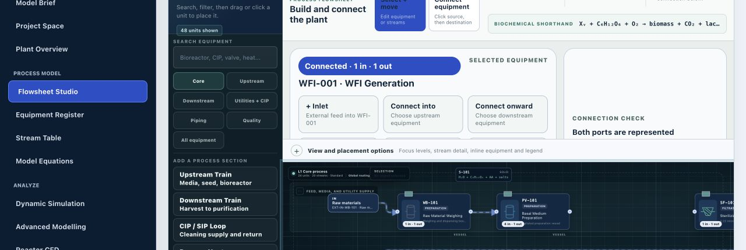
PRODUCT INTERFACE
One visual language from model to decision.
Navy anchors navigation, cobalt identifies action, and neutral surfaces keep dense engineering information readable.
AXION PROCESS OS · CORPORATE IDENTITY · 2026
06

Slide 7
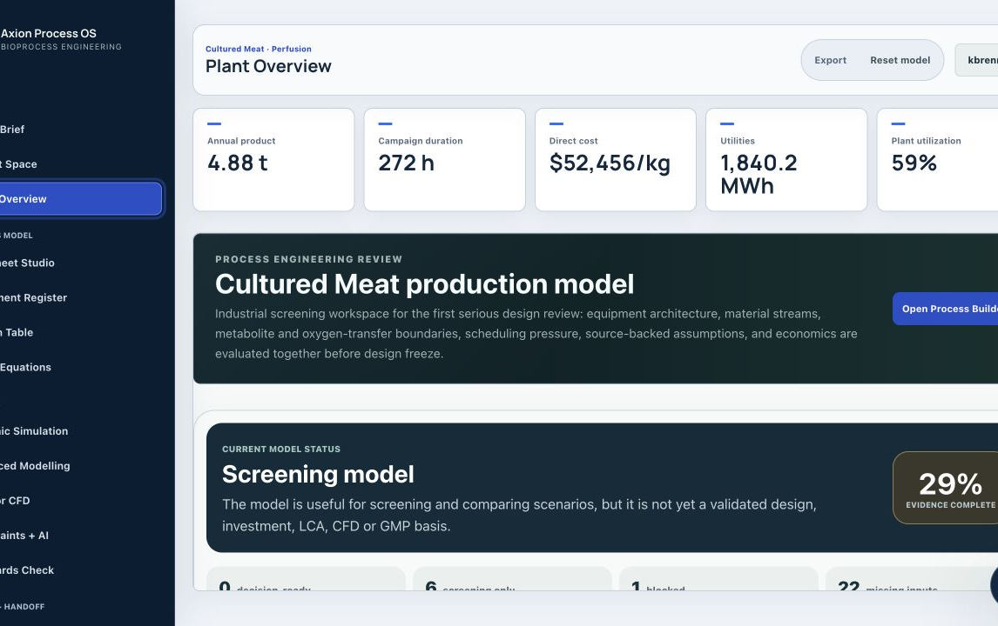
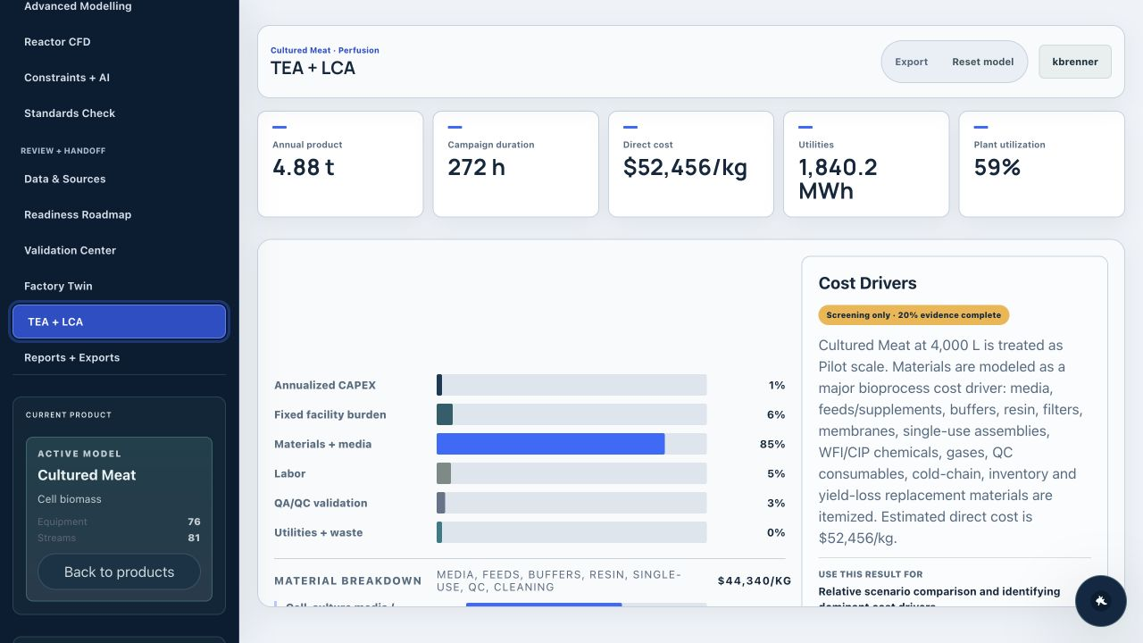
DECISION OUTPUTS
Evidence remains legible across disciplines.
Process architecture, readiness, TEA, and LCA use the same hierarchy and semantic color system.
PLANT OVERVIEW
TEA + LCA
AXION PROCESS OS · CORPORATE IDENTITY · 2026
07

Slide 8
RELEASE STANDARD
Every Axion surface must pass the same checks.
The identity is complete only when it remains readable, responsive, traceable, and consistent in the working product.
CONTRAST
WCAG AA for body text and controls
SEMANTICS
Color is paired with text, icon, or value
MOTION
Reduced-motion preserves meaning
LAYOUT
No overlap at desktop or mobile widths
PROVENANCE
Model, version, date, and source remain visible
EXPORT
PPT, SVG, reports, and screenshots use this system
AXION PROCESS OS · BIOPROCESS ENGINEERING, CONNECTED.
AXION PROCESS OS · CORPORATE IDENTITY · 2026
08

