Slide 1



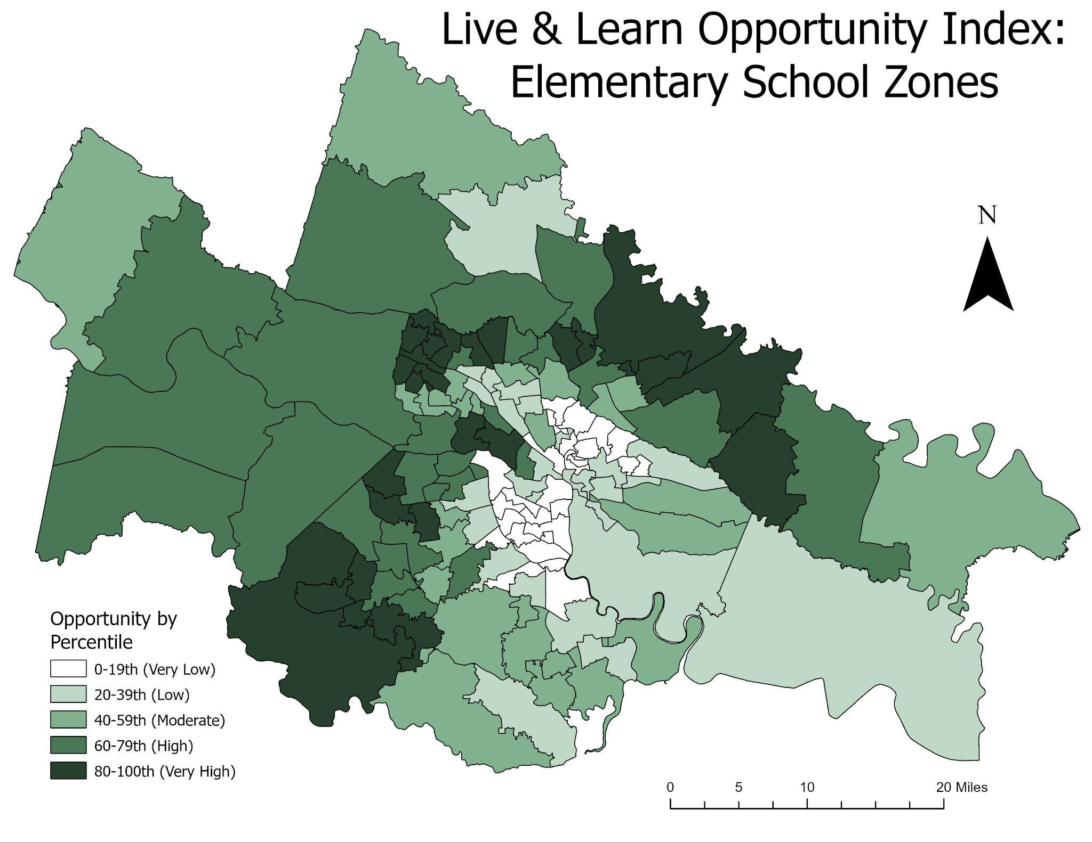
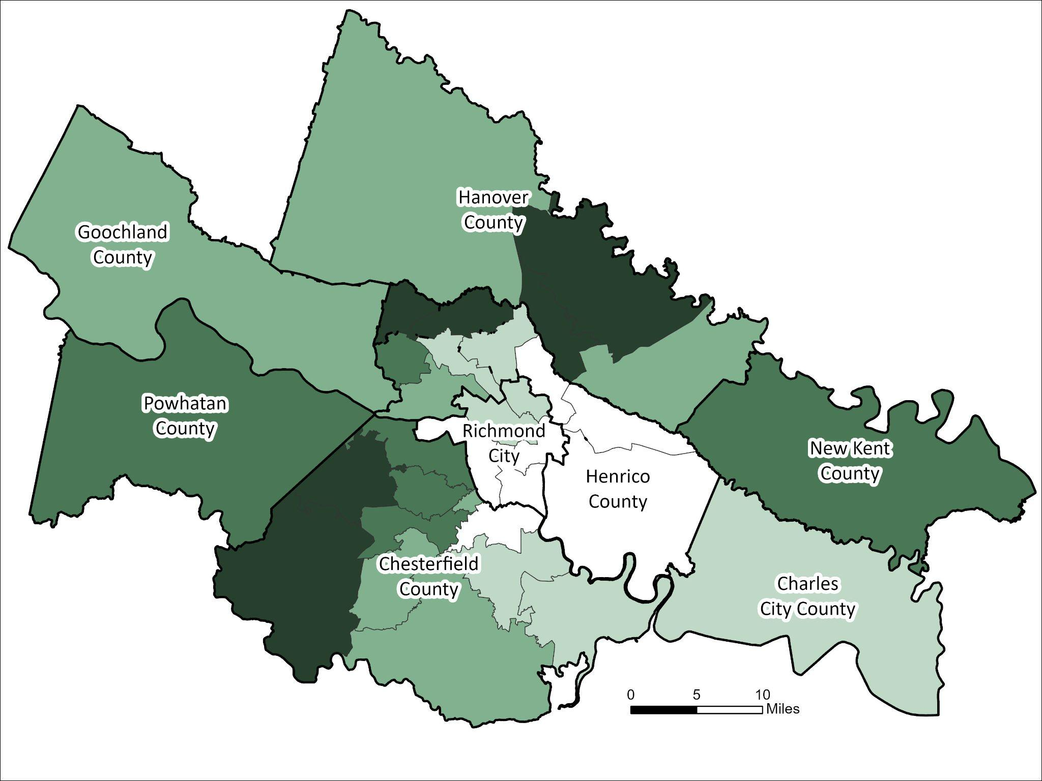
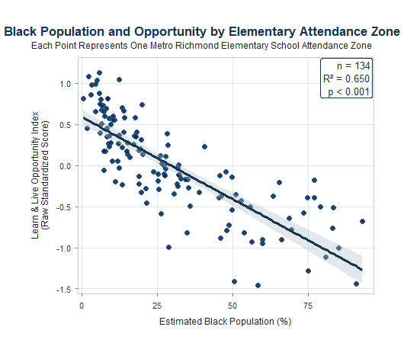
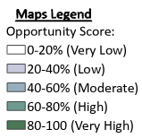
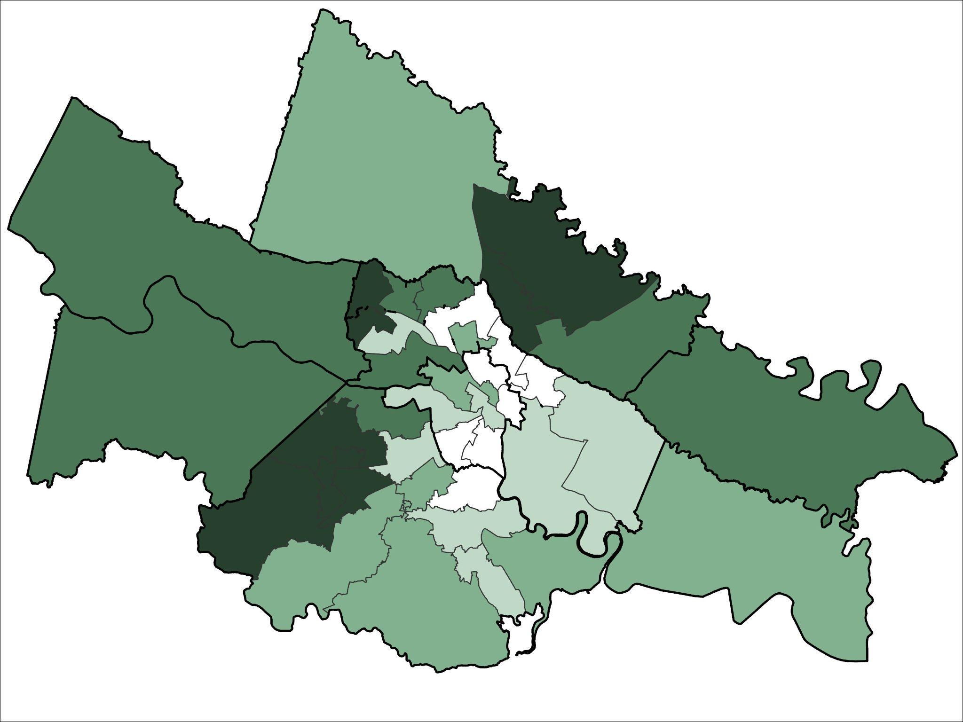
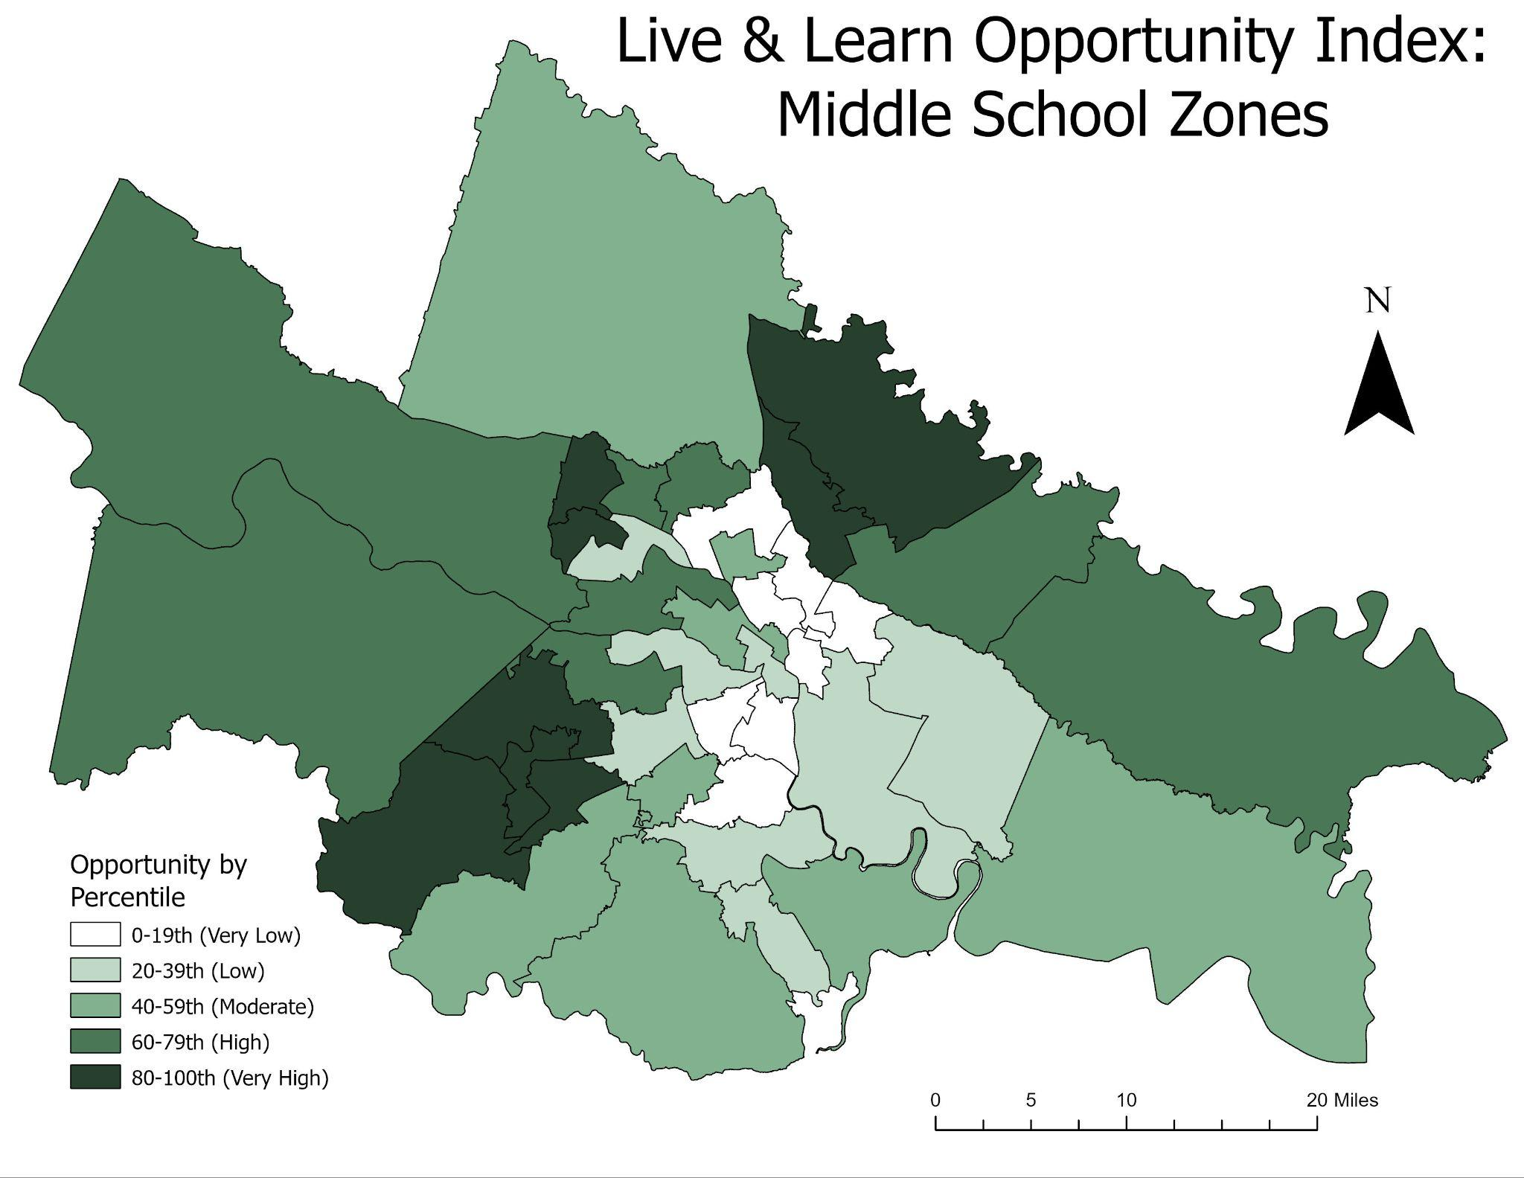
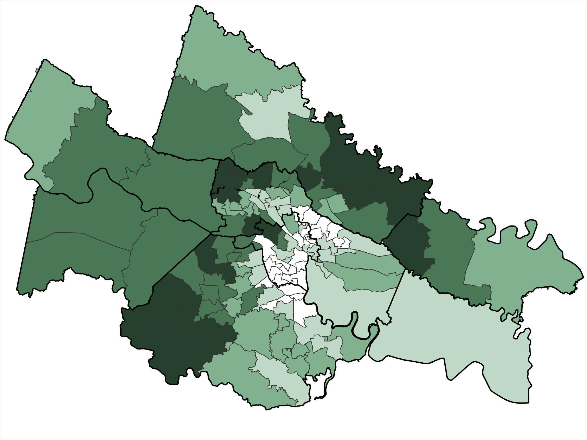

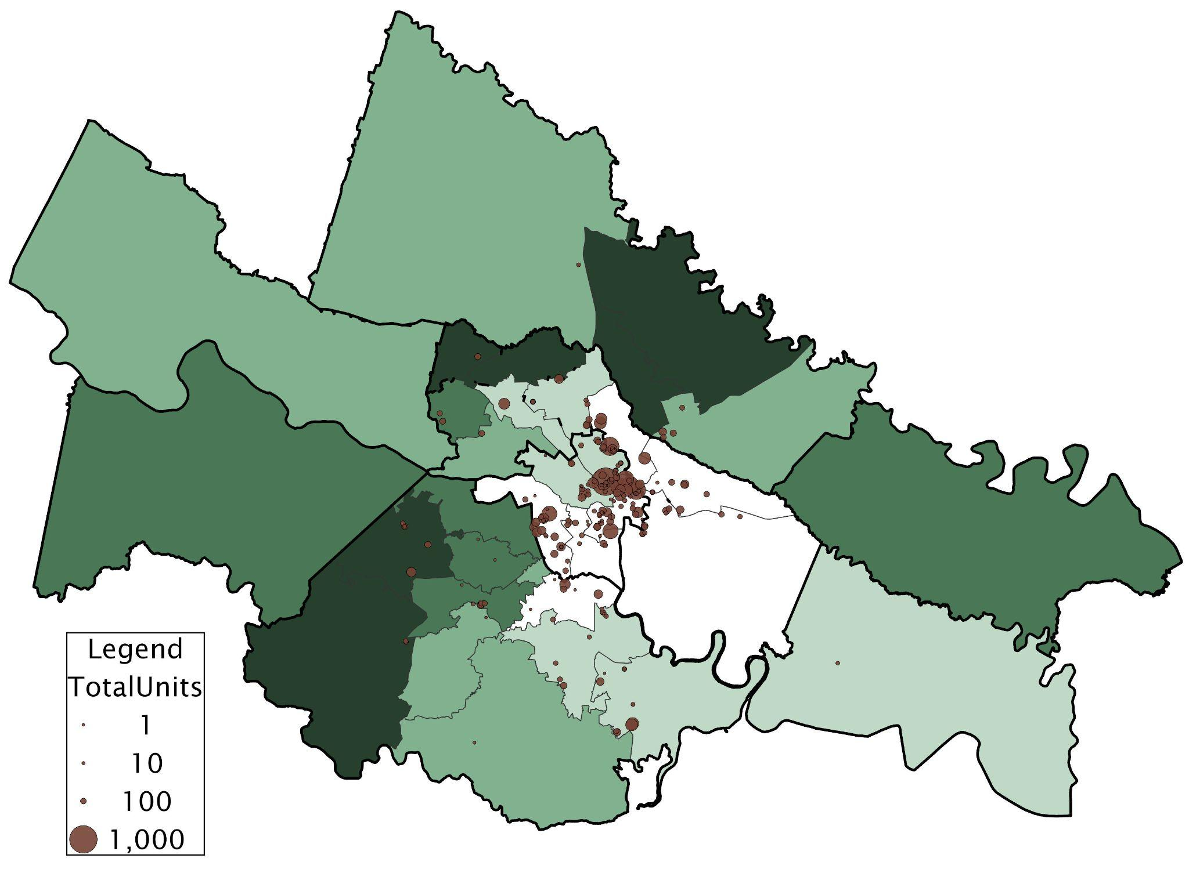
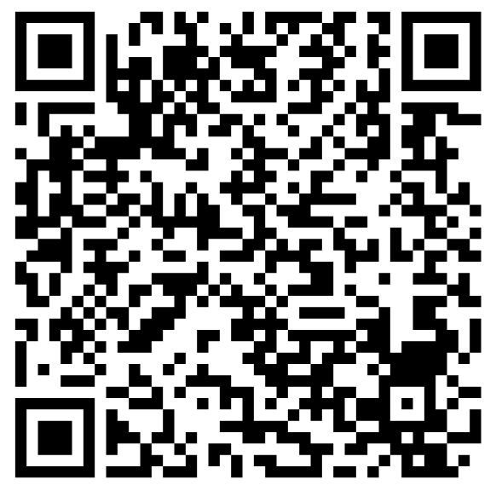
Learn and Live Opportunity Index: Mapping Housing & Education Inequality Across Metropolitan Richmond, Virginia
Tips and Techniques for Making an Effective Symposium Poster--
The Title Can Have One or Two Lines
Katharine Wells, Hays Stritikus, Savannah Hollen, Tom Shields, & Kyle Redican
Live & Learn Spatial Analysis Research Team, University of Richmond
Introduction
Mapping the LLOI by Attendance Zone: High Schools
The LLOI measures opportunity across 134 elementary, 40 middle, and 32 high school attendance zones across the eight jurisdictions.
Elementary attendance zones reveal the greatest variation in opportunity.
Higher-opportunity is clustered in western Henrico, Hanover, and portions of Chesterfield.
Lower-opportunity zones are concentrated in Richmond City and eastern portions of Henrico.
LLOI and Race
Living conditions and neighborhood environments directly influence children’s educational attainment, health outcomes, and long-term socioeconomic mobility (Chetty et al., 2018; Acevedo-Garcia et al., 2024).
Many indices have been created to describe patterns of inequality. Indices make it easier to show how multiple variables intersect in order to create a more comprehensive view of patterns of inequality.
  Diversitydatakids.org created the Child Opportunity Index (COI) using 44 indicators across education, environment, and socioeconomic areas by census tract and block group (Acevedo-Garcia et al., 2024).
This project builds off of research and work provided in the 2017 Live and Learn Report, and the 2024 Live and Learn 2.0 Report. Findings demonstrated historical patterns and policy suggestions around housing and education-based segregation in the metro Richmond area.
  The Live and Learn Opportunity Index (LLOI) uses demographic, education, and housing variables to determine the distribution of opportunity across school zones.
  School attendance zones are unique policy defined geographic boundaries that determine where students are assigned their education, acting as a unique spatial unit for the LLOI, and framework for examining patterns of inequality (Owens, 2018; Monarrez et al., 2022).
The LLOI measures opportunity across 134 elementary, 40 middle, and 32 high school attendance zones across the eight jurisdictions.
High schools across the eight counties illustrate broad concentrations and patterns of opportunity across the area.
The LLOI considers the characteristics that impact individuals who live in a given area. The presence of race and racial segregation is important to the LLOI, often demonstrated as consequences to the structures of inequality found in exclusionary housing and education practices (Monarrez, T., Choi, C., LaFortune, J., 2022). Which, is why we chose to compare race against the LLOI in a post hoc analysis rather than in the index itself.
To further examine this relationship, we compared the percentage of Black residents within each elementary attendance zone with its LLOI score.
Elementary attendance zones with higher concentrations of Black individuals generally had lower opportunity scores.
The R^2 value indicates that 65% of the variation in opportunity scores can be explained by change in racial composition across attendance zones.
This pattern is consistent with research showing that attendance boundaries often reflect residential segregation and access to opportunity (Owens, 2018; Monarrez et al, 2022).
Figure 2. The legend of each of the LLOI maps by school attendance zone. Demonstrating the color associated with both percentage and category of opportunity.
Figure 3. This map shows the LLOI by high school attendance zone and jurisdiction. Thicker black lines indicate county borders and thinner grey lines indicate school boundaries.
Middle Schools
Research Questions
Many regional opportunity patterns are consistent at the middle school level.
The urban core of the metro area in Richmond city and Henrico county show concentrations of low opportunity.
Areas of high opportunity can be located across more rural areas of Chesterfield, and Hanover counties.
  denser geographic areas and school zones exhibit overall less opportunity
Many regional opportunity patterns are consistent at the middle school level.
HERE
ADD POP UP ??
  WHICH MS ARE OF SPECIFICALLY THE HIGHEST + LOWEST OPPORTUNITY?
  BRING IN % VALUES
  LABEL COUNTIES!!
    BOLDER LINES!!
How can educational, housing, and neighborhood/demographic conditions be constructed into a single measure of opportunity by school attendance zones?
How does opportunity vary by attendance zone within metropolitan Richmond?
How does opportunity intersect with race and affordable housing?
Figure 7. This regression shows the relationship between the percent black population by school attendance zone with the LLOI standardized scores.
Methodology and Variables
Testing for Correlation: COI vs. LLOI
The LLOI is highly correlated with opportunity values demonstrated through the COI, however the methods and indicators of each index differ.
Selected variables for the LLOI based on established frameworks and Live & Learn research (Acevedo-Garcia et al., 2024).
Estimated census-based data to attendance zones using areal interpolation (areal package 0.1.8) and standardized variables using z-scores in R.
Compared the LLOI to additional demographic & housing variables, and ran correlations of the LLOI against other opportunity indices.
Mapped and analyzed spatial patterns of opportunity across school zones using ArcGIS Pro.
The COI is more comprehensive in scoring opportunity by including variables related to factors like health, safety, pollution, and employment.
The LLOI is unique in the foci of education and housing data.
  The LLOI includes additional housing variables not demonstrated in the COI, and mapped over a regionally unique spatial unit of analysis.
Attendance Zone | Mean Difference (LLOI - COI) | P-value | Spearman’s P
Elementary | -0.1958 | < 0.001 | 0.9393559
Middle | -0.2761 | < 0.001 | 0.9221388
High | -0.3198 | < 0.001 | 0.9109238
Figure 4. The LLOI by middle school attendance zone. Thicker black lines indicate county borders and thinner grey lines indicate school boundaries.
Elementary Schools
Elementary attendance zones reveal the greatest variation in opportunity.
Higher-opportunity is clustered in western Henrico, Hanover, and portions of Chesterfield.
Lower-opportunity zones are concentrated in Richmond City and eastern portions of Henrico.
These spatial patterns are not constrained by county or city boundaries.
Table 2. Results of Pearson’s correlation between Child Opportunity Index and the Live and Learn Opportunity Index are demonstrated above. Results show that the indices are highly correlated.
P = Percentile Rank of composite scores
d_{i} = direction coefficient orienting values to same direction
x_{ij} = raw value of variable i in zone j
x_{i} = mean of variable i across all zones
s_{i} = standard deviation of variable i across all zones
Discussion
Figure 1. This shows the formula for the summed z-scores which were used to create the LLOI.
The LLOI maintains patterns consistent with previous mapping of variables in the 2024 Live and Learn 2.0 Report mapped by school attendance zones rather than census tracts.
School attendance zones are policy-relevant geographic units, useful for understanding opportunity through boundaries that determine access to public education. They provide a finer spatial resolution to reveal localized variation in opportunity, especially at the elementary level.
The LLOI and COI are very similar, supporting the validity of the LLOI while demonstrating the value of incorporating region-specific housing and educational indicators.
Strong correlation between race and the LLOI reflect historical trends of housing and race-based segregation, and modern discussions of school zoning it’s impact on educational opportunity (Owens, 2017; Monarrez et al., 2022; Castro, A., et al., 2024).
Variables for the LLOI were chosen based off the Live & Learn 2.0 Report, that have direct relationships to opportunity, public availability, relevancy, and balancing broad categories.
Name | Category | Source | Date
Median Household Income | Demographic | American Community Survey(ACS) | 2024
Bachelor’s Degree | Demographic | ACS | 2024
Non-English Speaking Households | Demographic | ACS | 2024
Households Receiving SNAP/Food Stamps/Income Assistance | Demographic | ACS | 2024
<18 Without Health Insurance | Demographic | ACS | 2024-25
Economically Disadvantaged Students | Education | Virginia Department of Education(VDOE) | 2024-25
Chronic Absenteeism | Education | VDOE | 2024-25
Provisionally Licensed Teachers | Education | VDOE | 2024-25
Reading Proficiency Pass Rates | Education | VDOE | 2024-25
Housing Cost Burden | Housing | Department of Housing and Urban Development (HUD) | 2025
Small Area Fair Market Rent | Housing | HUD | 2025
Neighborhood Poverty Rate | Housing | ACS | 2024
Eviction Filing Rate | Housing | RVA Eviction Lab | 2018-25
Figure 5. The LLOI by elementary school attendance zone indicates more geographic variation in opportunity. Thicker black lines indicate county borders and thinner grey lines indicate school boundaries.
Mapping the LLOI & Affordable Housing Units
Low-Income Housing Tax Credit (LIHTC) is an affordable housing program where the federal government offers tax credits to states, who give them to private developers in order to incentivize the creation and distribution of affordable housing (Keightley, Mark 2025).
This map provides visualization of LIHTC affordable housing units across high school attendance zones. Two patterns emerge between concentrations opportunity and subsidized housing:
Acknowledgements
Special thanks to members of the Live & Learn 2.0 Report who helped to create and guide the work of this project; Woody Rogers at PHARVA, Genevieve Siegel-Hawley Professor of Education Policy at VCU, Laura Hobbs at HOME, and Ben Teresa at RVA Eviction Lab, and to Adam McEwan at the Richmond Realtors Association for providing data and feedback.
Future Work
References
The LLOI establishes a locally relevant measure of opportunity that can be replicated through R as new data becomes available.
Policymakers and local legislators can use the LLOI to identify schools that need the most investment, and where to equitably distribute local support initiatives throughout the region.
LIHTC units are most concentrated in the city center and densely populated urban areas
LIHTC units are concentrated within high school boundaries with lower opportunity.
Table 1. Each variable falls under a foci of (1) demographic (2) education, or (3) housing, recorded between 2024-25 from public agencies.
Figure 6. Total affordable housing units are represented as proportional symbols over high school opportunity zones. The highest amount of LIHTC Units recorded in the dataset was 781 in Richmond City.

