Slide 1


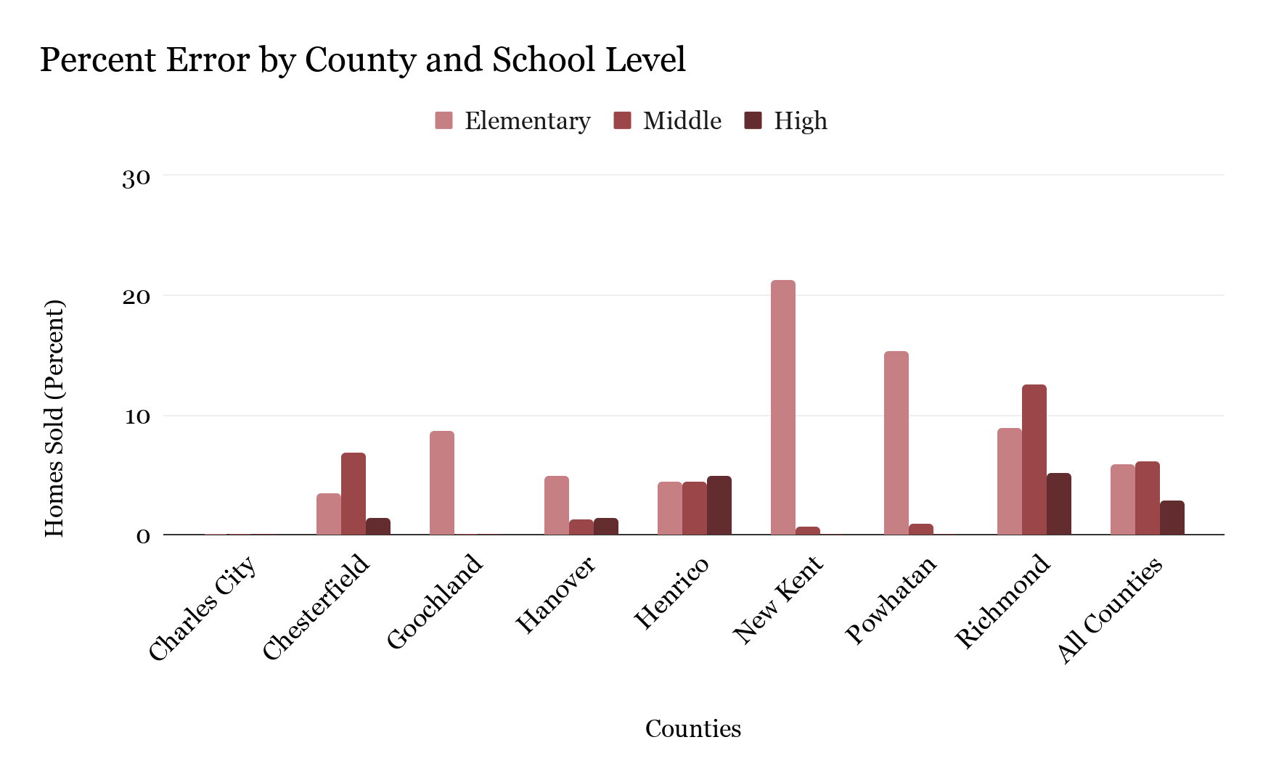
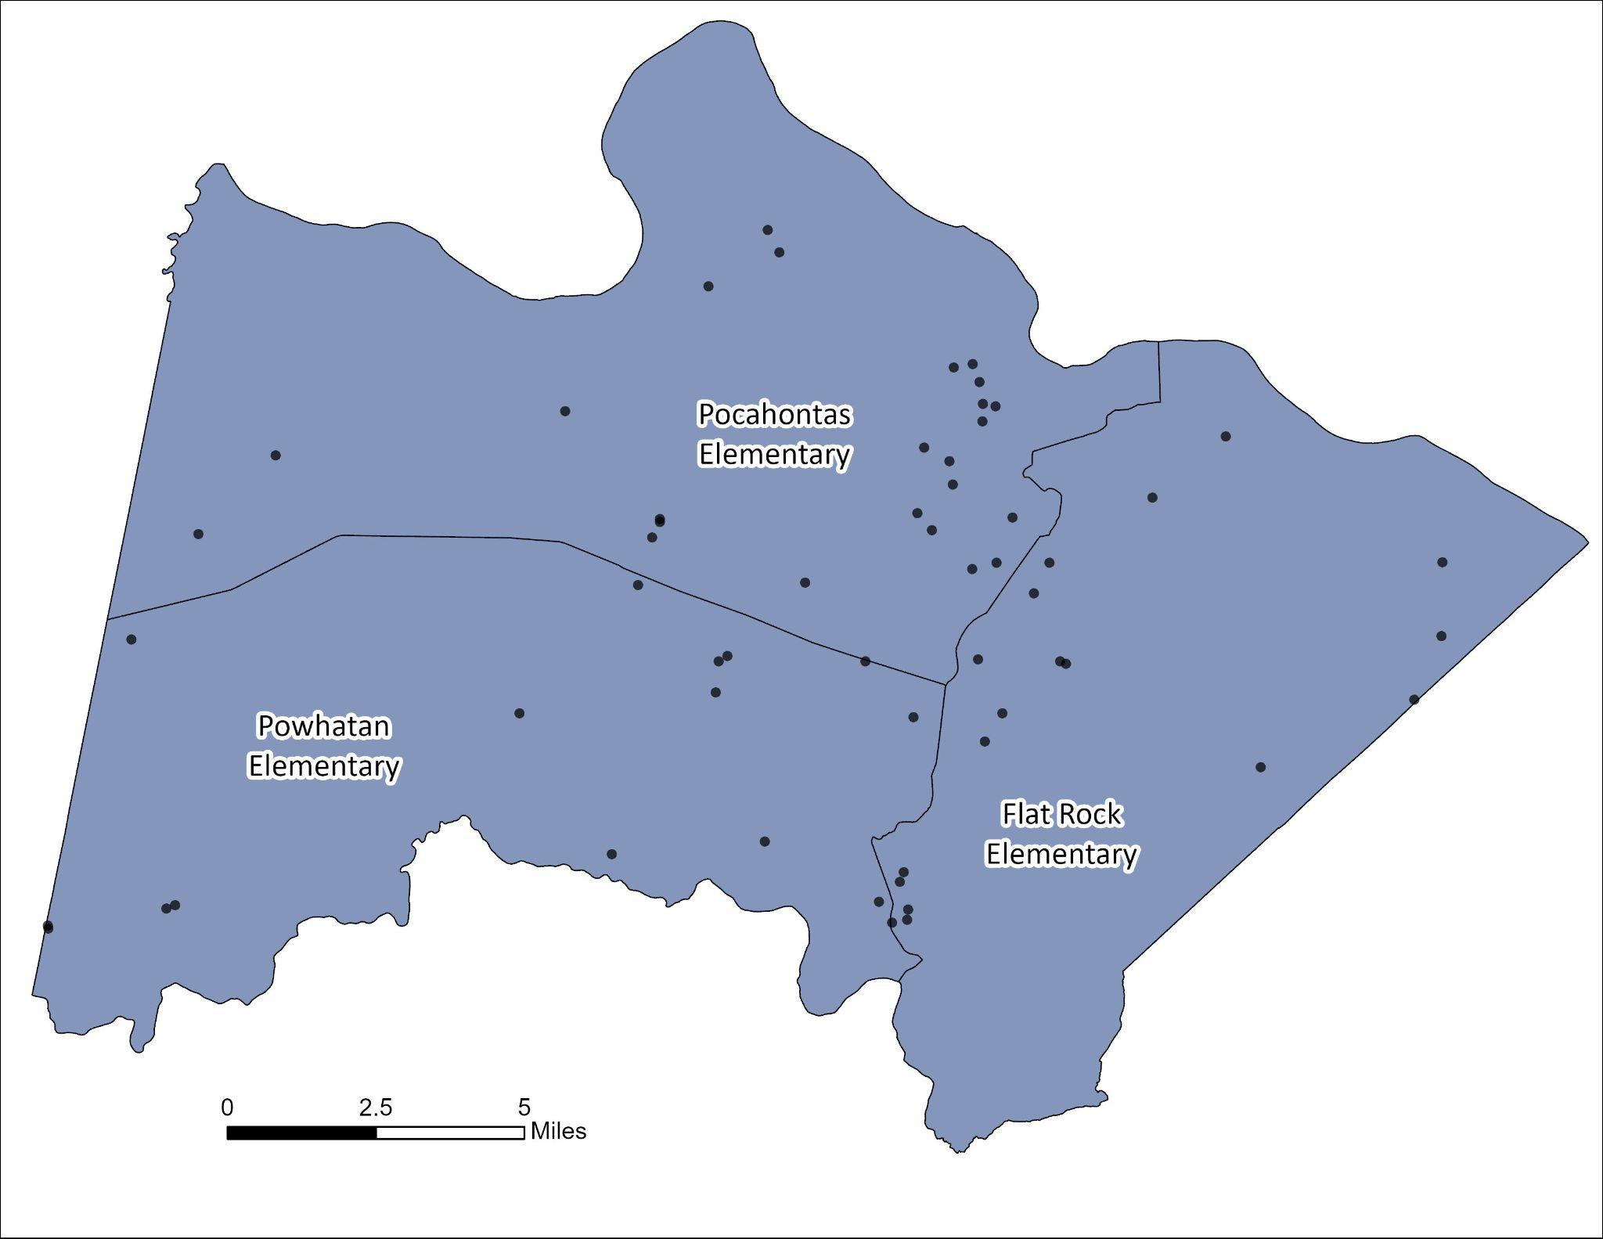
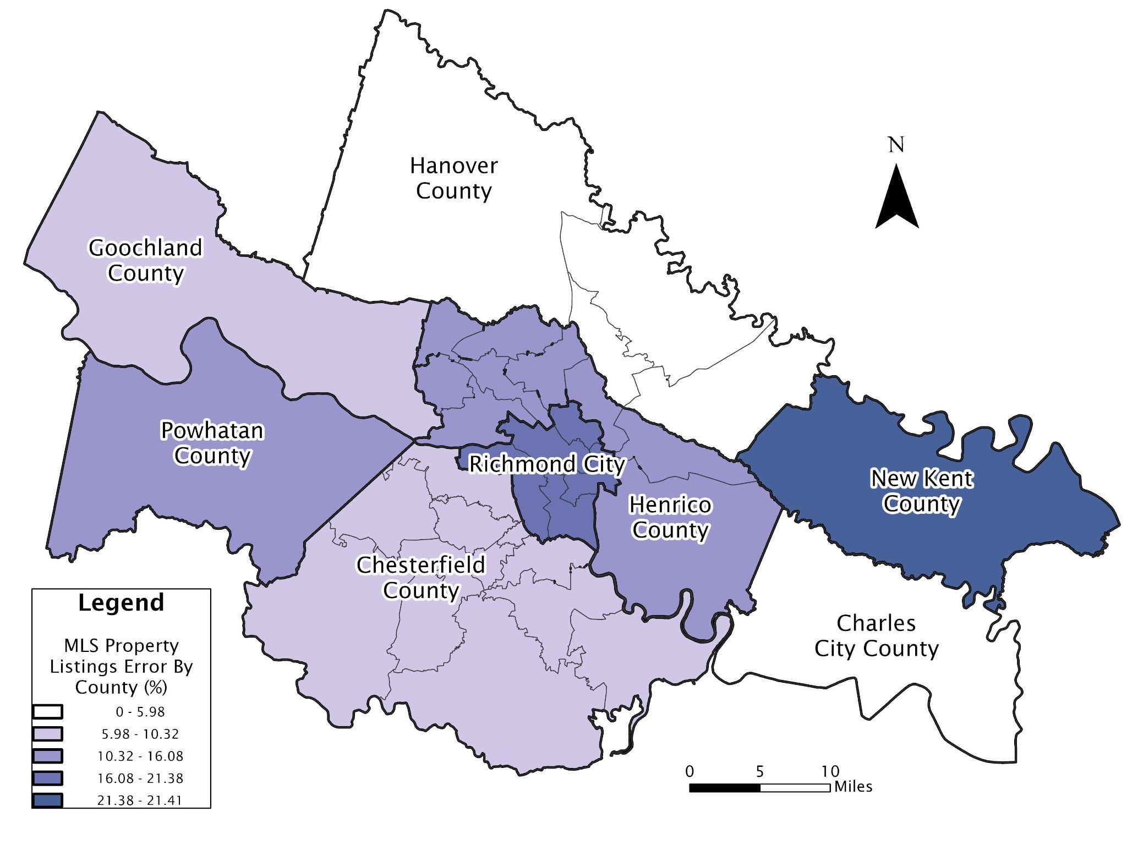
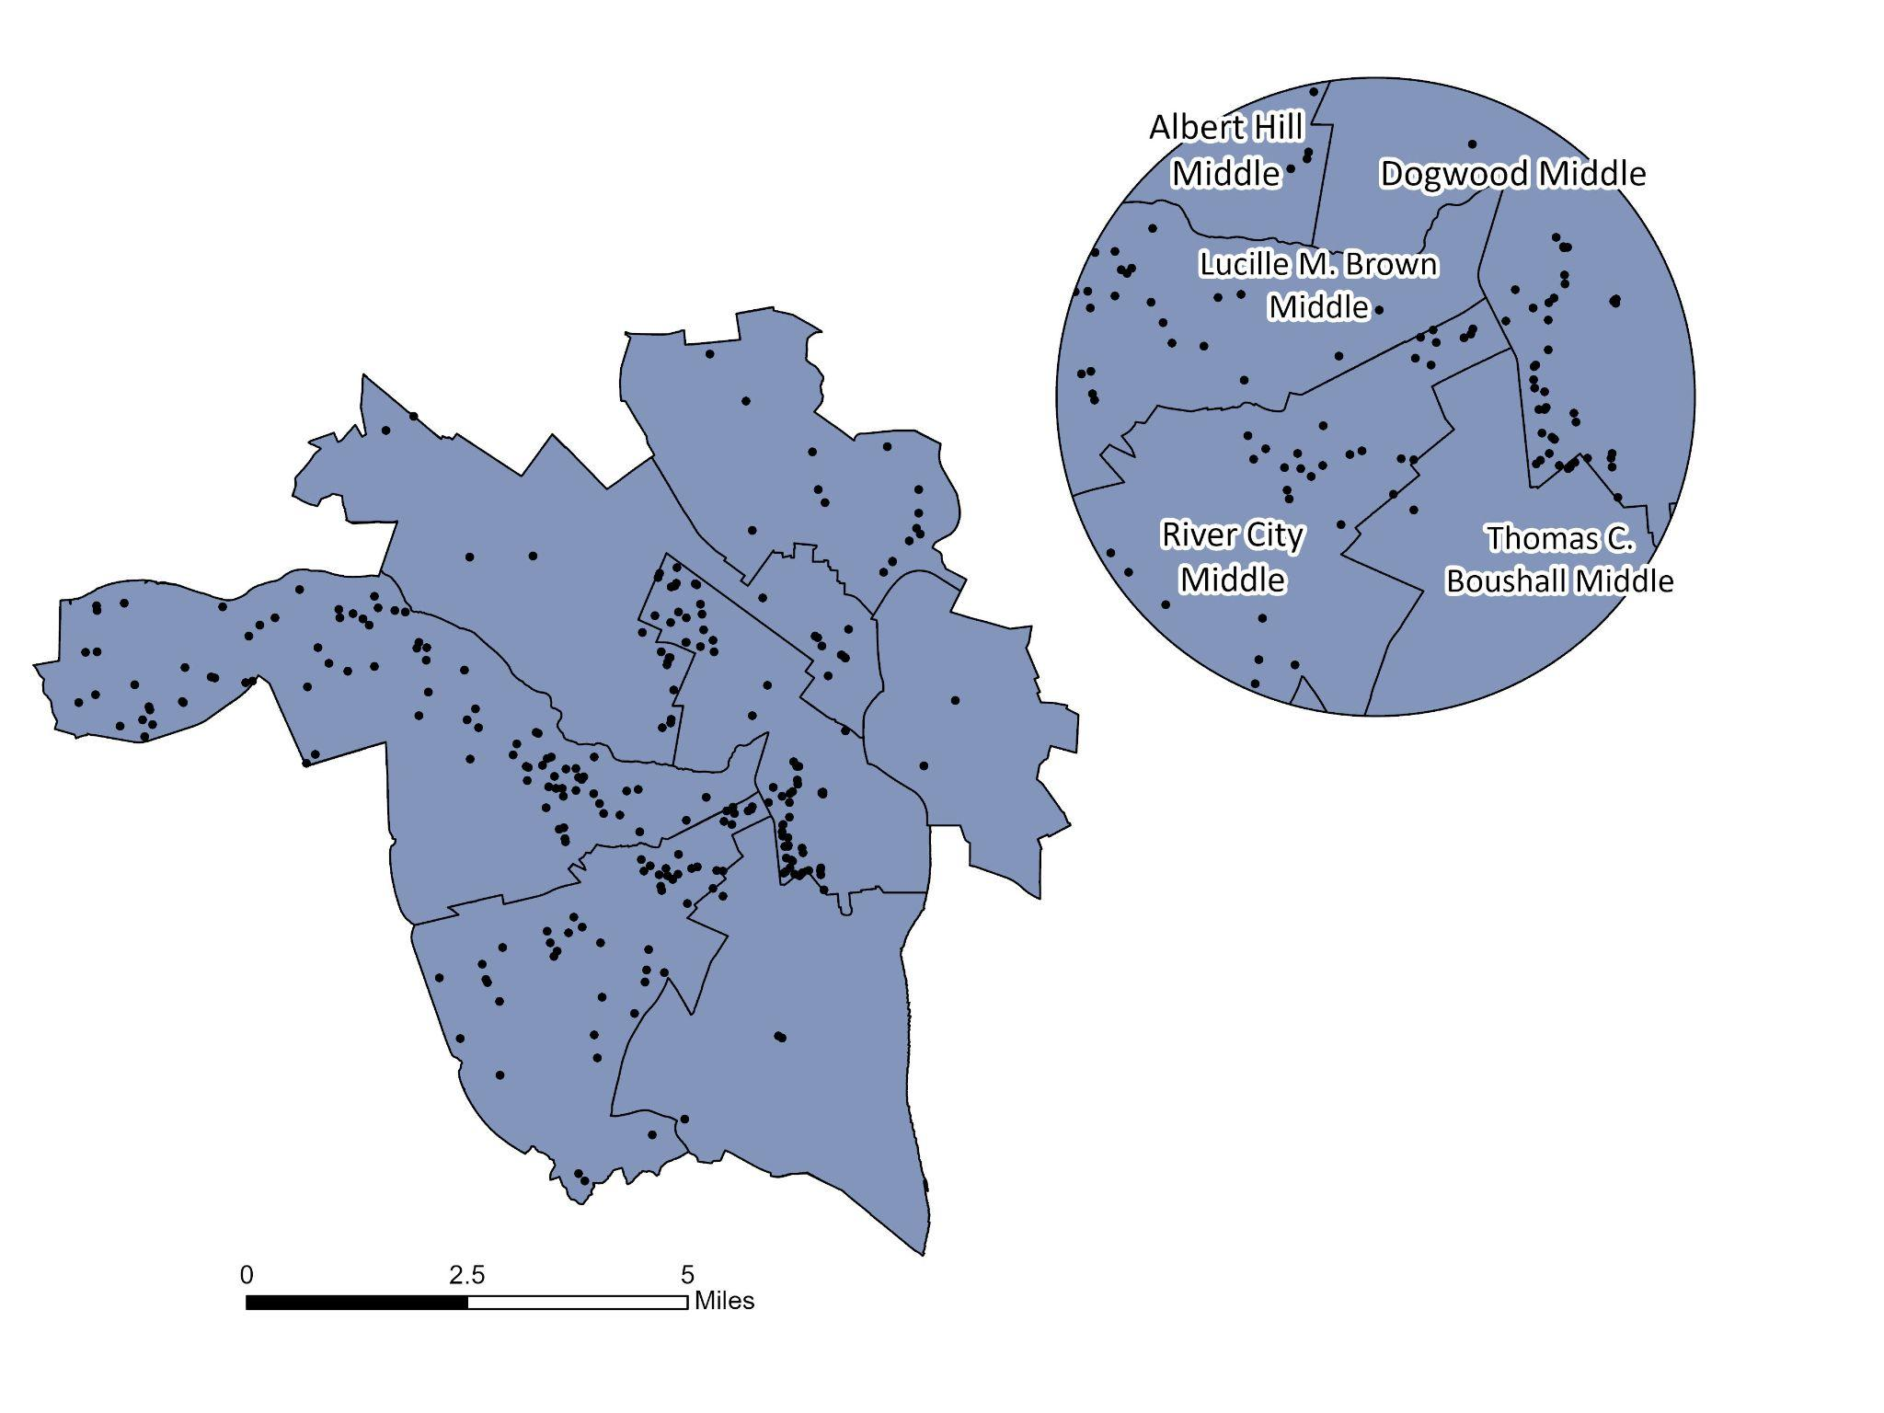
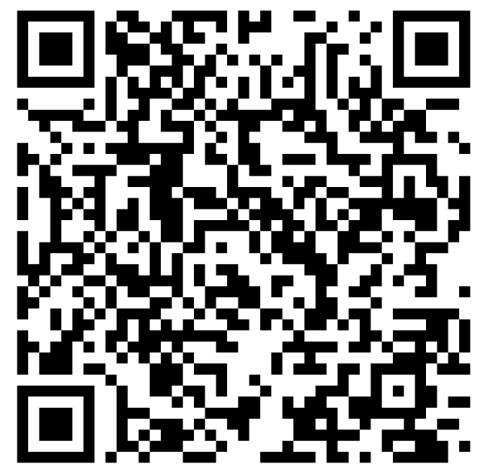
Measuring Inaccuracies in School Attendance Zone Data in the Central Virginia Regional Multiple Listing Service
Tips and Techniques for Making an Effective Symposium Poster--
The Title Can Have One or Two Lines
Katharine Wells, Hays Stritikus, Savannah Hollen, Tom Shields, & Kyle Redican
Department of Geography & School of Leadership Research Team, University of Richmond
Introduction
School Inaccuracy by County
Inaccuracy Analysis
A Multiple Listing Service (MLS) is an online real estate tool for real estate professionals to share information about for sale homes. The vast majority of residential property sales in America use MLS (Gillen, K. C., Schneider, K., & Sturtevant, L., 2023).
MLS data is entered by real estate listing agents and large real estate companies, and while most MLS’s have compliance officers, the sheer amount of information included the housing market, along with agents familiarity biases makes its hard to maintain complete accuracy. (Palm, 1976)
Each MLS listing is assigned a school zone, however, school attendance zones shift frequently to account for population shifts, changing educational demands, and updating infrastructure (Holme, J. J., Diem, S., & Welton, A., 2014).
The positive relationship between school quality and home prices has been well documented in the literature, and because of this, it is important that school attendance zones are accurate in the MLS (Collins, C. A., & Kaplan, E. K., 2017). However, very little academic literature examines the reliability of reported attendance zones within MLS.
This study examined MLS property data within eight jurisdictions of the Central Virginia Regional MLS (CVR MLS) Metropolitan Richmond area.
Powhatan and New Kent counties have the highest rates of inaccuracy likely due to lack of information or availability.
Powhatan lacks a school assignment locator and New Kent’s locator has a challenging user interface.
Changing boundaries also contribute to MLS errors.
For example, Chesterfield’s recently opened Deep Creek middle school, and that same school was the most likely to be misassigned.
The error rate varies significantly across counties and between school levels. The highest error rate was found in middle schools, and the lowest at high schools.
The low high school error is likely because there are fewer of them, and therefore it’s harder to make a mistake.
The high middle school error rate is likely because middle schools frequently rezone and redraw boundary lines to accommodate their less flexible capacity limits
The higher elementary school error rate is mostly likely because there are more elementaries than any other school, making the zones smaller and a mistake easier to make.
The overall error rate of 12.512% means that about 1 in 8 homes sold in this data set had an error in their school assignment.
 | ES | MS | HS | Incorrect Overall Properties
Properties | 717 | 751 | 348 | 1567/12524
Error Rate % | 5.73% | 6.00% | 2.78% | 12.512%
Figure 2. This bar chart demonstrates percent error in each county across each school level, demonstrating highest error in New Kent, Powhatan, and Richmond at the Elementary level.
Table 3. This table shows the number of errors in MLS school assignment per school level, and the overall error count and rate.
Research Questions
Rural Case Study: Powhatan County
Testing for Quality Bias in MLS School Assignments
How accurate are MLS property listings assigning school zones?
Which school zones are the most prone to error? How is this error distributed geographically?
What are the potential causes or reasons as to why MLS properties are being misassigned school zones? Are there any relationships between those errors and school quality?
At the elementary school level, Powhatan County had the second highest rate of error between MLS assignments and actual school zones.
Although only three elementary schools exist in the county, there are large error rates between each demonstrated through Table 2, suggesting that real estate agents are not properly aware or educated on the most recent or current drawn boundaries. There is also an issue with a lack of easy-to-access information about school attendance zones.
This is made more confusing by the presence of a Pocahontas Middle School in Henrico County, which some listings in Powhatan County had listed as a their assigned middle school.
One hypothesis for the cause of these inaccuracies was the intentional misrepresentation of school assignment by real estate agents. Initial research demonstrated financial incentive to selling a home in a higher quality school district (Carrillo, P., Cellini, S., Green, R., 2013).
To evaluate this hypothesis, we compared the quality of MLS-assigned schools with the quality of each property’s oficial school using a one-tailed binomial test.
  We used two publicly available, utilized measures of school quality; GreatSchools (GS) to represent perceived quality, and Virginia Department of Education School Performance and Support Framework (SPSF) to represent actual school quality (Feathers, 2020; Matthews, 2025).
Methods
Received data from VA CVRMLS for every home sold since 2020 (>130k listings).
Gathered current shapefiles for all school levels in all counties.
Found a timeframe where the attendance zones are constant and narrow data to that period.
Narrowed date to August 20, 2025 to present when recent redistricting took effect (n = 12,524 listings).
Conducted analysis for accuracy and binomial test to examine correlation with school quality.
School Level | Metric | MLS Higher % | P-Value | Interpretation
Elementary | GreatSchools(GS) | 51.25 | 0.291 | No statistical significance
Elementary | School Performance and Support Framework (SPSF) | 54.25 | 0.012 | Statistically significant evidence that MLS schools have higher SPSF score
Middle | GreatSchools(GS) | 42.91 | 0.998 | No statistical significance
Middle | SPSF | 45.94 | 0.944 | No statistical significance
High | GreatSchools(GS) | 35.82 | 1 | No statistical significance
High | SPSF | 33.13 | 1 | No statistical significance
Figure 3. This map shows the distribution of properties in Powhatan County that have incorrectly listed elementary schools. There seems to be a cluster of incorrectly zoned properties closer to the boundary lines between Pocahontas and Flat Rock, however most points show no spatial pattern of distribution.
School Inaccuracy Across Eight Counties
MLS Assigned | Actual School Zone | N*
Pocahontas | Powhatan | 26
Powhatan | Flat Rock | 20
Flat Rock | Pocahontas | 17
Table 1. This table demonstrates the amount of mismatches occurring across elementary schools in Powhatan.
Our research centers around eight localities in the Metropolitan Richmond area, indicated on our map through black boundary lines. Across the study area there are 134 elementary, 40 middle, and 32 high schools.
Table 4. This table demonstrates the difference between MLS-assigned school GS & SPSF scores and the quality of official attendance-zone schools. For each school level, binomial tests evaluated whether MLS-assigned schools were more likely than the actual school to have higher GS or SPSF scores than expected by change.
Some districts only have 1 school per level (Charles City County, New Kent and Powhatan for high school, Goochland for middle and high), resulting in their low error.
New Kent and Richmond City had the highest % error among MLS properties sold in the area.
With this, we can visualize that error varies significantly between counties and occurs at high rates in both urban (Richmond City) and rural (New Kent and Powhatan) jurisdictions.
Urban Case Study: Richmond City
The results of this test indicate that there is no statistically significant evidence of systemic intentional misrepresentation between MLS misassigned schools and actual school assignment.
The elementary SPSF scores were significantly higher for MLS assigned schools, however there was no observable pattern or distribution of difference.
Middle schools across the region had the highest error rate compared to elementary and high school zones.
In Richmond City, 12.41% of MLS properties are incorrectly listed to a specific middle school attendance zone.
More densely populated neighborhoods show no spatial pattern of misassignment, however we can see properties clustered across school boundary lines being the prone to error.
Conclusion
MAP
Inaccuracies vary greatly across the observed metro-Richmond counties & urban v. suburban areas.
Inaccuracies are most likely caused by human error, boundary complexity, and lack of information.
MLS Assigned | Actual School Zone | N*number of times incorrect assignment occured
Fairfield | Elko | 24
Albert Hill | Dogwood | 23
Dogwood | Albert Hill | 16
River City | Dogwood | 13
Most misassignments occur near geographically concentrated school attendance zone boundary lines.
There is no evidence of intentional misrepresentation between school zone quality and misassignment.
Future Work
References
Figure 4. This map shows the distribution of properties in Richmond City that have misassigned middle school zones. It shows a concentration of incorrectly listed properties in pockets close to school boundary lines, primarily between Thomas C. Middle, River City, Lucille M. Brown, Dogwood, and Albert Hill.
Table 2. The accompanying table shows amount of times each specific mismatch occurred. Houses were most often zoned to Elko but assigned to Fairfield.
Future work will examine the relationship between school quality, time on market, and bidding activity by incorrectly zoned property. Additional work is also needed to better understand how MLS reporting practices, attendance zone changes, and school quality information shape residential decision making.
Figure 1. This map shows the distribution of properties as a percentage of the total MLS property listings by county that have been assigned an incorrect school zone by a listing agent. The highest reported error by county was 21.41% in New Kent and 21.38% in Richmond City.

