Slide 1
Notes on data & codes
Rong Yu
12/4/2020

Slide 2
Note：Because the file size limit (100MB) and repository limit (1GB) in github, all codes and data (~ GB in total) mentioned in this note can be accessed through Google Drive.
https://drive.google.com/drive/folders/1j_gFaekFVLUdd5bc0rw96VFmkvHZpzLW?usp=sharing

Slide 3
Pheno-dates file summary
Data | File name | Notes
Phenocam | Phenocam_1000_3day_transition_dates.csv | GCC T10, T25, and T50 from GCC_90 smoothing line were used
Phenesse | phenesseFivesites.csv | est_05 and est_95 were used (5 and 95 percentiles)
MODIS 250m | modisPhenoDates250m.csv | Not used in the final analysis
MODIS 500m |  | Median across 4 pixels were used
VIIRS | viirsdates_threesites.csv | Median across 3-4 pixels were used
SI | SI_fivesites.csv
AGDD | AGDD_fivesites.csv | agdd0base were used (0 degree c used as base Ta)
Note: MODIS dates need to be updated.

Slide 4
MODIS 500 daily reflectances & snow QC

Slide 5
Codes and data files
Code file name | Description | File format
mcd43a4extract | MCD43A4 extraction and export: https://code.earthengine.google.com/343783ac317fd88221dcfef98cf4bb09 | GEE JavaScript
mcd43a2extract | MCD43A2 extraction and export: https://code.earthengine.google.com/59c7107d5f6de965d1786602d1f6218e | GEE JavaScript
importCombine.mlx | Combine MCD43A4 and MCD43A2 | Matlab live script
Data file name | Description | File format
siteInfo.mat | Site information: site-pixel, latitude, longitude | Matlab mat
MCD43A2combn.mat | MCD43A2 (2012-2020): snow QA | Matlab mat
MCD43A4combn.mat | MCD43A4 (2012-2020): bands 1, 2 & 3 and calculated NDVI & EVI2 | Matlab mat
MCD43A4wSnowFlag.mat | Merge MCD43A2combn & MCD43A4combn | Matlab mat
MCD43A4wSnowFlag.csv | Merge MCD43A2combn & MCD43A4combn | Csv file
Note: MCD43A4wSnowFlag.csv was used for MODIS transition date calculation, lag correlation & integrative data figures.

Slide 6
MODIS 500 daily reflectances & snow QC
Main issues:
MODIS products in GEE is in the global composites, and looks like it cannot be downloaded with clips/bounds
Only can download with small chunks, e.g., ~every 4 month of MCD43A4, ~every year of MCD43A2. “Error: User memory limit exceeded.“ （ JavaScripts ）
End date not included in the extractions, so need the overlapped dates between two chunks （ JavaScripts ）
Have to manuelly hit run to download each file !!! （ JavaScripts ）

Slide 7
MCD43A4.006 MODIS Nadir BRDF-Adjusted Reflectance Daily 500m
https://lpdaac.usgs.gov/products/mcd43a4v006/
Nadir_Reflectance_Band1 | NBAR at local solar noon for Band 1 | N/A | 16-bit signed integer | 32767 | N/A | 0 to 32766 | 0.0001
Nadir_Reflectance_Band2 | NBAR at local solar noon for Band 2 | N/A | 16-bit signed integer | 32767 | N/A | 0 to 32766 | 0.0001
Nadir_Reflectance_Band3 | NBAR at local solar noon for Band 3 | N/A | 16-bit signed integer | 32767 | N/A | 0 to 32766 | 0.0001

Slide 8
MCD43A2.006 MODIS BRDF-Albedo Quality Daily 500m
https://lpdaac.usgs.gov/products/mcd43a4v006/
Name | Description | Min | Max | Units | Scale
Snow_BRDF_Albedo | Snow-free or snow BRDF/albedo retrieved |  |  |  | 0
Snow_BRDF_Albedo Bitmask | Bit 0: Mandatory QA 0: Snow-free albedo retrieved 1: Snow albedo retrieved

Slide 9
VIIRS 500 daily reflectances and transition dates

Slide 10
Codes and data files
Code file name | Description | File format
VIIRStimeseries.mlx | clean APPEEARS downloaded VNP09H1 & VNP43IA4 time series | Matlab live script
VIIRSphenomatrix.mlx | extract VIIRS pheno matrix (vpn22q2) | Matlab live script
Data file name | Description | File format
VIIRSsitelocidx.mat | Site-pixel information: site, tile, line, sample | Matlab mat
h**v**.mat | Pheno-matrix at tiles | Matlab mat
VNP22Q2.???.h5 | Tile level pheno-matrix | HDF5-EOS
phenodate.****.mat | Extracted pheno-matrix at each NEON site | Matlab mat
neon-vnpdaily folder | APPEEARS downloaded daily time series
neon-vnp09h1 | APPEEARS downloaded 8-day time series

Slide 11
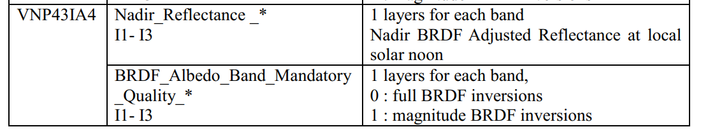
VIIRS: VNP43IA4 Nadir BRDF-Ajusted Reflectance Daily L3 Global 500m SIN Grid
Data files:
VNP43IA4clean.csv & NEON-VNPdaily-VNP43IA4-001-metadata.xml
Google drive link: https://drive.google.com/drive/folders/1_QyR0_yzoinM4VuxWjvrraaoYdIqBYEf?usp=sharing
Product notes:
The VNP43IA4 product is produced daily using 16 days of VIIRS data and is weighted temporally to the ninth day, which is reflected in the file name
VIs used:
NDVI=(VNP43IA4_001_Nadir_Reflectance_I2- VNP43IA4_001_Nadir_Reflectance_I1)/.(VNP43IA4_001_Nadir_Reflectance_I1+ VNP43IA4_001_Nadir_Reflectance_I2);
EVI2=2.5*(VNP43IA4_001_Nadir_Reflectance_I2- VNP43IA4_001_Nadir_Reflectance_I1)./(VNP43IA4_001_Nadir_Reflectance_I2+2.4* VNP43IA4_001_Nadir_Reflectance_I1 +1);
Pixels used:
VIIRS pixels cover 3*3 250m resolution MODIS pixels
When insufficient high quality reflectances are available (currently set to less than seven observations) or a poorly representative sampling of high quality reflectances is obtained (as indicated in the quality flags and determined through weights of determination), it is not possible to perform a full inversion. Instead, use is made of a database of archetypal BRDF parameters [11],[12] to supplement the observational data available and perform a lower quality magnitude inversion.

Slide 12
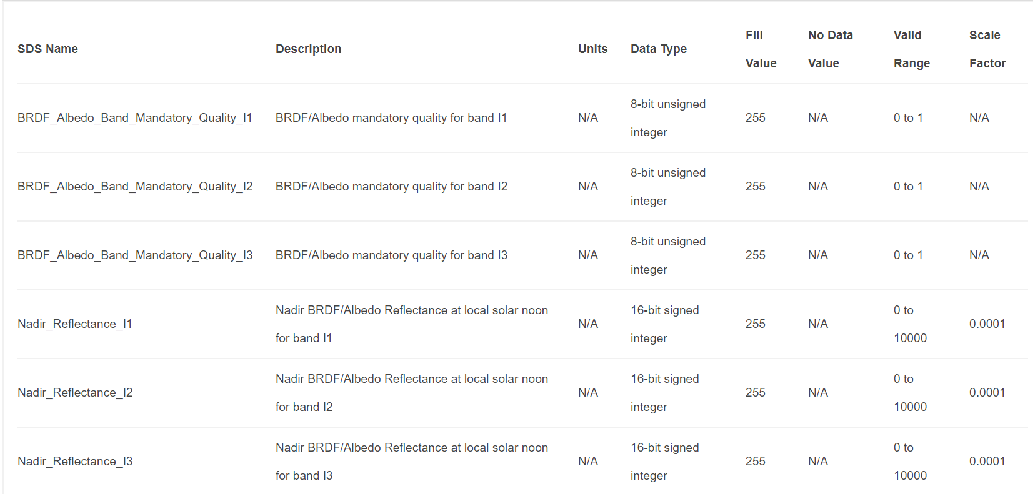
VIIRS: VNP43IA4 layers

Slide 13
VNP22Q2: Land surface phenology (Land surface dynamics) Yearly L3 Global 500m SIN Grid
Product notes:
The VNP22Q2 data product is derived from time series of the two-band Enhanced Vegetation Index (EVI2) calculated from VIIRS Nadir Bidirectional Reflectance Distribution Function (BRDF)-Adjusted Reflectance (NBAR). Vegetation phenology metrics at 500 meter spatial resolution are identified for up to two detected growing cycles per year.
The product contains six phenological transition dates: onset of greenness increase, onset of greenness maximum, onset of greenness decrease, onset of greenness minimum, dates of mid-greenup, and senescence phases. The product also includes the growing season length. The greenness related metrics consist of EVI2 onset of greenness increase, EVI2 onset of greenness maximum, EVI2 growing season, rate of greenness increase and rate of greenness decrease.

Slide 14
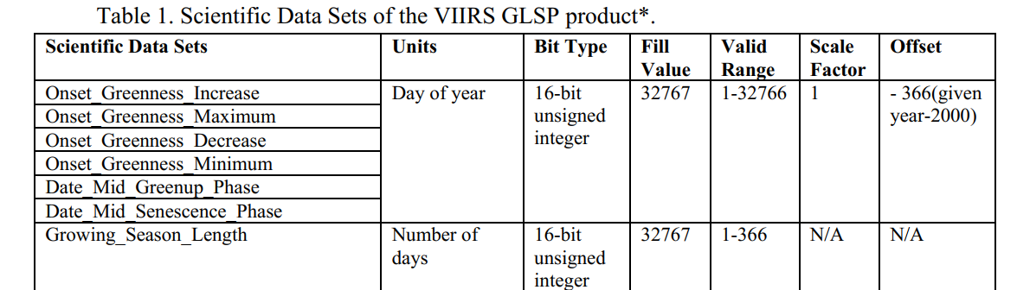

Slide 15
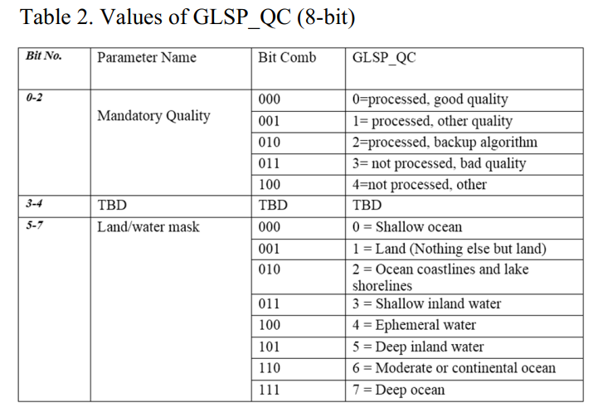

Slide 16
VNP22Q2 pheno matrix for NEON sites
ABBY: cycle 1 pheno dates
DSNY: NO pheno dates
HARV: cycle 1 pheno dates
ONAQ: cycle 1 pheno dates
OSBS: NO pheno dates

Slide 17
Info figures
The codes and final figures will be updated and shared soon

Slide 18
Scatter plots
The codes and final figures will be updated and shared soon

