Slide 1
Sales Dashboard Summary
A Katheeja Nazrin
Roll No: 23083301800812025
BSc AI
Date: 10-08-2025

Slide 2
Objective
The objective of this dashboard is to analyze sales and profit trends from the Superstore dataset, providing key business insights through visual representations.

Slide 3
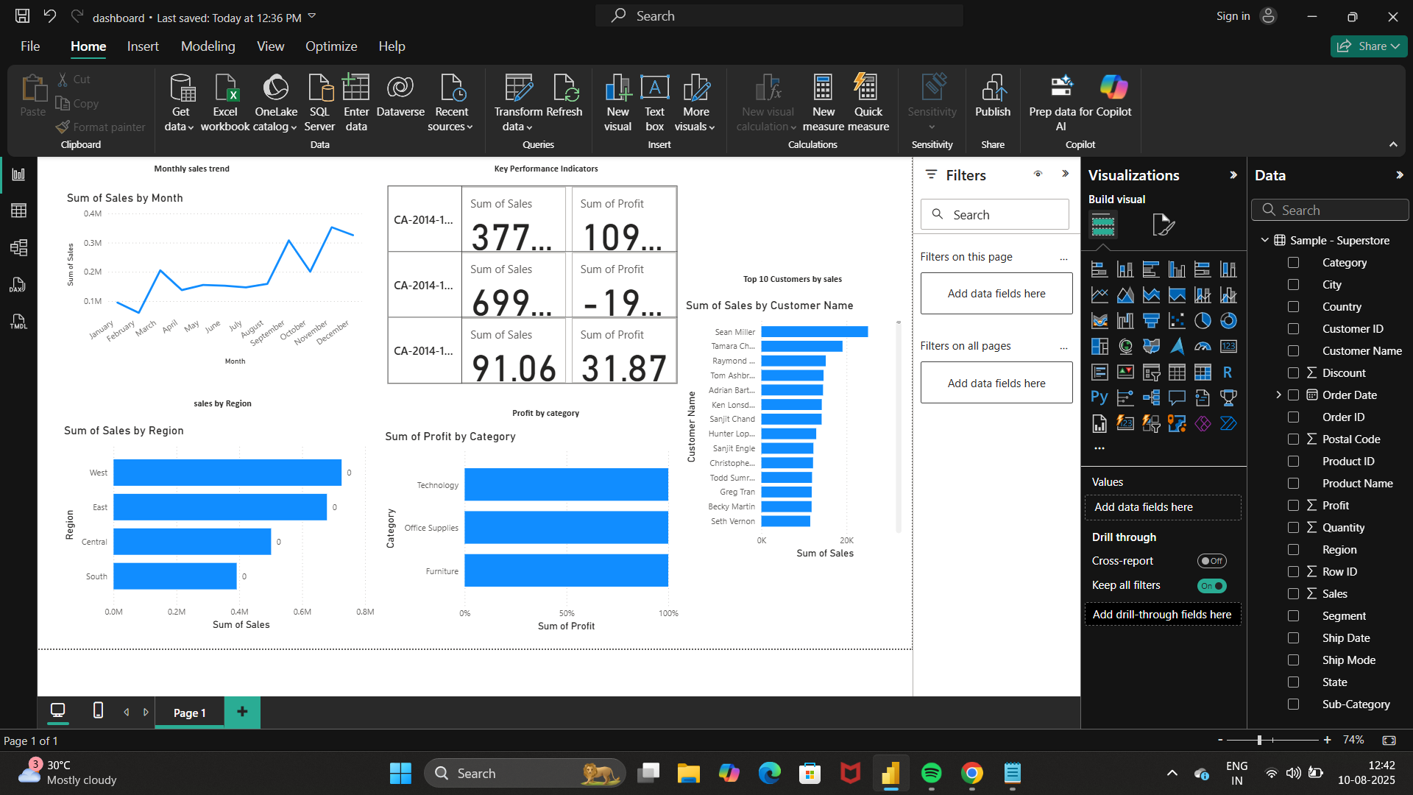
Dashboard Overview

Slide 4
Visual Explanations
1. Monthly Sales Trend: Shows how sales vary across months.
2. Key Performance Indicators: Displays sum of sales and profit for top orders.
3. Sales by Region: Highlights regional sales distribution.
4. Profit by Category: Shows profit share across categories.
5. Top 10 Customers by Sales: Lists highest contributing customers.

Slide 5
Key Insights & Conclusion
Highest sales occur in November and December.
West and East regions lead in sales.
Technology category yields the most profit.
A few customers contribute significantly to sales.
Conclusion: Focus marketing on high-sales months, top regions, and profitable categories to maximize returns.

