Slide 1
A Strategy for Training Neural Networks on Very Large Data Sets
Donifan Barahona¹ and Katherine Breen^{1,2}
1 - Global Modelling and Assimilation office
NASA Goddard Space Flight Center
Greenbelt, MD, USA.
2 – University System Research Association (USRA)

Slide 2
Typical Earth Science Problem
Regression style training (e.g., fit a NN function to data)
Satellite, model results, or campaign data in gridded format, i.e., netcdf, hdf..
Data size adds up very quickly, e.g., few Gb per file but could easily become Tb-ish for a given month.
Cannot be all loaded at once in memory. But one wants to load enough data to get good statistics.

Slide 3
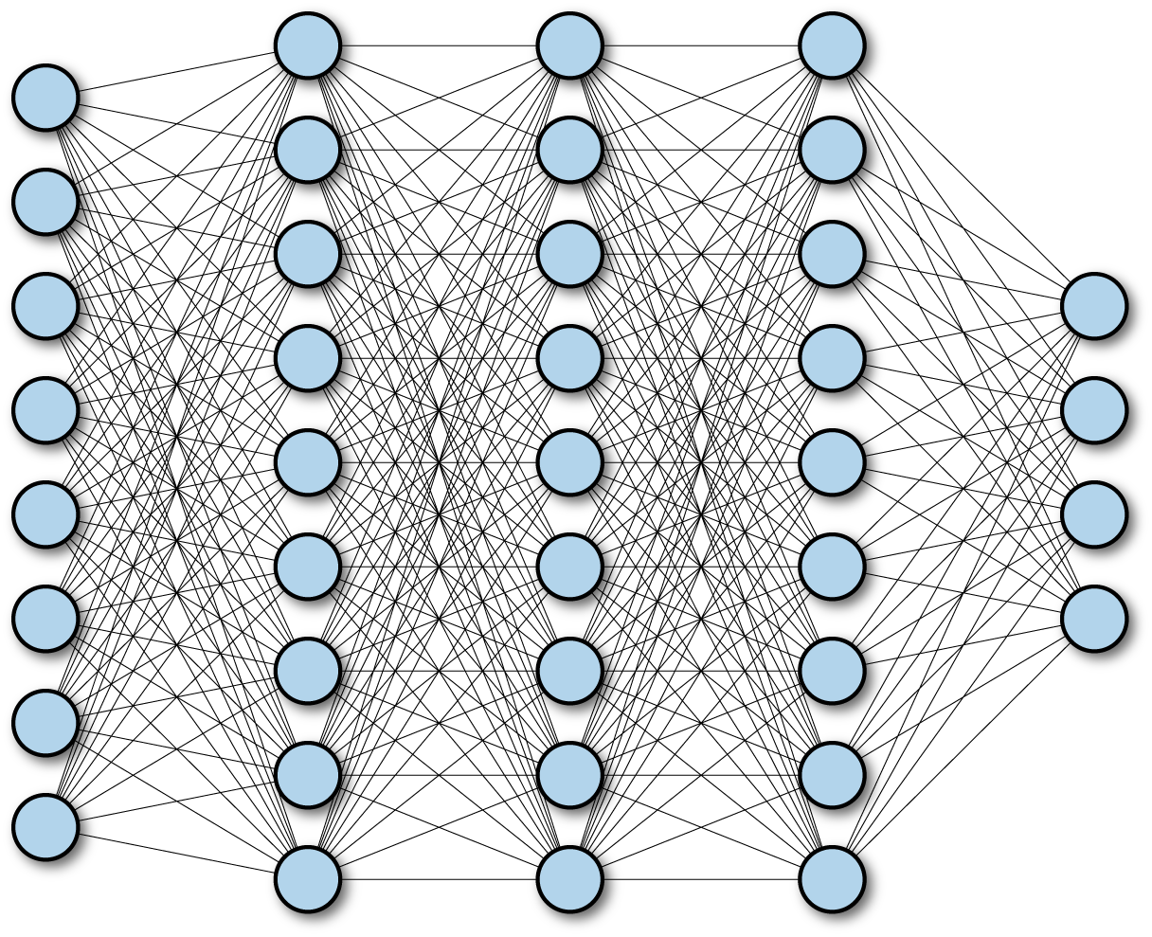
Example: training on the “nature” run
G5NR (or similar) 0.0625 °
Downsampling at 0.5° (stdev, N=64)
W
Downsampling to 0.5 °(mean, N=64)
U, V, T, Q…
Training
“Wnet”
(MLP ~ 1-2 hidden layers)
Transform
1 output variable
Transform and normalize
10 variables
Loss:
σ_{W}-σ_{W, G5NR}
σ_{W}
MERRA (offline)
Prediction
GEOS (online, Fortran-Keras-Bridge)
Notes:
3
If you are a ML scientist this can be disappointing
It is for us to decide when we are happy with the result

Slide 4
Using a Neural Network: Challenges
G5NR spans over 2 years, on 30 minutes time steps
Each variable, for each time step ~ 1 GB
G5NR ~ 17K time steps
A representative sample ~ 100 time steps could work but a 1000 would be great
~10 input variables, 1 output variable , ~5-11 TB of data! And this is just a small sample of the data
Notes:
4
Aerosol

Slide 5
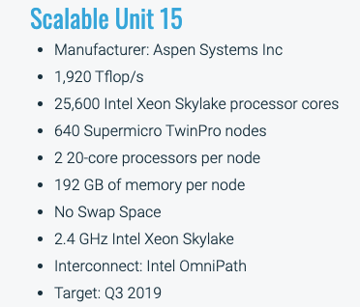
Resources
A “Skylake” node
4 GB per core (~3Gb before it chokes)
40 cores per node. But need to be leveraged with parallelization (how many cores per task)
Going multimode could be hard and time consuming to set up
This is quite modest compared to commercial clouds

Slide 6
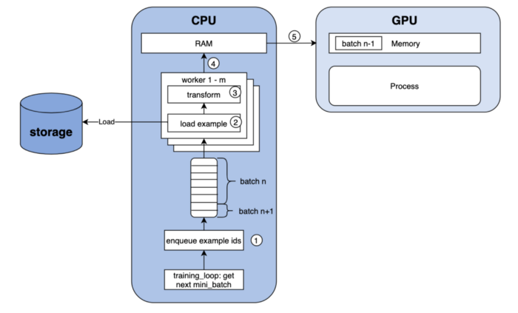
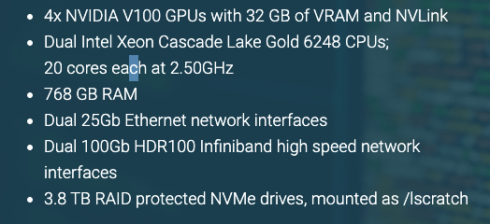
GPUs usually don’t do the I/O
GPUs are not great at handling I/O

Slide 7
Xarray
“Xarray introduces labels in the form of dimensions, coordinates and attributes on top of raw NumPy-like arrays, which allows for a more intuitive, more concise, and less error-prone developer experience.”
Anything you can do with Xarray you can do with other tools: Pandas, numpy, IDL, Matlab…,
Xarray makes it easier:
Indexing, and slicing directly by [time, lev, lat, lon]
Runs on python: open-source and can be “easily” integrated with ML. Tons of stack overflow posts.
Integrates dask, almost completely in the background: parallelism and big data

Slide 8
Xarray
What is easy: array manipulation
Example: Taking a time series of MERRA data, resampling it to 5 min doing linear interpolation, take a 3 time step rolling average, and subsampling data that aligns it with obs, that is:
dat_merra = dat_merra.resample(time="5min").interpolate("linear").rolling(time=3, center=True).mean()
dat_merra, dat_obs = xr.align(dat_merra, dat_obs, exclude = {'height', 'lev'})
What is not easy: modifying data directly:
dat_merra[:, :, :, 1] = 5 …. Can’t be done!

Slide 9

“Dask provides multi-core and distributed parallel execution on larger-than-memory datasets.”
- Provides a lot of functionality to handle big data: Dask arrays, bags, dataframes…
Many flavors: daks-ML, dask-parallel, dask-queue.
Makes it easier to embarrassing parallelization of python (no major code modifications)
When using Xarray, one does not really need to know much about Dask, or working directly with it.

Slide 10
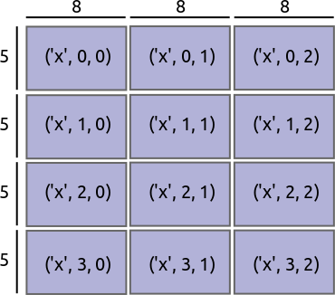
Dask arrays
Dask divides arrays into many small pieces, called chunks, each of which is presumed to be small enough to fit into memory.
Dask arrays are lazy. Operations queue up a series of tasks mapped over blocks, and no computation is performed until you actually ask values to be. At that point, data is loaded into memory and computation proceeds in a streaming fashion, block-by-block.
http://xarray.pydata.org/

Slide 11

How do you “use” Dask?
Well, you don’t. Xarray does. For example “open” a time-level series of obs data, with
Import Xarray as xr
yall= xr.open_mfdataset(filepath, parallel=True, chunks={"time": 4096})
open_mfdataset = open file as a dask array
“chunks={"time": 4096}” ::: optional. Make “chunks” of 4096 columns.
**Note: Always make sure you don’t ask for actual values, until you really need them, e.g., “print(yall[1, 2])” Would force loading of yalls in memory

Slide 12
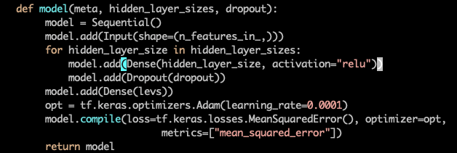

Typical Keras Training
Instantiate model:
Fit model:
batch_size: how many samples (i. e., columns) for each minibatch to calculate gradient
epochs: how many iterations, i.e., passes through the whole data set before stopping
Assumption: your data fits in memory

Slide 13

Keras training with larger than memory data
Train_gen and val_gen: custom functions that provide one minibatch of training and validation data every time they are called.
When training data can be loaded in memory at once, Keras uses the batch size to calculate the number of steps: #steps= number of samples/batch_size ➔ epoch
When using a generator one needs to tell Keras what to call an epoch: steps_per_epoch
There is a lot of info on the web on how to build custom generators, mostly involve loading individual files during training. But very little using Dask.

Slide 14
A Dask Generator Class
We want the minibatches to be dask “chunks”
import dask as da
class DaskGenerator(Sequence):
def __init__(self, data_object):
X_train, y_train = self.data_object.get_Xy()
self.sample_batches = X_train.data.to_delayed()
self.examples_batches = y_train.data.to_delayed()
def __len__(self):
return len(self.examples_batches)
def __getitem__(self, idx):
X, y = da.compute(self.sample_batches[idx,0],
self.examples_batches[idx,0])
return X, y
# Sequence: Keras would do the counting
# data_object: a class with a method that loads and transforms data (you build this)
# to_delayed: creates a list of 2D numpy arrays from the chunks (“flattens” the Dask array)
#__len__: tells Keras how many chunks there are
__getitem__: Keras uses this to get the minibatches by providing ramdom idxs until len is reached

Slide 15

Using Dask to train on chunks
Steps per epoch = total number of columns/chunk size (assuming each sample is a column)
In principle one could load all the data at once and let dask do the work… but each epoch would take years..

Slide 16
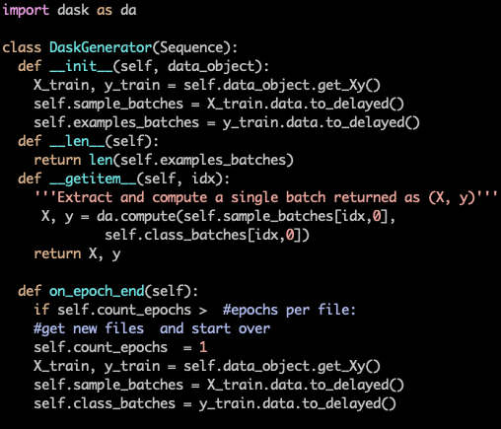
Regularization by Switching Data during Training
on_epoch_end: tells Keras to do somethinga at the end of each epoch
We load few time steps at random at once, and train them for a few epochs_per_fileFor example: we can load 5 time-steps of G5NR and train on them for 10 epochs at a time.
Training for a 2000 epochs would use 1000 time steps (without loading a TB of data…)
This method adds natural regularization to the NN… it would never overfit

Slide 17
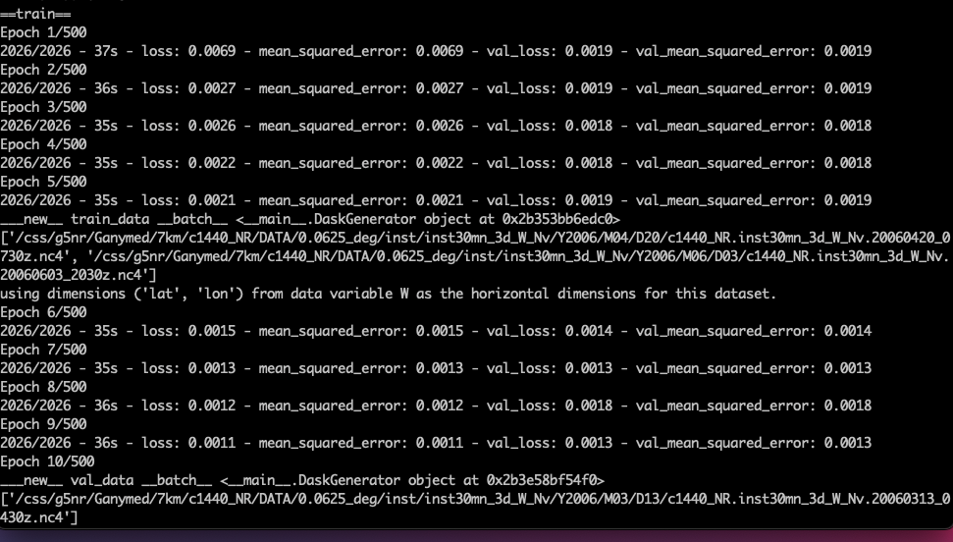

Slide 18
Wish List
The Dask_generator class works with GPUs as well. But not great when using multiple workers.
Dask allows simple parallelization over a single node. It can very easily set up a “local cluster”. Tensorflow also automatically scales to as many cores available in the local machine.
However real speed up requires multi-node parallelism. So far no luck.

