Slide 1
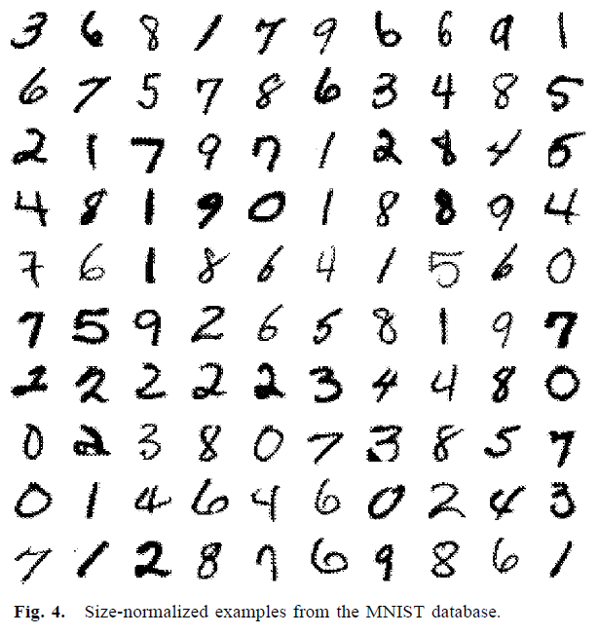
LeCun, Yann, et al. "Gradient-based learning applied to document recognition."
Proceedings of the IEEE 86.11 (1998): 2278-2324.
The “MNIST paper”
MNIST = Modified National Institute of Standards and Technology
Database of hand-written digits

Slide 2
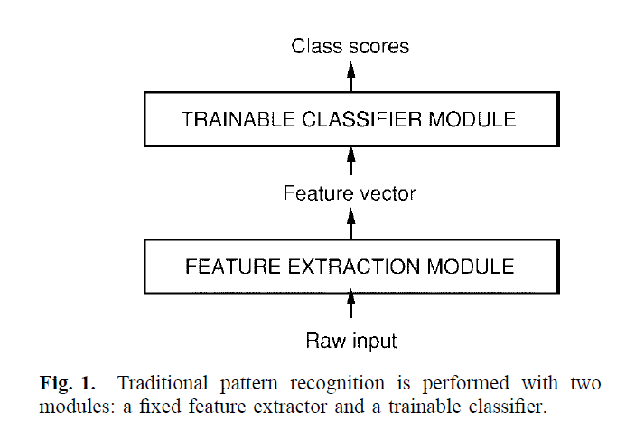
“The first module, called the feature extractor, transforms the input
patterns so that they can be represented by low-dimensional
vectors or short strings of symbols that: 1) can be easily
matched or compared and 2) are relatively invariant with
respect to transformations and distortions of the input patterns
that do not change their nature. The feature extractor
contains most of the prior knowledge and is rather specific
to the task. It is also the focus of most of the design effort,
because it is often entirely hand crafted. The classifier,
on the other hand, is often general purpose and trainable.”

Slide 3
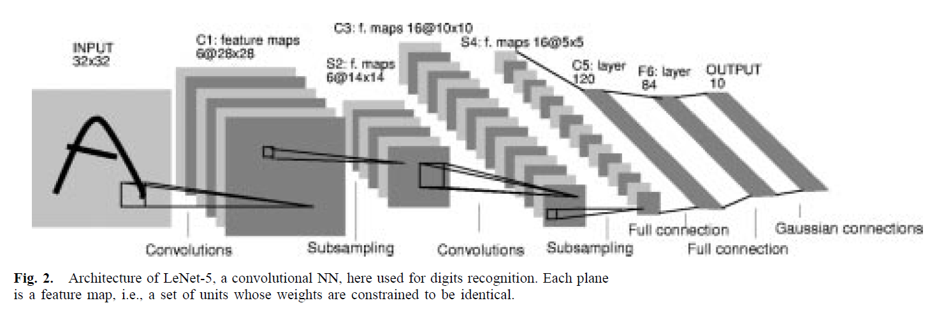
“LeNet-5 comprises seven layers, not counting the input, all
of which contain trainable parameters (weights). The input
is a 32 x 32 pixel image.”

Slide 4
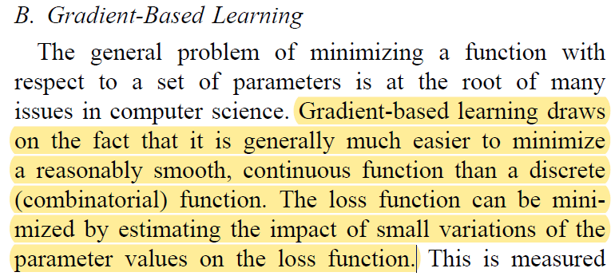
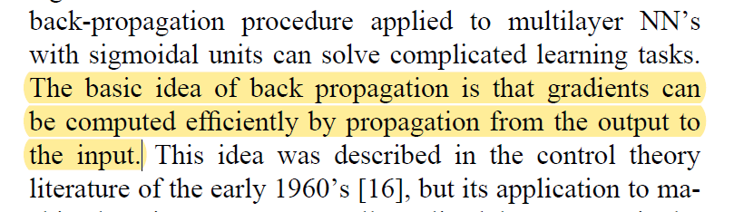
Excellent reference for basics of:
Gradient-based learning
Back propagation
Formulas used in this paper are explained conceptually in a way that is relatively digestible!

Slide 5
