Slide 1

SSAI’s Deep Learning Academy and Collaboration with the GMAO
Akira Sewnath
August 20th, 2021

Slide 2
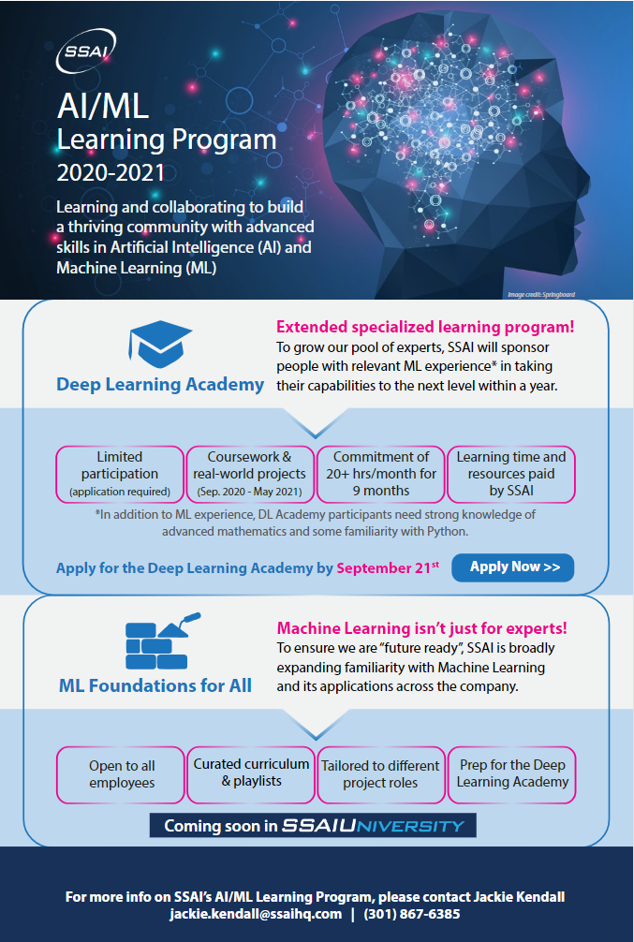
Artificial Intelligence & Machine Learning Development Programs
Jackie Kendall, SSAI, Chief Knowledge Officer
Brandon Smith, SSAI, AI/ML Technology Lead
Shelley Stover, SSAI, Chief Technologist / ESES-III

Slide 3
deep learning…

Slide 4
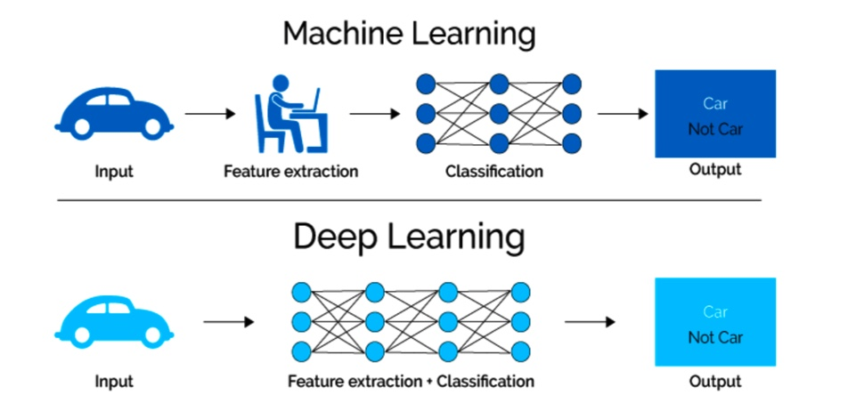
Brief Aside
*
*must be a neural network variation

Slide 5
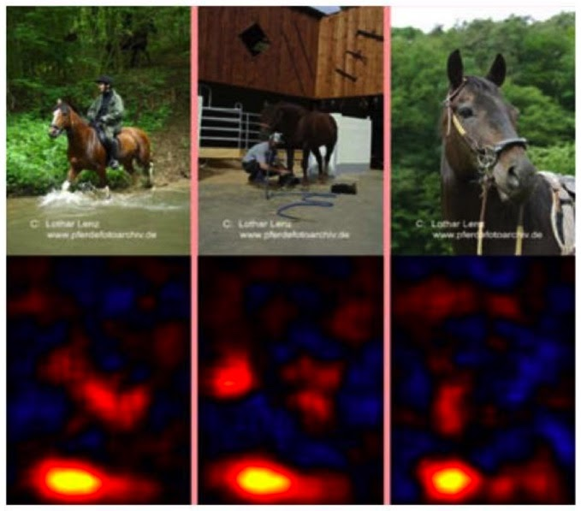

Slide 6


DL Academy Part 1: Coursework
Based on a highly regarded Coursera Specialization that includes 5 courses:
Neural Networks and Deep Learning
Improving Deep Neural Networks
Structuring Machine Learning Projects
Convolutional Neural Networks
Sequence Models

Slide 7


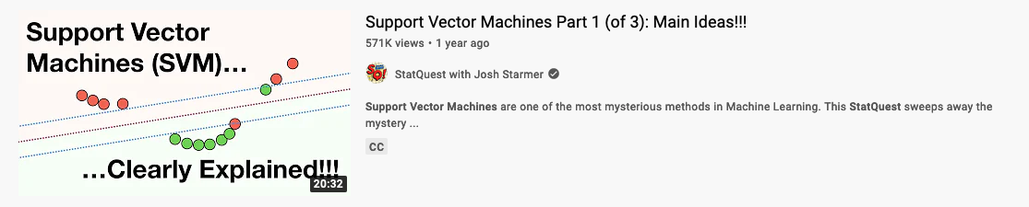
Coursera is great ☺

Slide 8
DL Academy Part 2: Projects
Two projects with distinct use cases
Time series forecasting (RNN for streamflow forecasting)
Semantic segmentation (CNN for land cover classification)
Each starts with a guided introduction and ends with a Challenge
Similar to Kaggle.com (“Start with more than a blinking cursor”)
Learners paired in Teams for the Challenge to promote collaboration
Project materials designed as reusable resources that can support future Academy cohorts as well as other SSAI or community initiatives

Slide 9
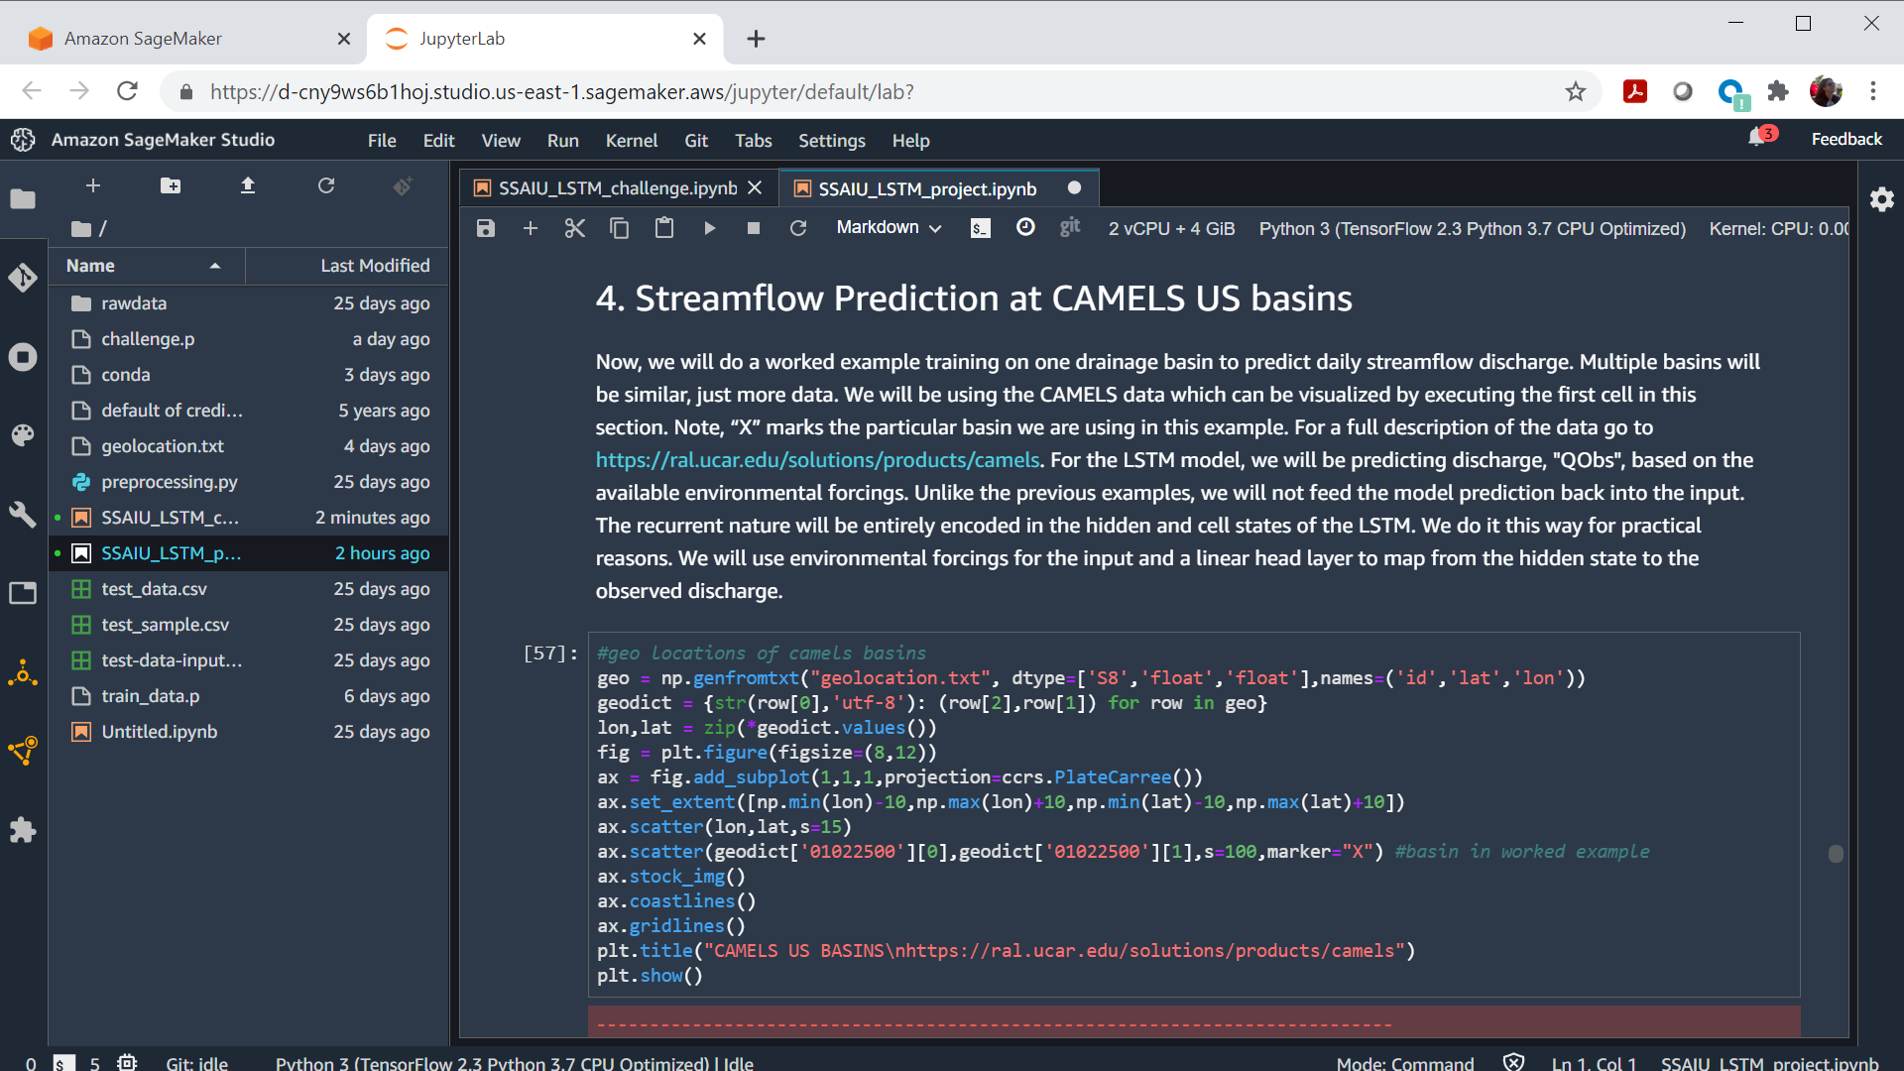
DL Academy Project Tools – AWS SageMaker Studio / Jupyter Notebooks

Slide 10
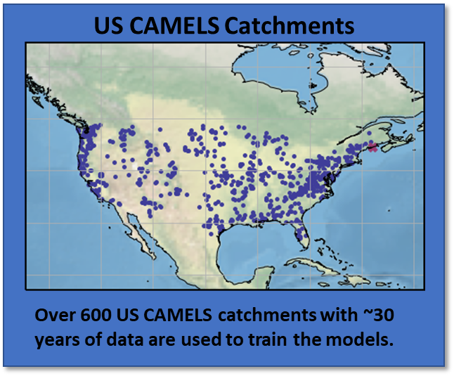
Project A: Time Series Prediction
Goal:
Make time series predictions on streamflows for Catchment Attributes and Meteorology for Large-sample Studies (CAMELS) basin dataset.
Requirements/Constraints:
Train and validate on a dataset of 100 basins (each basin contains 7000 samples)
Score final model on 100 different basins
Computational power constraints
Use Long Short-Term Memory (LSTM) architecture, a type of Recurrent Neural Network (RNN) used for time series prediction problems
Advisor: Craig Pelissier (606)

Slide 11
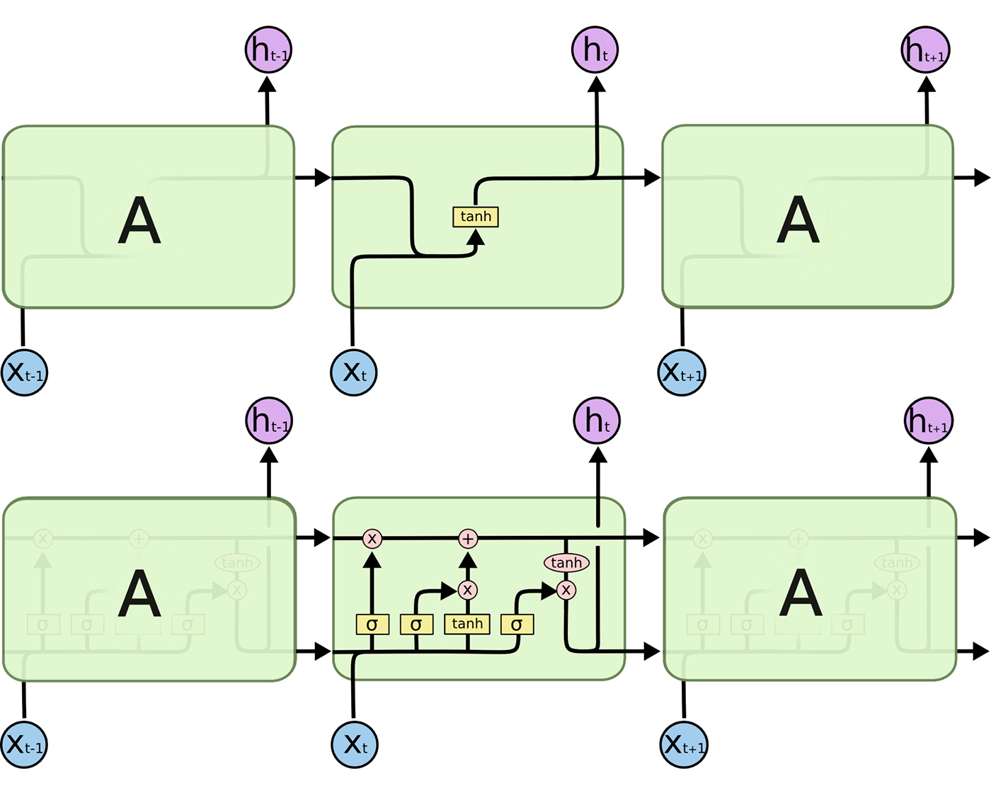
Standard RNN
LSTM RNN

Slide 12
Project A: Challenge Details
What we started with:
Exercise notebook in Sagemaker that walked through RNN and LSTM fundamentals
Infrastructure in Sagemaker that extracted time series steps from CAMELS dataset and ran a simple LSTM
Performed r² validation on streamflow predictions
Data
Features | Label (Regression)
n time series steps with 15 different attributes | value at n+1
Advisor: Craig Pelissier (606)

Slide 13
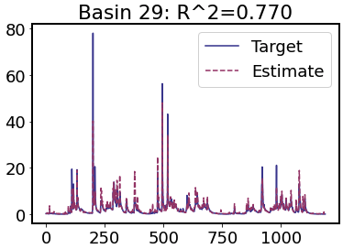
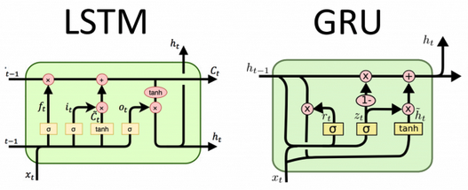
Project A: Implementation
Approach:
Added a Gated Recurrent Unit (GRU) layer to the LSTM model based on work in Using LSTM GRU and Hybrid Models for Streamflow Forecasting by Muhammad et al, 2019
Developed the simple model further through parameter tuning and tested different parameters during training such as different loss functions (most training time was spent here)
Validation Example
Final r² Score: 0.74 Highest r² Score: 0.77
Team Member: Zachary Fasnacht (614)

Slide 14
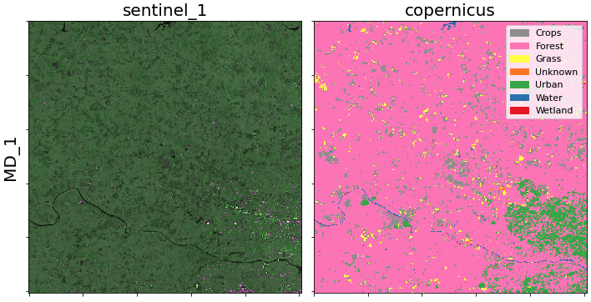

Project B: Semantic Segmentation
Goal:
Predict land cover classifications using Sentinel-1 Synthetic Aperture Radar (SAR) data and Copernicus landcover classes
Requirements/Constraints:
24 regions in Maryland and Virginia for training and validation
4 regions from North Carolina and Tennessee for final scoring
Use Convolutional Neural Networks (CNNs)
Computing power constraints
Advisor: Brandon Smith (619)

Slide 15
Project B: Challenge Details
What we started with :
Extensive custom package to read and extract patches from Sentinel-1 regions with it’s corresponding Copernicus labels
Infrastructure on Sagemaker to run a simple CNN that directly maps patches of features and labels
Evaluation methods using macro F1 scores to account for rarity of certain classes
Data
Features | Labels (Classes)
Vertical transmit, vertical receive SAR polarization Vertical transmit, horizontal receive SAR polarization | Crops Forest Grass* Unknown* Urban* Water Wetland*
*rare classes
Advisor: Brandon Smith (619)

Slide 16
Project B: Implementation
Approach:
Developed balanced datasets of given regions that had an even distribution of the land cover classes
Added an F1 loss function to help converge to a solution that accounted for rare classes
Added sentinel-1 features according to Land Cover Mapping Using Sentinel-1 SAR Data by Abdikan et al, 2016
Systematically developed and tuned a set of models and evaluated them on our validation sets
Ensembled the set of CNNs to produce a final prediction for each pixel
Developments:
Despeckling algorithm to replace outlier values with the average of its border
Undersampling for rare classes using a rare class threshold method
Final Macro F1 Score: 0.38 Highest Macro F1 Score: 0.40
Team Member: Truman Wilson (618)

Slide 17
Thoughts on Future Collaborations with the GMAO
Access to previous exercise notebooks developed by DLA advisors (through AICOE repository)
Talks from SSAI SMEs on past and current machine learning work
Ideas for DLA projects that learners can work on which can turn into resources for the GMAO

Slide 18
That’s it! Thanks! Happy Friday! ☺

Slide 19
back-up

Slide 20
ML Development Support: Infrastructure
Stuck on python environment stuff on Discover? Need some Fortran guidance when trying to use ML models with GEOS?
Contact Matt Thompson
Stuck on python stuff in general?
Contact Jules Kouatchou
Jules has an upcoming fall series for python training: https://www.nccs.nasa.gov/nccs-users/user-events/python-classes

Slide 21
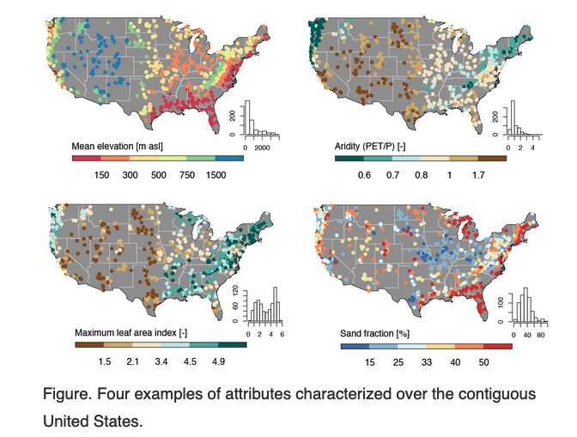
Catchment Attributes?
Attributes:
Topographic characteristics (elevation and slope)
Climatic indices (mean annual discharge and baseflow index)
Soil characteristics (porosity and soil depth)
Vegetation characteristics (leaf area index and rooting depth)
Geological characteristics (geologic class and the subsurface porosity)
https://ncar.github.io/hydrology/datasets/CAMELS_attributes

