Slide 1
CS5223 Distributed Systems
Lecture 5: Synchronization (Time and Clock)
Instructor: YU Haifeng

Slide 2
Today’s Roadmap
Chapter 6 of textbook
Physical clock synchronization
Software clocks and applications
Mutual exclusion
Leader election
Some contents (e.g., logical clocks and happened-before relation) overlap with CS4231
These concepts are critical in distributed system
So we need to cover these

Slide 3
Motivation for Physical Clocks
Example: Timestamp files
Creation time, modification time, etc.
Example: cron jobs
Virus scan
Software update
Advantage of physical clock reading: Portable and context-free
Reading in one system will make sense even in other context

Slide 4
Motivation for Physical Clock Synchronization
Electronic devices (including computers) usually advances clocks based on oscillations from some crystal
Clock rate drift: Caused by slight differences in oscillation frequency
E.g., 1 minute my time = 2 minute your time
Clock drift: Caused by clock rate drift and also lack of synchronization
E.g., your clock is 10 minute ahead of the correct time
Physical clock synchronization usually only deal with clock drift

Slide 5
Clock Synchronization Can be Confusing!
Human beings are usually used to talk about a single clock
Confusion usually arises when there are multiple clocks each may advance at its own pace
Such confusion already arises in some places in the textbook…
Need a crystal-clear formal model
T: Global accurate time (starts from time 0)
For node A:
Ta = T * (1+Xa) + Ya
clock reading on A
clock rate drift on A
initial clock drift on A
Xa
may change from time to time

Slide 6
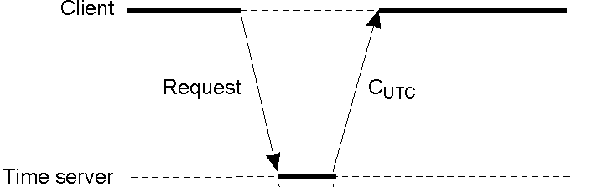
Cristian’s Algorithm
Assumptions
Propagation delay for request and reply is the same
Clock rate drift is 0
Ta1
Ta2
A
Reply
B
Tb1
Tb2
time

Slide 7
T1, T2, T3, T4 are accurate times
Ta2 – Ta1 = T4 – T1 (since clock rate drift is 0)
Tb2 – Tb1 = T3 – T2
Propagation delay d = ((T4 - T1) – (T3 - T2)) / 2
T1
T4
Ta1
Ta2
A
Reply
At time T4, B’s clock should be (Tb2 + d)
B
Tb1
Tb2
T2
T3
time

Slide 8
Key idea: (T4 – T1) is accurate even if A has clock drift
What is A’s clock rate drift is not 0?
Consider a scenario where d = 0, Tb2 - Tb1 = 1ms, Ta2 – Ta1 = 2 minutes
Thus this implicit assumption (not mentioned in textbook) is critical !
T1
T4
Ta1
Ta2
A
Reply
At time T4, B’s clock should be (Tb2 + d)
B
Tb1
Tb2
T2
T3
time

Slide 9
Network Time Protocol (NTP)
Inaccuracy in Cristian’s protocol comes from
Non-identical propagation delay for request and reply (quite common in wide-area network)
Clock rate drift not being 0 -- impact is usually small (why?)
Total propagation delay is an upper bound on the difference in propagation delays for request and response
d1+d2 = d ⇒ |d1 – d2| ≤ d
Synchronize with multiple servers and pick the one with smallest d

Slide 10
NTP Continued
Does not make sense to synchronize with a inaccurate clock
Stratum-1 servers:
Servers with UTC receiver or atimic clocks
Machines synchronize with Startum-1 servers become stratum-2
And so on…
Current worldwide NTP accuracy
1 to 50 milliseconds

Slide 11
The Berkeley Algorithm
Assumptions
Network delay = 0
Usually for cases where no machine has the “accurate time”
Idea: Hope that the clock drifts on different machines will cancel out

Slide 12
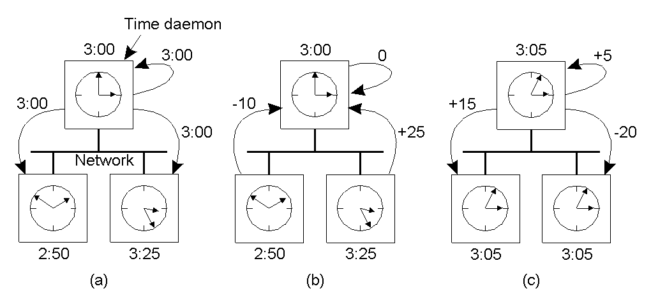
The Berkeley Algorithm: Example

Slide 13
The Berkeley Algorithm
Quite straight-forward
If you have a machine with “accurate time”
Should not take average
Just broadcast the time periodically

Slide 14
Problems with Physical Clocks
Many protocols need to impose an ordering among events
If two players open the same treasure chest “almost” at the same time, who should get the treasure?
Physical clocks:
Seems to completely solve the problem
But what about theory of relativity?
Even without theory of relativity – efficiency problems
How accurate is sufficient?
Without out-of-band communication: Minimum message propagation delay
With out-of-band communication: distance/speed of light
In other words, some time it has to be “quite” accurate

Slide 15
Software “Clocks”
Software “clocks” can incur much lower overhead than maintaining (sufficiently accurate) physical clocks
But does not allow comparison with external clocks
Allows a protocol to infer ordering among events
Goal of software “clocks”: Capture event ordering that are visible to users
Users do not have accurate physical clocks either
But what orderings are visible to users without physical clocks?

Slide 16
Assumptions
Process can perform three kinds of atomic actions/events
Local computation
Send a single message to a single process
Receive a single message from a single process
No atomic broadcast
Communication model
Point-to-point
Error-free, infinite buffer
Potentially out of order

Slide 17
Visible Ordering to Users
A → B (process order)
B → C (send-receive order)
A → C (transitivity)
A ? D
B ? D
A
B
user1 (process1)
C
user2 (process2)
user3 (process3)
D

Slide 18
“Happened-Before” Relation
“Happened-before” relation captures the ordering that is visible to users when there is no physical clock
A partial order among events
Process-order, send-receive order, transitivity
First introduced by Lamport – Considered to be the first fundamental result in distributed computing
Goal of software “clock” is to capture the above “happened-before” relation

Slide 19
Software “Clock” 1: Logical Clocks
Each event has a single integer as its logical clock value
Each process has a local counter C
Increment C at each “local computation” and “send” event
When sending a message, logical clock value V is attached to the message. At each “receive” event, C = max(C, V) + 1
3 = max(1,2)+1
4 = max(3,3)+1
1
2
3
4
user1 (process1)
1
3
4
5
6
user2 (process2)
1
2
6
user3 (process3)

Slide 20
Logical Clock Properties
Theorem:
Event s happens before t ⇒ the logical clock value of s is smaller than the logical clock value of t.
The reverse may not be true
1
2
3
4
user1 (process1)
1
3
4
5
6
user2 (process2)
1
2
6
user3 (process3)

Slide 21
Example Application for Logical Clock
Total-ordered broadcast protocol is the “standard” example application for logical clock (as in textbook)
But it is complex and will take half a lecture to go through
(The protocol is covered in CS4231…)
We will use a much simpler application example

Slide 22
Cary
Email 1:
I proved P=NP and here is my proof
Email 2:
I proved P = NP here is my proof
Malice
We want to decide who to give Turing award to
Both Cary and Malice try to claim credit
Malice says Cary copies her proof
Cary says Malice copies her proof

Slide 23
Software “Clock” 2: Vector Clocks
Logical clock:
Event s happens before event t ⇒ the logical clock value of s is smaller than the logical clock value of t.
Vector clock:
Event s happens before event t ⇔ the vector clock value of s is “smaller” than the vector clock value of t.
Each event has a vector of n integers as its vector clock value
v1 = v2 if all n fields same
v1 ≤ v2 if every field in v1 is less than or equal to the corresponding field in v2
v1 < v2 if v1 ≤ v2 and v1 ≠ v2
Relation “<“ here is not a total order

Slide 24
Vector Clock Protocol
Each process i has a local vector C
Increment C[i] at each “local computation” and “send” event
When sending a message, vector clock value V is attached to the message. At each “receive” event, C = pairwise-max(C, V); C[i]++;
C = (0,1,0), V = (0,0,2)
pairwise-max(C, V) = (0,1,2)
(1,0,0)
(2,0,0)
(3,0,0)
user1 (process1)
(0,1,0)
(0,2,2)
(2,3,2)
(2,4,2)
user2 (process2)
(0,0,1)
(0,0,2)
(2,4,3)
user3 (process3)

Slide 25
Vector Clock Properties
Event s happens before t ⇒ vector clock value of s < vector clock value of t: There must be a chain from s to t
Event s happens before t ⇐ vector clock value of s < vector clock value of t
If s and t on same process, done
If s is on p and t is on q, let VS be s’s vector clock and VT be t’s
VS < VT ⇒ VS[p] ≤ VT[p] ⇒ Must be a sequence of message from p to q after s and before t
s
p
t
q

Slide 26
Example Application of Vector Clock
Each Bitcoin node has some blocks (assume that Bitcoin runs on a fixed set of nodes)
Want all nodes to know all blocks
Each block has a vector clock value
I have seen all blocks whose vector clock is smaller than (2,3,2):
I can avoid linear search for existence testing
B1, (1,0,0)
(2,0,0)
(3,0,0)
user1 (process1)
B2, (0,1,0)
(0,2,2)
B1
(2,3,2)
user2 (process2)
B3
B3, (0,0,1)
(0,0,2)
user3 (process3)

Slide 27
Mutual Exclusion: Token-based Approach
Motivation is the same as in non-distributed systems
Token-based approached
A single token system-wide
Whoever holds the token has the privilege
Typical software architecture
A special node acts as “lock manager” or “token manager”

Slide 28
Process 1 requests
0
1
2
request
ok
C
queue
lock manager

Slide 29
Process 2 requests lock while process 1 is holding the lock
0
1
2
request
No reply
2
C
queue
lock manager

Slide 30
Mutual Exclusion: Token-based Approach
Also possible to implement it as a token ring
Pros:
Simplicity – lock manager approach is widely used
Fairness easy to ensure
No starvation
Cons:
Cannot deal with failures nicely

Slide 31
Mutual Exclusion: Token-based Approach
Dealing with client failures
Use leases – the lock is granted for only a finite amount of time
Automatically revoked after time out
Problem: A client is writing to a large file but cannot renew the lease due to lost network connection
Dealing with server (lock manager) failures
Need to start a new server
Need to ensure the number of token is exactly 1

Slide 32
Mutual Exclusion: Voting
We want to deal with server crashes
Have n servers instead of 1
Each server has a vote
A server may crash and recover
Assume clients do not crash
We can always use lease to deal with client crashes
To acquire a lock,a client needs to get (n/2+1) votes
Servers get the votes back after the client releases the clock
Called majority voting

Slide 33
Mutual Exclusion: Voting
Theorem:
No two clients can hold the lock at the same time with majority voting (even if some server crashes)
Can tolerate at most n/2-1 server failures
Usually quantified as availability
Disadvantage:
Need n servers instead of one
Need to contact n/2+1 servers to get lock

Slide 34
Mutual Exclusion: Voting
Majority voting is extremely flexible
How about assigning different number of votes to different servers?
A (5 votes), B(2 vote), C(2 vote), D(2 vote)
What is the impact on availability and performance?
What is the best vote assignment mechanism?
Machines fail iid with probability of p
Theorem: Democracy is the best and monarchy is the worst when p < 0.5
Theorem: Democracy is the worst and monarchy is the best when p > 0.5

Slide 35
Mutual Exclusion: Quorum Systems
A (5 votes), B(2 vote), C(2 vote), D(2 vote) =
{ {A, B}, {A, C}, {A, D},
{A, B, C}, {A, B, D}, {A, C, D}, {B, C, D},
{A, B, C, D} }
A voting system can always be expressed as a quorum system
The reverse is not true
But it happens that the best quorum systems corresponds to majority voting (under the earlier failure model)

Slide 36
History Readings (Non-compulsory)
“The reliability of voting mechanisms”, IEEE Transactions on Computers, pages 1197-1208, Oct 1987.
“How to assign votes in a distributed system”, Journal of ACM, October 1985.

Slide 37
Leader Election: Motivation
We often need a coordinator in distributed systems
Leader, distinguished node/process
We will only discuss leader election algorithms for failure-free contexts
Fault-tolerant leader election algorithms are related to fault-tolerance and will be covered later in the course

Slide 38
Leader Election on General Graph (n known)
Complete graph
Each node send its id to all other nodes
Wait until you receive n ids
Biggest id wins
Any connected graph
Flood your id to all other nodes (how?)
Wait until you receive n ids
Biggest id wins

Slide 39
Leader Election on General Graph (n unknown)
Complete graph
n must be known
Any connected graph
An auxiliary protocol to calculate the number of nodes
The protocol is initiated by any node who wants to know n
The protocol actually establishes a spanning tree starting from the initiator

Slide 40
Spanning Tree Construction
Remember: No centralized coordinator
Goal of the protocol: Each node knows its parent and children (i.e., a distributed tree)
The root is initially marked
Every marked node send “mark” msg to all its neighbors
Upon receiving the first “mark” msg, an unmarked node becomes marked, and sends back “I am your child” msg
For later “mark” msgs, send back “I am not your child” msg
Tree construction completed if every node has received all replies from all its neighbours

Slide 41
Counting Nodes Using a Spanning Tree
Disseminate “start count” msg down the tree
Count will be aggregated up the tree

Slide 42
Summary
Physical clock synchronization
Software clocks and applications
Mutual exclusion
Leader election

