Slide 1
CS5223 Distributed Systems
Lecture 6: Replication and Consistency
Instructor: YU Haifeng

Slide 2
Roadmap
Chapter 7 of textbook
Consistency model – specifies what is consistent and what is not
Consistency protocols – implements a certain consistency model
May use different protocols to implement the same model
Replica placement
Consistency is a large topic, we need 2 lectures and still will only have time to cover the major issues and not every detail in depth

Slide 3
Motivation for Data Replication
Replication can be used for data or functionality
Data replication is more prevalent
Reliability (durability)
Backup your data
Availability
Being available to clients all the time
Performance
Share the load
Being closer to clients using the data

Slide 4
Disadvantage of Data Replication: Consistency Maintenance
Data, by definition, allow reads and writes
Reads and writes are very different for replicated data
If data only allow reads, then it is readonly
Caching: A restricted form of replication
Usually refers to partial replication of readonly or rarely-updated data
But different people use the term differently in different context – important to know what exactly it refers to
Consistency: If one copy is updated, then other copies need to be “in synch” with the update
By definition, readonly data do not have consistency issue

Slide 5
Complications of Consistency Maintenance
Design complexity
Complexity is always bad
Reduction on reliability / availability / performance gains
Reads on readonly data always enjoy these gains
Writes may or may not enjoy these gains
Reads on read/write data may not enjoy these gains
Readonly data almost always benefit from replication
Only cost is design complexity and storage space

Slide 6
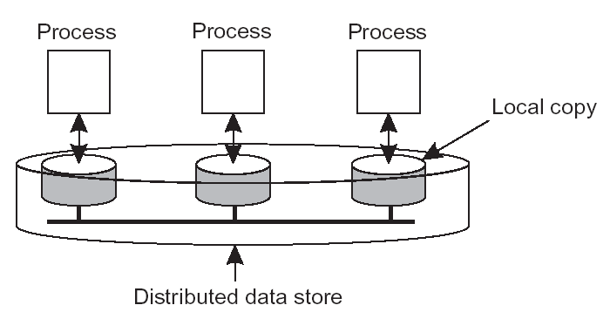
Model for Replicated Data
Read operation: A single or multiple reads
Similar as a readonly transaction
Write operating: A single or multiple reads/writes
Contains at least write
May contain read
Similar as an update transaction

Slide 7
What Is Consistency?
Consistency – a term with thousand definitions
Definition in this course:
Consistency model specifies what behavior is allowed when shared data are accesses by multiple node
When we say something is “consistent”, we mean it satisfies the specification (according to some given spec)
Specification:
No right or wrong – anything can be a specification
But to be useful, must:
Be sufficiently strong – otherwise the shared object cannot be used in a program
Can be implemented (efficiently) – otherwise remains a theory
Often a trade-off

Slide 8
The Consistency Spectrum
strong
easy-to-use
low performance
low availability
weak
hard-to-use
high performance
high availability
continuous consistency
linearizability
no consistency
serializability
eventual consistency
Note:
Huge number of consistency models have been defined by people
Not all consistency models are comparable
Continuous consistency does not capture all consistency models

Slide 9
Sequential Consistency
Perhaps the most widely used consistency model
Multiprocessors usually guarantees sequential consistency
First defined by Lamport
“…the results … is the same as if the operations of all the processors were executed in some sequential order, and the operations of each individual processor appear in this sequence in the order specified by the program”
Use sequential order as a comparison point
Focus on results only – that is what users care about
Require that program order is preserved
One-copy serializability in database context

Slide 10
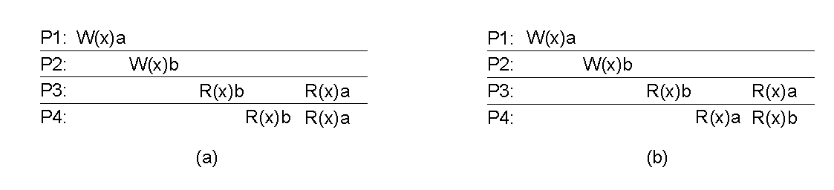
Examples
(a) = P2-W(x)b P3-R(x)b P4-R(x)b P1-W(x)a P3-R(x)a P4-R(x)a
OK for P2-W(x)b be ordered before P1-W(x)a according to the definition of sequential consistency – your program must accept such possibility

Slide 11
Examples
(b) = P2-W(x)b P3-R(x)b P4-R(x)b P1-W(x)a P3-R(x)a P4-R(x)a
P4-R(x)a cannot appear after P4-R(x)b
But still don’t know if it is sequentially consistent – why?
Enumerate all 6! orderings

Slide 12
Linearizability – A Stronger Model
The strongest consistency model define ever
Also called one-copy serializability + external consistency
Sequential consistency allows reading stale data – sometimes undesirable
Example?
Linearizability captures real-time
An operation O2 that occurs after O1 in real-time must be ordered after O1
Linearizability necessarily implies sequential consistency

Slide 13
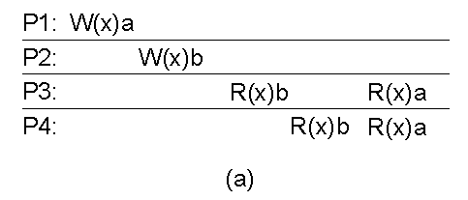
Examples
(a) = P2-W(x)b P3-R(x)b P4-R(x)b P1-W(x)a P3-W(x)a P3-R(x)a P4-R(x)a
Not OK for P2-W(x)b be ordered before P1-W(x)a
But still don’t know if it is linearizable – why?
Enumerate all 6! orderings

Slide 14
Linearizability – More precise
An operation O2 that occurs after O1 in real-time must be ordered after O1
What do we mean by “occurs after O1 in real-time”?
Each operation takes non-zero time to execute
O1
O1
O2
O2
O1
O1
O2
O2

Slide 15
Eventual Consistency
Eventual consistency (optimistic consistency)
No guarantee on the values observed by reads and writes
But if we stop doing updates to the data, all replicas will eventually be the same (i.e., converge)
The state of the replica depends on the sequence of write operations
Very weak guarantee but still sufficient in many cases
DNS replication/caching
Web page replication/caching
Allows extremely good performance/availability

Slide 16
Motivation for Continuous Consistency
In many applications, we want something in the middle
Don’t want to design a new consistency model for every application
Don’t want to implement a new consistency model for every application
Sometimes consistency needs may change on-the-fly – example?
Continuous consistency
Capture the consistency spectrum using a single consistency model and consistency protocol
Allow adjustment of consistency “strength” dynamically
Many continuous consistency models have been proposed
We will focus on the model developed in TACT (as described in the textbook)

Slide 17
System Model for Continuous Consistency in TACT
Data store fully replicated
Each replica may accept reads operations or write operations
Writes are re-executed at each replica
Writes may be undo or redo
Replica convergence achieved by propagating writes – eventual consistency always ensured
Internet
Updates / Writes
Application
Application
TACT
TACT
Application
Data Store
Data Store
TACT
Client Accesses:
Reads / Writes
Data Store

Slide 18
Intuition for Defining Continuous Consistency
Observed result: The result returned to client
Ideal result: The ideal result perfect consistency were maintained
Continuous consistency should quantify the “distance” between observed result and ideal result
Since eventual consistency is always ensured, we can conceptually define a “final image” – performing the operation against the final image would give us the “ideal result”
There can be multiple possible final images – all of them are good – but one and only one will be picked as reference
The system does not know the final image

Slide 19
Quantifying Consistency
Three consistency metrics:
With respect to some final image – the reference image
Numerical Error: How many writes are missing?
Order Error: How many writes are out of order? (According to serialization order in the reference image)
Temporal Error: How stale (in real-time)?
Largely orthogonal but not entire orthogonal
Consistency specified as bounds on the three metrics

Slide 20
Consistency Metric Example
Replica A
Replica B
W3 (accepted by A)
W1 (accepted by B)
W2 (accepted by B)
W3 (accepted by A)
(Absolute) Numerical Error = 2
(from W1 and W2)
(Relative) Numerical Error = 2/3
(from W1 and W2)
Order Error = 1
(from W3)
Temporal Error = currenttime -
accepttime of W1
(Absolute) Numerical Error = 0
(Relative) Numerical Error = 0
Order Error = 0
Temporal Error = 0
Assuming reference image is W1W2W3

Slide 21
Numerical Weight
Replica A
Replica B
W3: X += 5
W1: X += 7
W2: X += 10
W3: X += 5
(Absolute) Numerical Error = 17
(from W1 and W2)
(Relative) Numerical Error = 17/22
(from W1 and W2)
(Absolute) Numerical Error = 0
(Relative) Numerical Error = 0
Weight can be subjective
Weight not restricted to numerical data

Slide 22
Extremes of the Continuous Consistency Model
If none of NE, OE, TE are bounded:
Eventual consistency
If NE = 0, OE = 0, TE =0:
Linearizability
By tuning NE, OE and TE, applications obtain fined-grained consistency levels and corresponding performance / availability

Slide 23
Consistency Protocols
Linearizability / Sequential consistency
Eventual consistency
Continuous consistency

Slide 24
Linearizability/Sequential Consistency: Primary-based Protocol
1 primary replica, n-1 backup replicas
For now assume the primary replica is on some fixed node
For now assume the backup replicas are fixed as well
Reads are process locally by each replica (primary or backup)
All writes are forwarded to the primary (potentially via some backup replica)
Backup replicas never process writes directly

Slide 25
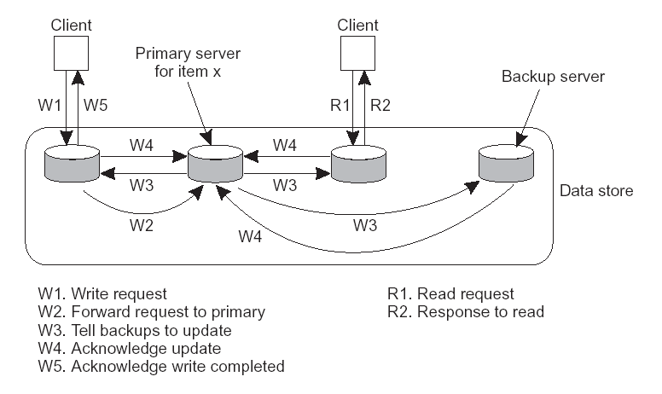
W5
This example from the textbook only ensures serializability (why?)
The red W5 will give us linearizability

Slide 26
Generalization of Primary-based Protocol
Dynamically create/destroy backup replicas
Create a new backup on a client’s machine if the client accesses the data frequent enough
The primary replica needs to maintain a directory (i.e., which are the backup replicas)
Destroy a backup replica if it is not used for long (why?)
Dynamically change a backup replica to a primary replica (and the old primary becomes backup)
Why do we want to do this?
Need a handshake with the old primary

Slide 27
Generalization of Primary-based Protocol
Invalidating backup replicas instead of updating them
At every write, the primary can invalidate the backup replicas
An invalidated backup replica needs to get the up-to-date data from the primary before it can processing reads
Typically invalidation is not on the entire data store, but rather on much smaller granularity (e.g., individual objects)

Slide 28
Application of Primary-based Protocol: Software Distributed Shared Memory
Software DSM is a middleware that provides a “shared-memory” abstraction for distributed applications running on a cluster
Hardware DSM usually refers to multiprocessor systems with distributed shared memory
Motivation for software DSM:
Clusters are cheaper than multiprocessor systems and have more computation power
A lot of old scientific computing programs has been developed for shared-memory multiprocessors
They all use shared memory instead of message passing
Nobody really understand these programs – the cost of updating them is too large
Software DSM allows clusters to run them without modification

Slide 29
Discussion on Primary-based Protocols
Very simple – good
Used widely
Performance is typically the focus
Improves read performance but hurts write performance
Many workloads (e.g., file systems) are dominated by reads
Do not use primary-based protocol if your workload is mostly writes!
More replicas ⇒ Better read performance and worse write performance
Availability
Good read availability
Poor write availability

Slide 30
Dealing with Failures in Primary-based Protocol
Primary-based protocol typically cannot deal with any failures
If any replica fails, writes cannot be done – a serious problem (worse than having poor write performance)
Extremely difficult to deal with primary replica failure
So we will assume below that the primary does not fail
If a backup replica fails – we can simply ignore it (i.e., not pushing writes to or waiting for ack from it)
Challenge: Cannot tell if it indeed fails or it is just slow or network partition
What if we mistakenly treat a partitioned backup replica as failed?

Slide 31
Dealing with Failures in Primary-based Protocol
Leases: A very simple and useful technique
Limited support to deal with backup replica failure / network partition
Assumes that clocks rate drifts are bounded
Primary periodically gives each backup replica a lease
“I will always consider you as a backup for 10 minutes from now.” – 10 minutes is the lease duration
Lease is renewed before expiration (either the primary can automatically issues a new lease or the backup may request one)
A backup replica “kills itself” if it does not have a valid lease
More precisely – “do not process any reads”
A primary can continue if it cannot reach a backup sufficient long
E.g., 15 minutes

Slide 32
Linearizability/Sequential Consistency: Replicated State Machine Protocol
Motivations:
Want to deal with primary failures – remember that availability is one of the motivation for replication
Replicated state machine:
All replicas are primary
Each replica is considered as a deterministic state machine
Each read/write operation consider as an “instruction”
All state machines needs to execute the same instructions in the same order
Each read/write operation is broadcast to all replicas
All replicas have the same instructions

Slide 33
Linearizability/Sequential Consistency: Replicated State Machine Protocol
Need to have an agreed ordering of all the instructions
Can be any order, but all replicas must use the same order
How?
The key issue in replicated state machine – needs fancy protocols to do so (in a fault-tolerant way)
In primary-based protocol, the order is chosen by the unique primary replica
The primary replica is a “serialization point” or “sequencer”
Replicated state machine with n replicas can usually tolerate n/2 replica failures
Availability!

Slide 34
Linearizability/Sequential Consistency: More Advanced Protocol
Primary-based protocol
Good performance, bad availability
Replicated state machine
Bad performance, good availability
More advance protocol
Have a single primary, but can regenerate the primary if it fails
Allow new nodes to dynamically join the replica group

Slide 35
History Readings (Non-compulsory)
“Implementing fault-tolerant services using the state machine approach: a tutorial”, ACM Computing Surveys, Volume 22 , Issue 4 (December 1990).

Slide 36
Eventual Consistency: The Anti-entropy Protocol
System model:
Data store fully replicated
Each replica may accept reads operations or write operations
Writes are re-executed at each replica
Writes may be undo or redo
Each replica has a write log – log of all writes applied
Writes are gossiped from replica to replica
Goal: Eventual consistency
All replicas see all writes – already ensured by gossiping
All replicas apply them in the same order (the serialization order) – this is the key

Slide 37
Generating a Total Order Among Writes
If no restriction on the serialization order
Trivial (how?)
Sometime the serialization order needs to preserve happened-before relation among writes
W1 creates a file and W2 deletes the file, then W1 should be ordered before W2 (what if we swap them?)
Order writes according to logical clocks

Slide 38
Example
Before Gossiping
After Gossiping
Replica A’s write log
Replica B’s write log
Replica A’s write log
Replica B’s write log
(A, 2)
(B, 3)
(A, 2)
(A, 2)
(A, 8)
(B, 4)
(B, 3)
(B, 3)
(B, 6)
(B, 4)
(B, 4)
(B, 6)
(B, 6)
(A, 8)
(A, 8)
writes ordered by logical clock values
What if logical clock values tie?

Slide 39
Committed vs. Tentative Writes
With eventual consistency, sometimes a user wants to know whether the effect of a write has been finalized
Example: Imagine that writes are bookings to airline tickets
Committed write: Its position in the write log will never change again
Its effect is guaranteed – if the write returns OK, you will get the ticket
Tentative write: Its final position is still to be determined
Its effect may change

Slide 40
Example
Before Gossiping
After Gossiping
Replica A’s write log
Replica B’s write log
Replica A’s write log
Replica B’s write log
(A, 2)
(B, 3)
(A, 2)
(A, 2)
(A, 8)
(B, 4)
(B, 3)
(B, 3)
(B, 6)
(B, 4)
(B, 4)
(B, 6)
(B, 6)
committed
(A, 8)
(A, 8)
tentative
writes ordered by logical clock values

Slide 41
Detecting “Holes” in Serialization Order
Determining whether a write is committed or tentative is surprisingly hard
How can Replica A be sure that (A,2) is a committed write?
Replica A’s write log
Replica B’s write log
Replica A’s write log
Replica B’s write log
(A, 2)
(B, 3)
(A, 2)
(A, 2)
(A, 8)
(B, 4)
(B, 3)
(B, 3)
(B, 6)
(B, 4)
(B, 4)
(B, 6)
(B, 6)
(A, 8)
(A, 8)

Slide 42
Use a Sequencer to Detect “Holes”
Use a distinguished/primary replica as serialization point or sequencer
Assign consecutive integers as “commit number” for writes
“commit number” = position in the final serialization order
(A, 2, 1)
A is the accepting replica
2 is the logical clock value
1 is the commit number

Slide 43
A
B
C (primary)
(A, 2, -)
(B, 3, -)
(A, 7, -)
(B, 4, -)
(B, 6, -)
A
B
C (primary)
(A, 2, 1)
(B, 3, -)
(A, 2, 1)
(A, 7, 2)
(B, 4, -)
(A, 7, 2)
(B, 6, -)
A
B
C (primary)
(A, 2, 1)
(A, 2, 1)
(A, 2, 1)
(A, 7, 2)
(A, 7, 2)
(A, 7, 2)
(B, 3, 3)
(B, 3, 3)
(B, 4, 4)
(B, 4, 4)
(B, 6, 5)
(B, 6, 5)

Slide 44
History Readings (Non-compulsory)
“Flexible Update Propagation for Weakly Consistent Replication” by K. Petersen, M. J. Spreitzer, D. B. Terry, M. M. Theimer, and A. J. Demers. In Proceedings of the 16th ACM Symposium on Operating Systems Principles, October 5-8, 1997.

Slide 45
Consistency Protocols for Continuous Consistency
Order error = # tentative writes
Any protocol for reducing number of tentative writes can be used for reducing order error
We discusses a protocol already…

Slide 46
Consistency Protocols for Continuous Consistency
Temporal error = staleness of the data
Idea:
Real-time vector clock – similar as vector clock
Assume loosely synchronized clocks
(8912,0,0)
(8938,0,0)
(0,8912,0)
(0,8935,8920)
(8938,8991,8920)
(8938,8960,8920)
(0,0,8912)
(0,0,8920)
(8938,8991,8999)
I have seen everything before real-time 8938 ⇒
staleness = current_time – 8938

Slide 47
Numerical Error Bounding Intuition
Application
TACT
Local View
Max Error
Data Store
Application
Application
Application
Application
TACT
TACT
TACT
TACT
Data Store
Data Store
Data Store
Data Store
Unseen updates
Unseen updates
Unseen updates
Unseen updates

Slide 48
Numerical Error Bounding Intuition
Application
TACT
Local View
Max Error
Data Store
Incoming updates…
Application
Application
Application
Application
TACT
TACT
TACT
TACT
Data Store
Data Store
Data Store
Data Store
Unseen updates
Unseen updates
Unseen updates
Unseen updates

Slide 49
Numerical Error Bounding Intuition
Application
TACT
Local View
Max Error
Data Store
Local bound Exceeded…
Application
Application
Application
Application
TACT
TACT
TACT
TACT
Data Store
Data Store
Data Store
Data Store
Unseen updates
Unseen updates
Unseen updates
Unseen updates

Slide 50
Numerical Error Bounding Intuition
Application
TACT
Local View
Max Error
Data Store
Push updates
Application
Application
Application
Application
TACT
TACT
TACT
TACT
Data Store
Data Store
Data Store
Data Store
Unseen updates
Unseen updates
Unseen updates
Unseen updates

Slide 51
Replica Placement
How many replicas do we use?
Each replica comes with a cost
Does the benefit justify the cots?
Where should each replica be?
Always want to be close to clients
But clients are distributed ⇒ Being close to one necessarily means being far away from the other

Slide 52
Replica Placement
Huge number of replica placement algorithms for readonly data
Web proxy caching being an example target application
Replica placement is often NP-hard
Most solutions are ad hoc and require global knowledge
In practice, only simple heuristics are used
Replica placement for read/write data is much harder than for readonly data
Only small number of algorithms for such data
Still NP-hard and solutions are ad hoc

Slide 53
Summary
Consistency model – specifies what is consistent and what is not
Consistency protocols – implements a certain consistency model
May use different protocols to implement the same model
Replica placement

