Slide 1
CS5223 Distributed Systems
Lecture 8: P2P
Instructor: YU Haifeng

Slide 2
Roadmap
Chapter 2 and Chapter 5 of textbook
Peer-to-peer systems

Slide 3
Peer-to-peer Systems Overview
First wave of research: Around 2000--2010
File sharing
Gnutella, Napster, Bittorrent
Some file sharing is illegal (i.e., copyright violation)
Example legitimate usage scenarios: Game companies often use Bittorrent to disseminate updates for games (e.g., world of warcraft)
Second wave of research: Past few years
Permissionless blockchains and cryptocurrencies
Bitcoin, Ethereum

Slide 4
What are p2p systems?
No strict definition – but usually refers to systems where users contribute by serving other users
Traditionally most distributed systems have the client-server paradigm
Web servers, DNS servers, game servers, file servers
Advantage of client-server paradigm
Easier to build – lower complexity
Security easier to ensure

Slide 5
Motivation for p2p Systems
File sharing
Large files to be shared among many users (e.g., software update)
Client-server paradigm requires
Powerful/dedicated servers – nobody wants to pay for that
Need to buy more servers if more clients come
High-bandwidth internet connection – nobody wants to pay that
P2p system
Clients will help share the file with other clients
Small number of servers or no server at all
System scales automatically!
No single point of failure

Slide 6
Motivation for p2p Systems
Permissionless blockchains and cryptocurrencies
Want to maintain a shared, public, trusted distributed ledger
Client-server paradigm
Users need to trust that the server is not malicious
Users need to trust that the system admin is not bribed
Users need to trust that the service won’t be compromised
Users need to trust …
P2p system gives decentralization
Users need to trust that the majority of the nodes are not malicious
…

Slide 7
Motivation for P2p Systems
Many other applications can benefit from p2p paradigm
Application-level multicast is already p2p
p2p games
p2p naming service (in place of DNS)
p2p search engine
We will mainly use p2p file sharing as a simple example in this module to illustrate p2p designs
Blockchains and cryptocurrencies are more complex, and are covered in other modules

Slide 8
A Deeper Look at P2p File Sharing
Similar as a file system
Some number of files
Some number of peer nodes
A file can be stored on some peer nodes
To retrieve a file
Find the peer storing the file
Contact that peer and retrieve the file
Finding that peer is the key

Slide 9
Unstructured P2p File Sharing: Design 1
Use a central directory server
Directory server knows all peers and all files (but don’t store the files)
File insertion:
Contact the server to get a random subset of the peers
Send files to those peers
Tell the server the file is on those peers
File lookup:
Contact the server to get the list of peers having the file
Pros: Simplicity
Cons: Server can still be overloaded – a half-way solution

Slide 10
Unstructured P2p File Sharing: Design 2
Use super-peers
Promote high-capacity peers into “directory servers”
All super-peers know each other
Normal peer knows one (or a few) super peers
Still have a server to maintain the membership of super-peers

Slide 11
Unstructured P2p File Sharing: Design 2
File insertion:
Contact the local super-peer to get a random subset of the peers
Send files to those peers
Tell the local super-peer the file is on those peers
File lookup:
Contact the local super-peer to get the list of peers having the file
The local-super will ask other super-peers if it does not have the file in its directory
But:
Super-peers can still be overloaded – a half-way solution
What if a super-peer crashes?

Slide 12
Unstructured P2p File Sharing: Design 3
Use flooding in the flat p2p topology
Each peer knows a few other peers
May need a server to enable this by maintaining a list of all peers
But the server does not need to handle lookups – peer joins/leaves much less frequent than lookups!
File insertion:
Store the file locally and then perhaps send it to a few neighbors
File lookup:
Flood (with a TTL) your request in the topology
Usually the retrieved file is kept locally as a replica even after use

Slide 13
Unstructured P2p File Sharing: Design 3
Pros:
Simplicity
No directory servers / super-peers overloaded by lookups
Cons:
Flooding is very inefficient
Difficult to find rare files

Slide 14
Unstructured P2p File Sharing: Design 4
Use random walks in the flat p2p topology
Each peer knows a few other peers
File insertion:
Store the file locally and then perhaps send it to a few neighbors
File lookup:
Do random walks in the topology
Many heuristics have been proposed
More efficient than flooding
Overhead is still large
Still difficult to find rare files

Slide 15
DHT: Structured P2p File Sharing
Distributed hash table (DHT) API
Hash the name (not content!) of each file object to get a id
put(id, object)
object = get(id)
Good performance guarantees:
Can always retrieve the object (under static condition)
The messgae and time complexity is O(log(n))
Good load balancing properties
Many DHTs have been proposed
We will discuss Chord from MIT

Slide 16
The Chord Ring
Each object has a 160-bit id (hash of its name)
Each node has a 160-bit id (hash of its IP address)
Each object has a root node – the node with the smallest id among all nodes with ids larger than the object’s id
4
23
121
25
hash(“myfile.doc”) = 57
97
61
root node for “myfile.doc”

Slide 17
Consistent Hashing
An object is always stored on its root node
Both object creation and lookup will get to that node
If we throw k balls into n bins (k > n), the average load of each bin is k/n
Balls-into-bins Theorem:
With high probability, the most load bin has O(k/n * log(n)) balls
On the chord ring with n nodes, if we insert k objects, the average load of each node is k/n
Consistent hashing theorem:
With high probability, the most loaded node has O(k/n * log(n)) objects
Theoretical foundation for load balancing in Chord

Slide 18
Lookup (Routing) on the Chord Ring
For now, assume every id has a node
Want to find the root node for “myfile.doc”
Find the node with id 57
Sufficient for each node with id i to know the IP address of the node with id (i+1)
Just follow the ring!
Problem: Need O(n) message/time complexity
4
5
6
hash(“myfile.doc”) = 57
57

Slide 19
Lookup (Routing) on the Chord Ring
Assume every id has a node
Assume the ring size is 16
Maintain long-haul pointers
Called routing tables or finger tables
Across 1/2 of the ring:
4+8 = 12
Across 1/4 of the ring:
4+4 = 8
Across 1/8 of the ring:
2+4 = 6
Across 1/16 of the ring:
1+4 = 5
4
5(=1+4)
6(=2+4)
8(=4+4)
12(=4+8)

Slide 20
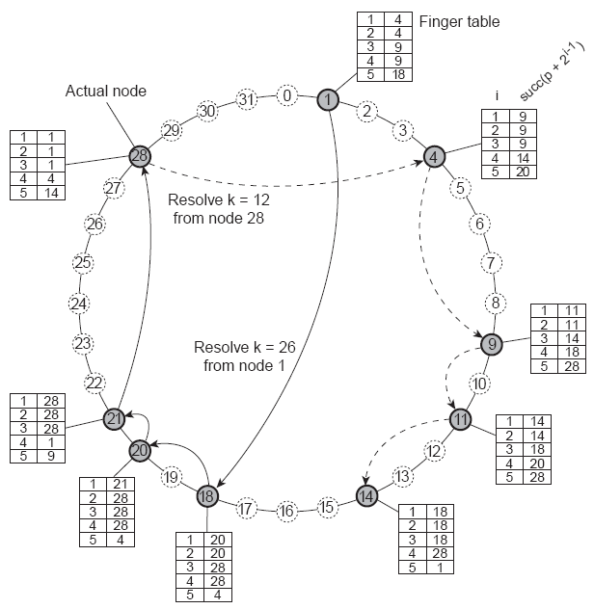

Slide 21
Optimizations
Successor tables
Pointers to k successors (clockwise) along the ring
Serves to make lookups more robust
Using only successor tables is already sufficient for robust (but inefficient) lookup
Replication
Each object make be replicated at r successors of the its root
Background regenerating technique to create new replicas if nodes leave/fail

Slide 22
Node Join/Leaves
Also called node churn
Need to move objects around and also need to keep replication degree
Need to ensure the finger tables and successor tables are still correct
Done by a background stabilization process
Intuitively, under excessive churn, the tables will have incorrect contents
How much churn is excessive? A complex analysis…

Slide 23
History Readings (Non-compulsory)
Ion Stoica, Robert Morris, David Karger, M. Frans Kaashoek, and Hari Balakrishnan, Chord: A Scalable Peer-to-peer Lookup Service for Internet Applications, ACM SIGCOMM 2001, San Deigo, CA, August 2001, pp. 149-160.
David Liben-Nowell, Hari Balakrishnan, and David Karger, Analysis of the Evolution of Peer-to-Peer Systems. ACM Conf. on Principles of Distributed Computing (PODC), Monterey, CA, July 2002.

Slide 24
Summary
Peer-to-peer systems

