Slide 1

Ames Housing Data
Katherine schumann

Slide 2
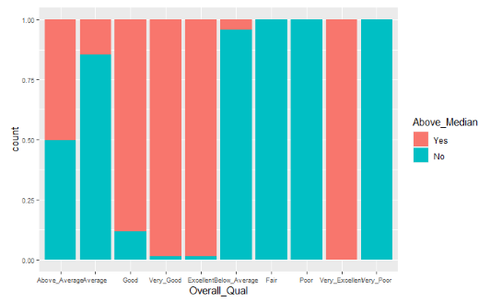
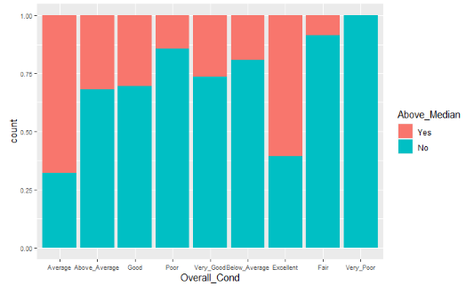
Condition
Overall quality
Overall condition
Both variables show a high likelihood of above median price if the house was in excellent condition to above average and decreasing above median as it gets to very poor.

Slide 3
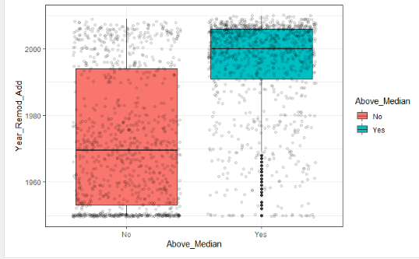
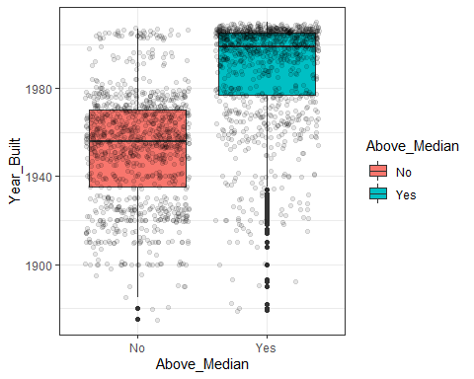
Newer Houses vs. Older Houses
Year remodel occurred
Year Built
Both variables show a high likelihood of above median price if the house was built after the 1980s or if the remodel occurred after the 2000s.

Slide 4
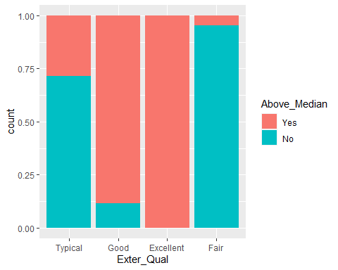
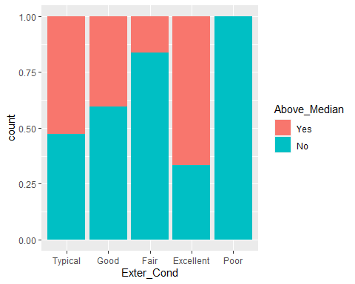
Exterior Features
Exterior quality
Exterior Condition
Both variables show a high likelihood of above median price if the exterior is in excellent condition and it decreases over the different conditions.

Slide 5
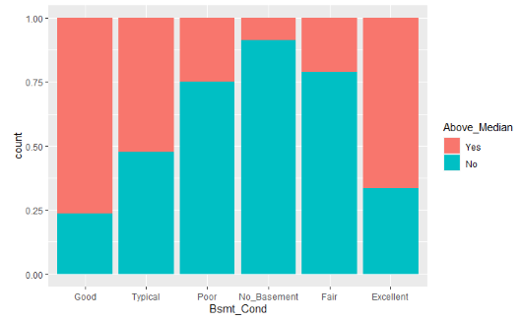
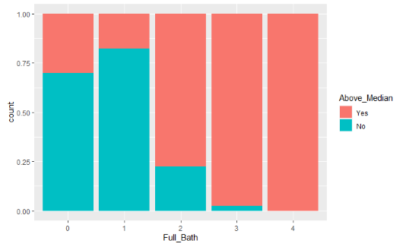
Additional Features
Basement condition
Full Bath
Both variables show a high likelihood of above median price if the if the number goes up than the above median price is more likely.

Slide 6
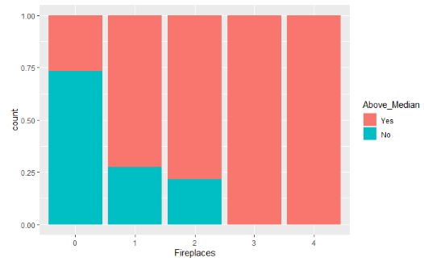
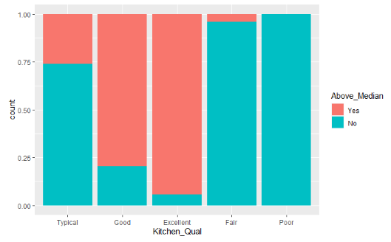
Additional Features
fireplaces
Kitchen quality
The fireplaces were surprisingly an accurate indicator of above median prices, as was the kitchen quality.

Slide 7
Conclusion
There are some very good indicators that are present in the data set, as depicted in the previous slides.
There is also a lot of data in the data set that are not good predictors.
Fireplaces and kitchen quality demonstrate a high importance to predicting the variable Above Median.
Thank you for your time!

