Slide 1








Movie Database General Assembly Final Project
Kate Benjamin

Slide 2
Goals for Final Project
I am addressing a data-related project in my field of work.
My data is from Box Office Mojo (http://www.boxofficemojo.com/)
My datasets include “Average Gross Per Theatre from 1980-2014” “ Average Ticket Price from 1980-2014,” “Movie Release by Season from 1980-2014,” “Studio Makeup by Year from 1980-2014,” and my largest and most valuable one, “Yearly Movie Gross from 1980-2014.”
My dataset “Yearly Movie Gross from 1980-2014” includes 13,113 movie title releases from 1980-2014. I ranked them by year and total gross. Included in the data is studio, total gross, opening week gross, opening day and gross per theatre. I created a new feature “2014 dollars.” This is the amount the movie would have made if it were released in 2014.
Using linear regression, I will predict the total gross of movies from 2000 to 2014 using opening week performance and the number of theatres it played in. I will then add in the studio name and year as new features to see if my prediction score becomes more accurate.
This summer, my team and I plan to update this dataset to include movies from 2015.

Slide 3
American Sniper was the highest grossing movie of 2014.
Rank | Studio | Movie Title | Total Gross | Opening | Theatres | Gross Per Theater
1 | WB | American Sniper | $337,209,000 | $633,456 | 3,885 | $86,798
2 | LGF | The Hunger Games: Mockingjay - Part 1 | $336,962,000 | $121,897,634 | 4,151 | $81,176
3 | BV | Guardians of the Galaxy | $333,176,600 | $94,320,883 | 4,088 | $81,501
4 | BV | Captain America: The Winter Soldier | $259,766,572 | $95,023,721 | 3,938 | $65,964
5 | WB | The LEGO Movie | $257,760,692 | $69,050,279 | 3,890 | $66,262
6 | WB | The Hobbit: The Battle of the Five Armies | $251,678,000 | $54,724,334 | 3,875 | $64,949
7 | Par. | Transformers: Age of Extinction | $245,439,076 | $100,038,390 | 4,233 | $57,982
8 | BV | Maleficent | $241,410,378 | $69,431,298 | 3,948 | $61,148
9 | Fox | X-Men: Days of Future Past | $233,921,534 | $90,823,660 | 4,001 | $58,466
10 | BV | Big Hero 6 | $218,056,000 | $56,215,889 | 3,773 | $57,794
11 | Fox | Dawn of the Planet of the Apes | $208,545,589 | $72,611,427 | 3,969 | $52,544
12 | Sony | The Amazing Spider-Man 2 | $202,853,933 | $91,608,337 | 4,324 | $46,913
13 | WB | Godzilla (2014) | $200,676,069 | $93,188,384 | 3,952 | $50,778
14 | Sony | 22 Jump Street | $191,719,337 | $57,071,445 | 3,426 | $55,960
15 | Par. | Teenage Mutant Ninja Turtles (2014) | $191,204,754 | $65,575,105 | 3,980 | $48,041
16 | Par. | Interstellar | $186,666,000 | $47,510,360 | 3,561 | $52,420
17 | Fox | How to Train Your Dragon 2 | $177,002,924 | $49,451,322 | 4,268 | $41,472
18 | Fox | Gone Girl | $167,628,577 | $37,513,109 | 3,284 | $51,044
19 | LG/S | Divergent | $150,947,895 | $54,607,747 | 3,936 | $38,351
20 | Uni. | Neighbors | $150,157,400 | $49,033,915 | 3,311 | $45,351
Source: Box Office Mojo

Slide 4
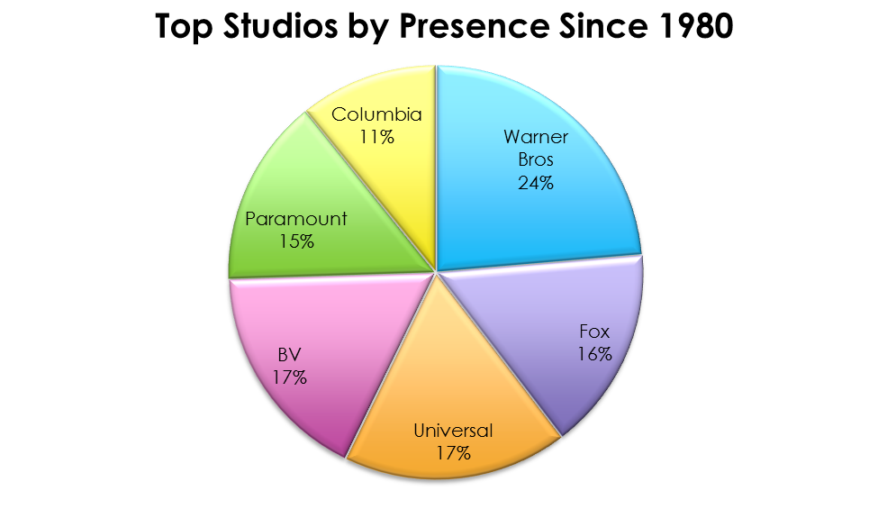


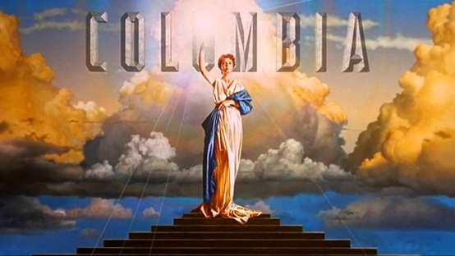

Since 1980, Warner Brothers has produced roughly ¼ of all new movies, in comparison to other top studios.
Source: Box Office Mojo

Slide 5
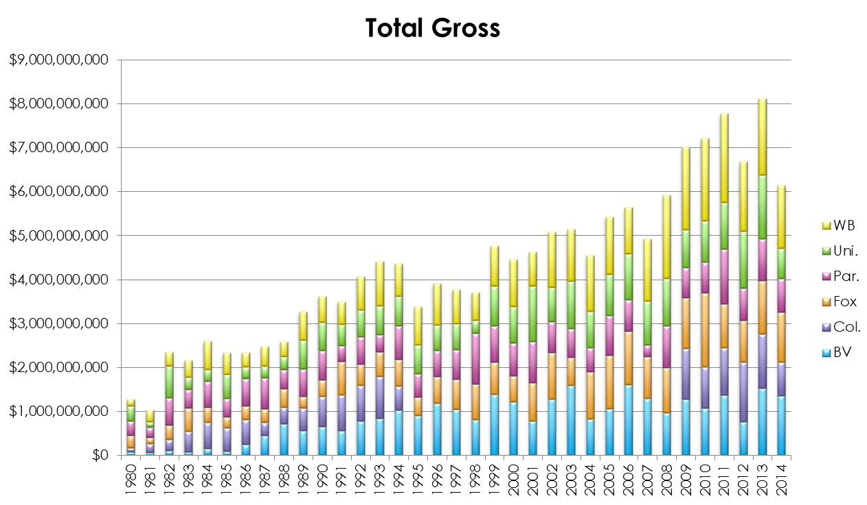
2013 was the highest grossing year for new movies, while 2012 and 2014 were unusually low.
Source: Box Office Mojo
Data unavailable for Columbia Pictures 1995 to 2008.
BV (Buena Vista) stands for Walt Disney

Slide 6
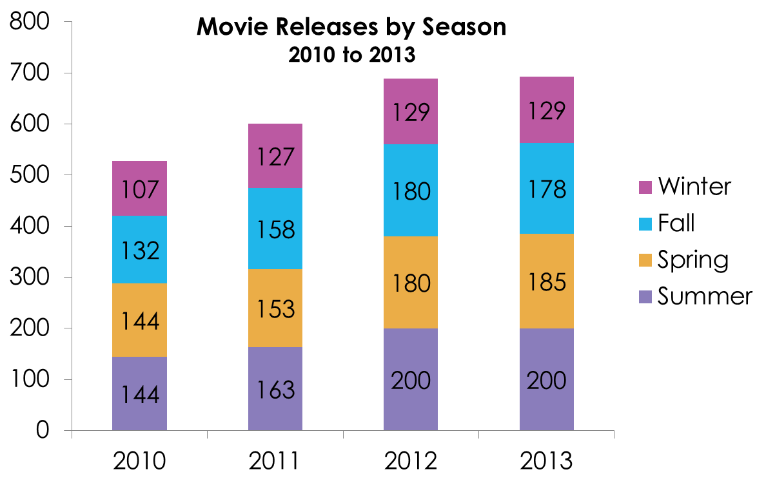
Summer months tend to be the most popular time for new movie releases, while the winter sees a significant drop.
Source: Box Office Mojo

Slide 7
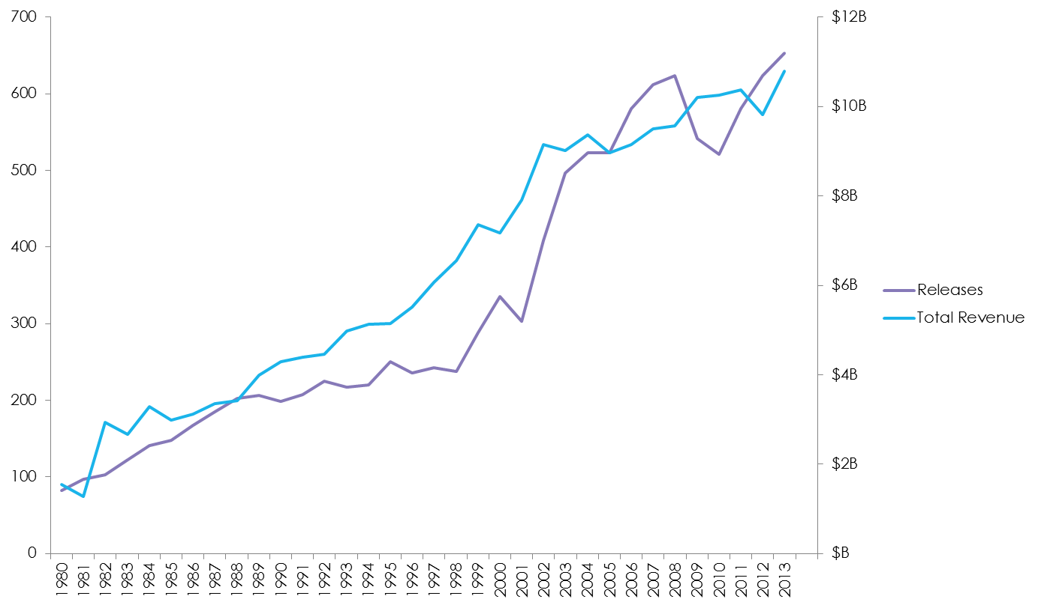
While the number of new movies released from 2008 to 2010 dropped significantly, total revenue was not impacted.
Source: Box Office Mojo
Data unavailable for 2014.

Slide 8
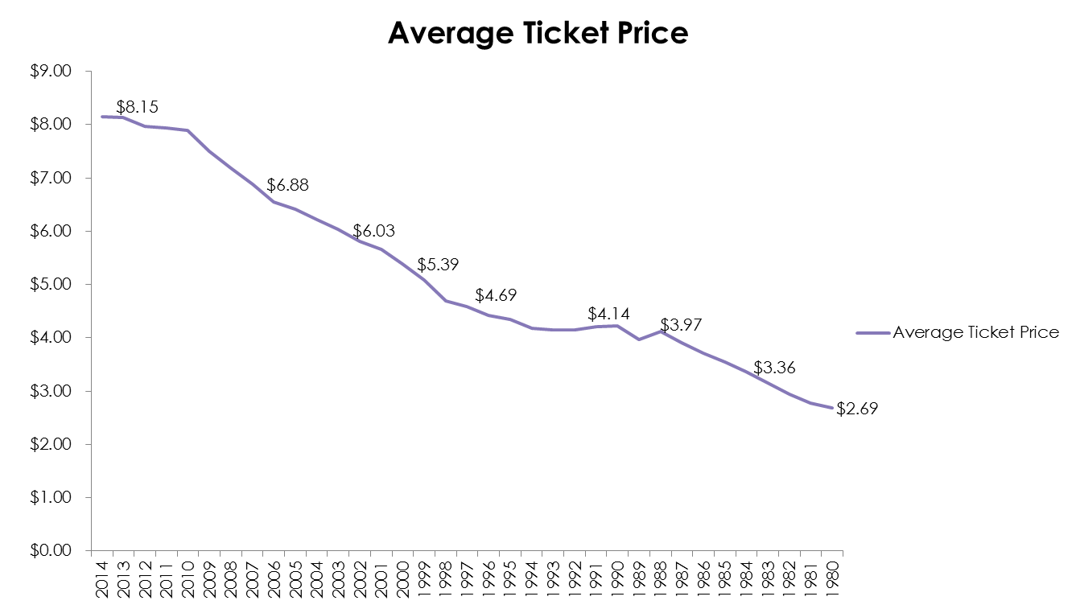
The average movie ticket price went up +203% from 1980 to 2014.
1980
$2.69
2000
$5.39
2014
$8.15
Source: Box Office Mojo

