Slide 1
Absolute community-level change
Most species lose
Most species benefit
+
Large community-level losses or gains
Species-level changes combine and amplify the community-level trend.
Declines without reshuffling
Growth without reshuffling
Correlation
Community reshuffling
Species are reshuffled within the community, altering its functioning.
Declines with reshuffling
Growth with reshuffling
-
-
Trend
+

Slide 2
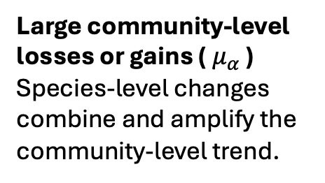




Most species lose
Most species benefit
+
$$μ_{α}$$
$$μ_{α}$$
Large community-level losses or gains (${ μ}_{α}$ )
Species-level changes combine and amplify the community-level trend.
Decline without reshuffling
Growth without reshuffling
Correlation
$$μ_{α}$$
$$μ_{α}$$
Community reshuffling
Species are reshuffled within the community, altering its functioning.
-
Decline with reshuffling
Growth with reshuffling
-
Trend
+

Slide 3











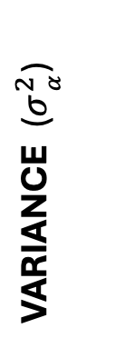
Most species decline
Most species grow
+
$$μ_{α}$$
$$μ_{α}$$
Absolute community-level change Species-level changes amplify change at the community level.
A
A
B
B
C
C
Decline without reshuffling
D
D
Growth without reshuffling
VARIANCE ($σ_{ _{α}}^{2}$)
CORRELATION ($μ_{R}$)
$$μ_{α}$$
$$μ_{α}$$
Community reshuffling Species are reshuffled within the community, altering its functioning.
A
A
A
D
B
C
C
A
-
Decline with reshuffling
Growth with reshuffling
D
B
-
TREND (${ μ}_{α}$ )
+

Slide 4
Most species decline
Most species grow
+
$$μ_{α}$$
$$μ_{α}$$
Absolute community-level change Species-level changes amplify change at the community level.
A
A
B
B
C
C
Decline without reshuffling
D
D
Growth without reshuffling
VARIANCE ($σ_{ _{α}}^{2}$)
CORRELATION ($μ_{R}$)
$$μ_{α}$$
$$μ_{α}$$
Community reshuffling Species are reshuffled within the community, altering its functioning.
A
A
A
D
B
C
C
A
-
Decline with reshuffling
Growth with reshuffling
D
B
-
TREND (${ μ}_{α}$ )
+

Slide 5
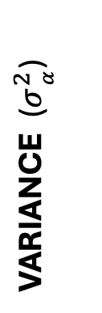

Most species decline
Most species grow
+
$$μ_{α}$$
$$μ_{α}$$
Absolute community-level change Species-level changes amplify change at the community level.
A
A
B
B
C
C
D
D
Growth without reshuffling
CORRELATION ($μ_{R}$)
$$μ_{α}$$
$$μ_{α}$$
Community reshuffling Species are reshuffled within the community, altering its functioning.
A
A
A
D
VARIANCE ($σ_{ _{α}}^{2}$)
B
C
C
A
Decline with reshuffling
Growth with reshuffling
D
B
-
-
TREND (${ μ}_{α}$ )
+

Slide 6
Most species decline
Most species grow
+
$$μ_{α}$$
$$μ_{α}$$
Absolute community-level change Species-level changes amplify change at the community level.
A
A
B
B
C
C
Decline without reshuffling
D
D
Growth without reshuffling
CORRELATION ($μ_{R}$)
$$μ_{α}$$
$$μ_{α}$$
Community reshuffling Species are reshuffled within the community, altering its functioning.
A
A
A
D
B
C
C
A
-
Decline with reshuffling
Growth with reshuffling
D
B
-
TREND (${ μ}_{α}$ )
+

Slide 7

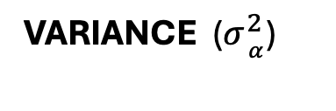
Risk of community instability.
Synchronous variations amplify community variability, lowering stability.
Portfolio effects maintain stability.
Asynchronous fluctuations have compensatory effects on community stability.
Short term (annual)
+
CORRELATION ($μ_{R}$)
-
VARIANCE ($σ_{ _{α}}^{2}$)
A
A
A
D
B
C
C
A
D
B

Slide 8
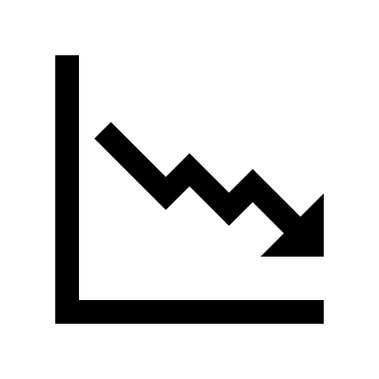

Average decline
Most species grow
Short term (annual)
High risk
Synchronized declines
Risk of community instability.
Synchronous variations amplify community variability, lowering stability.
-
CORRELATION ($μ_{R}$)
+
High risk
Portfolio effects maintain stability.
Asynchronous fluctuations have compensatory effects on community stability.
-
TREND (${ μ}_{α}$ )
+

Slide 9

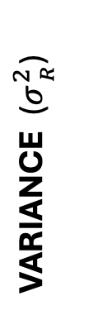
Short term (annual)
Portfolio effects may maintain stability.
Asynchronous fluctuations have compensatory effects on community stability.
Portfolio effects may maintain stability.
Asynchronous fluctuations have compensatory effects on community stability.
VARIANCE ($σ_{ _{R}}^{2}$)
Risk of community instability.
Synchronous variations amplify community variability, lowering stability.
-
+
AVERAGE CORRELATION ($μ_{R}$)

