Slide 1
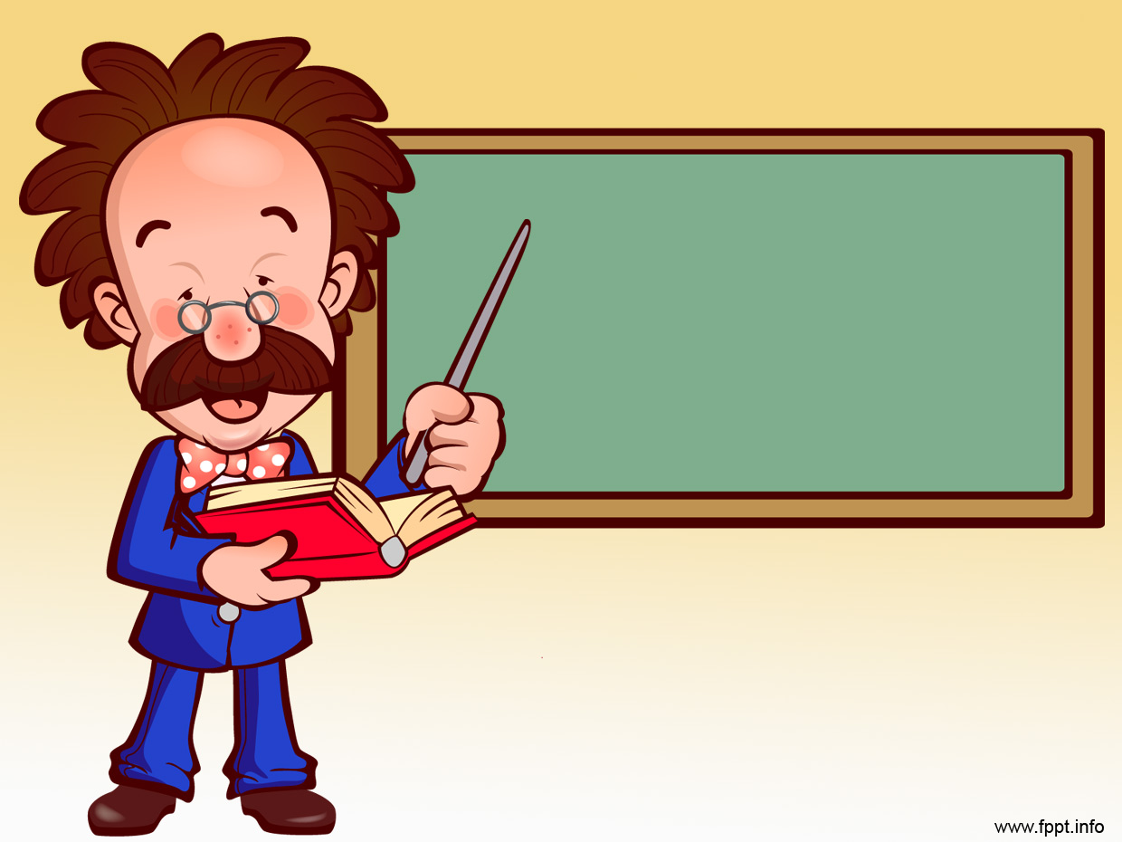
Welcome to HTML

Slide 2
HTML
Hypertext Markup Language
A standardized system for tagging text files to achieve
font
color
graphic
hyperlink effects on WWW pages

Slide 3
HTML
Is written in the form of HTML elements consisting of tags enclosed in angle brackets like <html></html>
A web browser can read HTML files and compose them into visible or audible web
pages

Slide 4
HTML
The browser does not display the HTML tags, but uses them to interpret the content of the page
HTML allows images and objects to be embedded and can be used to create interactive forms

Slide 5
HTML Structure
<!DOCTYPE html> declaration defines the document type
<html> </html> describes the web page
<head></head> tag is a container for all head elements. The following tags can be added to the head section: <title>, <style>, <link>,
<script> and so on…

Slide 6
HTML tags
<title></title> defines the title of the document and provides a title for the page when it is added to favorites.
<body></body> defines the document’s body and contains all the contents of an
HTML document, such as text,
hyperlinks, images, tables, lists, etc.

Slide 7
Important things to remember about HTML Tags
HTML tags are keywords surrounded by angle brackets<>
HTML tags normally come in pairs like <p> and </p>
The first tag in a pair is the start tag, the second one is the end tag
The end tag is written like the start tag just a slash insert before the tag name </html>
Start and end tags are also called opening tags and
closing tags

Slide 8
PARAGRAPHS
<p></p> we use paragraphs to tell something, so let’s create another <p></p>
and include some information about ourselves.
<p>Hello, I like HTML</p>

Slide 9
NOTE!
There are six heading sizes, where <h1> is the boss and <h6> is puny
<h1></h1>
<h2></h2>
<h3></h3>
<h4></h4>
<h5></h5>
<h6></h6>

Slide 10
Let’s try all the headings
Include all 5 headings in your previous program inside the body tag
<h1>Hello World</h1>
<h2>Hello World</h2>
<h3>Hello World</h3>
<h4>Hello World</h4>
<h5>Hello World</h5>
<h6>Hello World</h6>

Slide 11

Let’s start learning by doing
Let’s write our first HTML program

Slide 12
First Program in HTML
<!DOCTYPE html>
<html>
<head>
<title>My first HTML</title>
</head>
<body>
<h1>Hello World</h1>
<p>Hello World</p>
</body>
</html>

Slide 13
Styling the paragraph
<p style = "color:blue; text-align:center; font-family:cursive;">
Hello World </p>
We can use style inside a tag
The syntax will be <p style = “style1; style2;“>
color – stands for color of the text
#00FF00 – is equavalent to green color
more colors you can find on
http://html-color-codes.info/

Slide 14
What if we want to make only one world blue color?
To do so, we will use <span>
<p><span style ="color:blue;">Hello </span>World</p>
The <span> tag is used to group inline-elements
(<img>, <b>, <a>) in a document
<span> provides a way to add a hook to a part of a
text or a part of a document.

Slide 15
Is there any other way to do styles?
Yes, indeed
We can actually separate style from our <p> or <h1>

Slide 16
<style> inside <head>
<!DOCTYPE html>
<html>
<head>
<style>
h1 {color:#00FF00;}
p {color:blue;}
</style>
</head>
<body>
<h1>Hello world</h1>
<p>Hello world</p>
</body>
</html>

Slide 17
Styling the<span>
Just add <span> tag to the word you want to be styled inside <body>
<p><span>Hello</span> world</p>
call it in <head> inside <style> tag
span {color:#DF01D7;}

Slide 18
What if we have 2 or 3 paragraphs?
In this case, we can create id or class for each <p> tag
For example:
<p id = “one”>Hello World</p>
<p class = “two”>Hello World</p>

Slide 19
Let’s add these two statements
<p id = “one”>Hello Wold</p>
<p class = “two”>Hello world</p>

Slide 20
Inside <head></head> below <h1> and <p>
add #one{} and .two{}
#one{} represents an id
.two{} represents a class
we can use multiple ids or classes

Slide 21
NOTE!
ID’s are unique!
Each element can have only one ID
Each page can have only one element with that ID
Classes are not unique!
Classes can be used on multiple elements
Classes can be used on the same element

Slide 22
To call id, always use hashtag #
#one{color:#DF7401;}
To call class, always use period .
.two {color:#01DFD7;}
Notice each statement finishes with semicolons
Semicolons are important!!!

Slide 23
Finally let’s add
#one{color:#DF7401;}
.two{color:#01DFD7;}
between <style></style> tags
And add
<p id = "one">Hello World</p>
<p class = "two"> Hello World</p>
between <body> tags

Slide 24
Universal Selector
To select every element in HTML, we can use universal selector *{}
*{style1;style2;}

Slide 25
Let’s create few <p></p> and inside <style></style> tag let’s use universal selector.
<style>
*{color: yellow; font-weight: bold; font-style: italic;}
</style>

Slide 26
Notice!
<!- - - -> the text inside this tags won’t appear on the screen. It calls comments! And it is very useful for programmer to use them to remind what code is all about!

Slide 27
Did you know that HTML has Parents, children and siblings?
Yes, indeed it does!
If you think about <html> as a the trunk of the tree, you can name <head> and <body> as its children.
Because they are immediate children of <html>, they are siblings.

Slide 28
Let’s look at this diagram!
<!DOCTYPE html>
<html> <!--The trunk of the tree! Parent!-->
<head> <!--Child of <html>, parent of <title>, sibling of <body> -->
<title></title> <!--Immediate child of <head>, child of <head> AND <html>-->
</head>
<body> <!--Child of <html>, parent of <p> sibling of <head>-->
<p></p> <!--Immediate child of <body>, child of <body> AND <html>-->
</body>
</html>

Slide 29
Let’s try and test it!
In our example we have
<body>
<h1></h1>
<p></p>
<p></p?
</body>

Slide 30
So let’s make h1 be green color
To do so we will use parent – child property
First will go parent and child after
body h1 {color:green;}

Slide 31
We can call first-child property
p:first-child {background-color:blue;}
And in the body create
few <p></p>

Slide 32
But, what if we need to reach nth-child?
Then we will type
p:nth-child(3){color:green;}

