Slide 1
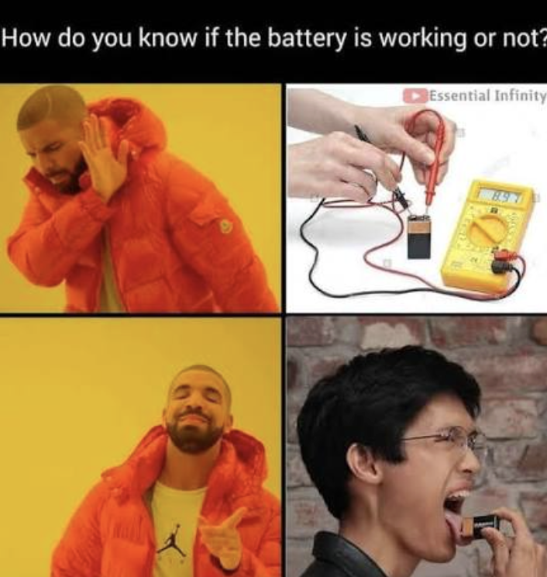

Accumulator EE
Katherine Chen
BMS BMS BMS BMS BMS

Slide 2
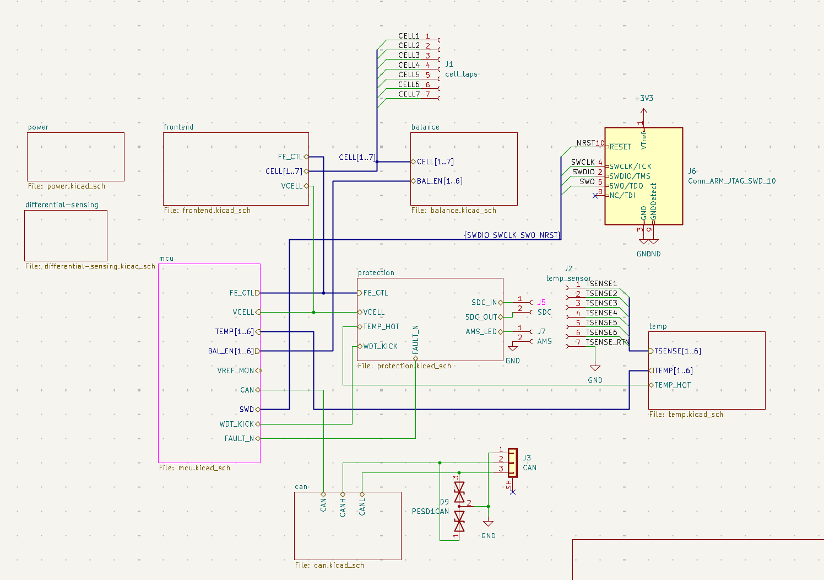
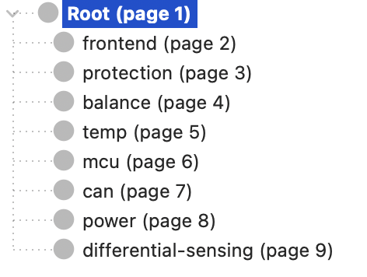
System Architecture
Project Overview:
BMS for one 14s4p segment: Enepaq 1x4p modules 35–58.8 V ~10 Ah
A BMS must: measure every cell, measure temperature, open the shutdown circuit on a fault, balance, report
Every cell needs to be measured bc:
The pack voltage hides the worst cell.
50 V = 30 healthy cells + 1 at 2.1 V
No dedicated BMS chip.
Reference FSAE_Rules_2026_V1 regulations

Slide 3
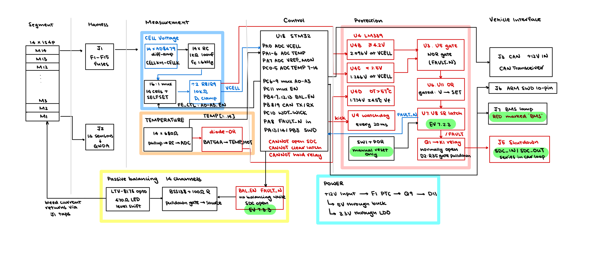
Block Diagram
Red rail – safety
Blue rail – measurement
Black rail -- control

Slide 4
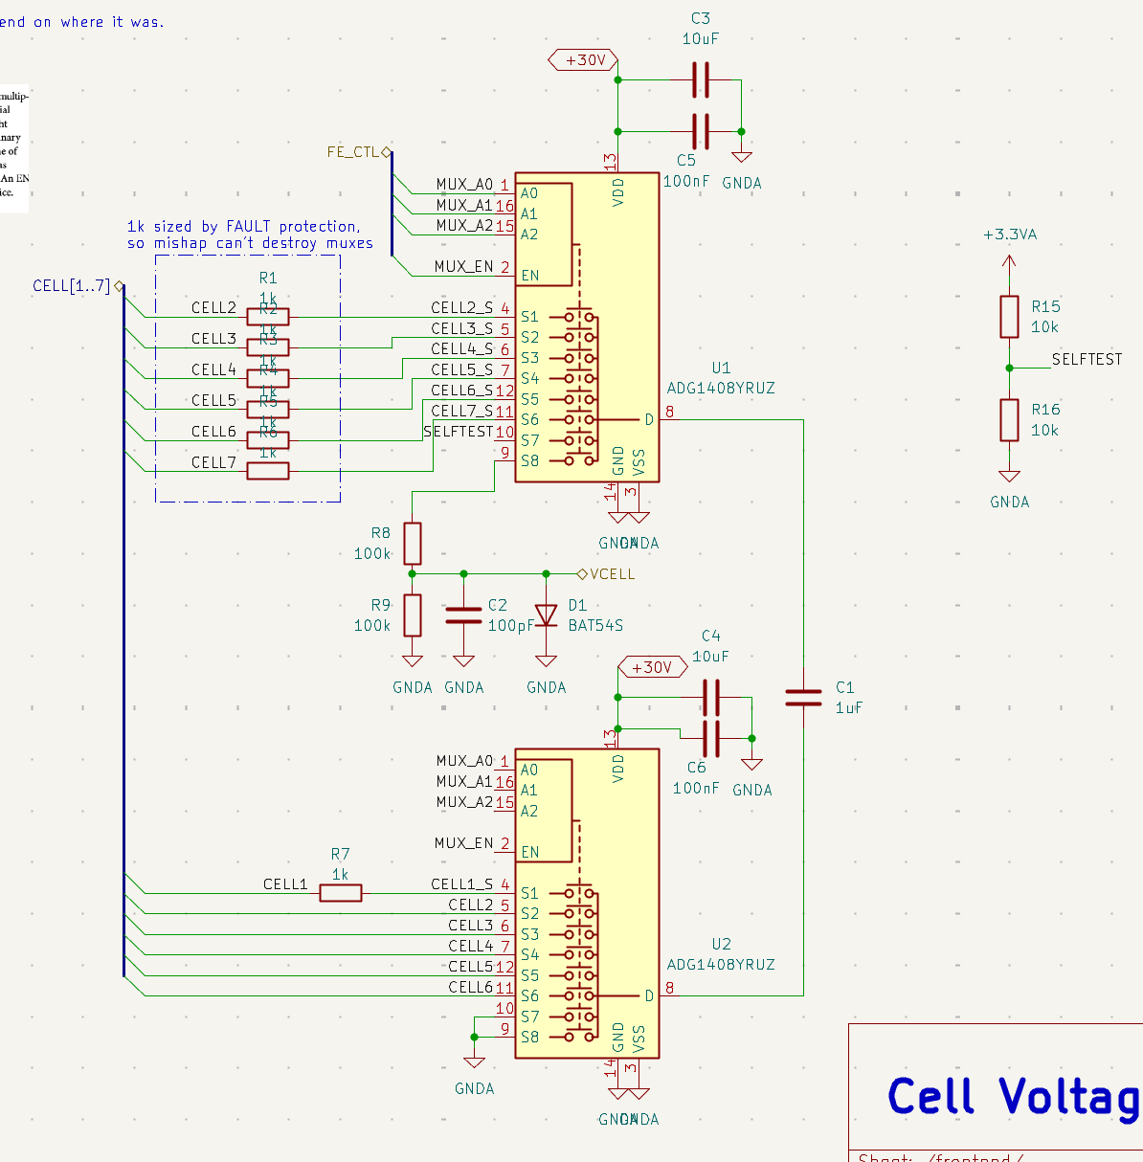
Cell Voltage – Initial solution
The idea: Flying Capacitor
Cell 14's terminals sit at 50–54 V; ADC reads 0–3.3 V against its own ground
Muxes connect a capacitor across one cell → disconnect both ends → connect it to ground and the ADC. It holds the cell voltage with no memory of where it was
One shared path → one gain error, common to all cells.
Problem:
We can NOT get all 14 series cells at once ➔ sequential
Capacitor starts at different capacitance everytime
This is for 6S modules!
Notes:
multiplexer - selector switch

Slide 5
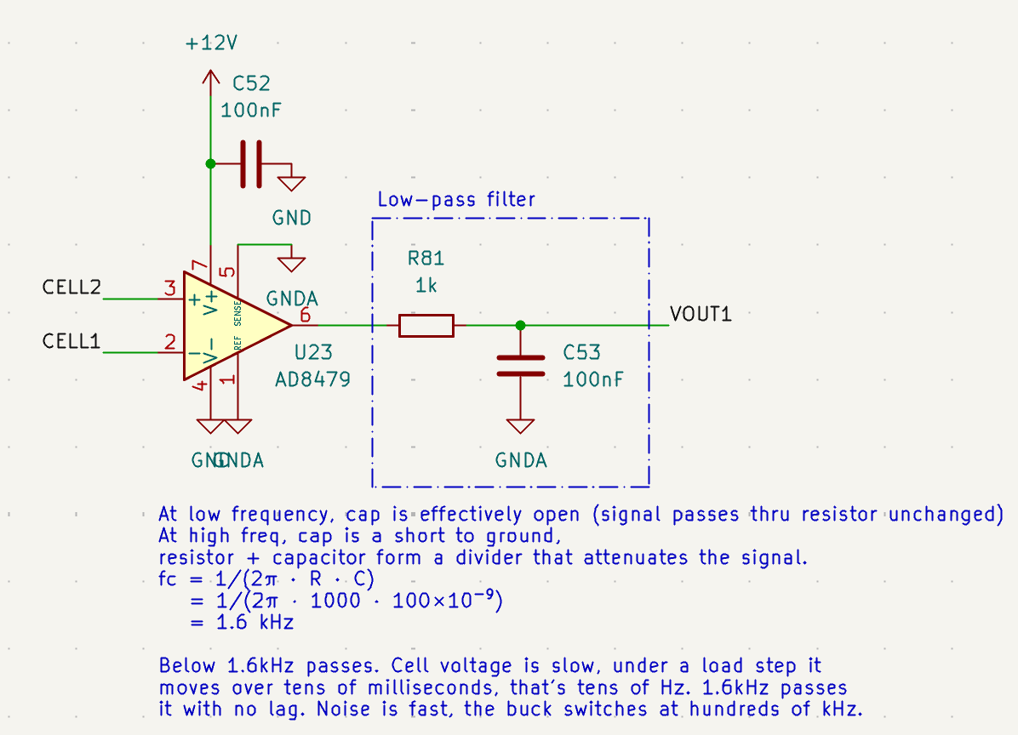
Cell Voltage – optimized version …
The idea: Differential Sensing
One difference amplifier per cell
➔ measure all cells at same time
inputs straight on the two terminals
Output = (CELL k+1) − (CELL k)
Added a low-pass filter for noise filtering
➔ output stable signal
VOUT goes to ADC pins on MCU
Notes:
There are two ways to measure voltage:
Single ended: measure one point against ground -- ADC pins
Differential: measure the gap between two points, and don’t care about where either one is relative to ground

Slide 6
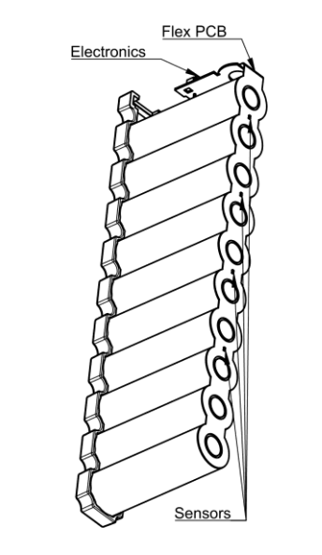
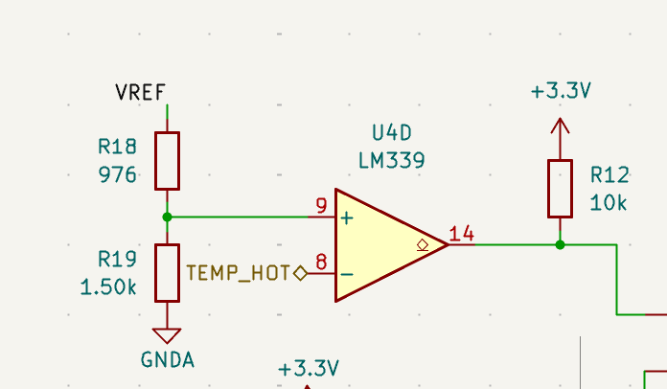
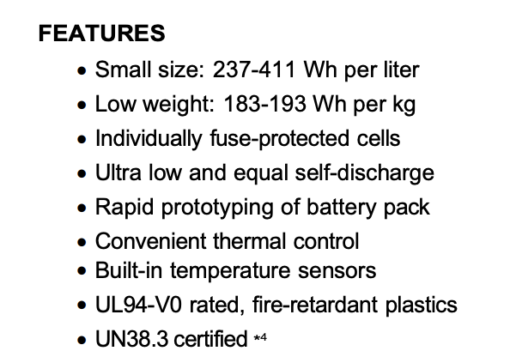
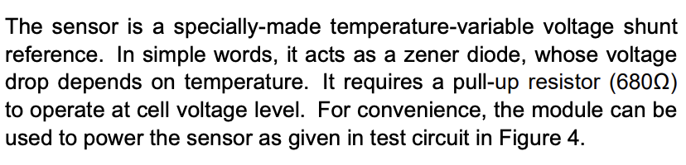

Temperature Sensing
Effectively, ADC can read temperature data precisely and compare to 60C (with a comparator U4!).
If firmware is dead, watchdog catches that.
But what if code is running but wrong, e.g. reads the wrong channel, has a stale value…
OR how can we know temp data while coding isn’t running
From module datasheet

Slide 7
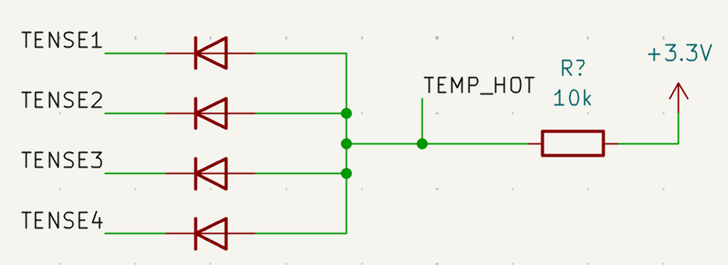
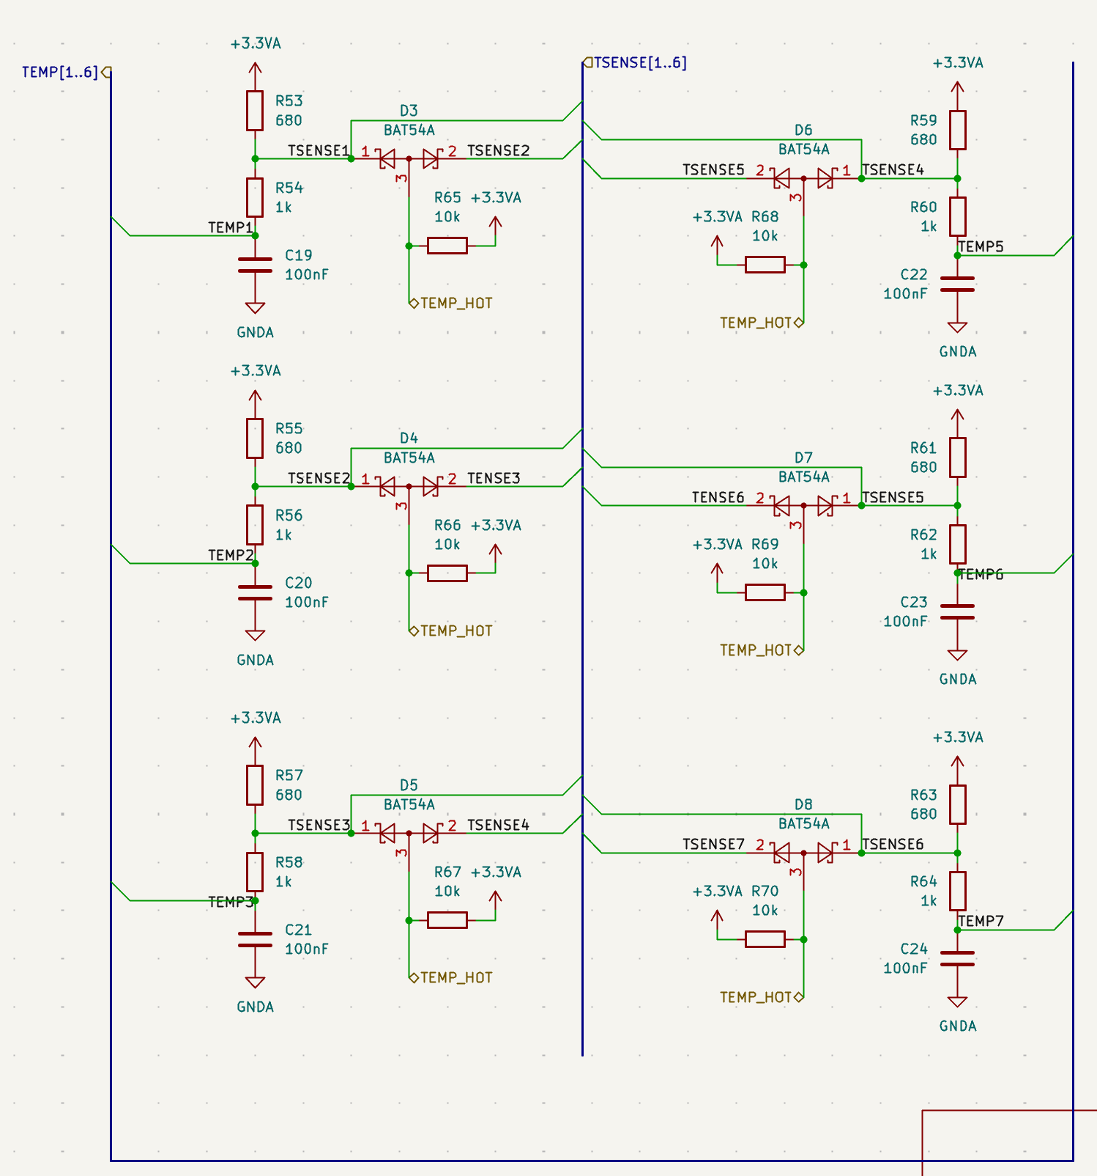
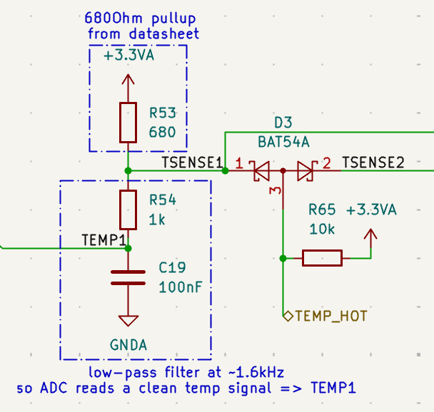
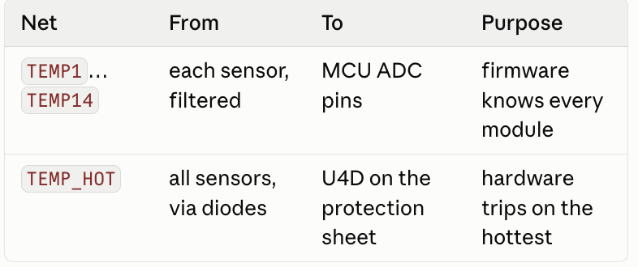
Temperature Sensing
Backstop: DIODES! 14 sensors for 14 voltages
The trick: hottest = lowest voltage (diode!)
diode is a one way valve, current can flow from
anode to cathode if anode >= cathode
e.g Sensor 1 at 1.9V (cool), Sensor 2 at 1.5V (hot)
pull TEMP_HOT up toward 3.3V, as it rises:
TEMP_HOT at 1.V: both diodes shut
TEMP_HOT at 1.7V: diode2 opens, current flows from
TEMP_HOT through D2 to sensor 2
That current holds TEMP_HOT at 1.7V bc D2 drains it
as fast as the resistor supplies it. D1 is never opened.
Goes to comparator
Goes to ADC pins
- Every sensor connects to a shared wire, TEMP_HOT, through a diode
- A 10 k pull-up lifts TEMP_HOT toward 3.3 V
- Each diode lets its sensor pull the wire down but can't push it up
- The wire rises until it hits the lowest sensor and stops
Notes:
Every sensor connects to a shared wire, TEMP_HOT, through a diode — anode on the shared wire, cathode on the sensor. A 10 k pull-up lifts TEMP_HOT toward 3.3 V. Each diode lets its sensor pull the wire down but can't push it up. So the wire rises until it hits the lowest sensor and stops
one of the diodes opens first and voltage holds at that level bc diode drains it as fast as resistor supplies it

Slide 8
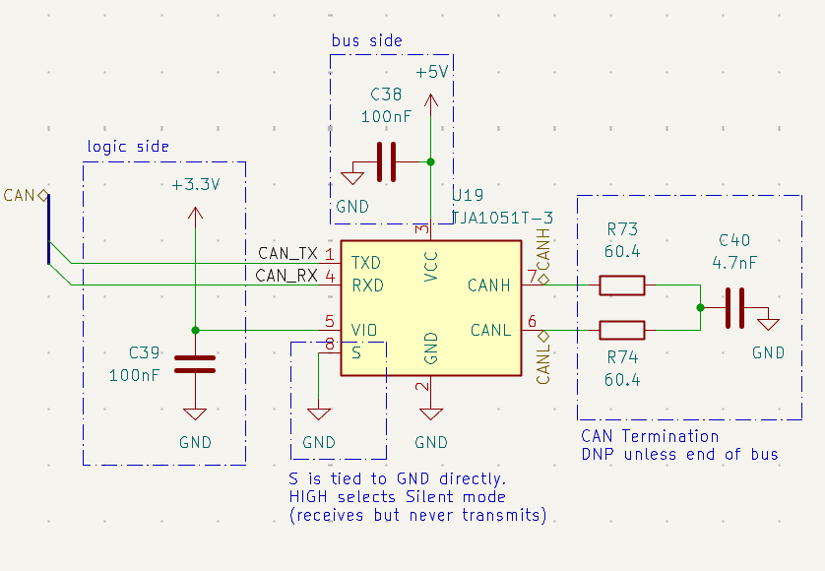
CAN transciever + termination (DNP)
CAN differential signaling
No master and slave, every address wants to talk at same time
Opposite polarity ➔ noise lands on both and cancels at the receiver
A node transmits when the bus is idle; collisions resolve by address; lower address has higher priority <== CAN actively low (prefer 0 over 1)
e.g cell temp data from BMS to datalogger, steering info from dashboard to control movements
How BMS interface with the car? CAN!
BMS is a node in the overall CAN line, usually not termination node ➔ DNP
(no starting node and terminating node ➔ if CAN line left floating, signals will reflect back ➔ put two resistors on each end)
CAN transceiver: a translator between 3.3 V logic
on MCU and differential signal on CAN harness.
Notes:
Because the microcontroller speaks CAN logic but can't drive CAN wire.

Slide 9
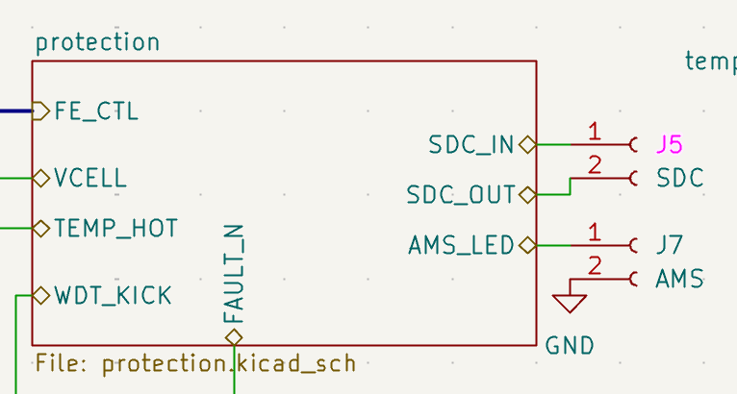
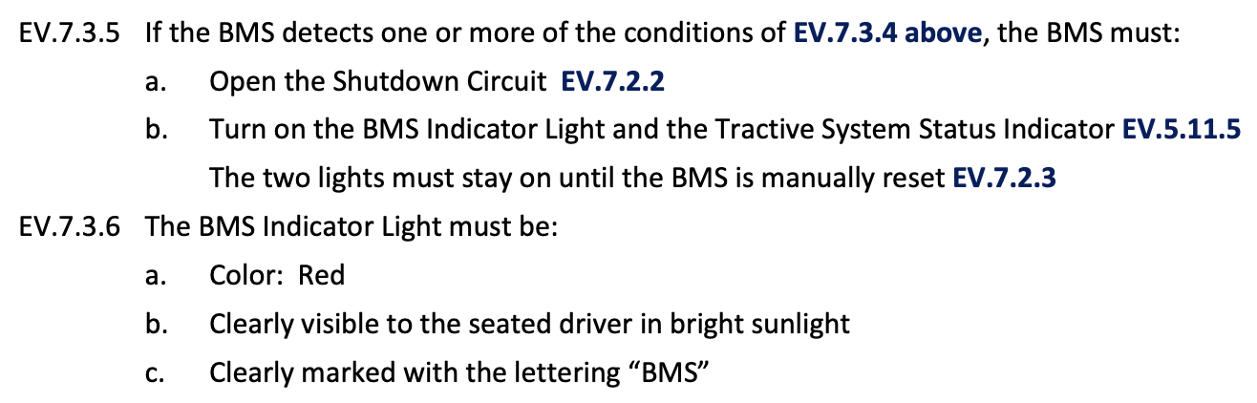
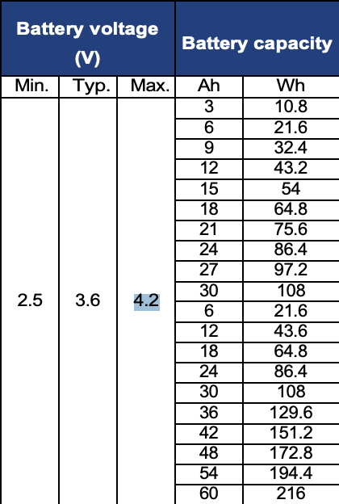
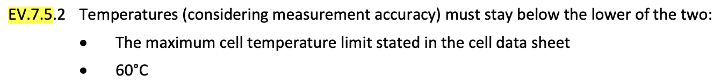
BMS interface (other than CAN)
Shutdown circuitry (BMS fault) : relay contactors in series with the car’s loop, SDC_IN/SDC_OUT on J5
  “The BMS, IMD, and BSPD parts of the Shutdown Circuit must be Normally Open” (EV.7.1.3)
BMS indicators (LEDs) for drivers
BMS fault limits:
(reference: SONY/Murata VTC6 datasheet & FSAE_Rules_2026_V1)
Notes:
relay contactors opens car loop
for regulation compliance

Slide 10
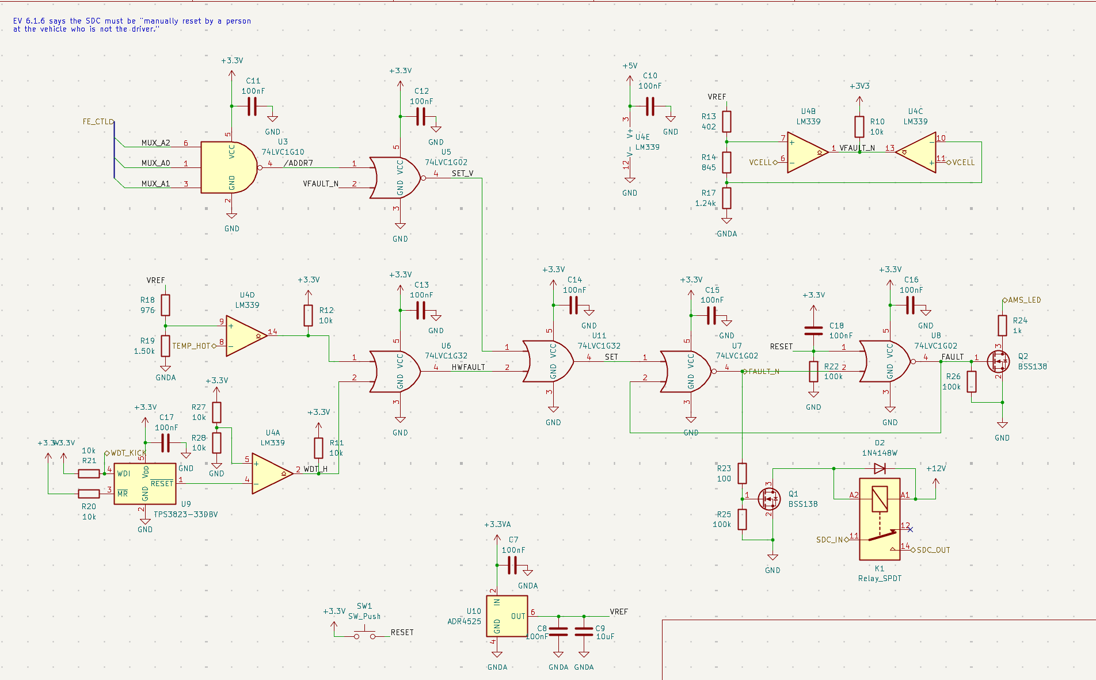
How system monitors unsafe conditions ➔ BMS fault
U4B: VCELL Overvoltage
Fixed ref: 2.096V
Faults when cell above 4.192V
When a cell or a module has left its safe range, open the shutdown circuit.
U4: LM339 (four comparators)
Each one holds a fixed voltage on one input and a live signal on the other, and outputs “yes/no”
Fixed voltage comes from resistor dividers off 2.5V ref
  R13/R14/R17: cell
  R18/R19: temperature
LM339’s output are open-collector: only pull down, each need pull-up resistor
Gate for timing
VCELL is only a real cell voltage while mux is pointed to a real cell (between steps are garbage)
VCELL comparators only count when valid
- U3 decodes mux
address;
- U5 combines that with
FAULT_N
U4C: VCELL Undervoltage
Fixed ref: 1.246V
Faults when cell below 2.493V
U4D: TEMP_HOT
- Fixed ref: 1.734V
- Faults hottest module above ~57C
Driver Interface
FAULT drives Q2 ➔ lights BMS indicator, stays lit until reset by a person at the car
Two OR gates
Any of 4 fault sources high → SET high
Two NOR gates
SET high flips them, nothing on fault inputs can un-flip it, except SW1 pushbottom
Output:
FAULT (high when tripped)
/FAULT (low when tripped)
Act
/FAULT drives Q1 ➔ energizes K1’s coil
K1 contact normally opens and sits in shutdown loop b/w SDC_IN and OUT
U4A: watchdog RESET
Fixed ref: 1.65V
Fault: Firmware stopped running
Relay health state:
/FAULT high ➔ Q1 on ➔ coil energized ➔ contact closed ➔ loop intact
FAULT state:
/FAULT low ➔ Q1 off ➔ coil drops ➔ contact opens ➔ loop broke
Notes:
EV.7.2.3 says that once the BMS opens the shutdown circuit, it stays open until a person at the car manually resets it — and specifically, the driver can't do it from the seat, and neither the shutdown buttons nor the master switch can clear it.
Latch "not-fault" output sits at 3.3 V.

Slide 11
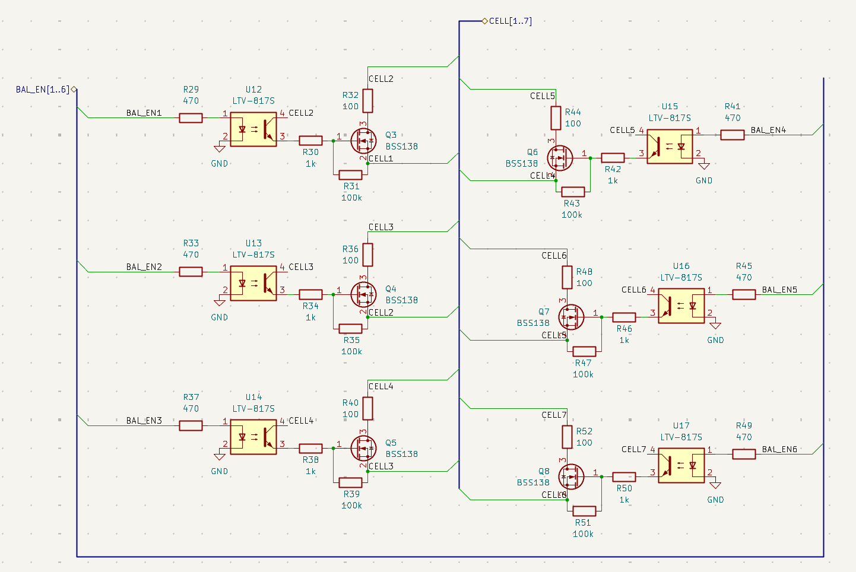
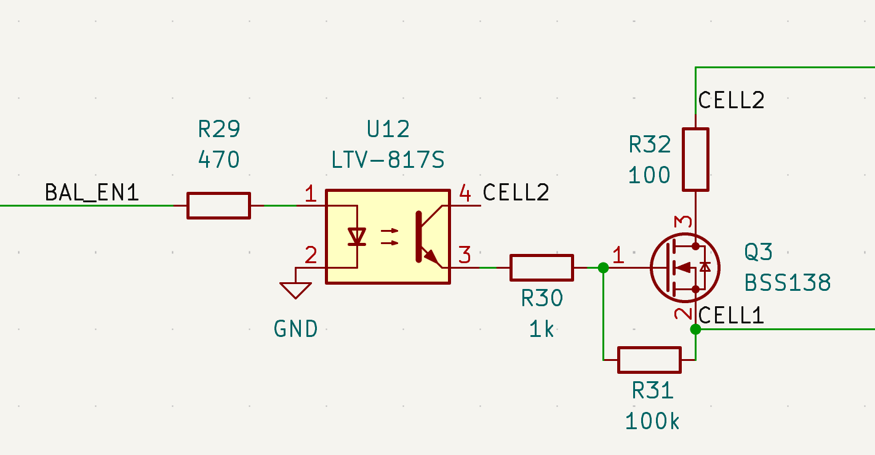
Cell Balancing
Why balancing: Each cell has a slightly different capacity, each self-discharges at a slightly different rate,
and the ones in the middle of the pack run warmer and age faster. Thus, the cells drift apart.
That's a problem because the pack is limited by its extremes.
On charge, the fullest cell hits 4.2 V first and the whole pack must stop, the others aren't full yet.
On discharge, the emptiest cell hits 2.5 V first and the pack must stop, the others still have charge.
Balancing pulls the cells back together so the pack can use its whole capacity
Passive balancing:
Close switch: cell drains through resistor
Open switch: comes down to match others
Firmware decides which switch to close based on voltage data from frontend:
bleed highest, stop when they match w lowest
Optocoupler: MCU lights the LED
The light turns on the phototransistor, which is wired between the cell's positive terminal and the FET’s gate, so it pulls the gate up relative to the source regardless of where that cell sits
Bonus:
this is galvanic isolation for free, which is what the rules want between the tractive side and the logic side anyway.
Cell 6's switch has its source at 18.5 V. If the MCU drives that
gate with a 3.3 V signal referenced to ground, the gate is 15 V
below the source. The transistor doesn't turn on.
Notes:
Passive disspate heat: switch + resistor
Switched caps: A capacitor connected across a full cell charges up to its voltage.
Switch it across an empty cell; it's now higher than that cell, so it dumps charge in. Flip back and forth, thousands of times a second.
Pack-to-cell: feed a weak cell from the whole pack.
LTC3300
a DC/DC from the pack down to 12 V, then a constant-current buck routed to the weak cell through MOSFETs.

Slide 12
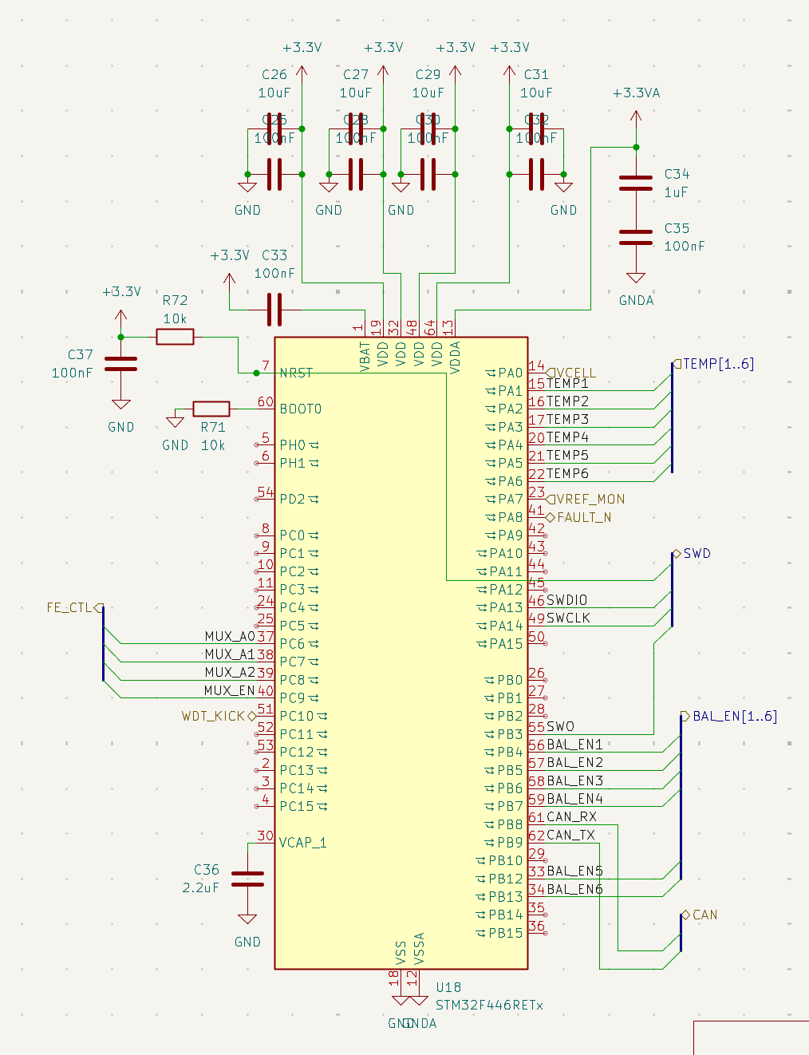
MCU pinout
STM32F446RE
- ADC: PA0 VCELL, PA1–6 TEMP, PA7 VREF_MON, PC0–5 spare
(14S)
GPIO out: PC6–9 mux, PB4–7,12,13 BAL_EN, PC10 WDT_KICK
GPIO in PA8 FAULT_N
CAN1: PB8 RX, PB9 TX
SWD: PA13/PA14/PB3
→ ADC ref = VDDA, corrected from the 2.500 V on PA7
→ WDT_KICK is a GPIO in the main loop
→ 14S: 16 of 16 ADC channels
ADC (VCELL, TEMPk, VREF_MON)
GPIO out
Notes:
VOUT1–14 → 16:1 mux → ÷2 → VCELL → PA0
Then the follow-up: "So it's still sequential?" sequenced by the ADC's ~20 µs sample time instead of a 20 ms capacitor settle.
Analog to digital converting:
ADC counts → volts (×2 for the divider)
ADC counts on the temperature pins → °C via the datasheet lookup table.
Balances. Finds the lowest cell, decides which are ahead, drives BAL_EN1–14, limits how many bleed at once, blanks the reading of a cell while it's bleeding, only balances when charging and when FAULT_N is high.
Sequences the measurement: Sets the mux address, waits, triggers the ADC, moves to the next cell.
What it explicitly does not do
Open the shutdown circuit — no pin exists for it
Clear the latch — SW1 only
Hold the relay closed — Q1 is driven by the latch, not by a GPIO

Slide 13
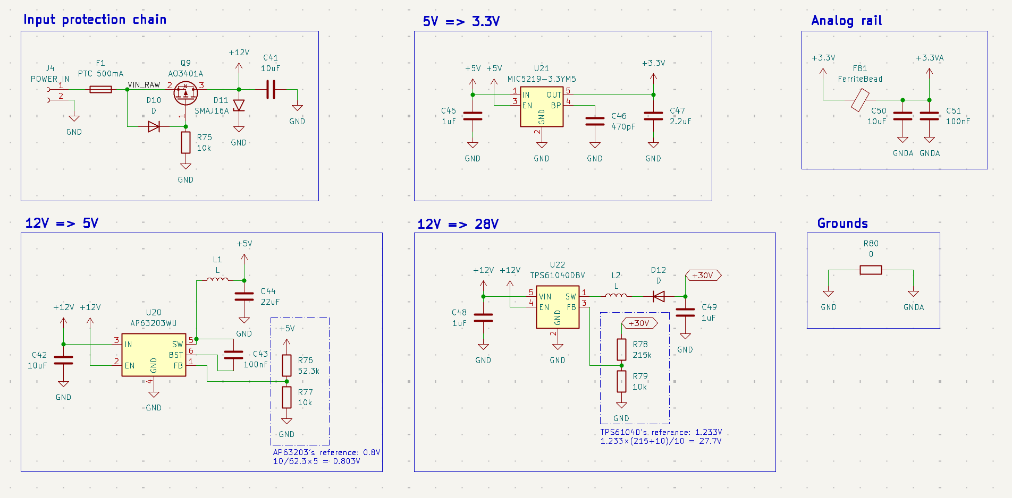
Power
Battery pack only powers motors and invertors.
Everything on BMS is powered from 12V LV system.
PTC fuse + P-FET reverse-polarity blocker for input protection
Two stage to 3.3V (Buck + LDO) for efficiency + tripping switching noise
FB1 for analog parts
LDO
Same voltage, separate copper
Noisy current return on GND
Measurement current return on analog GND
Buck
Boost (inductors + diodes)
mux can't pass a signal above its own supply, and the stack can't supply itself.
Not needed for diff-amp version

