Slide 1
Suppression of Acoustic Noise in Speech
By Katherine yun and hongyi li

Slide 2
Introduction
Implementation of Boll’s 1979 model [1]
Suppression of Acoustic Noise using Spectral Subtraction
Further improve the model based on Berouti’s modification [2]
Implementation of Wiener Filter [3]
Reduce specific kind of noise
System-related Design
Algorithm implementation (e.g. 50% overlap, online/offline Wiener filter)
User interface
Milestones and Test Verification

Slide 3

Background Research – Spectrum subtraction
Additive Noise Model
Input x(k) = s(k) + n(k) → $X(e^{jw})$ = S$(e^{jw})$ + $N(e^{jw})$
Spectral Subtraction Estimator
Replacing the noise spectrum with spectra which can be measured
$\tilde{S}(e^{jw})$ = [|X$(e^{jw})$| - $u(e^{jw})$] $e^{jθx(e^{jw})}$
Where $u(e^{jw})$] = E{|N($e^{jw}$)|}
Half-wave Rectification
$\tilde{S}(e^{jw})$ = [|X$(e^{jw})$| - $u(e^{jw})$] $e^{jθx(e^{jw})}$if |X$(e^{jw}$)| > $u(e^{jw})$
$\tilde{S}(e^{jw})$ = 0 otherwise

Slide 4
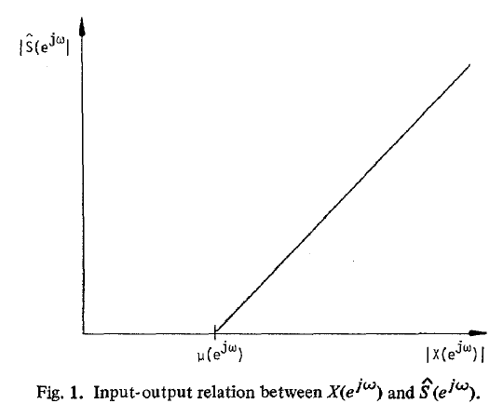

Background Research – Spectrum subtraction
Half-wave Rectification:
If |X$(e^{jw}$)| < $u(e^{jw})$, that frequency bin is very likely to be noise-dominated.

Slide 5

Background Research – Spectrum subtraction
Residual Noise Reduction
|$\tilde{S}i(e^{jw})$| = min{|$\tilde{S}i(e^{jw})$| i = i-1, i, i+1}, for |$\tilde{S}i(e^{jw})$| < max |Nr($e^{jw}$)|
Where Nr = N - $u e^{jθn}$ (noise residual)
Additional Signal Attenuation during Nonspeech Activity
The output is set to an attenuated version of the input
Need some time to collect statistics about the noise spectrum

Slide 6

Background Research - Wiener Filter
Noisy Signal: y, Clean Signal: x, Filter: h
Output of the filter $x_{hat}$ = convolution of y and h
Minimize the mean squared error E[${(x −x_{hat})}^{2}$]
Transform to frequency domain: H(f) = $\frac{P_{XY}(f)}{P_{YY}(f)}$
$P_{XY}(f)$: cross power spectrum of x and y
$P_{YY}(f)$: power spectrum of y

Slide 7

Background Research - Wiener Filter
Noise is uncorrelated to speech signals
Simplified as H(f) = $\frac{P_{XX}(f)}{P_{XX}\left(f\right)+P_{NN}(f)}$
$P_{NN}(f)$: noise power spectrum
Human voices have similar power spectrums
Use several trails to pretrain filters for a specific type of noise

Slide 8
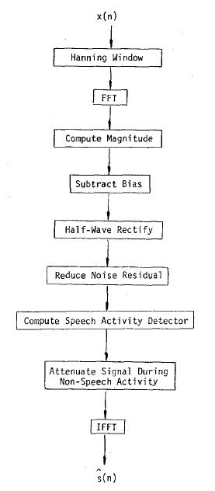
System Design – Spectrum subtraction
Implementation of Boll’s algorithm and its modification on Android tablet
Several things to consider
Real-time noise suppression
50% overlap
Buffer to store previous data frames
Need to introduce a delay of one frame
Runtime limitation

Slide 9
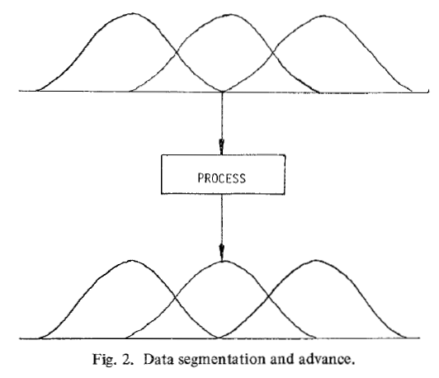
System Design – Spectrum subtraction
50%-Overlapping Frames:
Most data samples are used in two consecutive frames
Need for one-frame delay and buffering

Slide 10
System Design - Wiener Filter
Training Phase
Use clean signal and noise
Power spectrum of clean signal and noise: not available in real-time application
Offline
5 or more trials of noise and human speeches
Three types of noise: crowd noise, helicopter noise, engine noise

Slide 11
System Design - Wiener Filter
Android App
Online
Load trained filter coefficients for each type of noise
Convoluted with real-time speech data
Similar to the bandpass filter in Lab 2

Slide 12
System Design – User interface
Two Options:
General noise remover, based on spectrum subtraction
Specific noise remover, based on trained Wiener filters
--- Crowd noise
--- Helicopter noise
--- Engine noise

Slide 13
Milestones + TEST Verification
Week of 04/08 Goal
Finish the user interface, with the options and buttons to all types of noise removers
Working general noise remover

Slide 14
Milestones + TEST Verification
Week of 04/15 Test and Verification
Users can use the entry interface to select different modes of noise removal
Users can use the general noise remover in noisy environments and check the functionality of noise reduction

Slide 15
Milestones + TEST Verification
Week of 04/22 Goal
Finish the offline training of the Wiener filters for the three types of noise
Week of 04/22 Test and Verification
Apply the filters to noisy speeches and check output sound qualities, in python
Compare the spectrums of the output signals and clean signals, generated by python codes

Slide 16
Milestones + TEST Verification
Week of 04/29 Goal
Online Wiener filters working
Week of 04/29 Test and Verification
Users can choose each of the specific noise removers and use that in the corresponding environment (can be simulated by soundtracks)
Users can check for the attenuation of background noise

Slide 17

Assigned Project demo
Helicopter Noise (before and after)
Crowd Noise (before and after)

Slide 18
References
Boll, S.F. Suppression of Acoustic Noise in Speech using Spectral Subtraction. IEEE Transactions on Acoustics, Speech, and Signal Processing (27), pp. 113-120, 1979.
Berouti, M., Schwartz, R., and Makoul J. Enhancement of speech corrupted by additive noise. IEEE Transactions on Acoustics, Speech, and Signal Processing, pp. 208-211, 1979.
Paulraj, A., Roychowdhury, V., and Schaper, C., (editors). Communications, Computations, Control and Signal Processing. Kluwer Academic Publishers, 1997.

