Slide 1
Using The National Health and Nutrition Examination Survey (NHANES) to Predict Heart Disease
Final Capstone
March 2020
Presented by
Kathie King

Slide 2
Introduction: context of the project
Heart disease is the leading cause of death for men, women, and people of most racial and ethnic groups in the United States.
About 647,000 Americans die from heart disease each year—that’s 1 in every 4 deaths.
Heart disease costs the United States about $219 billion each year from 2014 to 2015. This includes the cost of health care services, medicines, and lost productivity due to death.
https://www.cdc.gov/heartdisease/facts.htm

Slide 3
Data source: The National Health and Nutrition Examination Survey (NHANES)
What is NHANES?
a major program of the National Center for Health Statistics (NCHS), which is part of the Centers for Disease Control and Prevention (CDC)
began in the early 1960s as a program of studies designed to assess the health and nutritional status of adults and children in the United States
changed in 1999 to became a continuous program with a changing focus on a variety of health and nutrition measurements to meet emerging needs
examines a nationally representative sample of about 5,000 persons each year

Slide 4
Data source: The National Health and Nutrition Examination Survey (NHANES)
Why NHANES?
Unique in that it combines interviews
interview includes demographic, socioeconomic, dietary, and health-related questions
AND Physical examinations
include laboratory tests and physiological measurements, administered by highly trained medical personnel.
Findings from this survey are used:
To determine the prevalence of major diseases and risk factors for diseases
To assess nutritional status and its association with health promotion and disease prevention
As the basis for national standards for such measurements as height, weight, and blood pressure
In epidemiological studies and health sciences research
To develop public health policy and to direct and design health programs and services

Slide 5
The Problem
The link between diet/nutrition and cardiac disease is long established
Understanding exactly what that link is has been incompletely understood and continues to evolve over time.
The goal of this capstone is to attempt to better understand the link between diet/nutrition and cardiac disease by exploring the relationship between various diet components, nutrients, and behaviors around nutrition.

Slide 6
Purpose of the Project
Medical science continues to search for both prevention methods and treatment methods to tackle the morbidity and mortality presented by cardiac disease.
This Capstone Project, although limited in size of data, can offer additional insights into the relationship between diet/nutrition and cardiac disease.
Much like a pilot study, the results of this study may offer researchers an insight into a specific nutrient or dietary behavior that warrants further study on a larger scale.

Slide 7
Original data sets
All data sets obtained from NHANES 2015 – 2016 cycle
Demographic data: 1 file
Demographic Variables and Sample Weights
Examination data: 2 files
Blood Pressure Measurements
Body Measurements

Slide 8
Original data sets
Laboratory data: 5 files
Dietary Interview - Total Nutrient Intakes, First Day
Cholesterol – Total
Complete Blood Count with 5-Part Differential - Whole Blood
High-Sensitivity C-Reactive Protein (hs-CRP)
Standard Biochemistry Profile
Questionnaire data: 2 files
Blood Pressure & Cholesterol
Medical Conditions

Slide 9
Original data sets
Dietary data: 4 files
Dietary Interview - Total Nutrient Intakes, First Day
Dietary Interview - Total Nutrient Intakes, Second Day
Dietary Supplement Use 24-Hour - Total Dietary Supplements, First Day
Dietary Supplement Use 24-Hour - Total Dietary Supplements, Second Day

Slide 10
Original data sets: counts
File Name | Unique “SEQN” Count | Total File Count
Demog_df | 9972 | 10,000
Med_cond | 9575 | 9600
Body_measures_df | 9545 | 9600
Bp_quest_df | 6328 | 6400
Cbc_df | 9166 | 9200
Hdl_df | 8022 | 8100
Tot_chol_df | 8022 | 8100
Hscrp_df | 9166 | 9200
Std_chem_df | 6745 | 6800
tot_intake1_df | 9545 | 9600
tot_intake2_df | 9545 | 9600
Tot_diet_supp_1_df | 9545 | 9600
Tot_diet_supp_2_df | 9545 | 9600
Total Count | 114,721 | 115,400

Slide 11
Merging, Cleaning, Wrangling
Merging:
Final file: 10,027 entries x 216 columns
Missing lab info for ~33% of unique “SEQN” files
unable to accurately fill; drop for full exploration
Combining & Calculating:
Target value: positive indicator for any of 4 questions re heart disease
Calculating average of individual nutrient + supplement intake over 2 days
Final data file:
4712 entries x 168 columns

Slide 12
Target value
MCQ160B: Ever told you had congestive heart failure?
No/don’t know = 3731 + 862 = 4593
Yes = 119
MCQ160C: Ever told you had coronary heart disease?
No/don’t know = 3689 + 872 = 4561
Yes = 151

Slide 13
Target value
MCQ160D: Ever told you had angina/angina pectoris?
No/don’t know = 3754 +864 = 4618
Yes = 94
MCQ160E: Ever told you had heart attack?
No/don’t know = 3691 + 863 = 4554
Yes = 158
'heart_dz’ value counts
No (0) = 4403
Yes (1) = 309

Slide 14
Additional wrangling
Outliers:
Reduced using log transformation
Retained small number of outliers to reflect the possibility that extreme values may be influential in indicating heart disease
Categorical variables:
Multiple possible answers
Converted to dummy variables using ‘pd.get_dummies’, drop first

Slide 15
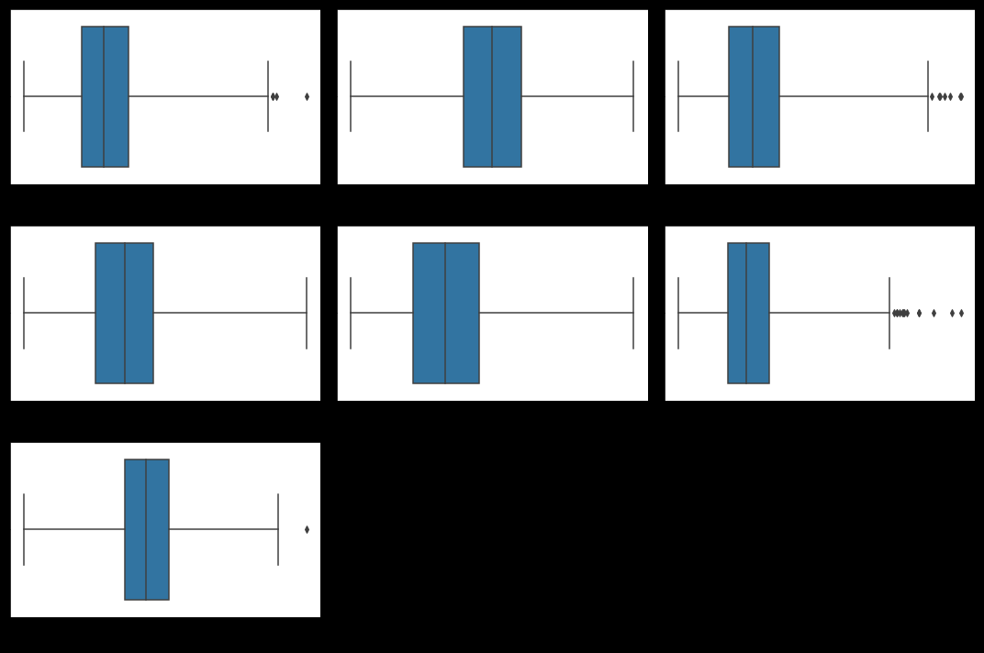
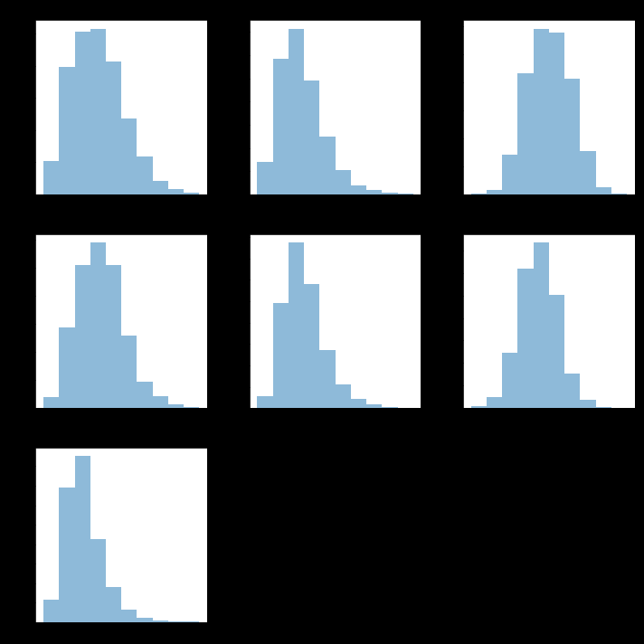
Outliers: body measurements

Slide 16
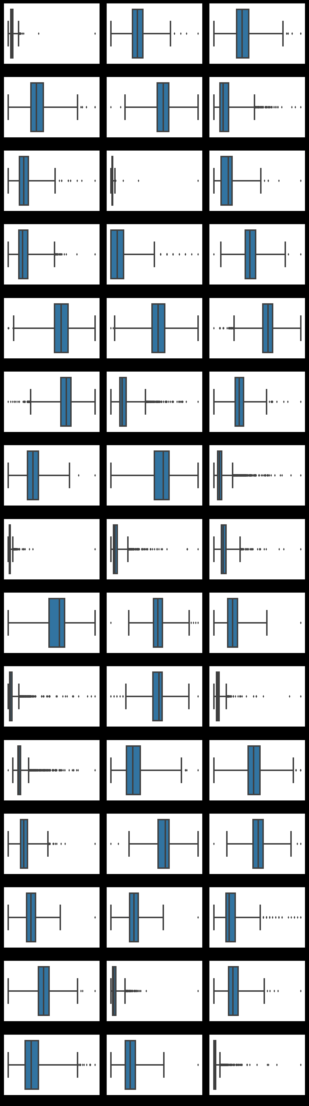
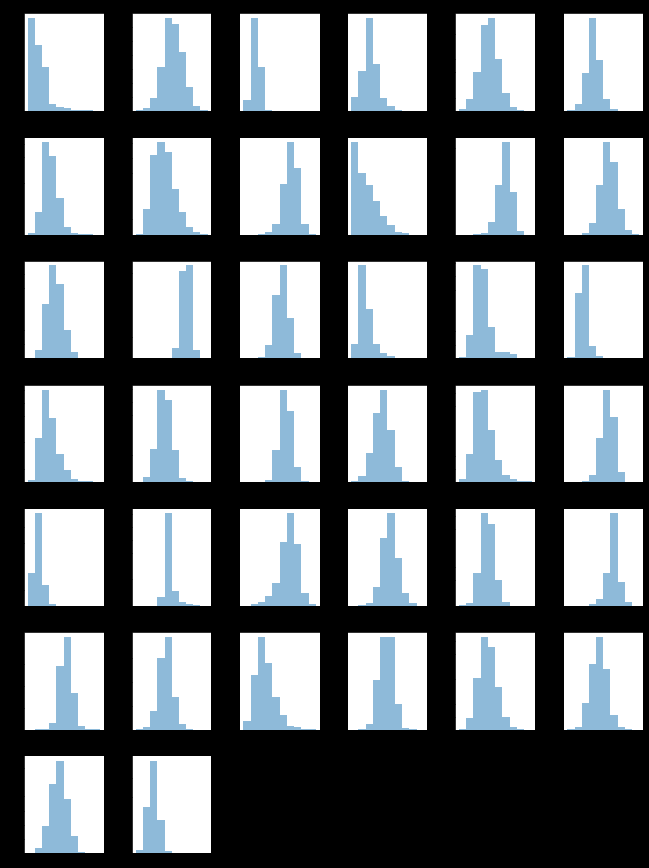
Outliers: lab values

Slide 17
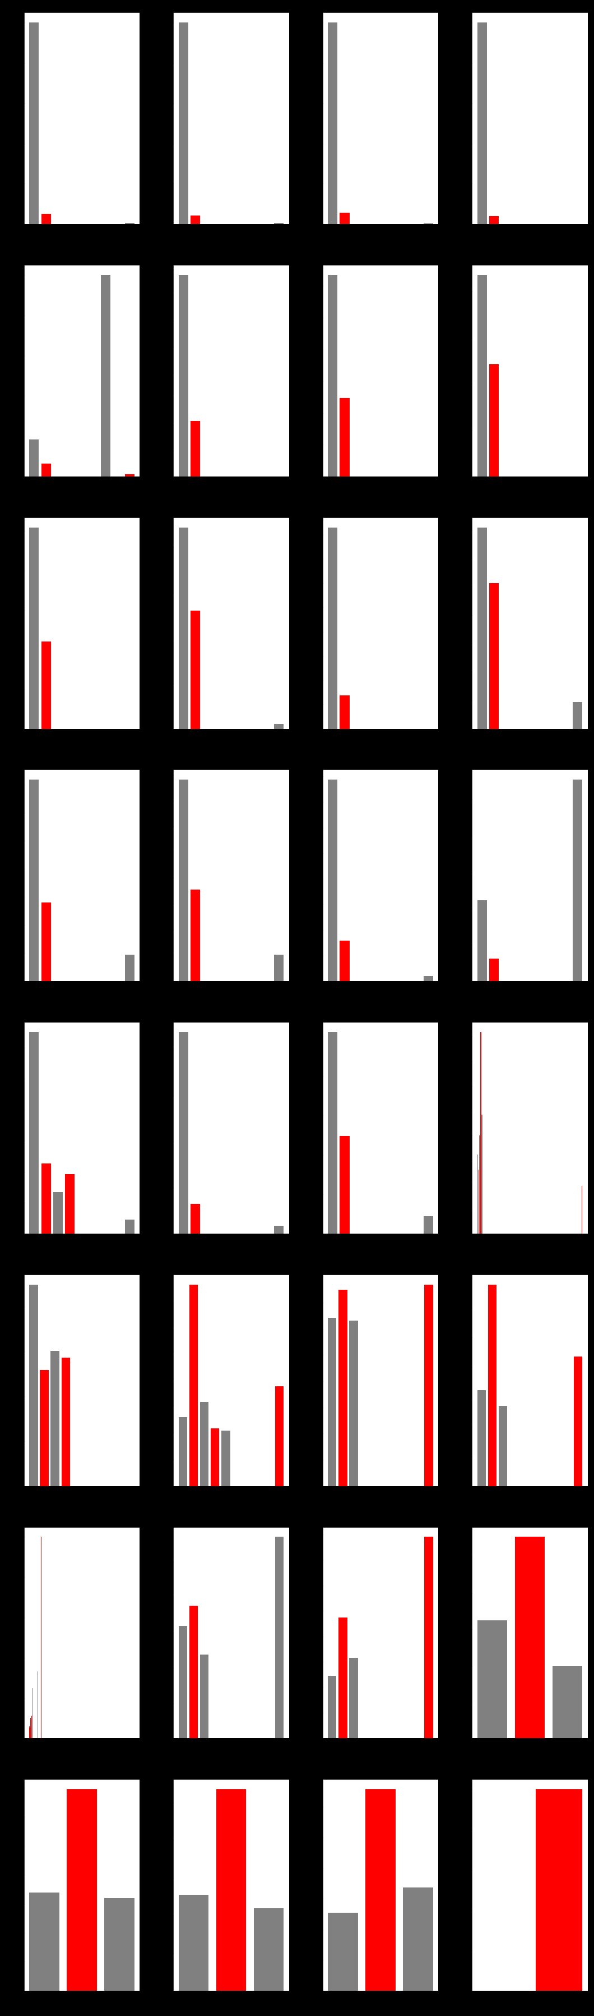
Categorical values, encoded

Slide 18
Unsupervised Learning: Clustering
Classification problem
Used 3 data sets:
Combined (body measurements + lab data)
Body measurements
Lab data
Attempted clustering 3 ways:
kmeans cluster, mini batch kmeans, and means shift

Slide 19
Unsupervised Learning: Clustering
Best performing per silhouette score:
combined cluster (body measurements & labs), means shift : 0.2584470929714834;
lab cluster, means shift: 0.25752785123194827;
body measurement cluster, kmeans: 0.17285573317869343;
Add clusters to data set as a variable in supervised model.

Slide 20
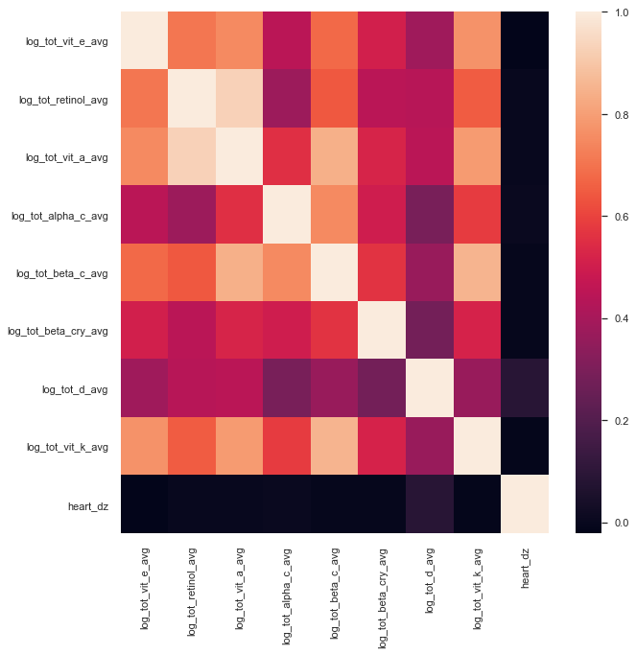
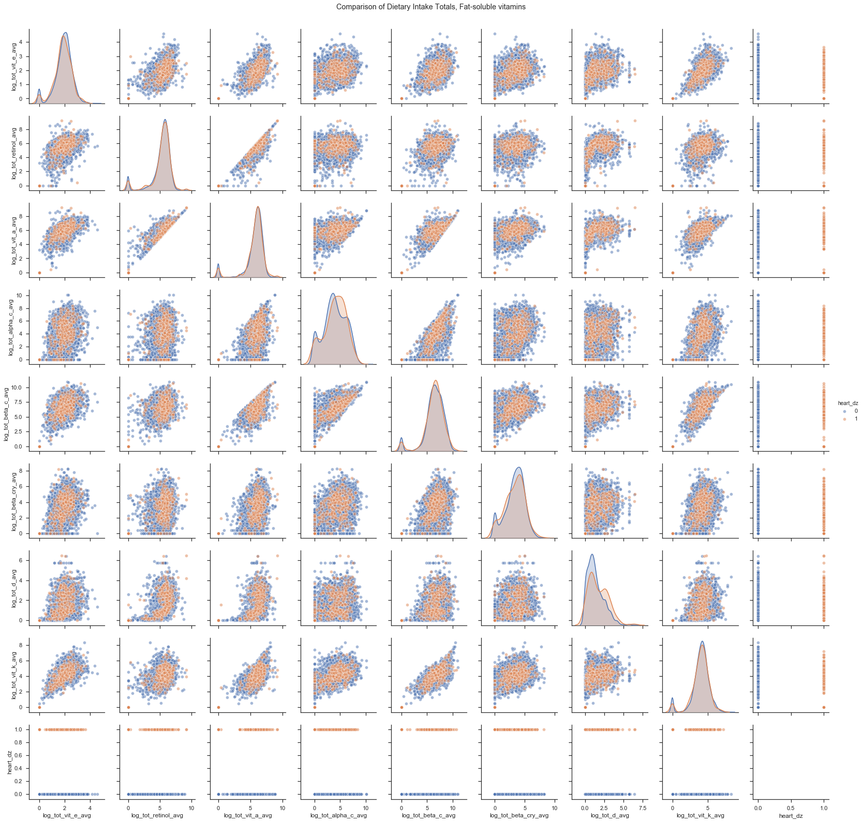
Supervised Learning: Visualize final data set (fat-soluble vitamins)

Slide 21
Supervised Learning: Final data set
Classification problem:
Finding best features to indicate presence of heart disease
Remove highly correlated features
Pair-plots suggest non-linear relationships
Multiple features available (107)
Balanced vs Imbalanced data set
Class 0: No heart disease indicated: 4403 (93.44%)
Class 1: Heart disease indicated: 309 (6.56%)

Slide 22
Supervised Learning: Models
Models to run:
Random Forest Classifier
Gradient Boosting Classifier
Support Vector Classifier
Feature engineering
Hyperparameter tuning
Important Metrics:
Recall Class 1
F1-score Class 1
Confusion Matrix – maximize number of true positive for Class 1
AUC-ROC vs accuracy

Slide 23
Supervised Learning: Random Forest Classifier
Multiple runs of model with manipulation of above parameters
Best run: balanced data (SMOTE, oversample class 1), top 15 features, hyperparameters NOT tuned
Metrics:
Cross-validation mean score for top 15 features: 0.948072479713932
ROC-AUC mean score for top 15 features: 0.9859698648112545
Accuracy score top 15 features: 0.8896434634974533

Slide 24
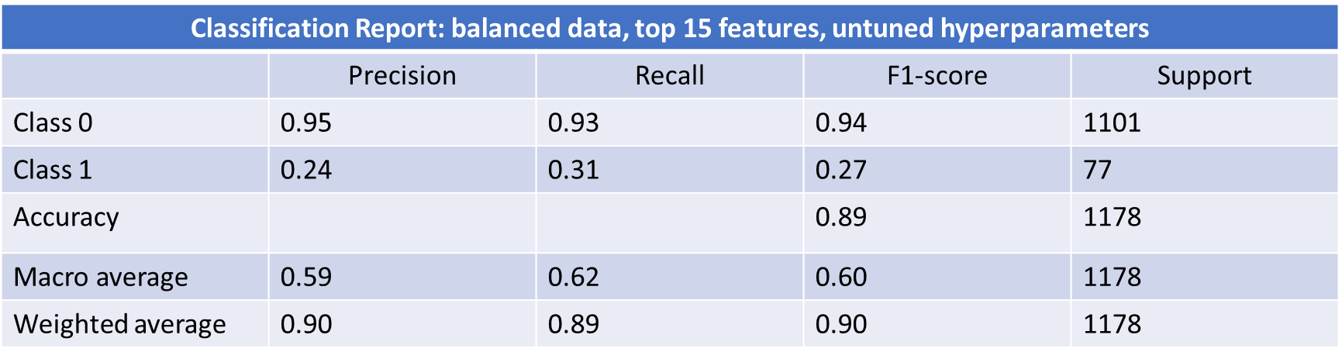
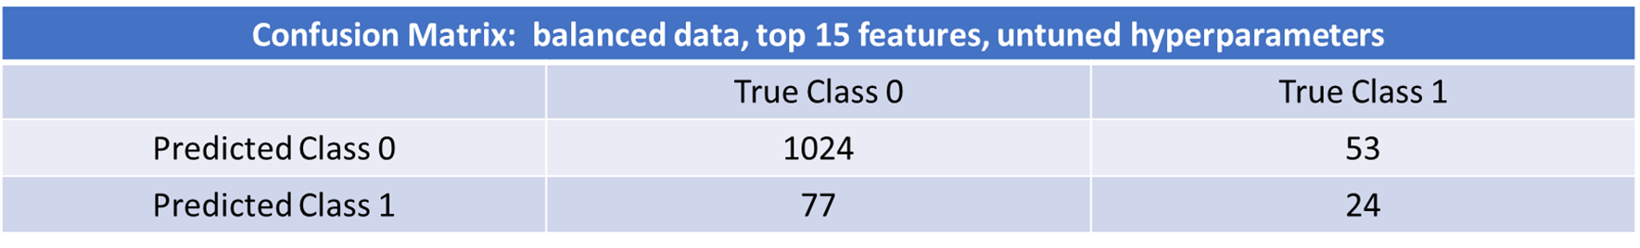
Supervised Learning: Random Forest Classifier

Slide 25
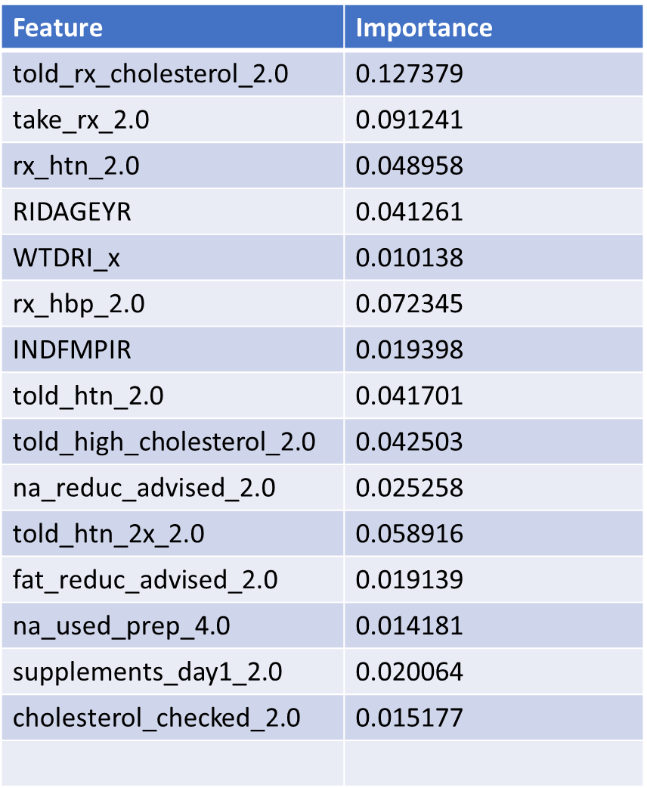
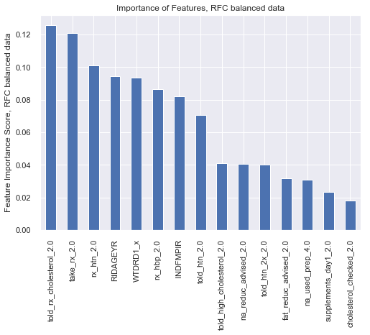
Supervised Learning: Random Forest Classifier, top 15 features

Slide 26
Supervised Learning: Gradient Boosting Model
Multiple runs of model with manipulation of above parameters
Best run: balanced data (SMOTE, oversample class 1), top 15 features, hyperparameters NOT tuned
Metrics:
Accuracy of the GBM for top 15 features: 0.876

Slide 27
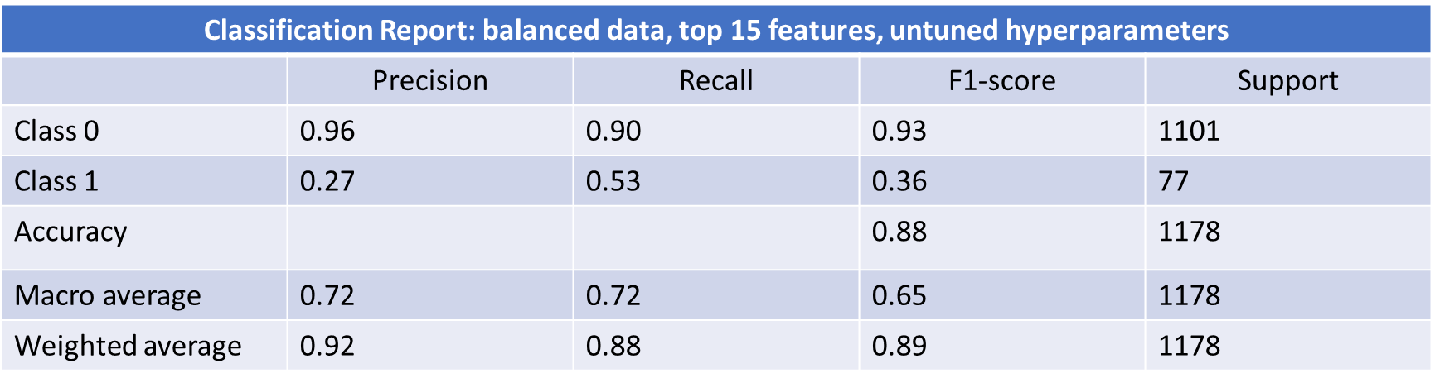

Supervised Learning: Gradient Boosting Model

Slide 28
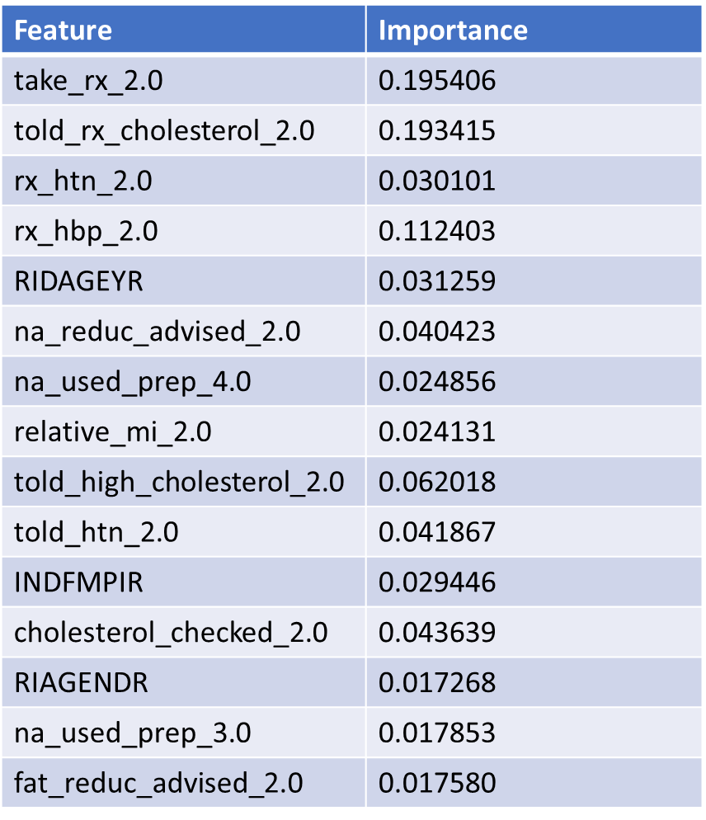
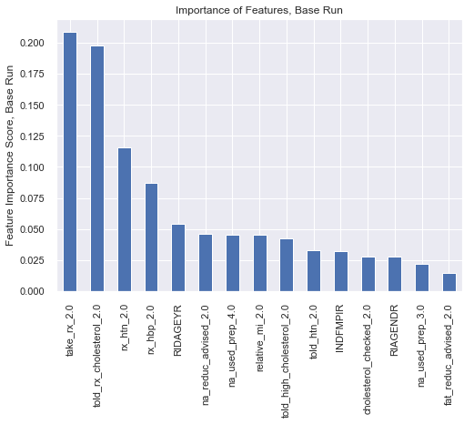
Supervised Learning: Gradient Boosting Model, top 15 features

Slide 29
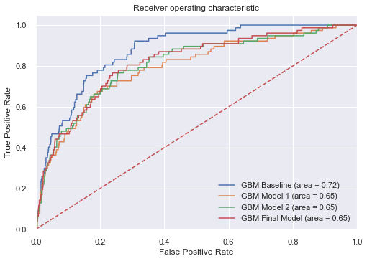
Supervised Learning: Gradient Boosting Model, tuning hyperparameters

Slide 30
Supervised Learning: SVM
Four kernels available:
Linear
Poly
RBF
Sigmoid
Multiple runs of model with manipulation of above parameters and kernels
Best run: linear kernel, balanced data (SMOTE, oversample class 1), top 30 features, hyperparameters NOT tuned

Slide 31
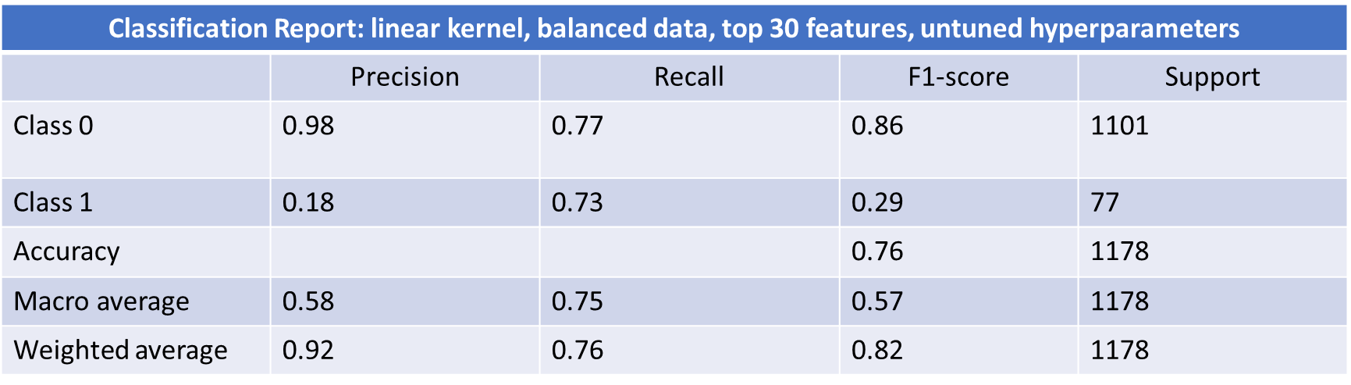
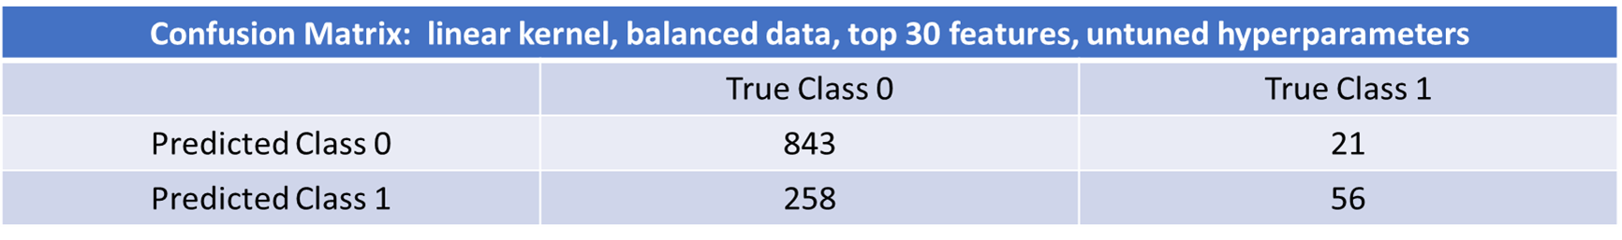
Supervised Learning: SVM

Slide 32
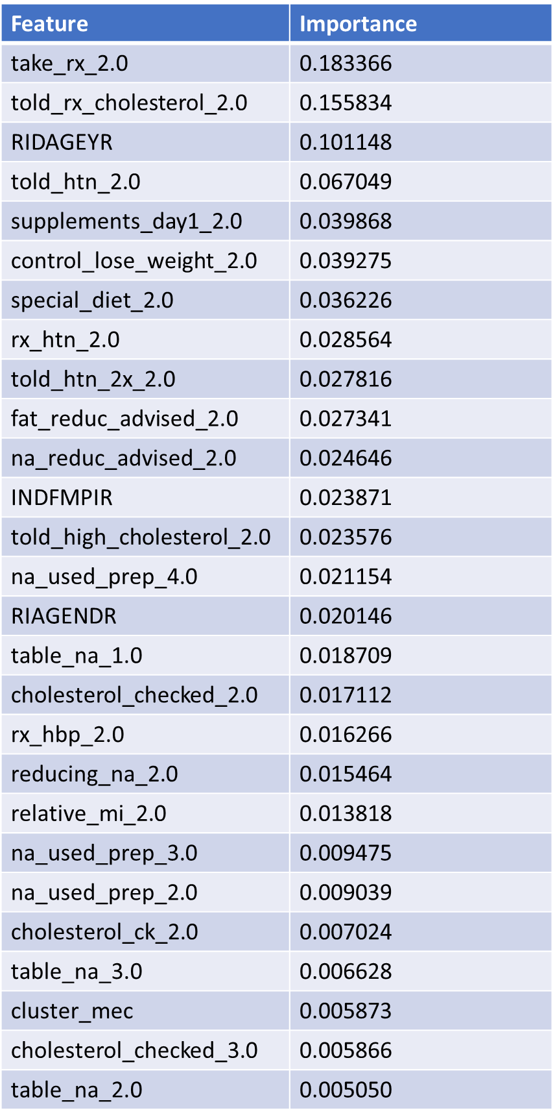
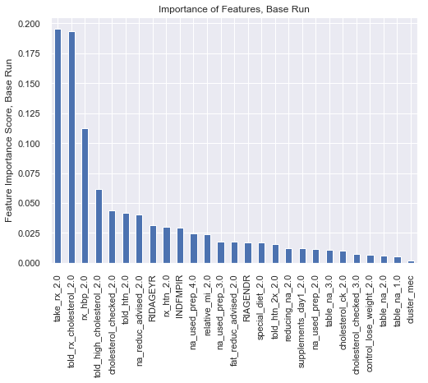
Supervised Learning: SVM, top 30 features (from GBM model)

Slide 33

Supervised Learning: SVM, also best?
Classification Report: linear kernel, balanced data, top 15 features, untuned hyperparameters
 | Precision | Recall | F1-score | Support
Class 0 | 0.97 | 0.84 | 0.90 | 1101
Class 1 | 0.22 | 0.65 | 0.33 | 77
Accuracy |  |  | 0.82 | 1178
Macro average | 0.59 | 0.74 | 0.61 | 1178
Weighted average | 0.92 | 0.82 | 0.86 | 1178

Slide 34

Supervised Learning: SVM, top 15 features (from RFC model)

Slide 35
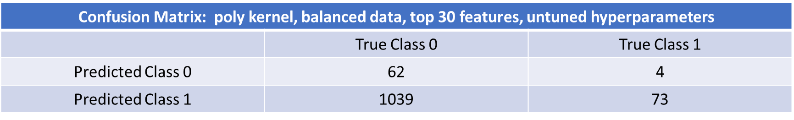
Supervised Learning: SVM, also best?
Classification Report: poly kernel, balanced data, top 30 features, untuned hyperparameters
 | Precision | Recall | F1-score | Support
Class 0 | 0.94 | 0.06 | 0.11 | 1101
Class 1 | 0.07 | 0.95 | 0.12 | 77
Accuracy |  |  | 0.11 | 1178
Macro average | 0.50 | 0.50 | 0.11 | 1178
Weighted average | 0.88 | 0.11 | 0.11 | 1178

Slide 36
Best Model?
SVM linear kernel, balanced data, top 30 features, untuned hyperparameters
Trade-off of precision for recall, but only to a certain extent
Clinical value/perspective
What else can we learn?

Slide 37
Biostatistics
Time-to-event (survival analysis)
Indicating likelihood of onset of heart disease by age
Differences in gender at onset of heart disease
Likelihood to develop heart disease by age

Slide 38
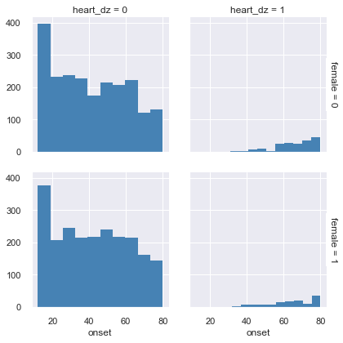
Biostatistics: current incidence of heart disease by gender/age

Slide 39
Biostatistics: time-to-event summary
Time | Surv prob | Surv prob SE | Number at risk | Number events
32 | 0.999360 | 0.000640 | 1563 | 1.0
37 | 0.997222 | 0.001389 | 1402 | 3.0
38 | 0.995765 | 0.001727 | 1369 | 2.0
41 | 0.002045 | 0.002045 | 1280 | 2.0
45 | 0.987486 | 0.003122 | 1121 | 2.0
50 | 0.984490 | 0.003560 | 944 | 1.0
55 | 0.972916 | 0.005068 | 770 | 3.0
60 | 0.950833 | 0.007512 | 602 | 4.0
65 | 0.917885 | 0.010720 | 421 | 5.0
70 | 0.866525 | 0.015382 | 264 | 4.0
75 | 0.821899 | 0.020097 | 163 | 2.0
80 | 0.569251 | 0.039046 | 94 | 22.0

Slide 40
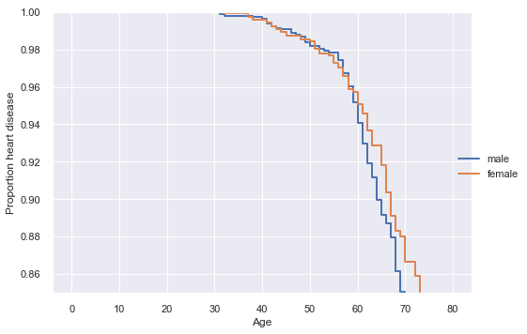
Biostatistics: Survival plot (age of onset) by gender

Slide 41
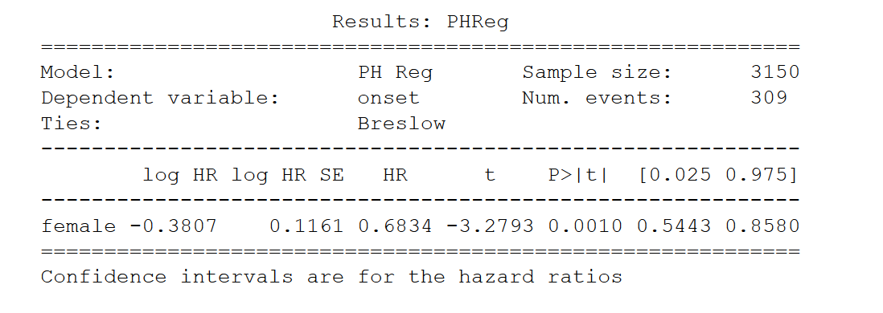
Biostatistics: Cox PH test gender difference

Slide 42
The practical uses of the model
Predictive power
Confirms what is known about heart disease
Risk factors:
Age
Gender
Elevated blood pressure and cholesterol
SODIUM use
Poverty
Body measurements/weight

Slide 43
The practical uses of the model
Explanatory power

Slide 44
Weak points/shortcomings of model
Random Tree Classifier is considered a “black box”

Slide 45
What do you anticipate to be the biggest challenge you’ll face?
The sheer size of the data is a challenge. The survey program is divided into five major categories: Demographic, Dietary, Examination, Laboratory, and Questionnaire Data. Each of these five major catgories has multiple sub-categories. There are 5,000+ respondants every year since 1999.
The subcategories each contain multiple files of individual variables/features. There are literally thousands of possible features available. These variables must be paired down to a managable level prior to reading into Python.
In addition to the quantity of data available, the structure of the data presents challenges. The data are only available in the SAS platform/format. In order to work with the data in Python, the SAS Universal Viewer must be installed locally. Once converted to a CSV format, the multiple files must be read into Python and merged together before and work can be done.

Slide 46
Conclusions
Healthcare in the United States is among the costliest and most inefficient in the industrialized world
Efforts to improve care and reduce expenses is in the best interest of all involved
Better understanding of the factors which contribute to the incidence of heart disease is vital in improving care and reducing expenses

