Slide 1
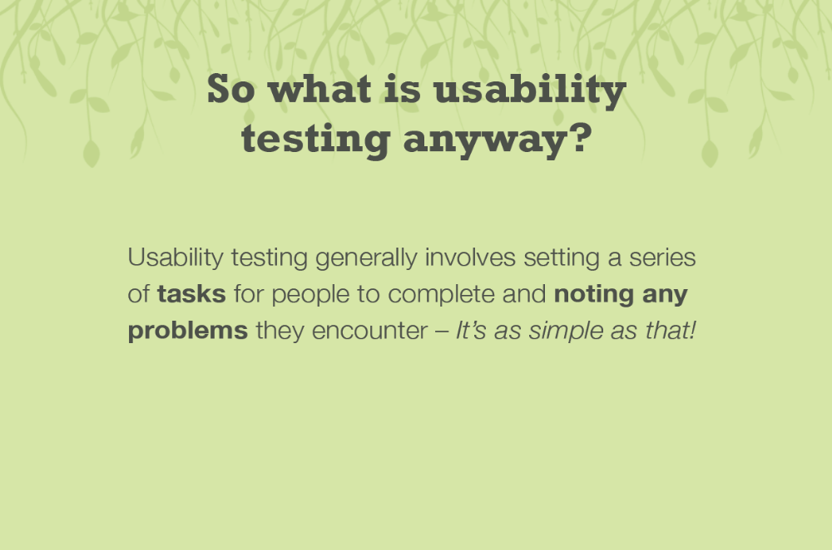

Slide 2
Human Factors –
Usability testing for web designing
What is ….
Why is it required ….
Who tests for whom
How is Usability testing performed
Characteristics
Benefits
Don’t dos
Point Blank
Certifications – QA and Testing

Slide 3
Requirement for Usability testing
› Identify and capitalize on opportunities that will enable successful penetration of the market
› Analyze the impact of trends and lifestyle changes on users to develop appropriate positioning and design of new products and services
› Capture rich data that will enable in-depth understanding of the users and their ecosystems
› Synthesize and co-relate data in a systemic way that will inspire innovative ideas
› Correlate design research, market understanding and business goals to define new markets, branding strategies, product positioning, and new business models
› Translate actionable insights to new product, service and business ideas that will have a positive impact on the lives of users
› Validate and test new ideas to minimize risks and determine criteria that are important for success

Slide 4
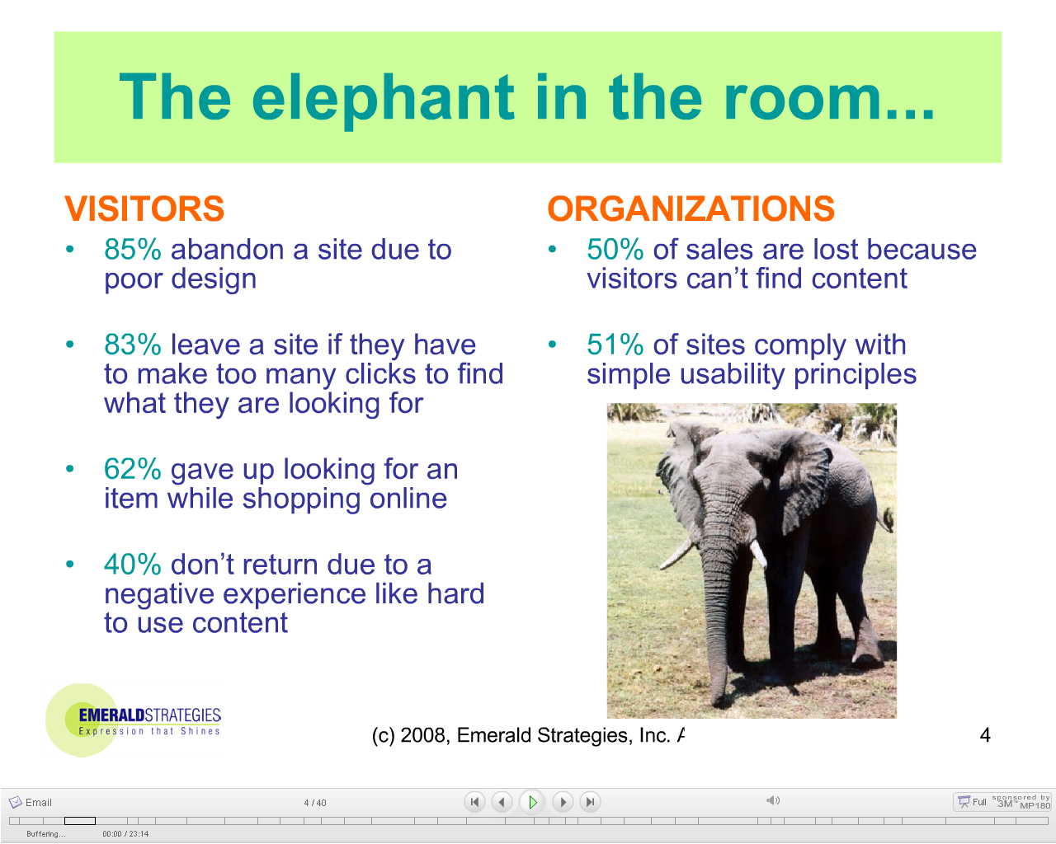

Slide 5
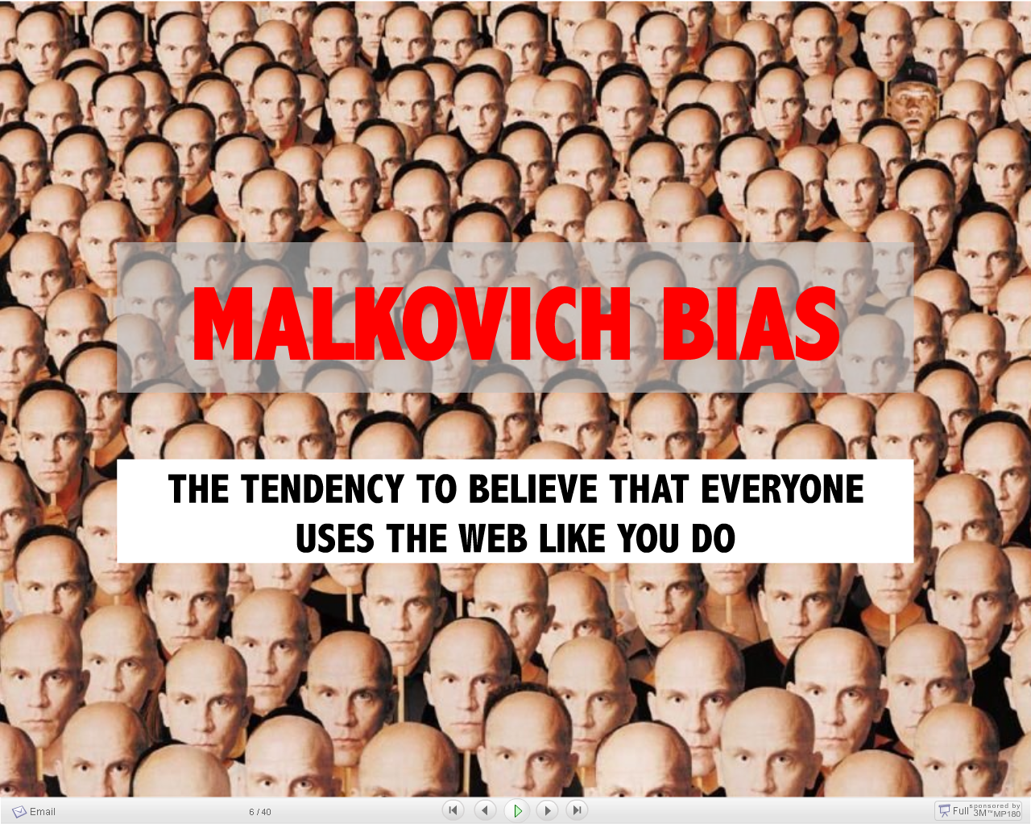

Slide 6
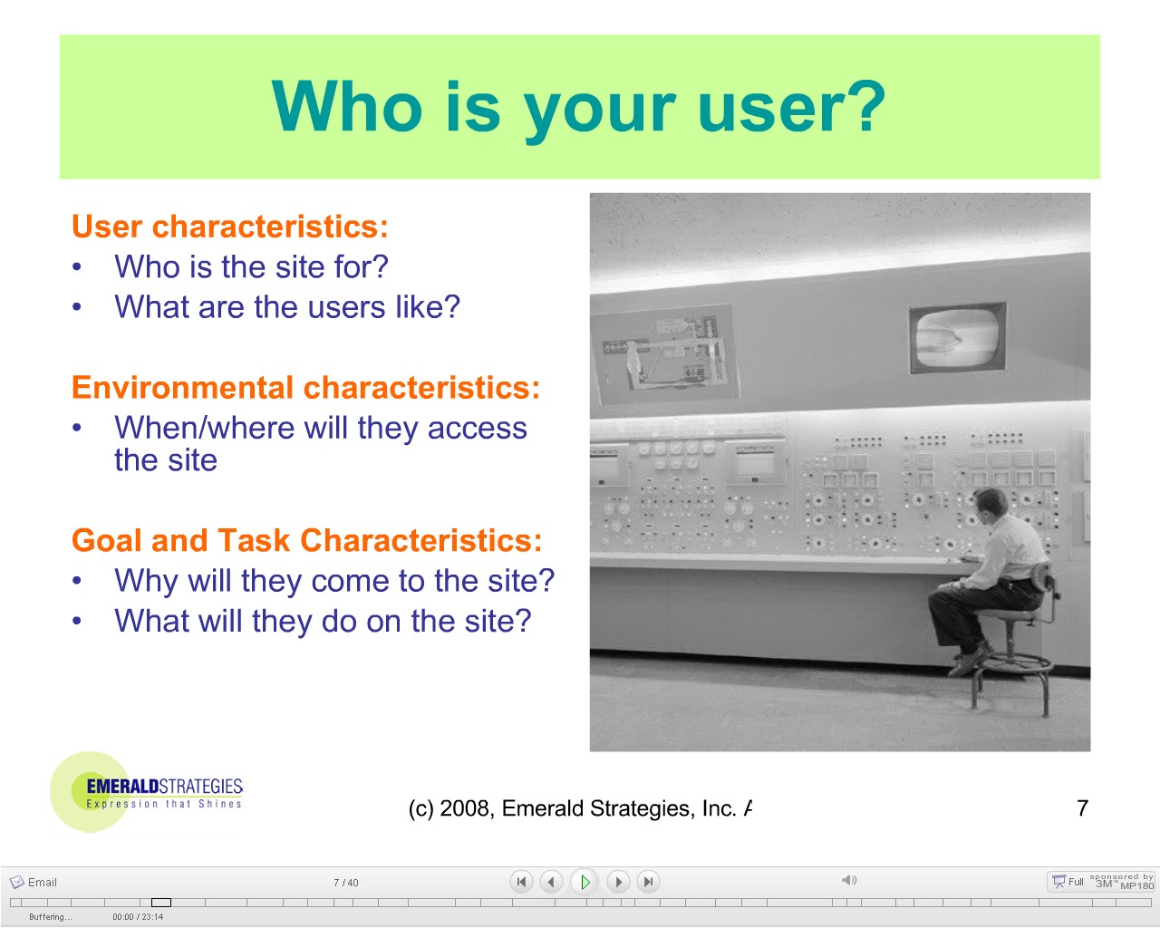

Slide 7
Usability considerations
Corporate hosting or public hosting
Who are the users, what do they know, what can they learn?
What do users want or need to do?
What is the users' general background?
What is the users' context for working?
What must be left to the machine?
Does the product meet the special needs of disabled users?
Is the user interface intuitive (self-explanatory)?
Is it easy to perform simple operations?
Is it feasible to perform complex operations?
Does the software give sensible error messages?

Slide 8
In a general test you want to know:
how do users interact with the web site you are testing?
what is difficult for people to do?
where do they go out of track?
what makes sense to them?
what makes them feel distrustful or insecure?
what do they like and what do they hate?

Slide 9
When evaluating the design and usability of a website, consider the following -
Know the user, and YOU are not the user
Things that look the same should act the same – live upto visual expectations
The information for the decision must be there when the decision is needed.
Error messages should actually mean something to the user and tell the user how to fix the problem – Meaningful and contextual error messages
Every action is expected to have an appropriate reaction – Newton’s law?
Everyone makes mistakes, rollback or fix should be included
Don't overwhelm the user
Consistency, consistency, consistency
Minimize the need for a mighty memory
Keep it simple
The user should always know what is happening
The user should control the system. The system should not control the user. The user is the boss and the system should show it
Eliminate unnecessary decisions and illuminate the rest.
The best journey has the fewest steps. Shorten the distance between the user and the goal.
Alert users to an error before things get lengthy or voluminous
Users should always know how to find out what to do next – procedural Information
Strive to empower the user, not speed up the system

Slide 10
Qualities of a usable Web site
Learnability
  Can customers easily grasp how to use the site the very first time?
Memorability
  Do customers remember how the next time?
Ease-of-use
  Can customers navigate easily?
  Is the design consistent and predictable?
Efficiency
  Can customers complete tasks and transactions effectively?
Appeal
  More than visual: do customers feel positive about the experience?

Slide 11
Characteristics of a usability test
Uses real customers (users)
Customers perform actual tasks with the site or a prototype
Data is recorded
  May be qualitative or quantitative
  Includes customer comments
Provides objective information
Facilitated by a skilled specialist
Observed by a skilled specialist
Notes:
Note: you would specifically not use the people who designed the site as usability testing participants

Slide 12
Customer-centered design process
Analysis
Understand objectives
Understand customers
Understand their tasks
Design
Develop design concept
Specify the details
Iterative!
Evaluation
Test with real customers (usability testing)
Review with design specialists

Slide 13
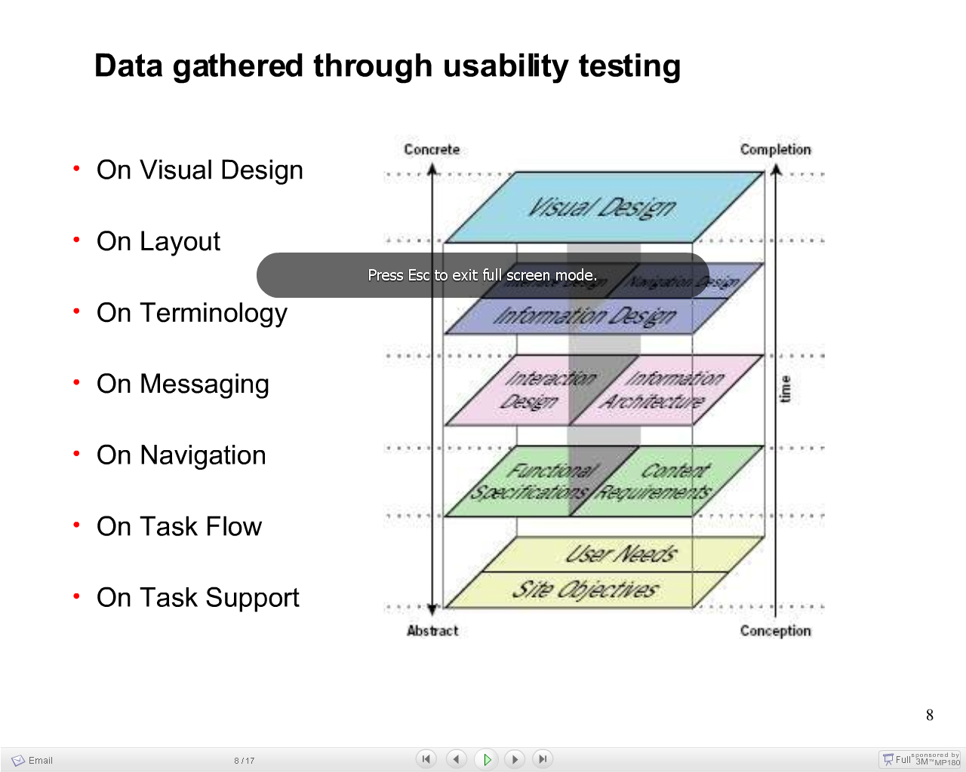

Slide 14
Discoverability
Is the user ever expected to do something that is not obvious? (e.g., Are important features only accessible by right-clicking on a menu header, on a text box, or on an unusual GUI element?)
Are there hints and tips and shortcuts that appear as the user is using the software?
Should there be instructions in the manual that actually belong as contextual tips shown in the program?
Is the user at a disadvantage if they don't know certain keyboard shortcuts? A user has the right to know all major and minor keyboard shortcuts and features of an application.
Is the learning curve (of hints and tips) skewed towards point-and-click users rather than keyboard users?
Quick helps or action wizards

Slide 15
What and Why PET design?
Persuasion, emotion, and trust are critical factors for creating successful online interactions.
Traditional user-centered design focuses on designing for usability, it is now essential to leverage the science of PET to influence users.
Your site can be an application, or product is informational, functional, or transactional,
PET design is a proven method how to motivate people to make decisions that lead to conversion.
Create designs that motivate specific actions and align with measurable business goals
Increase customer conversion, loyalty, and adoption
Test and measure the emotional impact and credibility of your website
Present PET design research and user analysis with concrete deliverables, including: PET personas, persuasion flow diagrams, emotion maps, strategies, and trust scorecards

Slide 16
Designing for Trust
Before you can persuade customers to act,
you must ensure that your site engenders trust.
Learn how to: design for credibility and trust,
take hygiene factors into consideration, and how
various online “markers” engender trust such
as—credible organizations, design quality, FAQs, citations, current content, archives, testimonials and more.

Slide 17
Emotional Design
Learn how to tap customer emotion to increase
engagement via proven psychological principles
- including: utility, practicality, and drive fulfillment;
hierarchy, specificity, and depth of needs;
Eliciting negative and positive emotions; optimal levels of stimulation;

Slide 18
Persuasion Design
Once the emotions are tapped, introduce
the science of persuasion.
Learn the psychological constructs required to get your consumers to act—every time.
Discover how to use pay, impression, and pressure to your advantage via: extrinsic
rewards, unanticipated costs, contrast principle,
social proof, social learning, the power of people
We like, scarcity, and more.

Slide 19
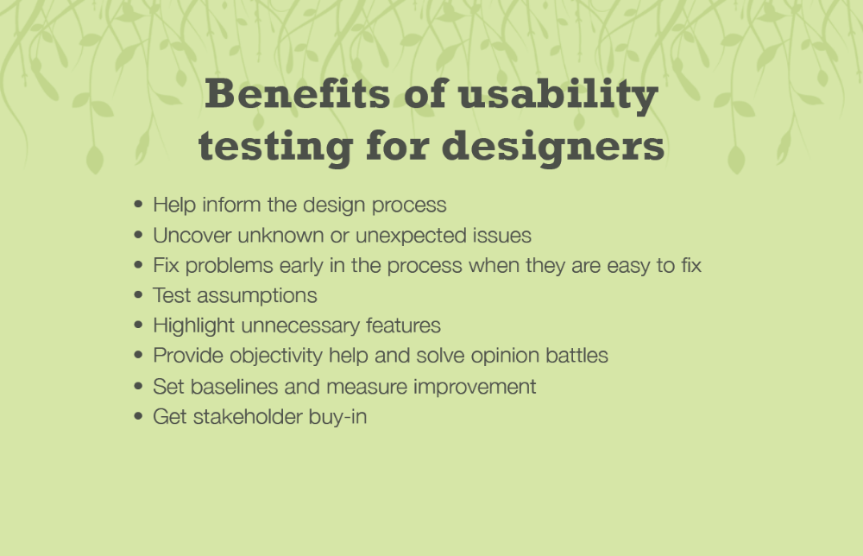

Slide 20
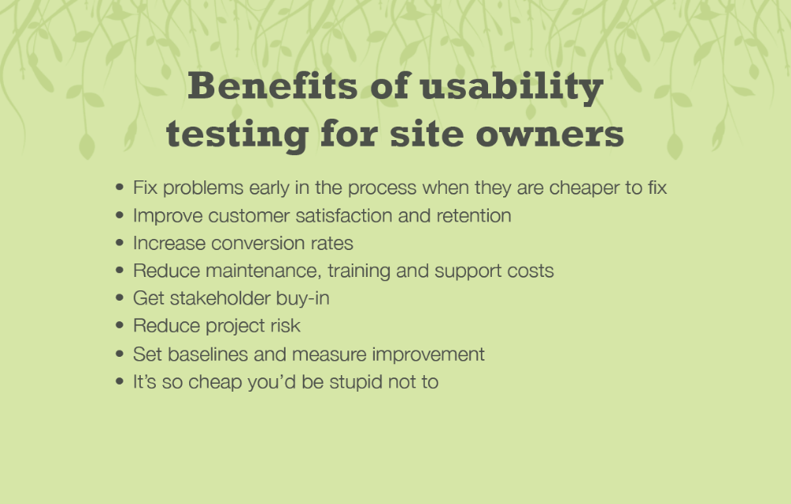

Slide 21
Things to avoid
Provide compelling content / something of value
Avoid Sleazy Elements – distracting effects – colors, pictures, fonts,etc.
Don't annoy your visitors with pop-up windows
Don't use image backgrounds
Put some thought into content organization
Minimize clicking!
Limit page length to 2 screenfuls, or 6-7 screenfuls for articles.
Include a way to get back to the home page, on every page
Don't use frames
Compress your image files
Website Readability – text, page width, colours, backgrounds
Make viewable or highlight – Links
Be Accessible - Contacts
Make sure it works, and that it keeps working -3rd Party links
No Negative stuff should be encouraged

Slide 22
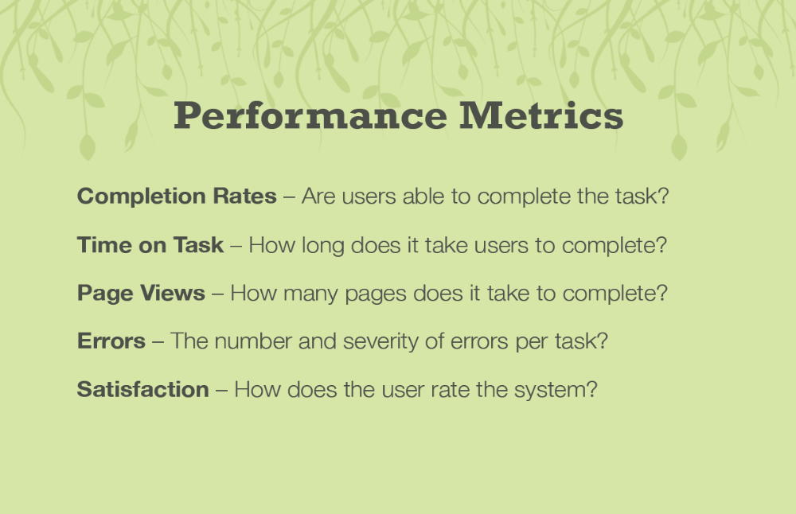

Slide 23
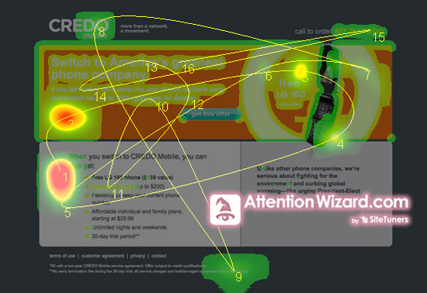

Slide 24
QA/ Testing Certifications
CUA – Certified Usability Analysts
CXA – Certified User Experience Analyst
Certified Associate in Software Quality (CASQ)
Certified Associate in Software Testing (CAST)
Certified Associate Business Analyst (CABA)
Certified Software Business Analyst (CSBA)
Certified Software Process Engineer (CSPE)
Certified Quantitative Software Process Engineer (CQSPE)

Slide 25
Sources
Eternal Google
Human Factors International - HFI
Slideshare.net
Various generous people across the world

Slide 26
Finally….
Wishing all of you a Happy, Prosperous, Healthy, Wealthy, Joyous Years ahead

Slide 27
THANK YOU
PRESENTED BY
-N PRANEETH

