Slide 1



AUGUMENTED REALITY IN EDUCATION
USING AR CORE
Presented By,
KATHIRVEL P (811722104070)
MOHANA RENGAN N (811722104090)
NIKHAAL AHAMED A K (811722104101)
Guided By,
Mr. M.Saravanan, M.E.,
09/06/2025

Slide 2


ABSTRACT
Traditional teaching is often passive and lacks engagement.
AR provides an interactive, visual learning environment.
This project uses ARCore and Unity for real-time educational simulations.
Students can explore concepts like circuits and electronics hands-on.
The goal is to boost retention and simplify complex topics.
09/06/2025

Slide 3
OBJECTIVE
Implement Augmented Reality (AR) to enhance engagement.
To expand immersive learning through ARCORE.
Address rote memorization with interactive learning and improve knowledge on the required domain.
Develop real-world AR simulations for more understanding of the concept to improve user experience
Simulate real-world electrical experiments using AR.
Deliver accessible and user-friendly learning tools.
09/06/2025

Slide 4
LITERATURE SURVEY
S.No. | Paper Title | Year | Remark
1 | Applications of AR in Electrical Engineering Education | 2024 | Demonstrates how AR enhances engagement and simulates virtual labs for better understanding
2 | AR Tools for Circuit Simulation | 2024 | Focuses on interactive AR tools for building and testing electrical circuits.
3 | Use of AR to Reinforce Learning of Power Electronics | 2023 | Implements AR for visualizing RLC circuits and converter behavior with hands-on interaction
09/06/2025

Slide 5
LITERATURE SURVEY
S.No. | Paper Title | Year | Remark
4 | Real-Time Markerless Tracking for AR on Mobile Devices | 2023 | Explores efficient AR tracking without markers using computer vision for mobile platforms.
5 | Interactive AR System for Industrial Assembly Tasks | 2022 | Enhances assembly processes using AR for step-by-step guidance and accuracy.
6 | Immersive AR Environments for Smart City User Experience | 2022 | Uses AR to evaluate and improve user interaction in smart city applications.
09/06/2025

Slide 6
LITERATURE SURVEY
S.No. | Paper Title | Year | Remark
7 | Object Recognition in AR Environments | 2022 | Focuses on enhancing AR with machine learning for accurate object identification.
8 | Efficient 3D Object Tracking for AR Applications | 2021 | Improves AR interaction using robust 3D object tracking techniques.
9 | AR Applications in Healthcare | 2021 | Reviews AR tools used for medical training, surgery planning, and diagnostics.
09/06/2025

Slide 7
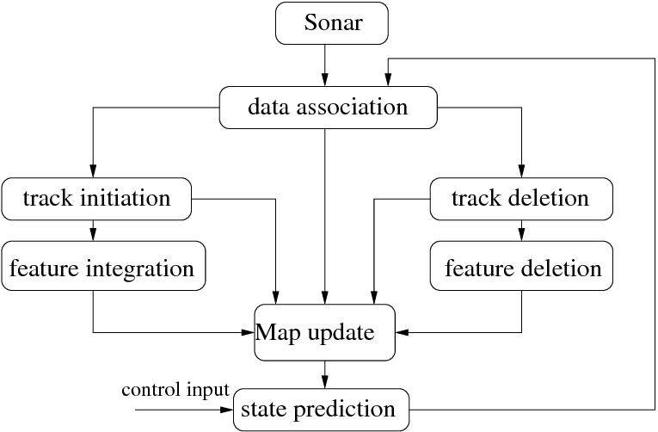
EXISTING SYSTEM
09/06/2025

Slide 8
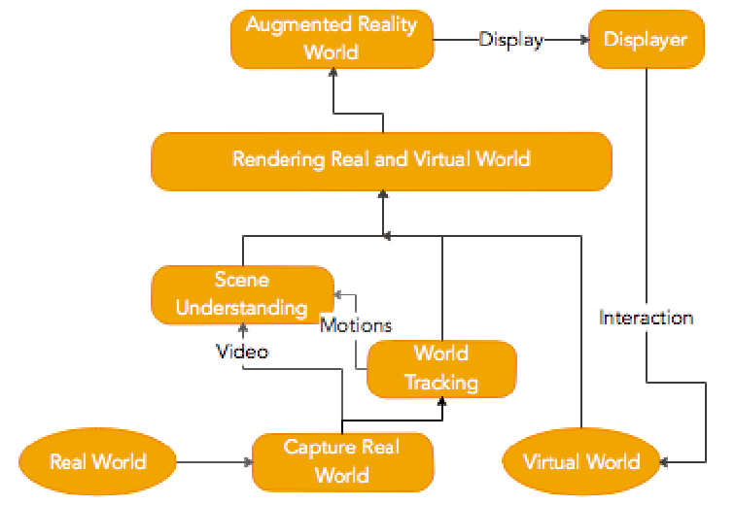
PROPOSED SYSTEM
09/06/2025

Slide 9
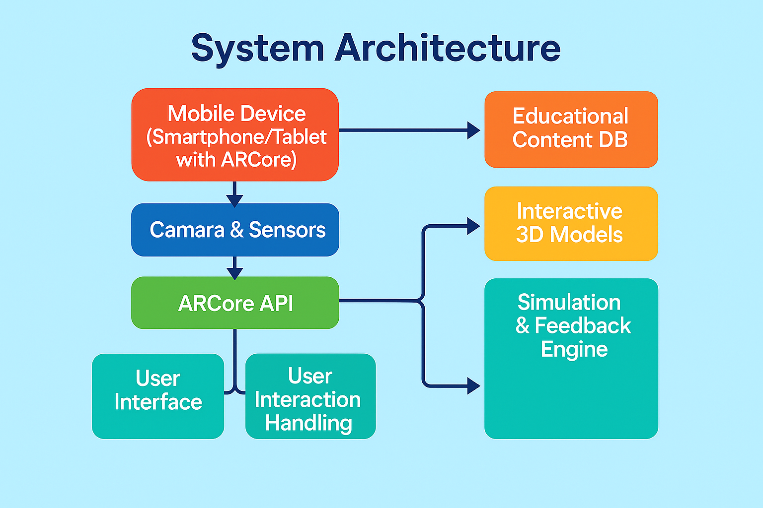
SYSTEM ARCHITECTURE
09/06/2025

Slide 10
MODULE 1 : USER INTERFACE(UI)
Description:
This module manages all the visual elements with which users interact, such as buttons, menus, and navigation tools. It provides an intuitive layout to control the AR experiences.
Key Features:
Simple and accessible layout for students and educators. Options to choose between various electrical engineering simulations or experiments. Start, pause, and reset features for experiments. Help and tutorial section for new users.
09/06/2025

Slide 11
MODULE 2 : 3D OBJECT RENDERING
Description: Handles the creation, loading, and manipulation of 3D models in the AR/VR environment. This is essential for creating simulations of electrical components (resistors, circuits, transformers, motors, etc.).
Key Features:3D models of electrical equipment (transformers, circuit boards, etc.). Zoom, rotate, and inspect features for better visualization.
Dynamic updates to objects (e.g., changing the resistance in a circuit affects other components).
09/06/2025

Slide 12
MODULE 3 : AR DISPLAY AND TRACKING
Description: Controls the way AR/VR content is displayed and tracked in the real or virtual environment. For AR, it integrates marker-based or markerless tracking, while VR involves handling head tracking and peripheral inputs.
Key Features: AR Module: Uses Vuforia/ARCore/ARKit for image or marker-based tracking (e.g., place virtual circuits on physical tables or equipment).
VR Module: Implements immersive environments where students can interact with virtual tools and systems using headsets like.
09/06/2025

Slide 13
MODULE 4 : SIMULATION AND INTERACTION
Description: Allows the users to perform real-time experiments or simulations in the AR/VR environment. This module controls how components behave based on user inputs and how real-world interactions impact the virtual objects.
Key Features: Simulates physical phenomena (e.g., electric current flow, voltage changes, circuit behaviors).
Interactive components like switches, resistors, capacitors, motors that can be connected and tested.
Provides feedback based on the simulation results (e.g., changing resistance affects voltage levels).
09/06/2025

Slide 14
MODULE 5 : EARNING AND EVOLUTION
Description: This module incorporates assessments and guides that help users learn and test their knowledge.
Key Features: Interactive quizzes, problem-solving tasks, or experiments to validate student understanding.
Provide hints or tutorial pop-ups to guide the user through complicated tasks.
Track performance (time taken, accuracy, completion of tasks) and provide results or evaluations.
09/06/2025

Slide 15


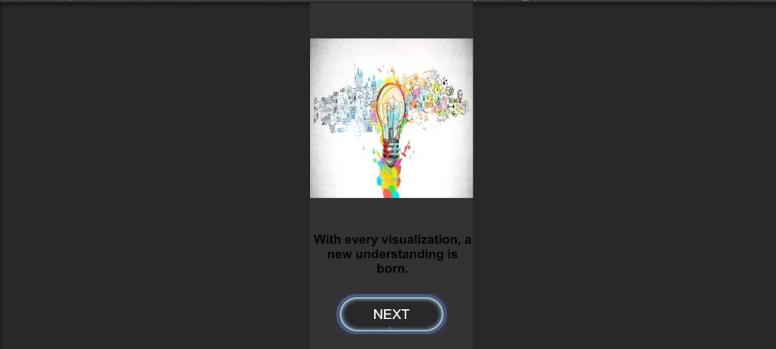

OUTPUT
DD/MM/YYYY

Slide 16

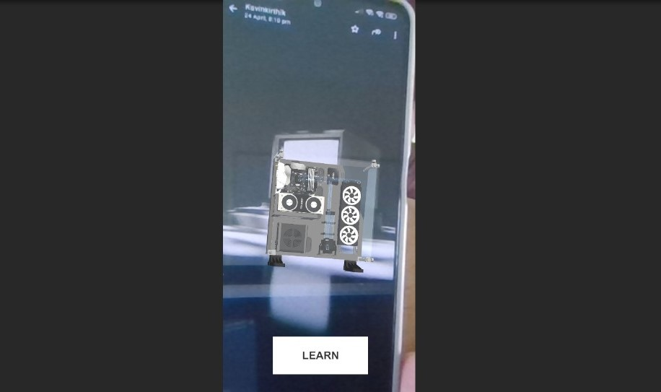
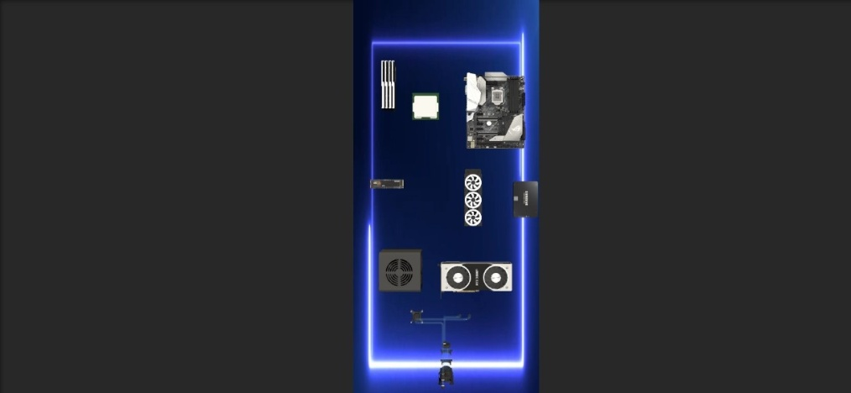
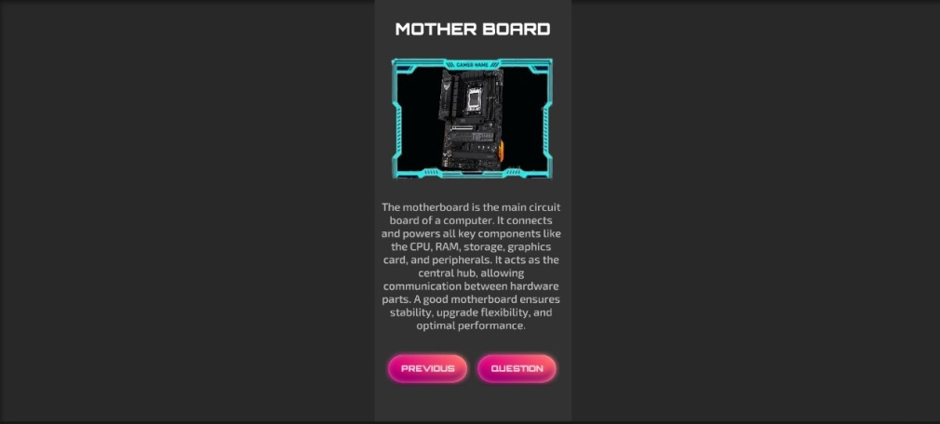
OUTPUT
DD/MM/YYYY

Slide 17


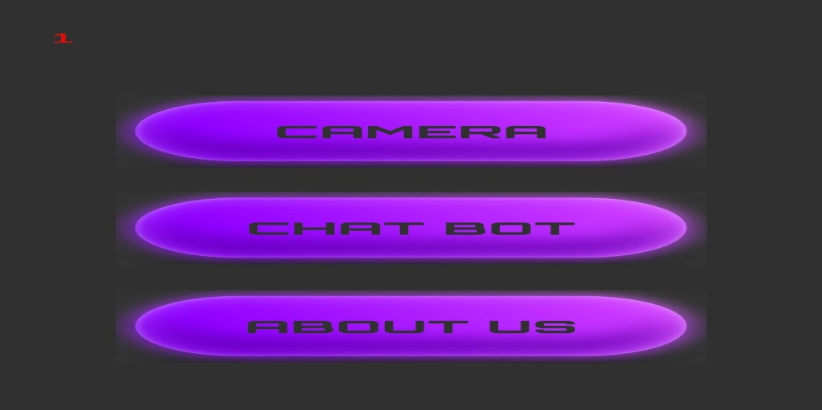
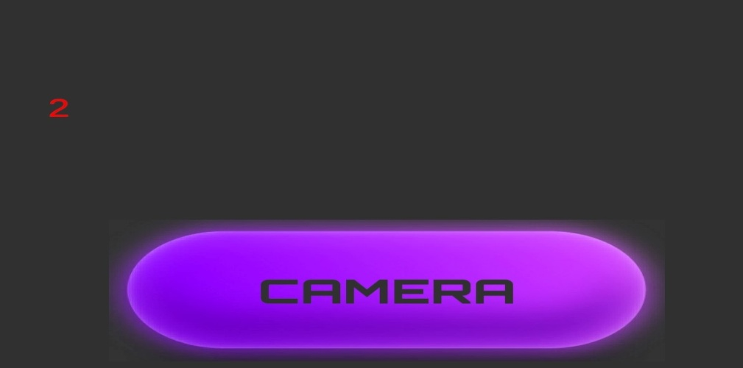
OUTPUT
DD/MM/YYYY

Slide 18
CONCLUSION & FUTURE ENHANCEMENT
1. Successfully developed an AR application for electrical engineering education using ARCore.
2. Improved student engagement, understanding, and accessibility through immersive virtual simulations.
3. Application is stable, user-friendly, and compatible with various Android devices.
4. Future Enhancements include gesture-based controls, multi-user collaboration, and cross-platform support.
5. Integration of AI and machine learning planned for smarter object recognition and adaptive learning experiences.
09/06/2025

Slide 19
REFERENCES
Liu, H., Wang, Q., & Chen, Y. (2024)."Enhancing STEM Learning through AR-based Mobile Applications: A Case Study Using ARCore." Journal of Educational Technology & Society, Ramos, A., & Ortega, M. (2023)."Integrating ARCore with Unity for Immersive Science Education."International Journal of Interactive Mobile Technologies,17(2), 45–58. Patel, R., & Singh, N. (2023)."Augmented Reality in Engineering Education: A Practical Review of ARCore-Based Tools." Education and Information Technologies, 28, 10345–10361. Martínez, J. A., & Torres, D. (2022). "Unity and ARCore for Real-Time Learning Environments in Physics." Computers & Education: Artificial Intelligence, 3, 100053. Chowdhury, S., & Islam, M. (2022). "Design and Evaluation of an AR-Based Learning System for Circuit Simulation." IEEE Access, 10, 87654–87668.
09/06/2025

Slide 20

DD/MM/YYYY

