Slide 1
Java Full Stack Development
Introduction to Java, Frontend, Backend, Databases, JVM, JRE, JDK and Eclipse IDE

Slide 2
What is Java Full Stack?
Java Full Stack Development means developing both front end and back end applications using Java technologies.
Front end handles user interface and user interaction.
Back end handles business logic, API and server-side processing.
Database stores application data.

Slide 3
Front End Development
Front end is the visible part of the application.
Technologies: HTML, CSS, JavaScript, React, Angular,Thymeleaf,jquery.
Responsible for user experience and design.
HTML , CSS and JavaScript are the core pillars of front end Development.
These are programming language to create a browser Based Application.
React js is a JavaScript Library
Bootstrap(Twitter) and Tailwind CSS

Slide 4
Back End Development
Back End is the server-side part of the application.
Technologies: Java, Spring Boot, JavaScript,Python,.Net,PHP.
Handles business logic, API and authentication.
JS2E,J2EE,Jakarta EE
MVC Architecture
Spring Framework, Spring MVC, Spring Webflux,Spring Security,Spring Boot
Hibernate, Spring JPA and Spring JDBC

Slide 5
BUILD and VERSION CONTROL TOOLS
Build Tool: Maven, Gradle
Version Control: Git and Git Hub

Slide 6
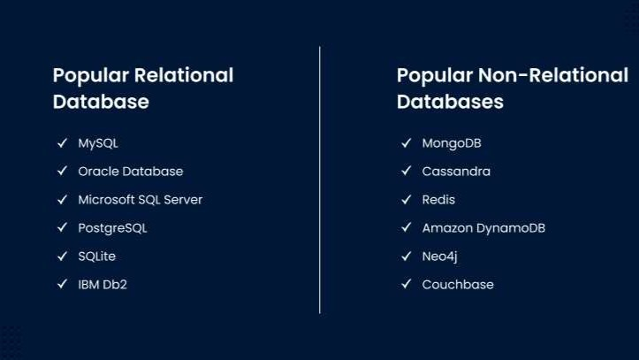
Databases
Databases store and manage application data.
Examples: MySQL, Oracle, PostgreSQL, MongoDB,SQLite,H2 Databases.
Supports data retrieval, updates and transactions.
MySql Mapping is difficult-- DB→Table(Rows and Columns)
MongoDb Mapping is easy—DB→Collection→Document→BSON
(Binary JSON light Weight)

Slide 7
Server
Apache Tomcat Server- Acts like a engine for the programming.
Apache Tomcat is an open-source web server and servlet container developed by the Apache Software Foundation. It’s mainly used to run Java-based web applications.
Tomcat implements key Java web technologies:
  Servlets (Java classes that handle requests/responses)
  JSP (JavaServer Pages) (dynamic web pages)
  WebSocket (real-time communication)
So instead of serving just static HTML like a basic web server, Tomcat can execute Java code on the server.
Other Servers in Market :Glassfish,Nginx

Slide 8
Java Full Stack Architecture
Front end
HTML, CSS,
JavaScript, React
Back end
Java,
Spring Boot
Database
MySQL,
Oracle

Slide 9
Introduction to Java
Java is a high-level(easy to read,write and Understand), object-oriented programming language.
Java was first developed in 1990s by James Gosling(Green Team)
Its initially name was OAK. In 1994 OAK was renamed as Java.
Developed for Sun Micro Systems.
Now Oracle is the Owner of Java from 2010. Sun Micro System is Subsidiary for Java.
Platform independent because of JVM.
Used for web, desktop, mobile and enterprise applications.

Slide 10
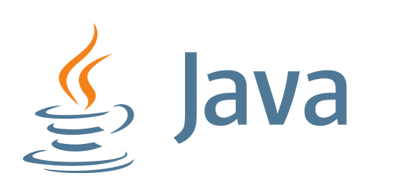
Java logo

Slide 11
Java Version
Jdk -26 but LTS version is Java 25.Still widely used java 21.

Slide 12
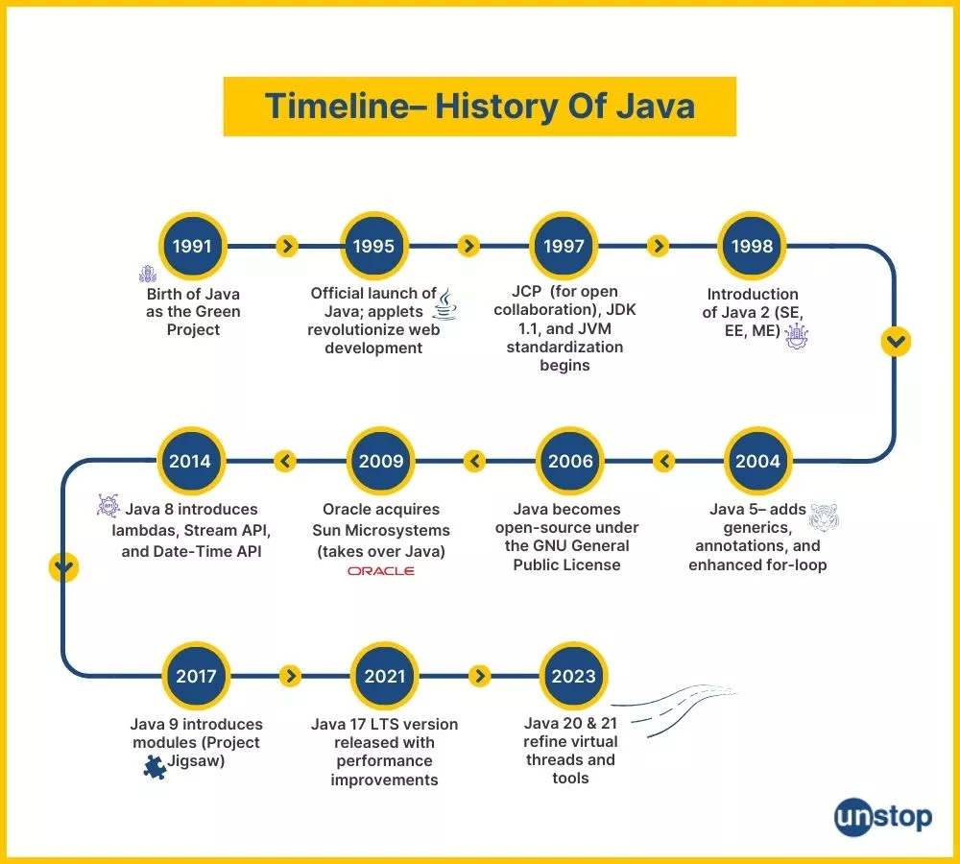

Slide 13
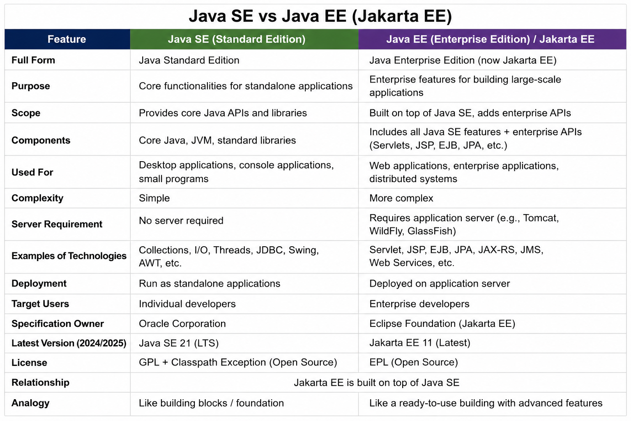

Slide 14
Why Java?
Platform Independent-“Write Once, Run Anywhere” -This means Java programs can run on any operating system that has a JVM installed.
Object-Oriented Language-This helps build:Reusable code,Modular applications,Large enterprise systems
Secure-Java provides:No direct memory access,Bytecode verification,Automatic garbage collection,Secure runtime environment

Slide 15
What is JVM?
JVM stands for Java Virtual Machine.
It executes Java bytecode.
Provides platform independence.
It reads Bytecode and Convert to Machine Code.
Executes the program.

Slide 16
What is JRE?
JRE stands for Java Runtime Environment.
Contains JVM and libraries required to run Java applications.
Cannot develop program because no complier included.

Slide 17
What is JDK?
JDK stands for Java Development Kit.
Contains JRE + development tools like compiler and debugger.
JIT (Just in time complier used to increase the java performance)
Develop,Complie and Run Application
Compiler Converts Java code to bytecode(javac).

Slide 18
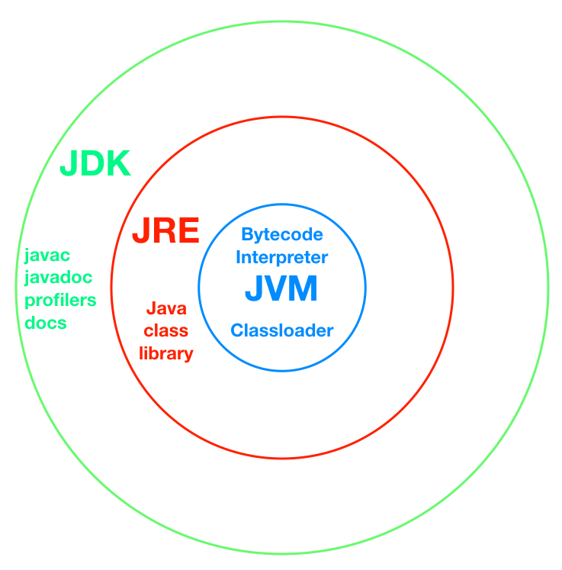
JDK, JRE and JVM
Java Program (.java)
↓
Compiled by JDK
↓
Bytecode (.class)
↓
Executed by JVM

Slide 19
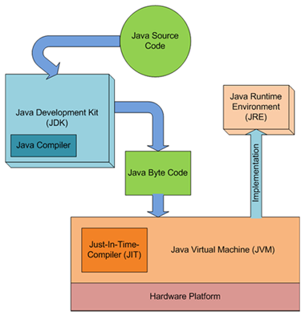

Slide 20
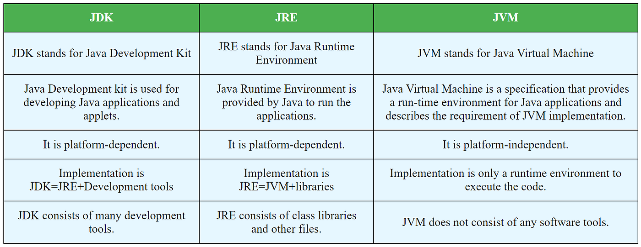

Slide 21
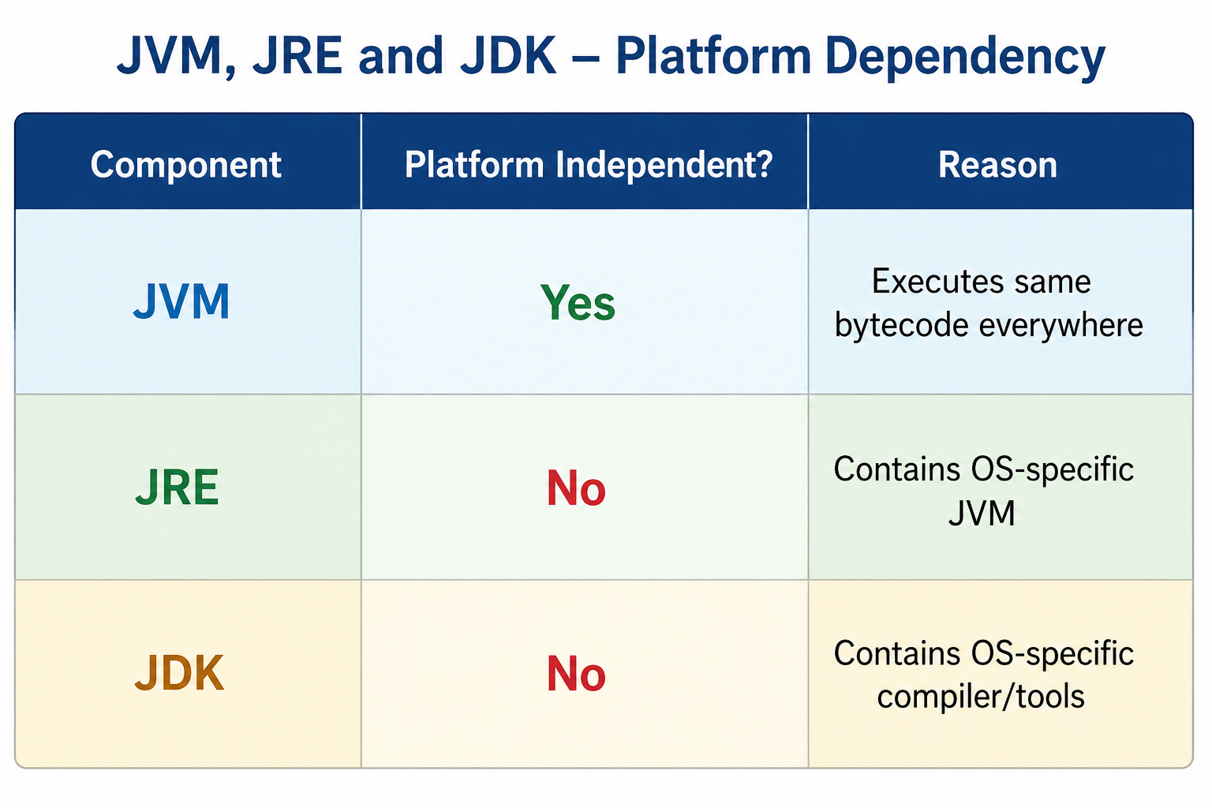

Slide 22
Installation of Java
Download JDK from Oracle official website.
Install JDK on your system.
Set JAVA_HOME environment variable.
Verify installation using 'java -version' command.

Slide 23
Installation of Eclipse and Intellij IDE
Download Eclipse IDE from official Eclipse website.
Install Eclipse and launch the IDE.
Configure JDK path if required.
Create Java projects and start coding.
Intellij is light Weight compared to eclipse .
.JAR file

Slide 24
Simple Java Program Example
Example: Hello World Program
public class HelloWorld {
public static void main(String[] args) {
System.out.println("Hello World");
}
}

Slide 25
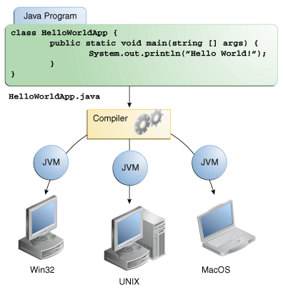
Why java Platform Independant?

Slide 26
What is Complier and Interpreter
Both are used to convert programming code into machine-understandable instructions. Execution Speed is Faster.
Compiler--->A compiler translates the entire program at once into machine code or bytecode.
Interpreter--> An interpreter translates and executes code line by line. Eg : Python

Slide 27
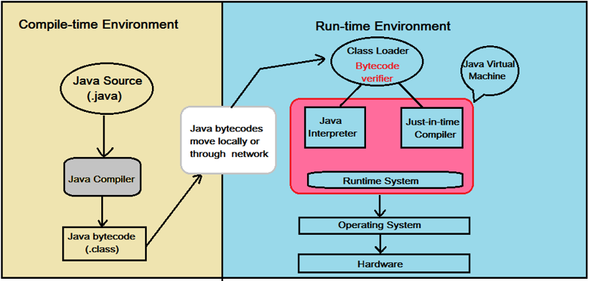
Is Java a Complier Language or Interpreter Language
Java is both a compiled and interpreted language.

Slide 28
Main() Method
public static void main(String[] args) .This is the entry point of a Java application.
Public Means---->
✅ Accessible from anywhere.JVM must access the method to start the program.If main() is not public:❌ JVM cannot call it.
Void---->Means:✅ Method does not return anything.
main() only executes program logic.
Main---->This is the predefined method name recognized by JVM.JVM specifically searches for:If method name changes:❌ Program won't start automatically.
Static Means---->✅ Method belongs to the class, not object.JVM can call main() without creating object.Without StaticIf main() were non-static:void main(String[] args)
  JVM would need:
  Test t = new Test();
  t.main();
To avoid object creation, main() is static.

Slide 29
String args[]
Used to receive command-line arguments.
public class Test {
public static void main(String[] args) {
System.out.println(args[0]);
}
}
  java Test Hello
java Test Hello . o/p:- Hello

Slide 30
DataTypes
Primitive Data Types
Non-Primitive Data Types
Used to store different kinds of values

Slide 31
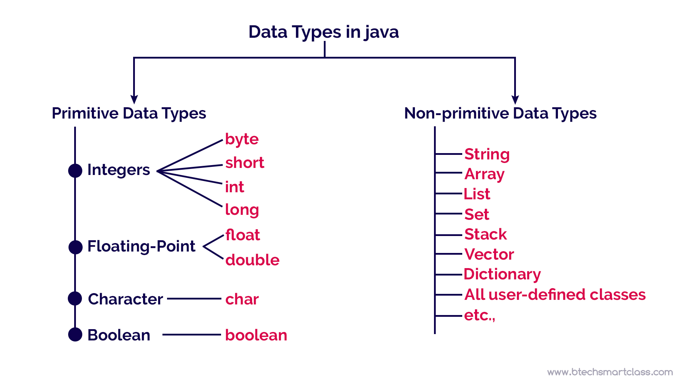
DataTypes

Slide 32
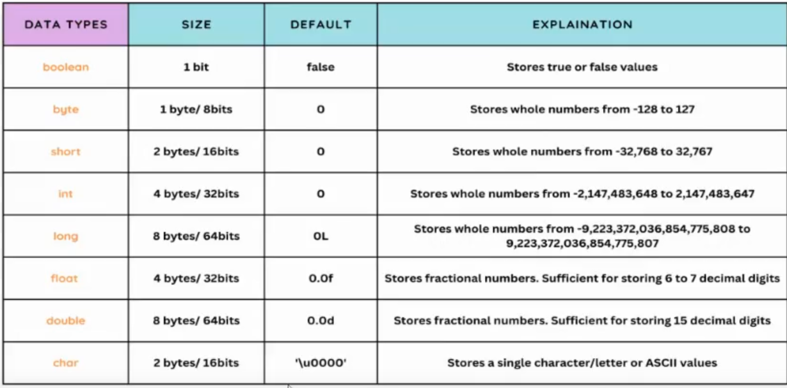
DataTypes

Slide 33
Variables
A variable is a named memory location used to store data.
Syntax: datatype variableName;
Example:public class Demo {
public static void main(String[] args) {
int age = 25;
float height = 5.9f;
char grade = 'A';
boolean passed = true;
String name = "John";
System.out.println(age);
System.out.println(height);
System.out.println(grade);
System.out.println(passed);
System.out.println(name);
}
}

Slide 34
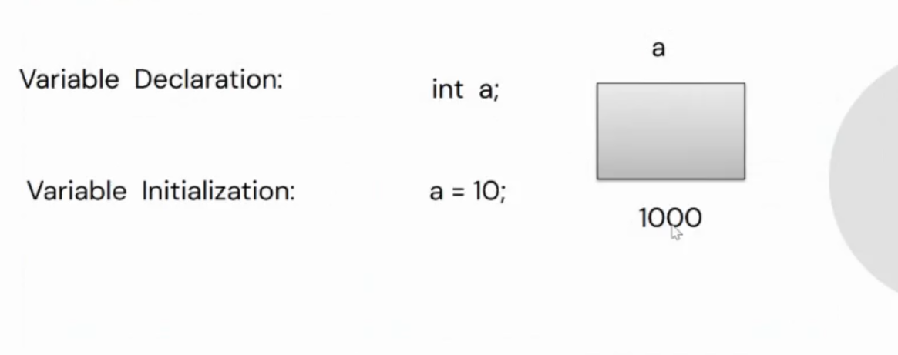
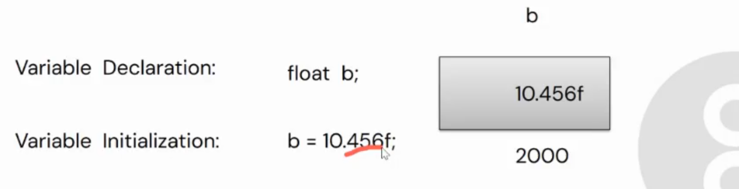

Slide 35
Tokens
Tokens are the smallest individual units in a Java program.
Java programs are made up of tokens.
Tokens in java---> Keywords,identifiers,Constant,Special Symbol,Operators,Comments,Separators.
Total 68 reserved keywords in java.

Slide 36
