Slide 1





















































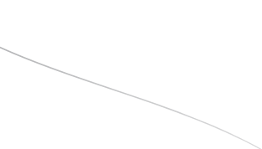
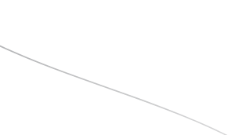
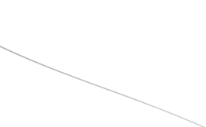
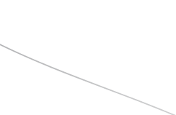
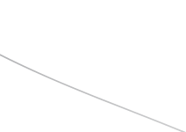
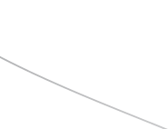
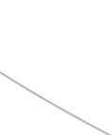
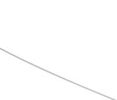

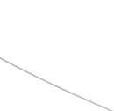
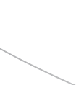




TITLE:PLAGIARISM + AL CONTENT DETECTOR
Teame Name:Dual core
Department:B.Tech AI&DS
INSTITUTION: NPR COLLEGE OF ENGINEERING AND TECHNOLOGY

Slide 2
PROBLEM STATEMENT
INCREASING USE OF AL TOOLS ALLOWS STUDENTS TO GENERATE ASSIGNMENTS
AUTOMATICALLY.
Traditional plagiarism checkers only detect copied text,
not Al-generated content.
Educators struggle to ensure originality and academic
honesty.
Need for a system that can identify both plagiarized and
Al-generated content using NLP models.

Slide 3
IDEA TITLE
THE AL-ENHANCED TOEA INTEGRITY CHECKER IS A NEXT GENERATION PLAGIARISM DETECTION SYSTEM
THAT:
CHECKS SEMANTIC ORIGINALITY-NOT JUST TEXT SIMILARITY.
DETECTS AL GENERATED CONTENT THROUGH LANGUAGE STYLE ANALYSIS.
BUILDS A WRITING FINGERPRINT FOR EACH STUDENT TO IDENTIFY SUDDEN STYLE CHANGES.
IT PROVIDES A DETAILED "ORIGINALITY & INTEGRITY SCORE" THAT REFLECTS HOW MUCH OF
THE SUBMISSION GENUINELY HUMAN, UNTQUE, AND SELF-WRITTEN

Slide 4
TECHNICAL APPROACH
Built using HTML, CSS, and JavaScript for a simple user interface.
Allows users to upload text or documents for checking.
Implemented with Python Flask /FastAPI.
Handles processing, NLP model execution, and database connection
Uses spaCy / Transformer models for semantic similarity
detection.
Classifies Al-generated text vs human-written text.

Slide 5
Feasibility and viability
Technical Feasibility: Uses open-source NLP libraries
and pretrained models.
Operational Feasibility: Easily deployable as a website
for teachers and students.
Economic Feasibility: Low development cost, requires
only Python and open-source tools.
Scalability: Can later support multilingual plagiarism
and Al code detection.

Slide 6









IMPACT AND BENEFITS
Encourages originality and fair academic practices.
Detects Al-written or copied content effectively.
Reduces misuse of Al tools for unethical purposes.
Builds trust in academic evaluation systems.

Slide 7
REFERENCE
spaCy - https://spacy.io/
Hugging Face Transformers https://huggingface.co/
OpenAI GPT Research https://openai.com/research
Flask Framework - https://flask

Slide 8
THANK YOU

