Slide 1
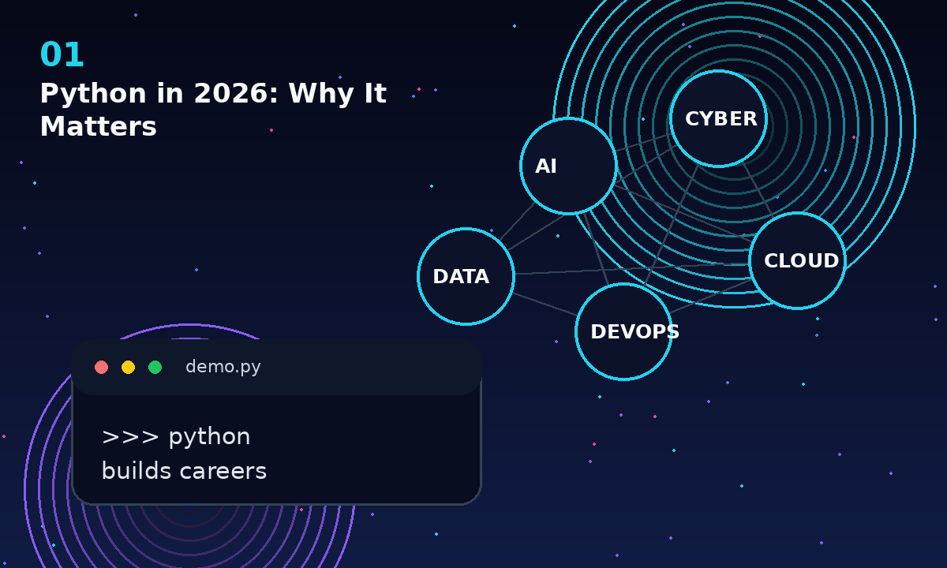
INDUSTRY CONTEXT
Python in 2026: Why It Matters
AI, cybersecurity, cloud, DevOps and automation all rely heavily on Python.
- Python is a practical skill across modern tech teams.
- One language can open multiple career tracks.
- Day 1 starts with control: talk, remember, listen.
Premium teaching hook
Connect every concept to real-world work so beginners feel the purpose immediately.
01 / 15
Vallinate Python Day 1

Slide 2
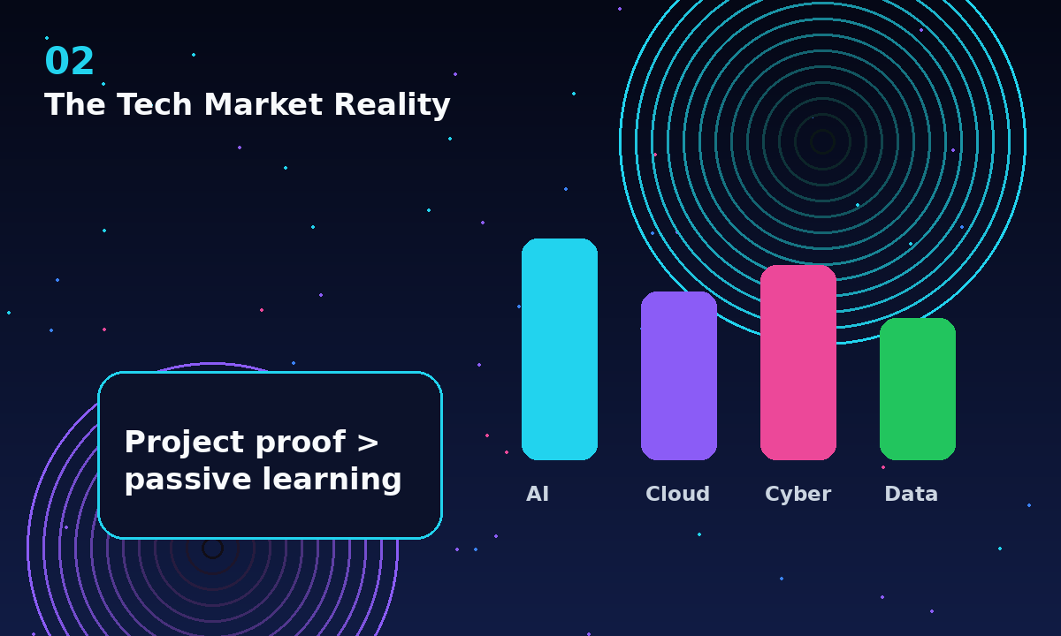
MARKET REALITY
The Tech Market Reality
Companies hire problem-solvers, not certificate collectors.
- Python appears in automation, AI, data and platform roles.
- Hiring teams value clear thinking and project evidence.
- Your learning goal: build small proof every day.
Premium teaching hook
Connect every concept to real-world work so beginners feel the purpose immediately.
02 / 15
Vallinate Python Day 1

Slide 3
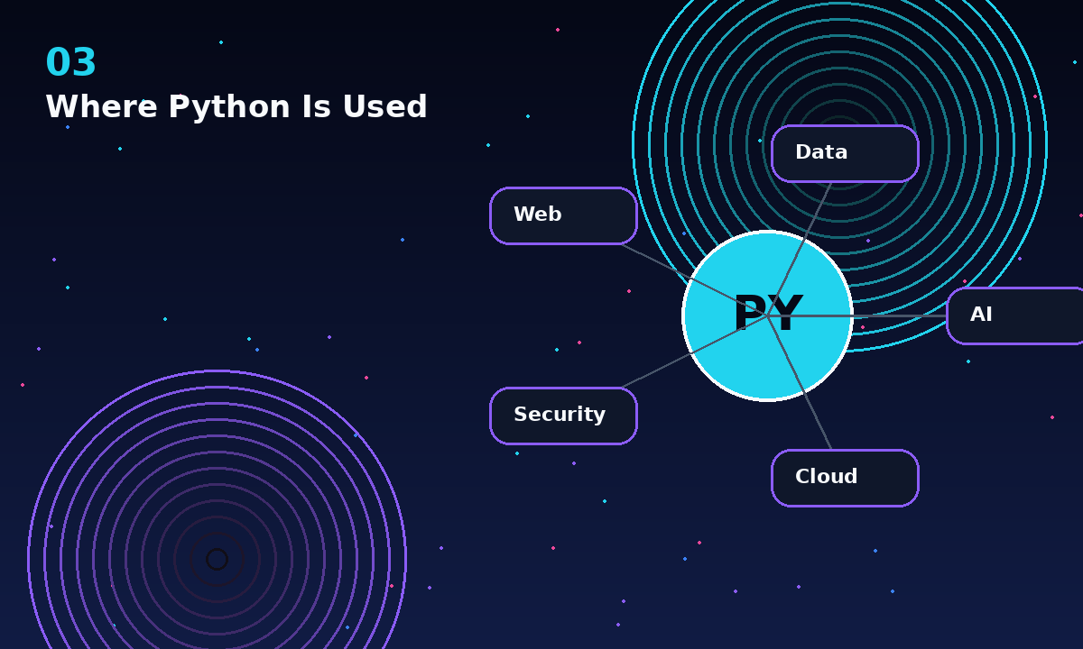
WHERE IT IS USED
Where Python Is Used
AI assistants, cloud automation, security tools, analytics and web apps.
- AI: prompts, models, agents and data pipelines.
- Cloud and DevOps: scripts, APIs and infrastructure helpers.
- Cybersecurity: scanning, parsing logs and building tools.
Premium teaching hook
Connect every concept to real-world work so beginners feel the purpose immediately.
03 / 15
Vallinate Python Day 1

Slide 4
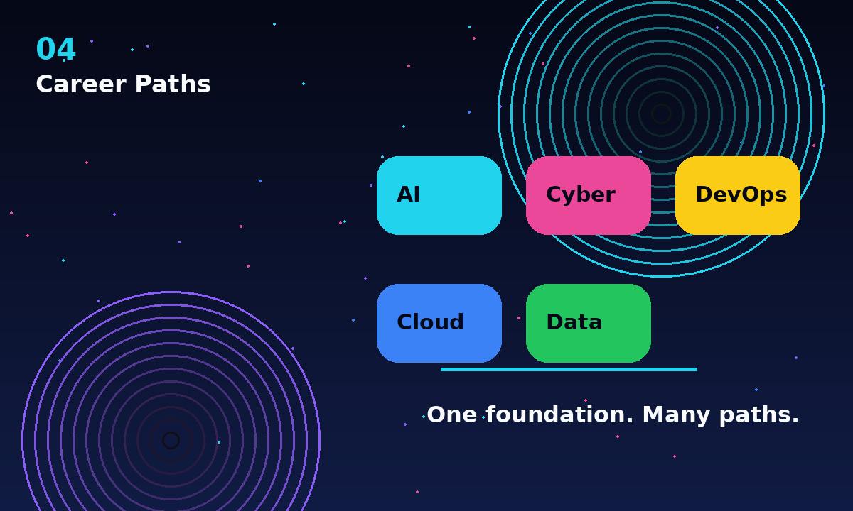
CAREER MAP
Career Paths
Python can become your common language across tech specializations.
- AI Engineer
- Cybersecurity Analyst
- DevOps Engineer
- Cloud Engineer
- Data Engineer
Premium teaching hook
Connect every concept to real-world work so beginners feel the purpose immediately.
04 / 15
Vallinate Python Day 1

Slide 5
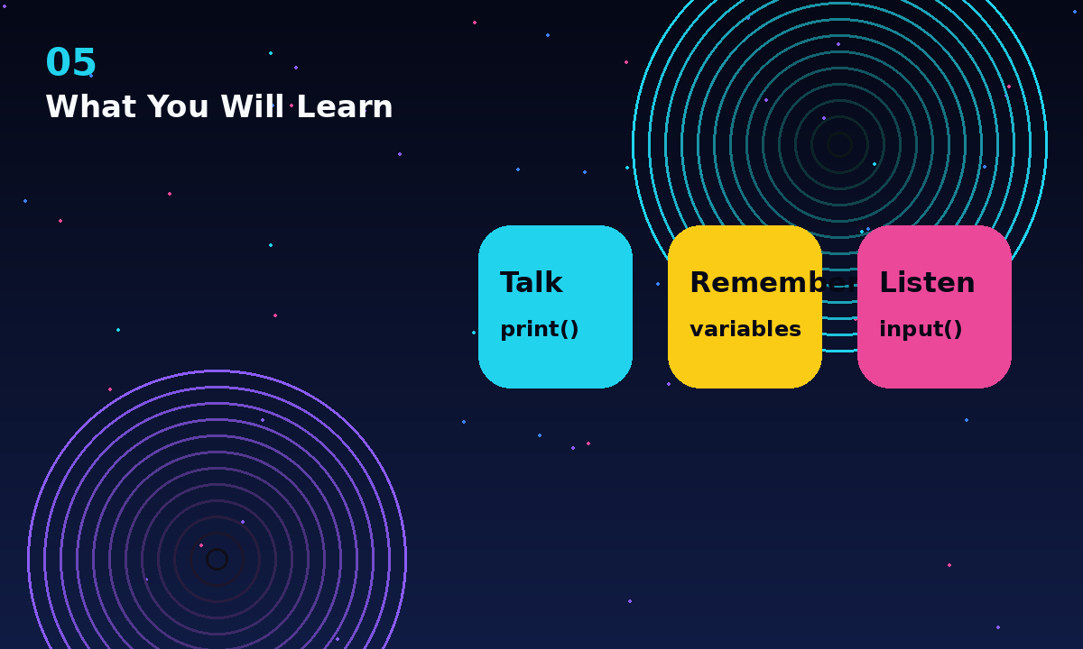
DAY 1 FRAMEWORK
What You Will Learn
Talk. Remember. Listen.
- Talk: print() shows output.
- Remember: variables store values.
- Listen: input() collects user data.
Premium teaching hook
Connect every concept to real-world work so beginners feel the purpose immediately.
05 / 15
Vallinate Python Day 1

Slide 6
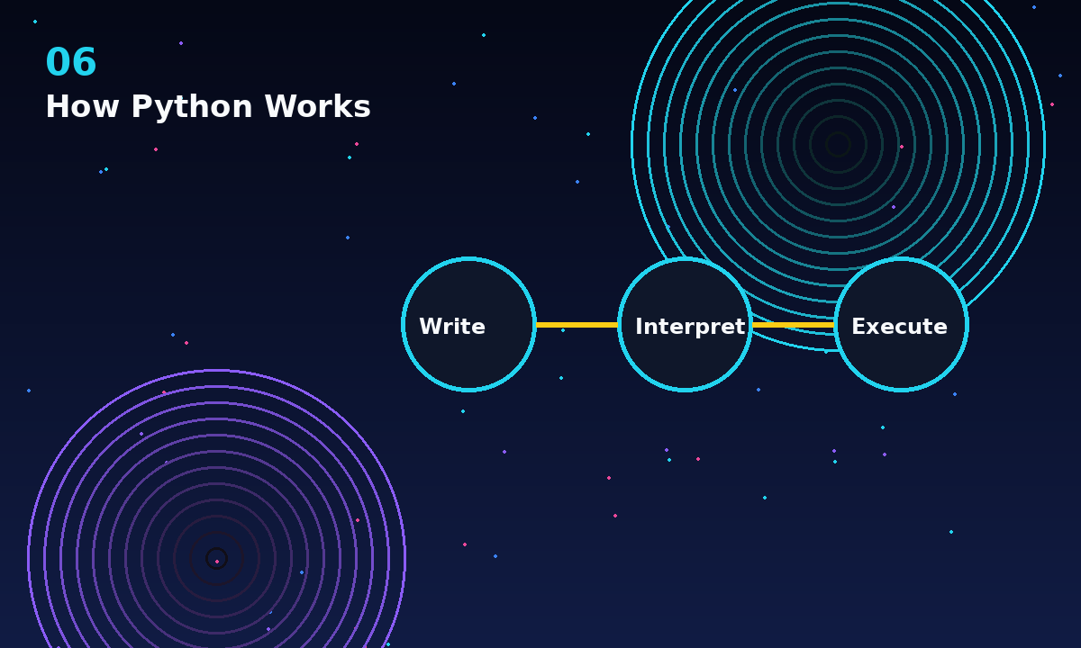
HOW IT RUNS
How Python Works
You write code -> Python interprets it -> the computer executes it.
- The interpreter reads your code.
- Instructions run in order.
- The result appears in the terminal or app.
Premium teaching hook
Connect every concept to real-world work so beginners feel the purpose immediately.
06 / 15
Vallinate Python Day 1

Slide 7
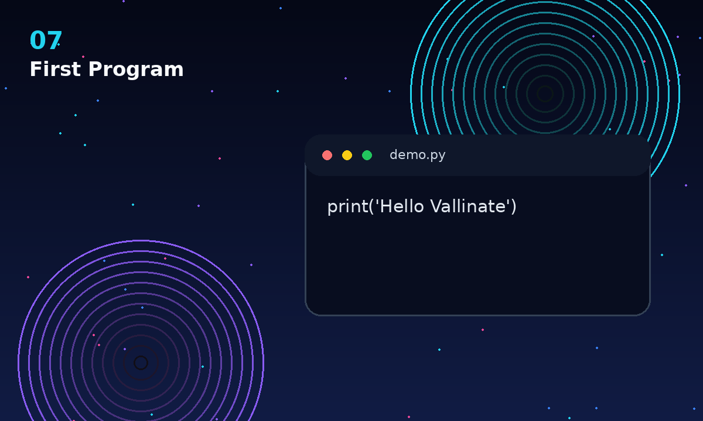
FIRST PROGRAM
First Program
The smallest useful program is a message on the screen.
- print() is your first output command.
- Quotes hold text.
- Parentheses carry the message into the function.
demo.py
print('Hello Vallinate')
07 / 15
Vallinate Python Day 1

Slide 8
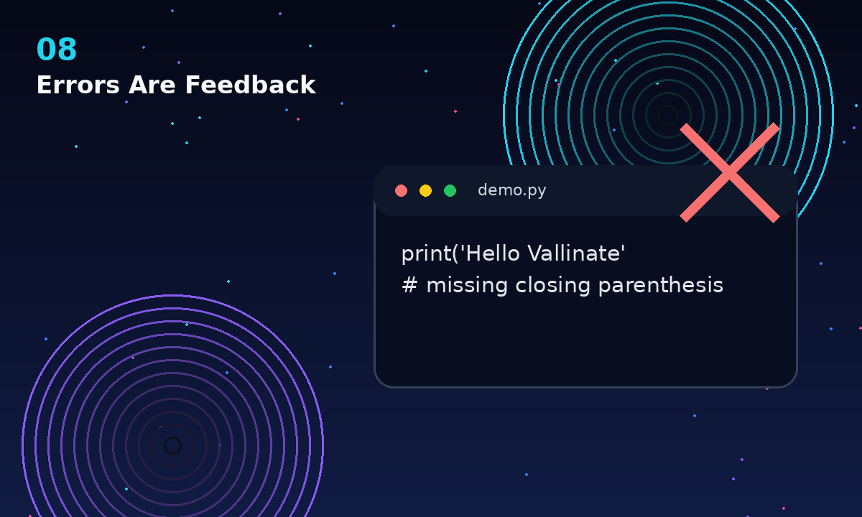
DEBUG MINDSET
Errors Are Feedback
Errors help developers locate problems quickly.
- An error is not a failure.
- Read the line number first.
- Fix one problem, then run again.
demo.py
print('Hello Vallinate' # missing closing parenthesis
08 / 15
Vallinate Python Day 1

Slide 9
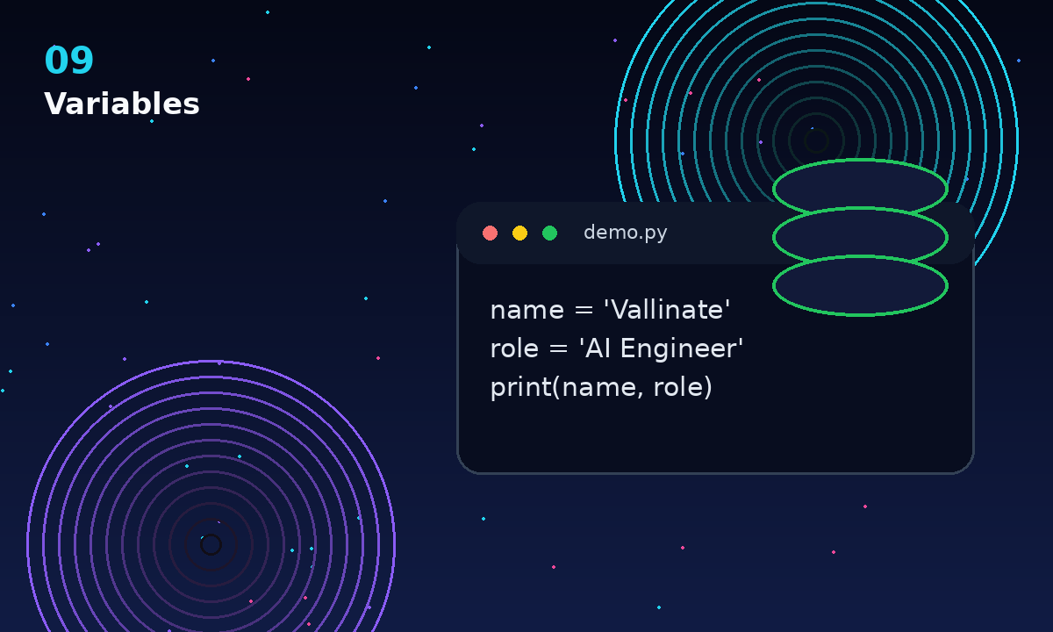
VARIABLES
Variables
Applications remember users, products and settings using stored data.
- A variable is a name tag for a value.
- Use readable names.
- Change the value once, reuse it many times.
demo.py
name = 'Vallinate' role = 'AI Engineer' print(name, role)
09 / 15
Vallinate Python Day 1

Slide 10
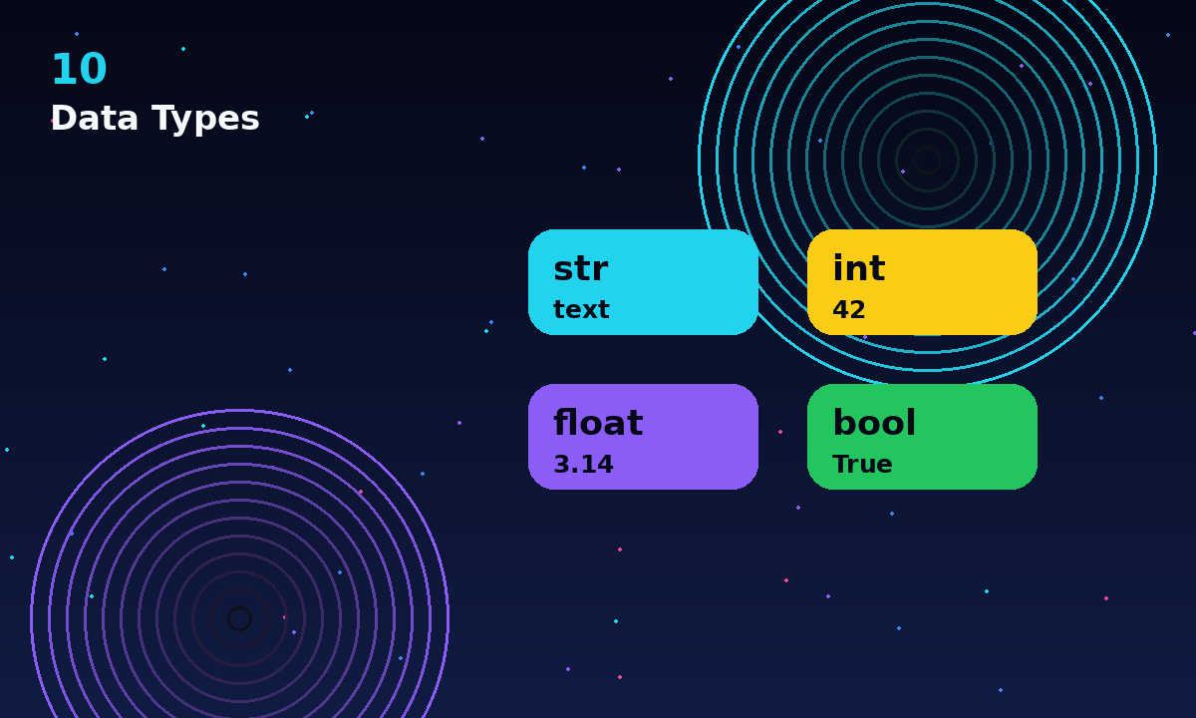
DATA TYPES
Data Types
String, integer, float and boolean with real-world examples.
- str: text like a name or city.
- int: whole numbers like age or score.
- float: decimals like price or rating.
- bool: True or False decisions.
Premium teaching hook
Connect every concept to real-world work so beginners feel the purpose immediately.
10 / 15
Vallinate Python Day 1

Slide 11
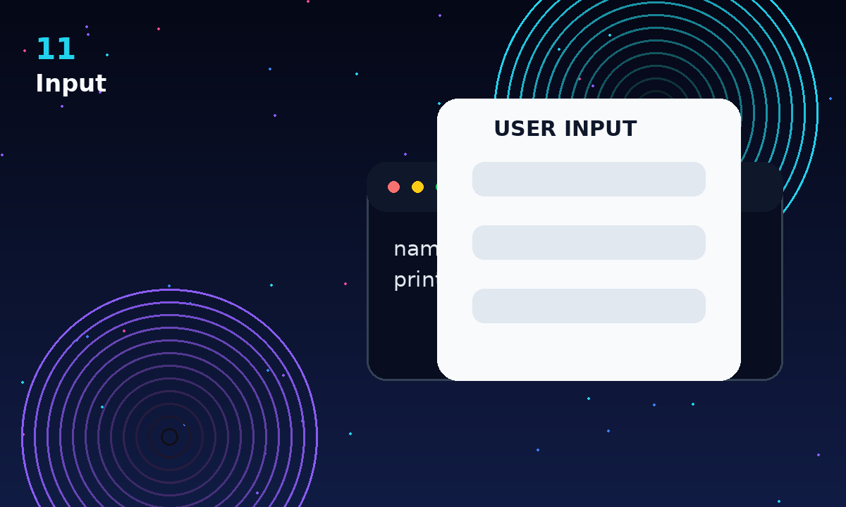
INPUT
Input
Collect information from users like login and signup forms.
- input() pauses the program.
- The user types an answer.
- Python stores that answer as text.
demo.py
name = input('Your name: ') print('Welcome', name)
11 / 15
Vallinate Python Day 1

Slide 12
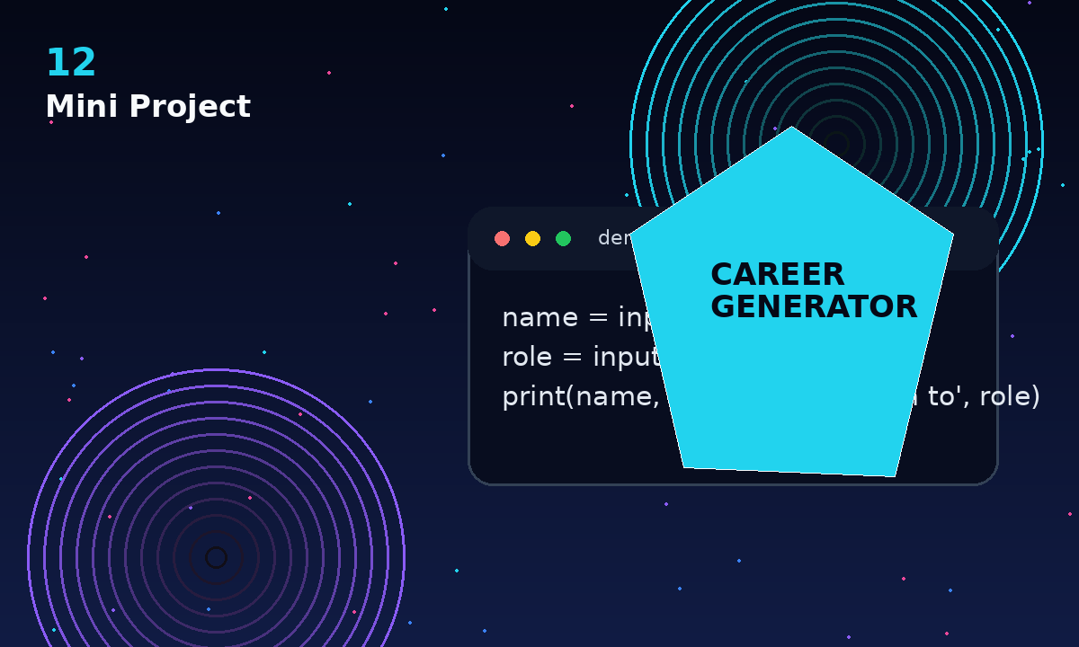
MINI PROJECT
Mini Project
Career Path Generator: ask name and dream role, then display a personalized message.
- This feels like a real app interaction.
- It combines print(), variables and input().
- It gives learners a Day 1 win.
demo.py
name = input('Name: ') role = input('Dream role: ') print(name, 'can start the path to', role)
12 / 15
Vallinate Python Day 1

Slide 13
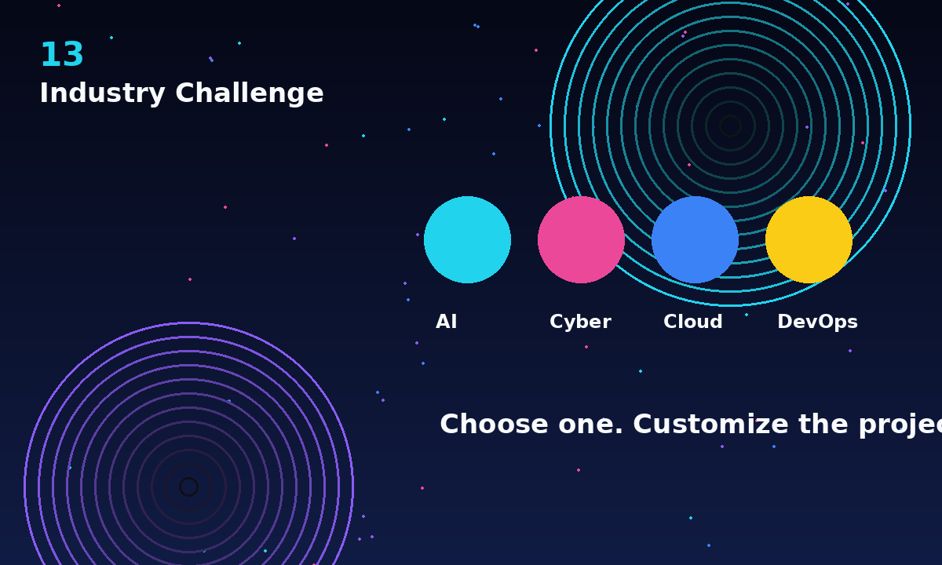
INDUSTRY CHALLENGE
Industry Challenge
Modify the project for AI, cybersecurity, cloud or DevOps careers.
- Ask for one target career.
- Print a custom first project idea.
- Share the output in the comments.
Premium teaching hook
Connect every concept to real-world work so beginners feel the purpose immediately.
13 / 15
Vallinate Python Day 1

Slide 14
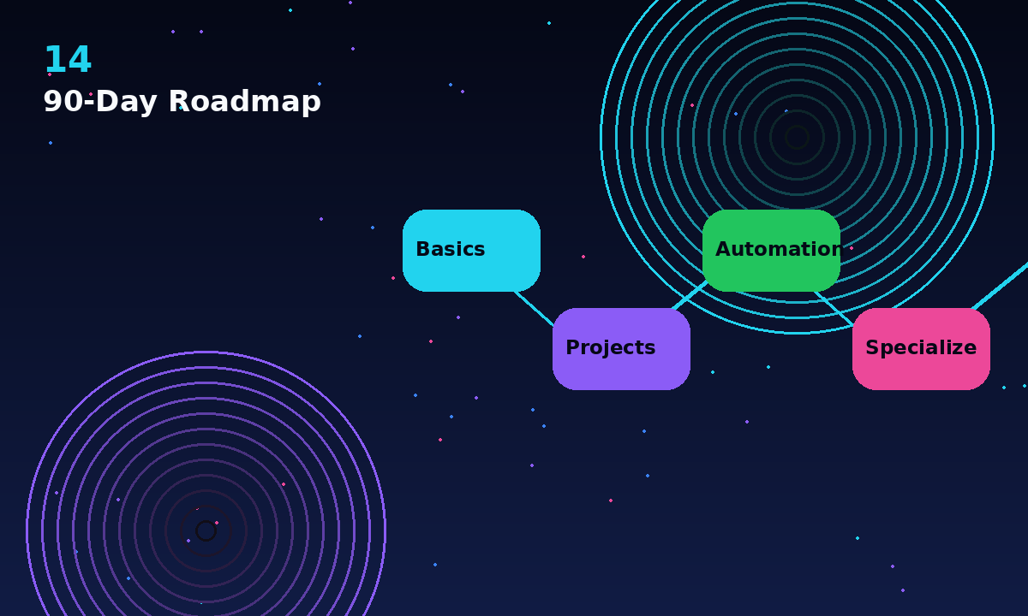
90-DAY ROADMAP
90-Day Roadmap
Basics -> projects -> automation -> specialization.
- Basics: syntax, variables, conditions and loops.
- Projects: small apps with visible outcomes.
- Automation: files, APIs and repeatable workflows.
- Specialization: AI, cyber, cloud, DevOps or data.
Premium teaching hook
Connect every concept to real-world work so beginners feel the purpose immediately.
14 / 15
Vallinate Python Day 1

Slide 15
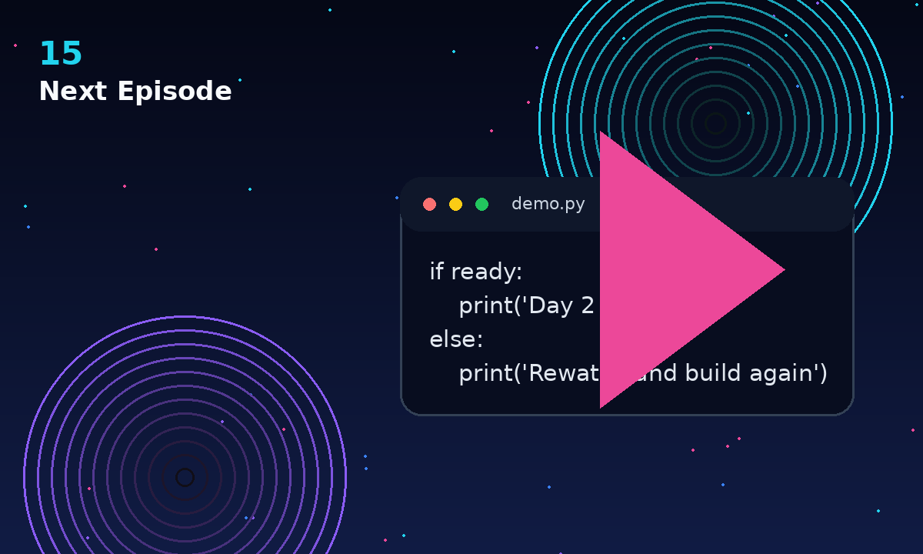
NEXT EPISODE
Next Episode
if, else and decision making.
- Next, Python will choose between paths.
- Decision making turns scripts into smarter programs.
- Bring your mini project output.
demo.py
if ready: print('Day 2 begins') else: print('Rewatch and build again')
15 / 15
Vallinate Python Day 1

