Slide 1
ANNA UNIVERSITY REGIONAL CAMPUS COIMBATORE
FACE RECOGNITION SMART LOCK SYSTEM USING
RASPBERRY PI
Presented by
Kathir S - 710022106005
Arulraj S - 710022106016
Al Hasim Ali R - 710022106045
Vasanthkumar - 710022106704
Rithick S - 710022106308

Slide 2
FACE RECOGNITION SMART LOCK SYSTEM USING RASPBERRY PI
This project presents a face recognition-based security system that leverages computer vision and embedded systems to provide robust access control. Utilizing OpenCV and the LBPHFaceRecognizer, the system captures facial images through a webcam, processes them to identify authorized individuals, and communicates results to a simulated Raspberry Pi in Proteus via serial communication. The system comprises two primary components: dataset creation and real-time face recognition. The dataset creation script prompts users for a name, captures 50 grayscale face images using the Haar Cascade classifier, and stores them in a designated folder for training. In real-time operation, the face recognition script processes webcam video, detects faces, and compares them against the trained dataset. If the confidence score is below 80, it identifies the person as known, displays their name, and sends a `1' via serial port (COM3, 9600 baud). Otherwise, it labels the face as “Unknown,” sends a `0,' and saves the image after 100 frames in an “unknown_person” folder. The Raspberry Pi, simulated in Proteus, interfaces with a 16x2 LCD, DC motor, buzzer, PIR sensor, and switch. Upon receiving a `1,' the LCD displays “Valid Person Door Open,” and the motor activates to simulate unlocking. A `0' prompts “Unknown Person Door close,” with the motor remaining off and the PIR sensor checking for motion. A switch press triggers the process, accompanied by a buzzer sound. The Proteus simulation ensures reliable testing of hardware interactions, validating system performance. By integrating face recognition, serial communication, and hardware control, this project offers a scalable, efficient solution for secure access management. Its applications include home security, office access control, and restricted area monitoring, demonstrating the potential of combining open-source software and embedded systems to address real- world security challenges effectively.

Slide 3
INTRODUCTION
The face recognition-based security system is an innovative solution for secure access control, integrating computer vision with embedded systems. Utilizing OpenCV and a webcam, it captures and processes facial images to identify authorized individuals. The system employs the LBPHFaceRecognizer for real-time recognition and communicates results via serial communication to a Raspberry Pi simulated in Proteus. Hardware components, including a 16x2 LCD, motor, buzzer, PIR sensor, and switch, provide feedback and control. The Proteus simulation validates the system's functionality, ensuring reliable performance. This project demonstrates a scalable approach to security for applications like home and office access management.
OBJECTIVE
The primary goal of this project is to:
Capture face images using a webcam and OpenCVfor dataset creation.
Perform real-time face recognition withLBPHFaceRecognizer.
Transmit 1' (known) or 0' (unknown) via serial to a simulated Raspberry Pi.
Control a motor and display status on a 16x2 LCD based on recognition.
Simulate the system in Proteus for reliable software-hardware validation.
COMPONENTS REQUIRED
Hardware:
Raspberry Pi (simulated in Proteus)
16x2 LCD Display
DC Motor (for door lock simulation)
Buzzer
PIR Sensor
Push Button (Switch)
Virtual Simulation:
Proteus 8 Professional
SOFTWARE TOOLS
Python (with OpenCV, NumPy, PySerial)
OpenCV (Haar Cascade Classifier,LBPHFaceRecognizer)
Proteus
Virtual Serial Ports Emulator

Slide 4
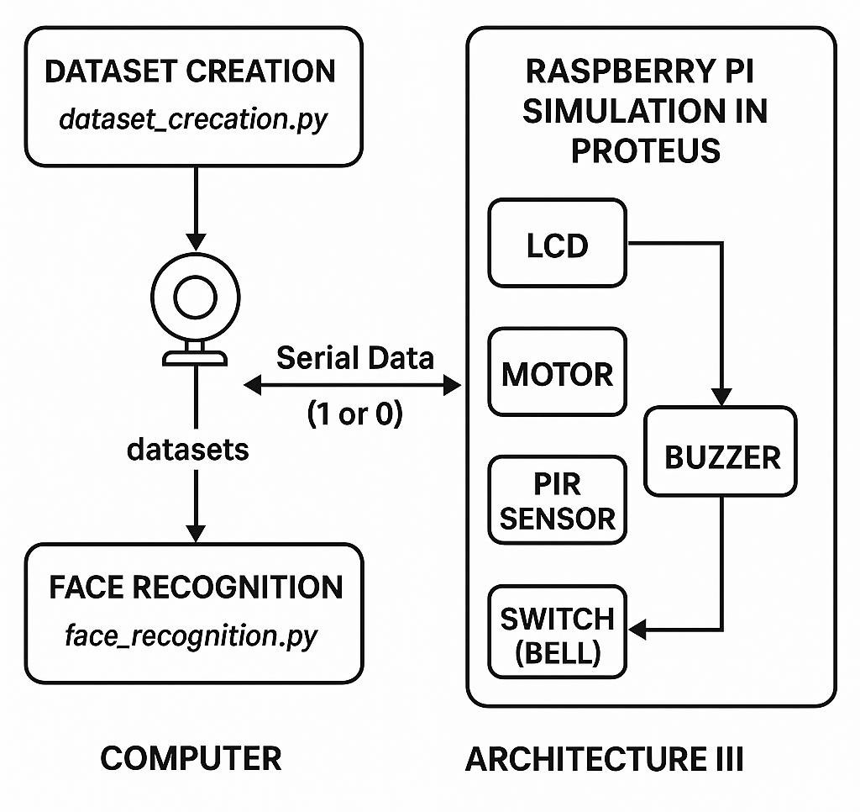

SYSTEM ARCHITECTURE
The project consists of two primary blocks:
Client Side (Computer): Captures webcam input, performs face recognition using trained datasets, and sends 1 (known) or 0 (unknown) via serial communication.
Server Side (Raspberry Pi in Proteus): Receives serial data to control hardware— unlocks the door and updates the LCD for known faces, or checks for motion with a PIR sensor for unknown faces.

Slide 5
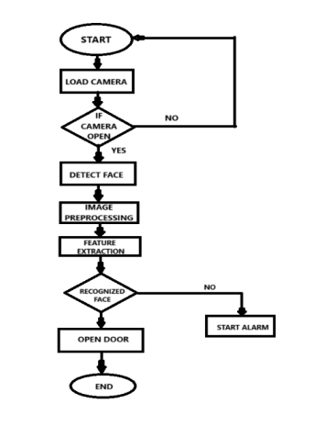
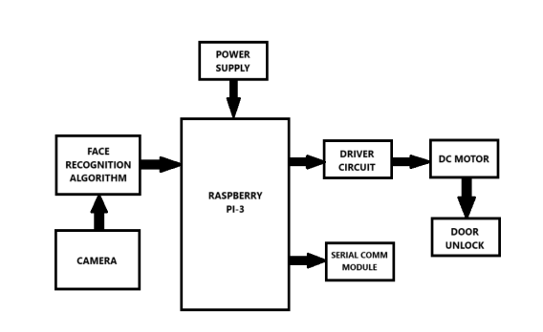
WORKFLOW
Start – The system initializes and prepares to begin face recognition.
Load Camera – Activates and connects to the camera hardware.
Camera Check – Verifies if the camera is functioning; loops if not.
Detect Face – Scans the video feed to locate human faces.
Feature Extraction – Preprocesses the image and extracts facial features.
Recognition Decision – If the face is recognized, the door opens; otherwise, an alarm is triggered.

Slide 6
IMPLEMENTATION
FACE DATA CREATION
In the Face Data Creation phase, the system captures multiple images of a person's face using a camera. These images are saved in a designated folder to form a dataset. This dataset is essential for training the face recognition model to accurately identify individuals during the detection process.
Python Code (data_creation.py):
import cv2 import os
haar_file = 'haarcascade_frontalface_default.xml' datasets = 'datasets'
sub_data = input("Enter the name:")
path = os.path.join(datasets, sub_data)
# Create the directory if it doesn't exist if not os.path.isdir(path):
os.makedirs(path)
(width, height) = (130, 100)
face_cascade = cv2.CascadeClassifier(haar_file)
webcam = cv2.VideoCapture(0) # Camera initialization, use 0 for the default camera
count = 1
while count < 51: print(count)
ret, im = webcam.read()
if not ret:
print("Failed to capture image") break
gray = cv2.cvtColor(im, cv2.COLOR_BGR2GRAY) faces = face_cascade.detectMultiScale(gray, 1.3, 4)
for (x, y, w, h) in faces:
cv2.rectangle(im, (x, y), (x + w, y + h), (255, 0, 0), 2) face = gray[y:y + h, x:x + w]
face_resize = cv2.resize(face, (width, height)) cv2.imwrite(f'{path}/{count}.png', face_resize)
count += 1 cv2.imshow('OpenCV', im) key = cv2.waitKey(10)
if key == 27: # Press 'ESC' to exit break
webcam.release() cv2.destroyAllWindows()
FACE RECOGNITION
This script captures real-time video using a webcam and performs face recognition using a pre-trained LBPH model. It reads labeled face images from a dataset folder, trains the model, and detects faces using a Haar Cascade classifier. If a known face is recognized, it sends a signal '1' via serial communication to unlock a device and displays the name on-screen. If the face is unknown, it sends '0', keeps the device locked, and optionally saves the image for future reference.
Python Code (face_recognition.py):
import cv2
import numpy as np import os
import serial
import time
from datetime import datetime
# Initialize serial communication (adjust COM port and baud rate as needed) serial_port = 'COM3' # Change to your serial port (e.g., COM3, /dev/ttyUSB0) baud_rate = 9600
try:
ser = serial.Serial(serial_port, baud_rate, timeout=1) print(f"Connected to {serial_port} at {baud_rate} baud") time.sleep(2) # Allow time for serial connection to stabilize
except serial.SerialException as e:
print(f"Serial connection failed: {e}") ser = None
haar_file = 'haarcascade_frontalface_default.xml' # Ensure the path is correct datasets = 'datasets' # Folder containing your dataset
unknown_folder = 'unknown_person' # Folder to save unknown person images

Slide 7
RASPBERRY PI CODE IN PROTEUS
This script initializes GPIO pins for various peripherals and sets up a 16x2 LCD to display system messages. When a button (switch) is pressed, it triggers the Raspberry Pi to request face recognition results via UART serial communication. If the response is '1', the script activates the motor to unlock the door and displays a success message; if '0', it keeps the door locked and checks for motion using a PIR sensor. The LCD and buzzer provide user feedback, enhancing the interactivity and security of the embedded system.
Python Code:
#!/usr/bin/python import time import os
import RPi.GPIO as GPIO import pio
import Ports
pio.uart=Ports.UART () # Define serial port GPIO.setmode(GPIO.BOARD)
GPIO.setwarnings(False)
# Define GPIO to LCD mapping LCD_RS = 7
LCD_E = 11
LCD_D4 = 12
LCD_D5 = 13
LCD_D6 = 15
LCD_D7 = 16
pir_pin = 29
buzzer_pin =31
switch_pin =32
motor_pin1 =33
motor_pin2 =36
# Timing constants E_PULSE = 0.0005
E_DELAY = 0.0005
delay =
GPIO.setup(LCD_E, GPIO.OUT) # E GPIO.setup(LCD_RS, GPIO.OUT) # RS GPIO.setup(LCD_D4, GPIO.OUT) # DB4 GPIO.setup(LCD_D5, GPIO.OUT) # DB5

Slide 8
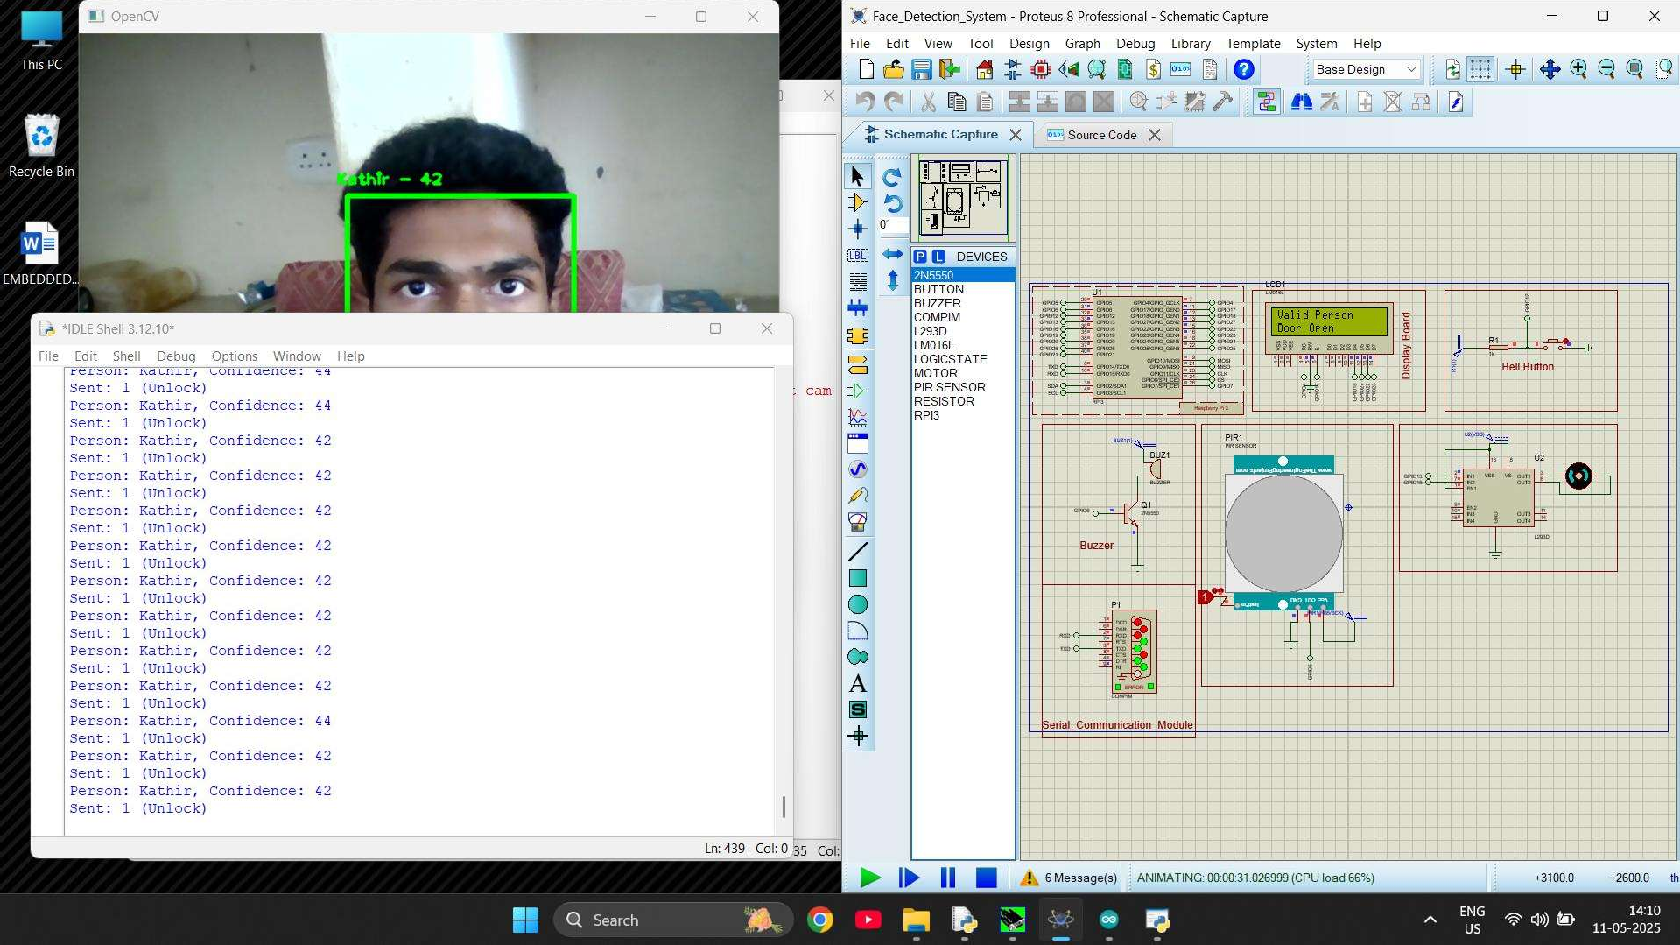
RESULT(KNOWN PERSON DETECTED)
The Face Recognition Smartlock System accurately detects and recognizes faces using a webcam and LBPH algorithm. Upon identifying a known individual, it opens the door via motor control and updates the LCD display. If an unknown face is detected, it triggers an alert mechanism and monitors motion using a PIR sensor. The system ensures secure and automated access control. All actions are visualized through a real-time video feed and hardware simulation..

Slide 9
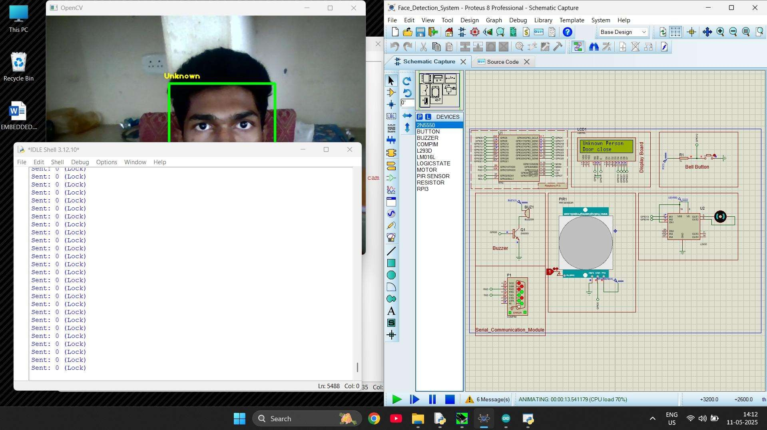
RESULT(UNKNOWN PERSON DETECTED)
The Face Recognition Smartlock System accurately detects and recognizes faces using a webcam and LBPH algorithm. Upon identifying a known individual, it opens the door via motor control and updates the LCD display. If an unknown face is detected, it triggers an alert mechanism and monitors motion using a PIR sensor. The system ensures secure and automated access control. All actions are visualized through a real-time video feed and hardware simulation..

