Slide 1
AMERICAN EXPRESS
AIR
|
Agentic Incident Response
From signals to action. Faster resolution. Lower MTTR.
Product Overview
Notes:
Welcome. AIR is an agentic incident response platform — introduce the tagline and set up that this is an architecture review.

Slide 2
AGENDA
What we’ll cover
01
Problem Statement
02
Product vision
Why incident response is slow today
Where AIR inserts itself in the chain
03
Business benefits
04
Platform architecture
MTTR, SLA, cost, and productivity
Layers, from raw signal to knowledge base
05
AI Agent Orchestration
06
AIR Workflow
Seven agents, one governed data flow
From Alert to Learning
07
Design walkthrough
Alerts, investigation, and incident detail
Notes:
Quick roadmap of the deck — seven stops from problem to delivery plan.

Slide 3
PROBLEM STATEMENT
Traditional SRE remains reactive and manual
Fragmented tools and expertise-dependent workflows delay confident action.
01
Reactive by design
Work begins after an incident is detected—often while customer impact is already unfolding.
02
Fragmented context
Alerts, dashboards, logs, Kubernetes, runbooks and scripts are reviewed across disconnected tools.
03
Manual operational toil
Root-cause analysis, capacity planning and performance diagnosis rely on repetitive human effort.
04
Expertise bottleneck
Resolution speed and consistency depend on the availability of experienced engineers.
Impact: slower resolution, inconsistent response quality, and less capacity for proactive reliability work.
Notes:
01 — Reactive by design
Emphasize that traditional SRE often begins after an incident is detected and customer impact may already be visible. This increases exposure and puts immediate pressure on responders.
02 — Fragmented context
Explain that engineers must manually correlate alerts, dashboards, logs, Kubernetes state, runbooks and scripts. Switching between disconnected tools delays a shared understanding of the incident.
03 — Manual operational toil
Highlight that root-cause analysis, capacity planning and performance diagnosis still require repetitive human effort. This consumes engineering time and introduces inconsistency.
04 — Expertise bottleneck
Stress that resolution speed often depends on an experienced engineer being available. Tribal knowledge does not scale and creates variable response quality across teams.
Closing takeaway
Traditional SRE practices slow resolution, increase operational risk and leave less capacity for proactive reliability improvements.

Slide 4
PRODUCT VISION
AI SRE moves reliability from reactive to proactive
A context-aware reliability platform that continuously understands, predicts, acts and improves.
01
Reactive → Proactive
Predict emerging incidents and capacity risks before customer impact.
02
Manual → Intelligent
Analyze signals continuously, identify probable causes and recommend the next best action.
03
Siloed → Unified
Correlate metrics, logs, traces, changes, Kubernetes and runbooks in one operational context.
04
After impact → Prevent impact
Use adaptive automation and learning to strengthen resilience over time.
05
Expert-dependent → AI-amplified
Give every engineer expert context, guidance and evidence while keeping humans in control.
06
Static → Self-improving
Learn from outcomes to continuously improve alerts, runbooks, recommendations and automation.
Product vision: fewer incidents, faster decisions, lower toil and continuously improving reliability.
Notes:
Product Vision
Position AI SRE as a shift in the operating model—not simply another monitoring tool. The product continuously understands context, predicts risk, supports action and learns from outcomes.
01 — Reactive → Proactive
Explain that the goal is to identify emerging incidents and capacity risks before customers are affected. The platform moves teams from responding to symptoms toward preventing impact.
02 — Manual → Intelligent
Highlight continuous AI analysis across operational signals. It proposes likely causes and the next best action, while engineers retain control over consequential changes.
03 — Siloed → Unified
Emphasize a shared operational context that connects metrics, logs, traces, deployments, Kubernetes state and runbooks. This reduces tool switching and accelerates confident decisions.
04 — After impact → Prevent impact
Describe how adaptive automation helps teams prevent or contain customer impact, while guardrails keep high-consequence actions under human control.
05 — Expert-dependent → AI-amplified
Explain that the platform makes experienced operational knowledge available to every responder through contextual guidance and supporting evidence. AI amplifies engineers rather than replacing them.
06 — Static → Self-improving
Show the continuous learning loop: incident outcomes improve alerts, runbooks, recommendations and automation. Reliability becomes stronger with every resolved event.
Closing takeaway
AI SRE amplifies engineers, reduces toil and transforms reliability from reactive recovery into proactive, continuously improving customer-impact prevention.

Slide 5
BUSINESS BENEFITS
How AI SRE creates measurable business impact
50%
Stronger SLA performance
Evidence-backed resolution lowers breach risk and protects service commitments.
Target MTTR reduction
Faster resolution reduces downtime, disruption and revenue risk.
Lower operating cost
Scalable SRE capacity
Greater customer trust
Reduce senior-engineer time spent on repetitive investigation and triage.
Handle more incidents without proportional headcount growth.
Faster recovery protects customer experience and confidence.
Notes:
Business Benefits — Impact to the Business
Frame AIR as a business-value platform, not only an engineering productivity tool. Faster and more consistent incident response protects revenue, service commitments and customer trust while lowering the cost of operations.
50% target MTTR reduction
Use the target as the headline business lever. Shorter incidents mean less downtime, reduced customer disruption and lower revenue exposure.
Stronger SLA performance
Evidence-backed resolution helps more incidents remain inside their SLA window, reducing breach risk and protecting contractual commitments.
Lower operating cost
AIR reduces repetitive investigation and triage work, freeing senior engineers for higher-value reliability and product work.
Scalable SRE capacity
Automation and guided response allow teams to handle a larger incident volume without proportional growth in operational headcount.
Greater customer trust
Less alert noise and faster recovery protect service experience, strengthen confidence and reduce the reputational cost of recurring incidents.
Evidence note
The prototype-modeled figures—21-minute average MTTR, 47% improvement versus baseline, 63% automated triage and 99.4% SLA compliance—are illustrative indicators, not committed production results.

Slide 6
BUSINESS BENEFITS
How AI SRE creates measurable business impact
Stronger SLA performance
50%
Evidence-backed resolution lowers breach risk and protects service commitments.
Lower operating cost
Reduce senior-engineer time spent on repetitive investigation and triage.
Target MTTR reduction
Scalable SRE capacity
Faster resolution reduces downtime, disruption and revenue risk.
Handle more incidents without proportional headcount growth.
Greater customer trust
Faster recovery protects customer experience and confidence.
Notes:
Lead with the MTTR number, then the supporting benefits.

Slide 7
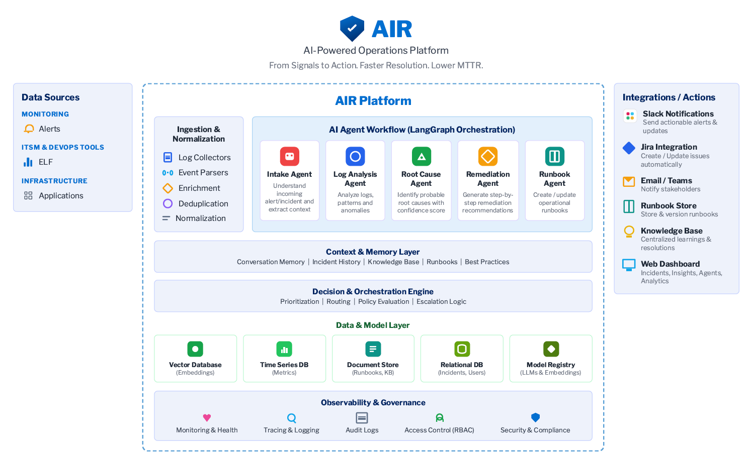
PLATFORM ARCHITECTURE
The platform ingests every signal and routes it to an agent workflow
Notes:
Business Benefits — Impact to the Business
Frame AIR as a business-value platform, not only an engineering productivity tool. Faster and more consistent incident response protects revenue, service commitments and customer trust while lowering the cost of operations.
50% target MTTR reduction
Use the target as the headline business lever. Shorter incidents mean less downtime, reduced customer disruption and lower revenue exposure.
Stronger SLA performance
Evidence-backed resolution helps more incidents remain inside their SLA window, reducing breach risk and protecting contractual commitments.
Lower operating cost
AIR reduces repetitive investigation and triage work, freeing senior engineers for higher-value reliability and product work.
Scalable SRE capacity
Automation and guided response allow teams to handle a larger incident volume without proportional growth in operational headcount.
Greater customer trust
Less alert noise and faster recovery protect service experience, strengthen confidence and reduce the reputational cost of recurring incidents.
Evidence note
The prototype-modeled figures—21-minute average MTTR, 47% improvement versus baseline, 63% automated triage and 99.4% SLA compliance—are illustrative indicators, not committed production results.

Slide 8
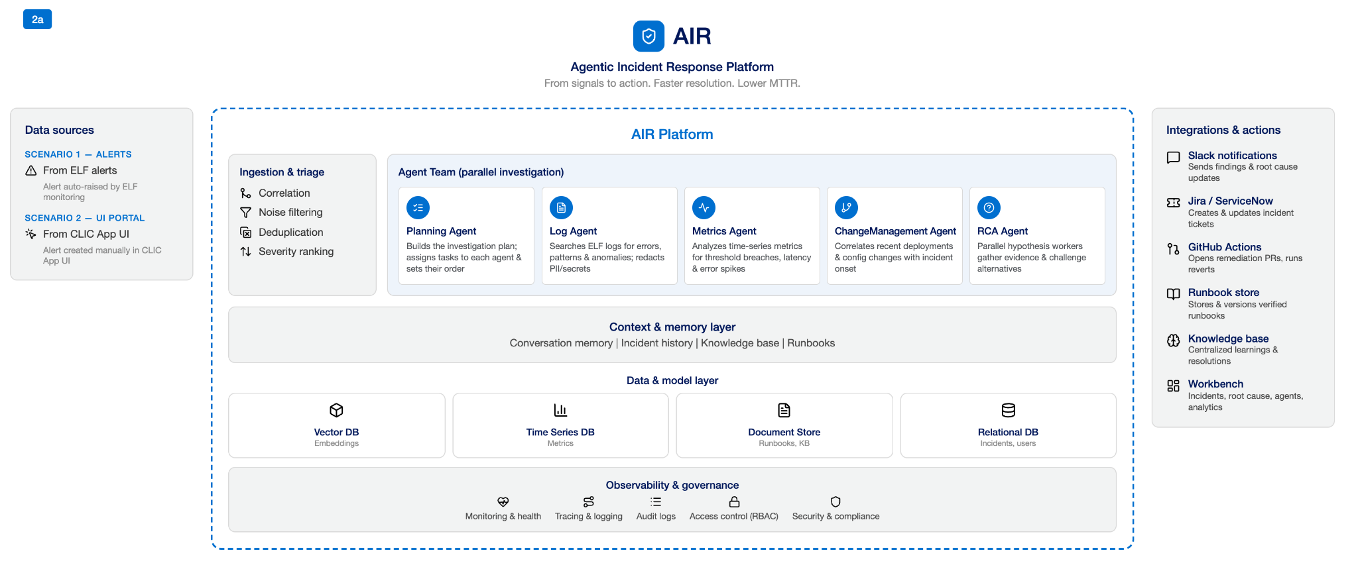
PLATFORM ARCHITECTURE
The platform ingests every signal and routes it to an agent workflow
Notes:
Business Benefits — Impact to the Business
Frame AIR as a business-value platform, not only an engineering productivity tool. Faster and more consistent incident response protects revenue, service commitments and customer trust while lowering the cost of operations.
50% target MTTR reduction
Use the target as the headline business lever. Shorter incidents mean less downtime, reduced customer disruption and lower revenue exposure.
Stronger SLA performance
Evidence-backed resolution helps more incidents remain inside their SLA window, reducing breach risk and protecting contractual commitments.
Lower operating cost
AIR reduces repetitive investigation and triage work, freeing senior engineers for higher-value reliability and product work.
Scalable SRE capacity
Automation and guided response allow teams to handle a larger incident volume without proportional growth in operational headcount.
Greater customer trust
Less alert noise and faster recovery protect service experience, strengthen confidence and reduce the reputational cost of recurring incidents.
Evidence note
The prototype-modeled figures—21-minute average MTTR, 47% improvement versus baseline, 63% automated triage and 99.4% SLA compliance—are illustrative indicators, not committed production results.

Slide 9





AI AGENT ORCHESTRATION
Five agents orchestrate evidence-backed incident response
Investigation Agent
RCA Agent
Runbook Agent
Sources: alerts, logs, metrics, traces and deployment changes.
Guardrail: redact PII and secrets; emit evidence IDs for downstream agents.
Parallel hypothesis workers gather evidence and challenge alternatives.
Artifact: ranked confidence, citations and blast-radius impact.
Retrieve approved, versioned runbooks; rank options by risk and time.
Gate: manual approval, execution and recovery verification.
Communication Agent
Postmortem Agent
Sync incident context with Slack and enforce authorized status transitions.
Record: timeline and audit events; live progress over SSE.
Draft timeline, impact, RCA and actions from selected sources.
Gate: human review; approved content becomes pgvector knowledge.
LangChain Framework for Governed Agent Orchestration
Notes:
AI Agent Orchestration — Speaker Notes
LangChain coordinates specialized agents through a governed incident-response workflow.
Investigation Agent
Collects alerts, logs, metrics and traces. PII, secrets and sensitive data are protected before analysis.
RCA Agent
Runs multiple root-cause hypotheses in parallel. Evidence is compared and conclusions are ranked by confidence.
Runbook Agent
Recommends approved response steps based on the available evidence. Human approval remains part of the process.
Communication Agent
Keeps responders aligned with consistent incident context, progress updates and an auditable timeline.
Postmortem Agent
Turns reviewed incident evidence into lessons, actions and reusable knowledge.
Policy guardrails
Input and output checks protect sensitive data, validate evidence and keep recommendations within approved boundaries. Human oversight ensures decisions remain safe and accountable.

Slide 10









AIR WORKFLOW
From alert to learning: one clear, governed response
Alert
Investigation
Incident
A possible issue is flagged.
Relevant signals are gathered.
One shared record is created.
Monitoring, APIs and Slack all feed the first signal.
Logs, metrics, traces and deploy history pull in automatically.
Matching alerts are deduplicated into it, not left as separate pages.
Context
Root Cause
Impact
Evidence and history are organized.
Possible explanations are tested.
Who and what are affected.
Conversation memory, runbooks and prior incidents are attached.
Parallel hypotheses are ranked by confidence and evidence.
Blast radius and customer exposure are estimated.
Response
Human
Resolve and learn
Safe next steps are recommended.
An owner reviews before action.
Recovery is confirmed and lessons are captured.
Runbook options are ranked by risk and execution time.
Approval is required before any runbook executes.
Approved post-mortems feed the pgvector knowledge base.
AIR keeps people in control: evidence is organized, options are compared, and approval happens before action.
Notes:
AI Agent Orchestration — Speaker Notes
LangChain coordinates specialized agents through a governed incident-response workflow.
Investigation Agent
Collects alerts, logs, metrics and traces. PII, secrets and sensitive data are protected before analysis.
RCA Agent
Runs multiple root-cause hypotheses in parallel. Evidence is compared and conclusions are ranked by confidence.
Runbook Agent
Recommends approved response steps based on the available evidence. Human approval remains part of the process.
Communication Agent
Keeps responders aligned with consistent incident context, progress updates and an auditable timeline.
Postmortem Agent
Turns reviewed incident evidence into lessons, actions and reusable knowledge.
Policy guardrails
Input and output checks protect sensitive data, validate evidence and keep recommendations within approved boundaries. Human oversight ensures decisions remain safe and accountable.

Slide 11
DESIGN WALKTHROUGH
Three screens carry the investigation from alert to resolution
01
02
03
Alerts
AI Investigation
Incident Detail
Correlated and deduplicated before an engineer ever sees them.
Starts automatically on alert receipt, with evidence and a confidence score.
Ranked root-cause hypotheses and a remediation plan ready for approval.
Notes:
Set up the three screens we'll walk through, and where each sits in the incident lifecycle.

Slide 12
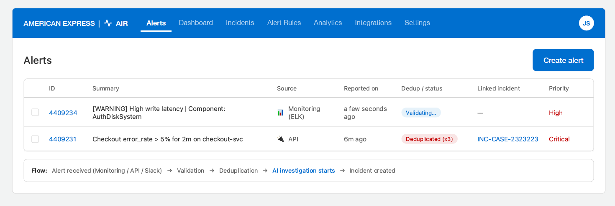
DESIGN WALKTHROUGH · ALERTS
Alerts are correlated and deduplicated before they reach an engineer
Alerts sharing the same service, metric, and error signature within a 5-minute correlation window are grouped automatically — the engineer sees one actionable item, already linked to its incident, not three separate pages.
Notes:
Show the alert list. Point out the dedup badge and the expanded group of three correlated alerts collapsing to one linked incident.

Slide 13
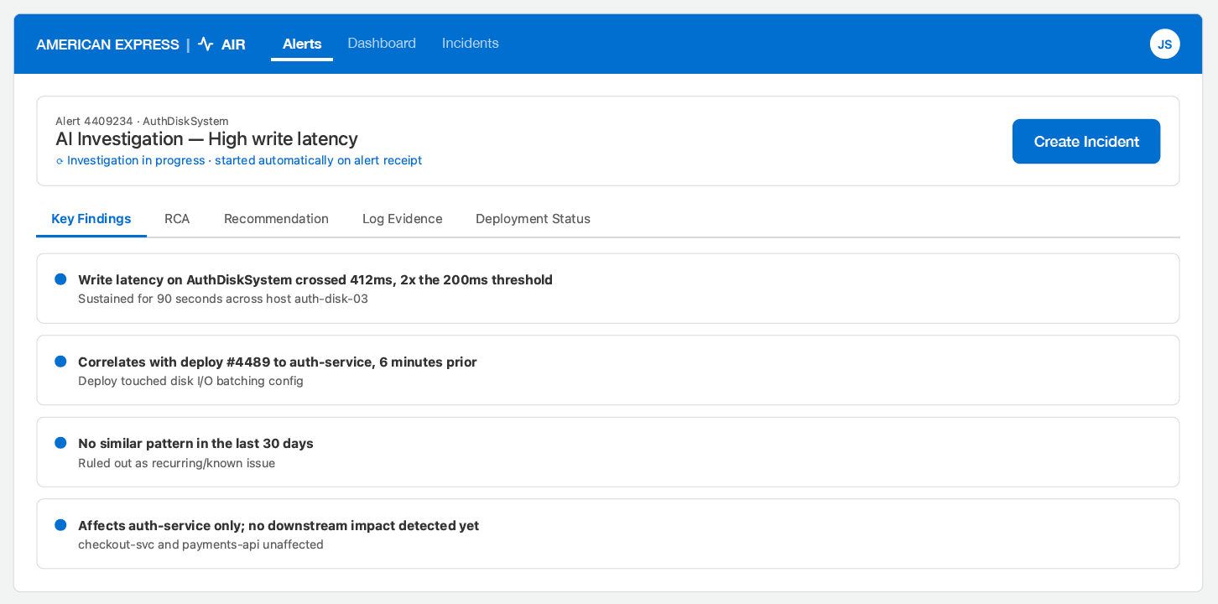
DESIGN WALKTHROUGH · AI INVESTIGATION
Investigation begins automatically the moment an alert arrives
By the time an engineer opens the alert, the threshold breach, the correlated deploy, and a 78% confidence root cause are already documented — with the evidence attached.
Notes:
Show the alert list. Point out the dedup badge and the expanded group of three correlated alerts collapsing to one linked incident.

Slide 14
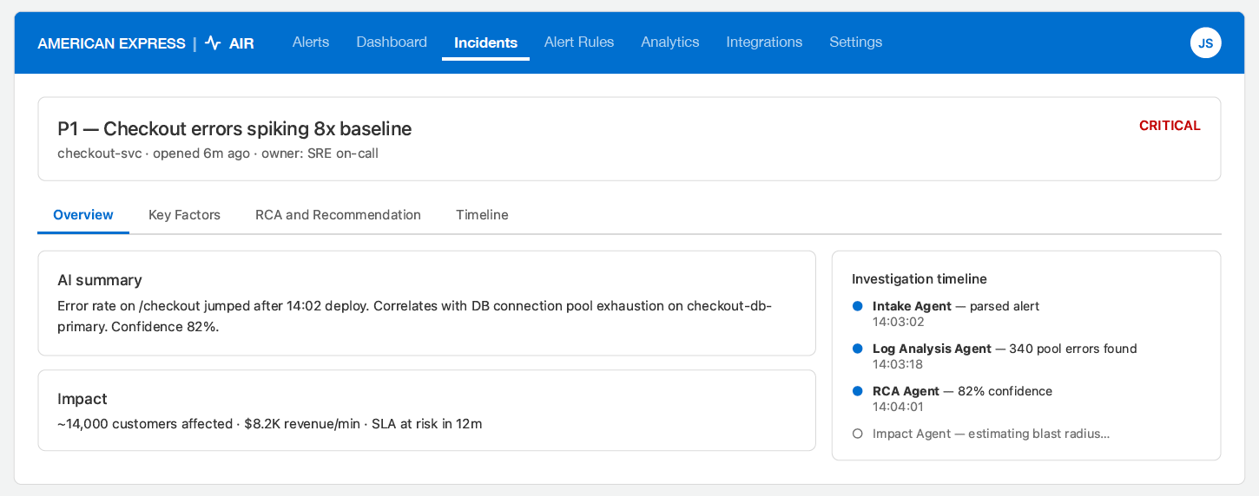
DESIGN WALKTHROUGH · INCIDENT DETAILS
Root cause hypotheses are ranked, evidenced, and ready for approval
Each hypothesis carries a confidence score and cited evidence. The top-ranked remediation is proposed with an explicit risk level — an engineer clicks approve, AIR executes.
Notes:
Show the alert list. Point out the dedup badge and the expanded group of three correlated alerts collapsing to one linked incident.

Slide 15
AMERICAN EXPRESS
AIR
|
Prototype Demo
Notes:
Welcome. AIR is an agentic incident response platform — introduce the tagline and set up that this is an architecture review.

Slide 16
DELIVERY TIMELINE
Five sprints to UAT completion
27 Jul – 09 Aug
10 Aug – 23 Aug
24 Aug – 06 Sep
07 Sep – 20 Sep
21 Sep – 30 Sep
30 Sep
Sprint 1
Sprint 2
Sprint 3
Sprint 4
Sprint 5
UAT Complete
Foundation: Infra, DB schema, API Spec Design, Repo, Auth, CI/CD, UI
Scenario 1 (ELF ingestion), orchestrator, Intake Agent, core dashboard
Scenario 2 (UI-triggered), Diagnostic Agent, RAG / knowledge base
RCA & Runbook agents, Slack Integration, approvals, notifications
Hardening, security review, load testing, UAT & sign-off
MVP release scope ends at UAT sign-off
Notes:
Show the alert list. Point out the dedup badge and the expanded group of three correlated alerts collapsing to one linked incident.

Slide 17
TEAM & RESPONSIBILITIES
Six people and Two scenario
Rajakumari
Narmada
Vignesh
UI & UX - Designer & Dev
UI Dev
UI Dev
Ragul
Nishant
Arunkumar
Backend and AI
Backend and AI
Backend and AI
Scenario : 1
Alerts from ELF logs flow through ingestion, normalization and deduplication, auto-converting into incidents the agent pipeline investigates.
Scenario : 2
A user or support engineer reports a user-facing issue directly from the UI, creating an incident that triggers the same agent pipeline.
Notes:
AI Agent Orchestration — Speaker Notes
LangChain coordinates specialized agents through a governed incident-response workflow.
Investigation Agent
Collects alerts, logs, metrics and traces. PII, secrets and sensitive data are protected before analysis.
RCA Agent
Runs multiple root-cause hypotheses in parallel. Evidence is compared and conclusions are ranked by confidence.
Runbook Agent
Recommends approved response steps based on the available evidence. Human approval remains part of the process.
Communication Agent
Keeps responders aligned with consistent incident context, progress updates and an auditable timeline.
Postmortem Agent
Turns reviewed incident evidence into lessons, actions and reusable knowledge.
Policy guardrails
Input and output checks protect sensitive data, validate evidence and keep recommendations within approved boundaries. Human oversight ensures decisions remain safe and accountable.

Slide 18
Thank You
Notes:
Close on the reframe: AIR is a standing operating system, not a tool. Humans keep the decisions that matter; agents remove the manual-lookup loop. Propose aligning on Phase 1 scope next.

