Slide 1
AI Time-Audit
CAPSTONE 42 | Before and After Productivity Study
Research question: How much time can AI save across common student or office tasks?
Compare six tasks with and without AI assistance.
Evaluate both speed and output quality.
Illustrative demo dataset — replace with measured observations.

Slide 2
Tasks and Method
A fair comparison includes prompting, review, and rework
Summarising notes • Formal email • Weekly schedule
Research comparison • Spreadsheet formulas • Presentation outline
Record manual time and AI-assisted time using matched briefs.
Score outputs on the same 1–5 rubric; use a blind reviewer if possible.

Slide 3
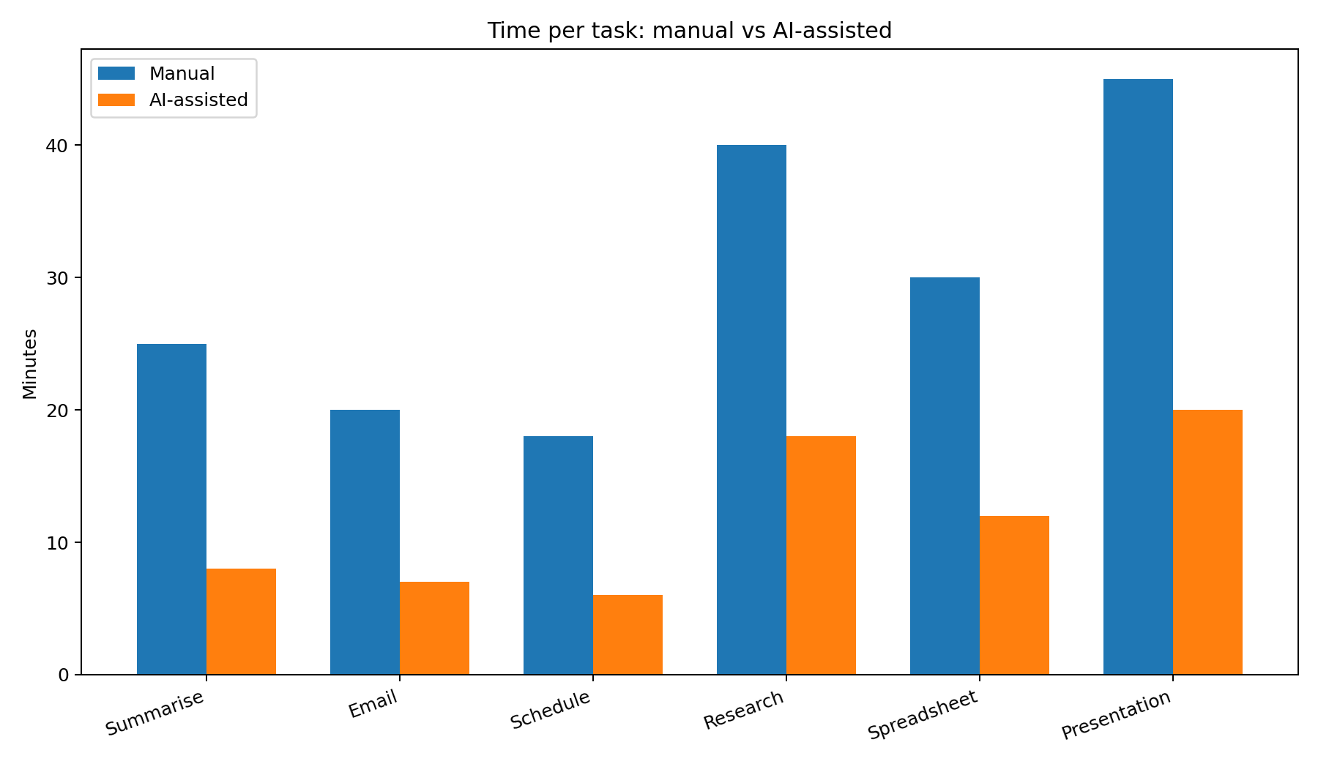
Time Comparison
Example figures only — not real experiment results

Slide 4
Illustrative Findings
Manual 178 min | AI-assisted 71 min | Difference 107 min (60.1%)
Average quality: manual 3.83/5; AI-assisted 3.83/5.
The research-comparison example has lower AI quality, highlighting the need for source checks.
Speed is only useful when the output remains accurate and fit for purpose.

Slide 5
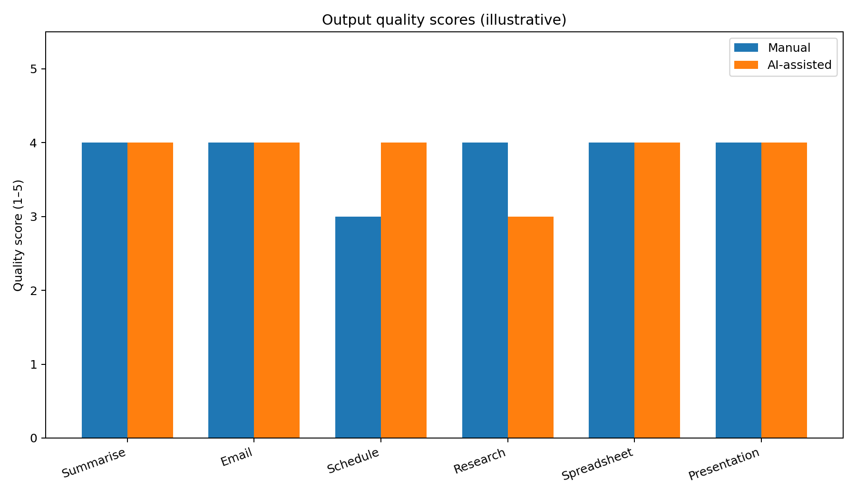
Quality and Responsible AI
Illustrative quality scores
Verify facts and citations.
Test formulas on edge cases.
Include correction time.
Protect private information.

Slide 6
Conclusion and Next Steps
Replace sample values with actual timed runs.
Repeat tasks and apply consistent quality scoring.
Report task-by-task differences and limitations.
Discuss when AI made work worse, not only when it saved time.
Final claim must be based on verified observations.

