Slide 1
Visitor Management System
Name : patel kathit
Ento_no : 21162121023
Branch : BDA(33)
OOP Project

Slide 2
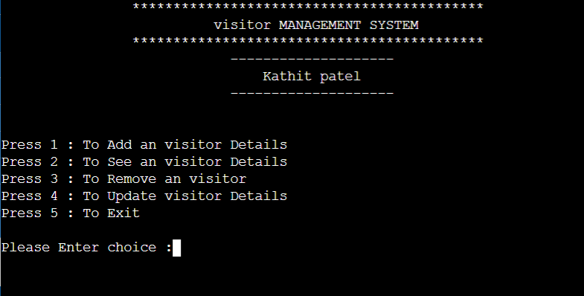
ENTER FACE

Slide 3
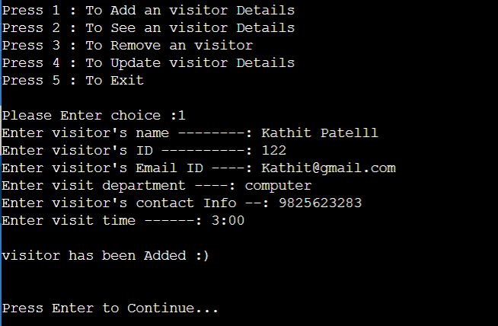
ADD VISITOR DETAILS

Slide 4
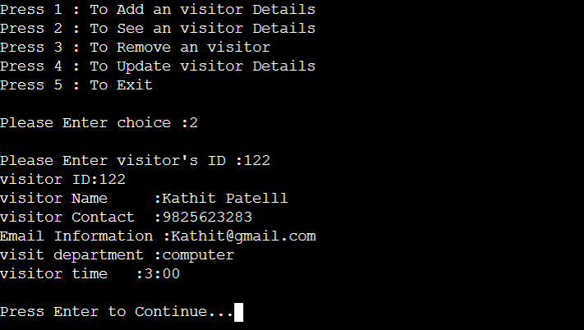
SEE VISITOR DETAILS

Slide 5
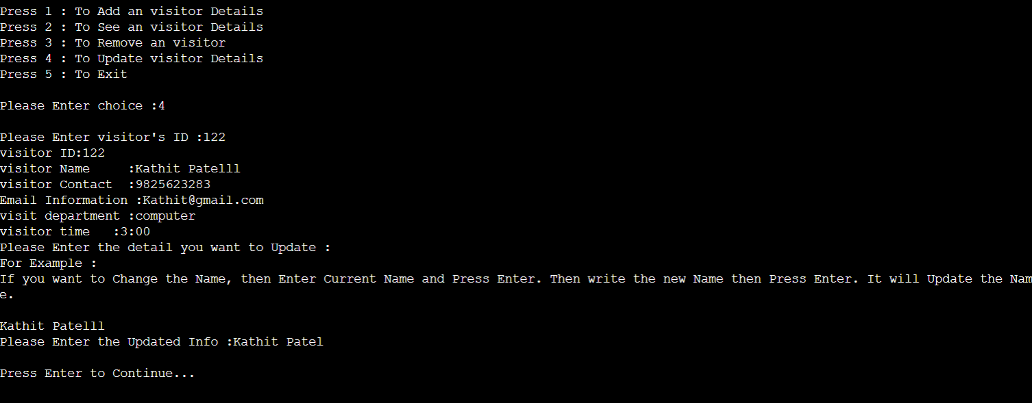
UPDATE VISITOR DETAIL

Slide 6
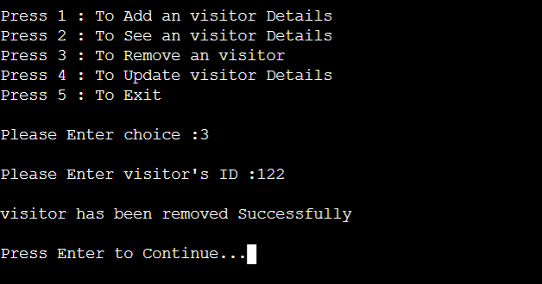
REMOVE VISITOR DETAILS

Slide 7
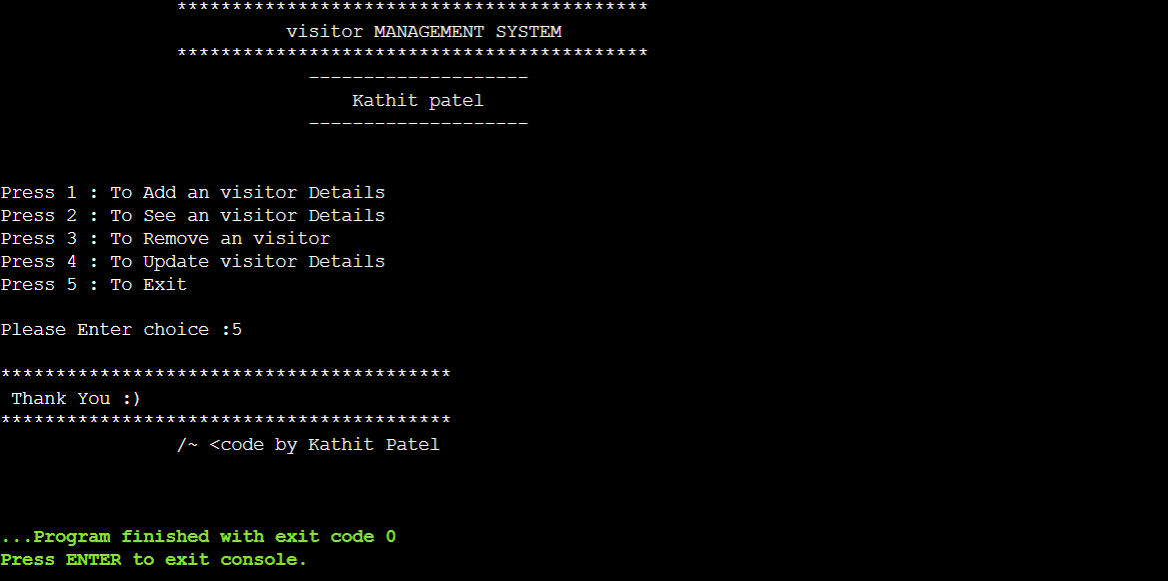
EXIT

Slide 8


