Slide 1
Who Can Make Science? Access and
Representation in the Culture of Science
Kathleen Leeper
10 March 2015

Slide 2
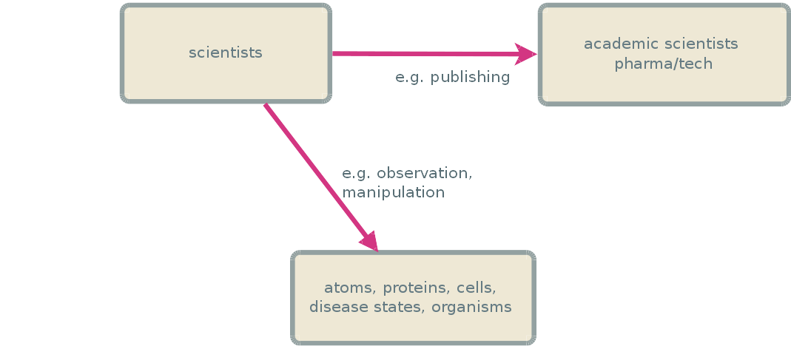

Slide 3
ACCESS

Slide 4
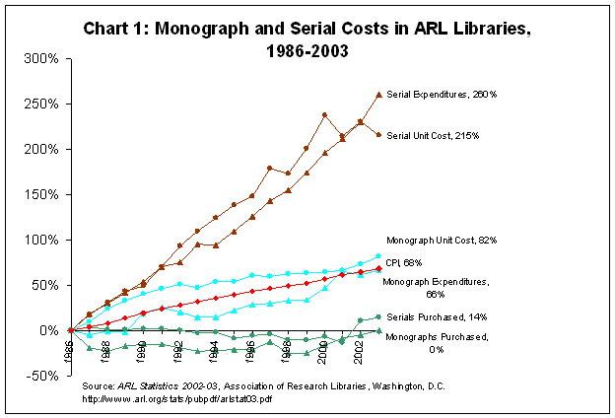

Slide 5
“Access to the scientific literature is not a serious concern of most scholars in developed nations, and most researchers feel that their access to the literature is steadily improving.”
              Davis & Walters, The impact of free access to the scientific : a review of recent research

Slide 6
A problem for who?
Academia and industry
  Libraries
  Faculty
Non-academics
  Independent researchers
  Faculty?
  Lay people
  journalists

Slide 7
Milwaukee, WI, USA
“I'm an associate professor of biology at a small, women's college in Milwaukee, WI. As a small school with a limited budget . . . The open access materials at Harvard allows access to many first generation minority and Pell-grant eligible students that would otherwise not be able to access this information.”
  Faculty member, U.S.

Slide 8
Pakistan
“Open Access has made it possible for me to work on my Master's thesis from home. This is extremely important to me because I am the mother of a small child and it would not have been possible for me to pursue a degree otherwise as the institution that I am enrolled at only allows periodical access from the library.”
  Graduate student, Pakistan

Slide 9
Iran
“I am phd student in Iran, and I am doing my thesis on creativity, but because of the sanctions against Iran, we do not have access to many references, but I need many of them. Having open access to this site was a gift.”
  Graduate student, Islamic Republic of Iran

Slide 10
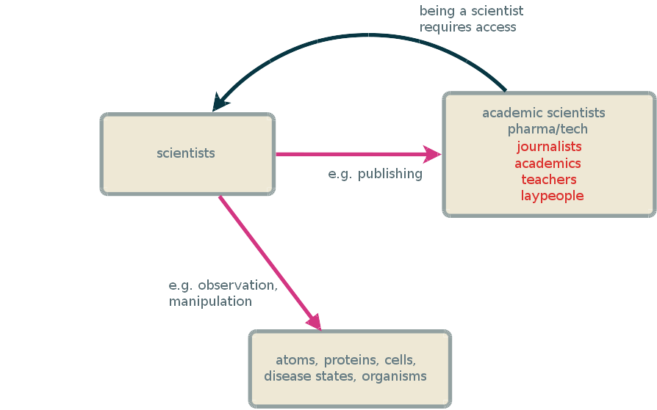

Slide 11
WEIRD Scientists

Slide 12
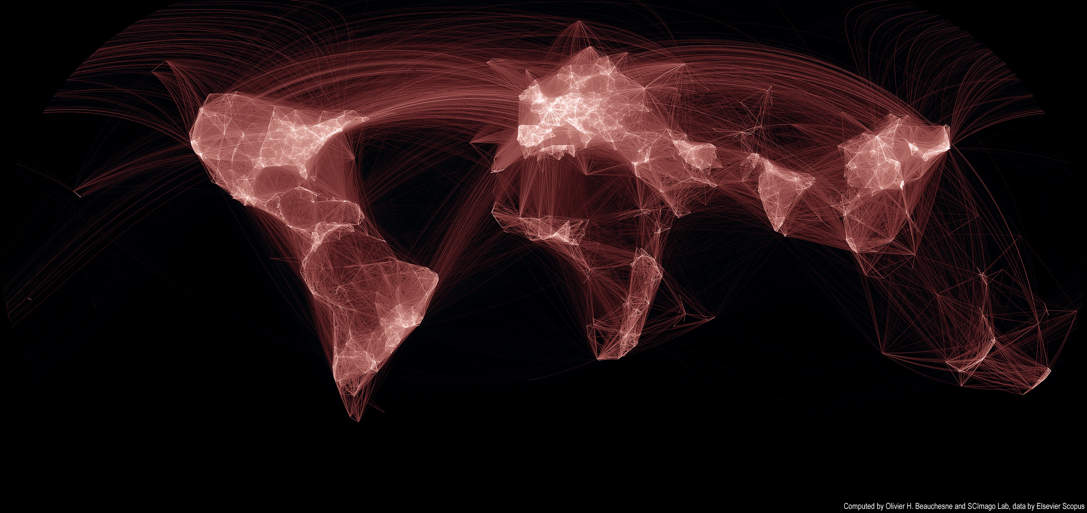
Scientific collaborations

Slide 13
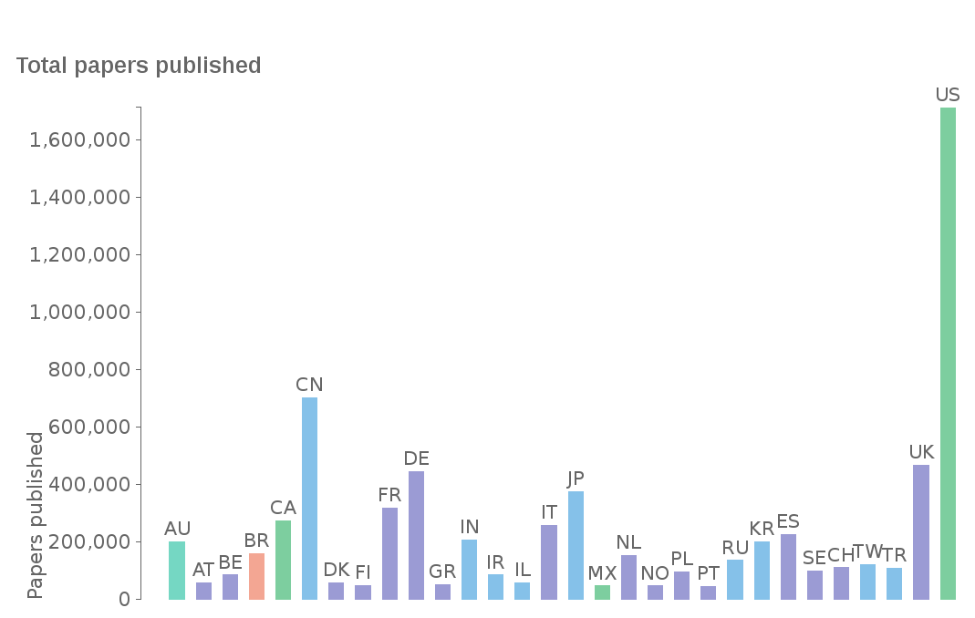
Papers published, WoS, 2008-2012

Slide 14
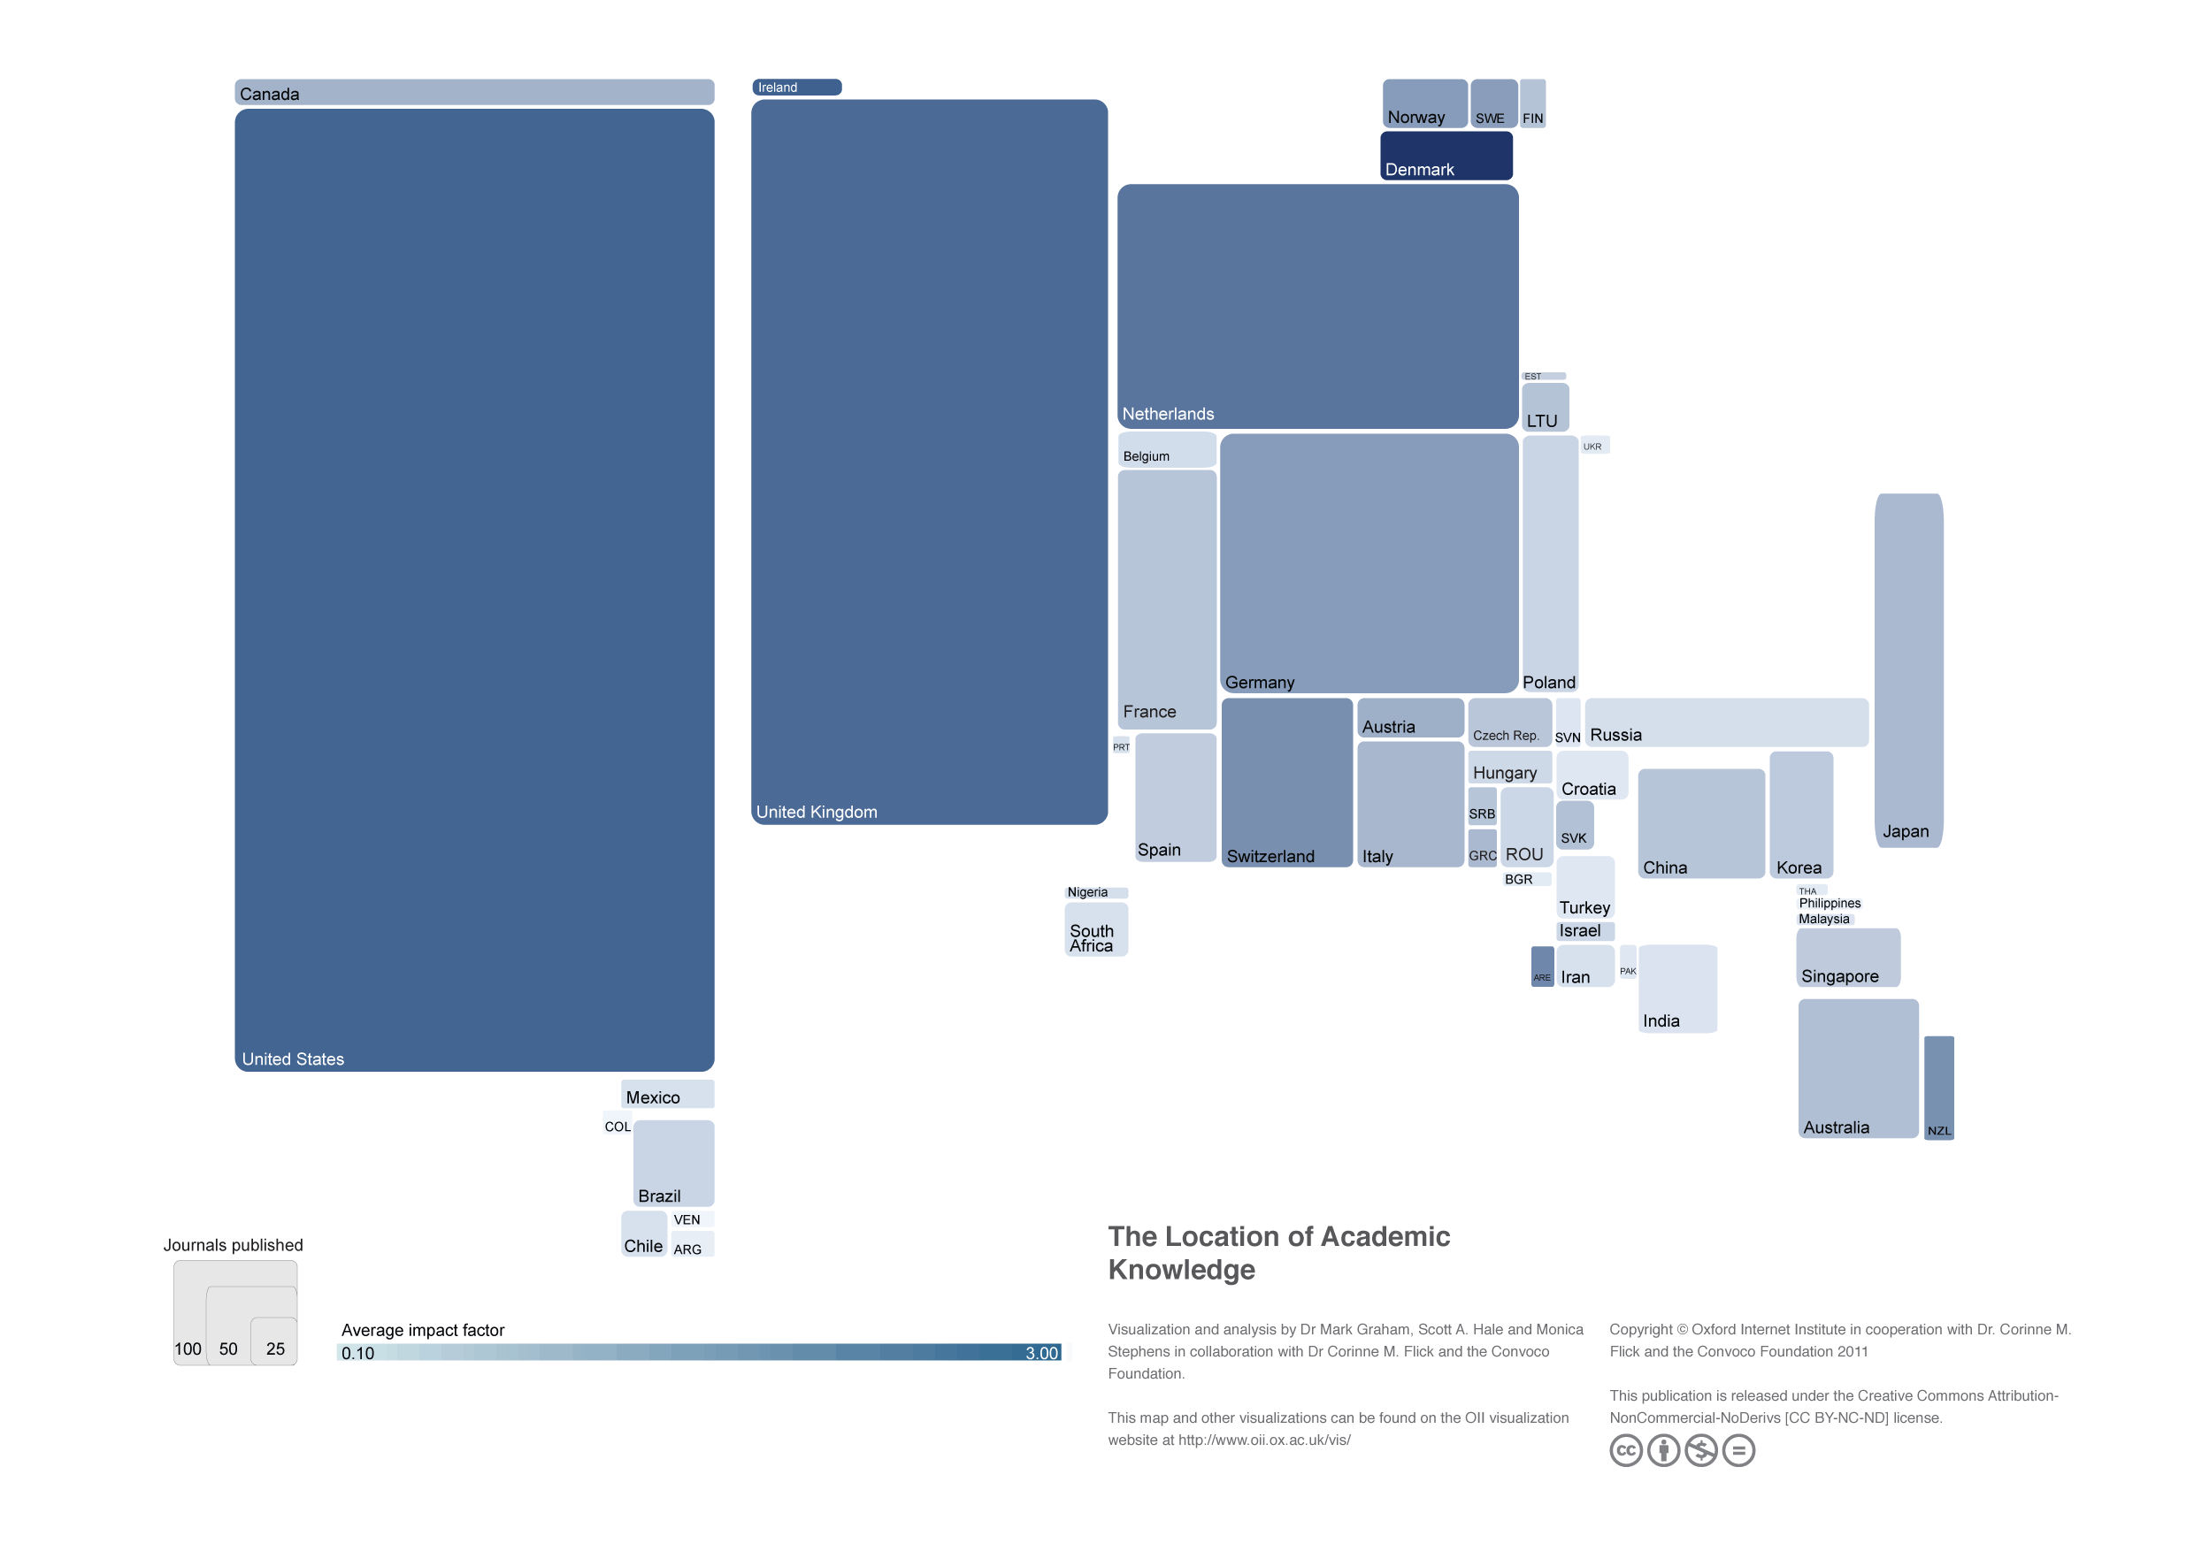

Slide 15
“...it is clear that the journals most important to the international research community will publish full text in English.”
      Thomson-Reuters
      Standards for inclusion in the Web of Knowledge

Slide 16
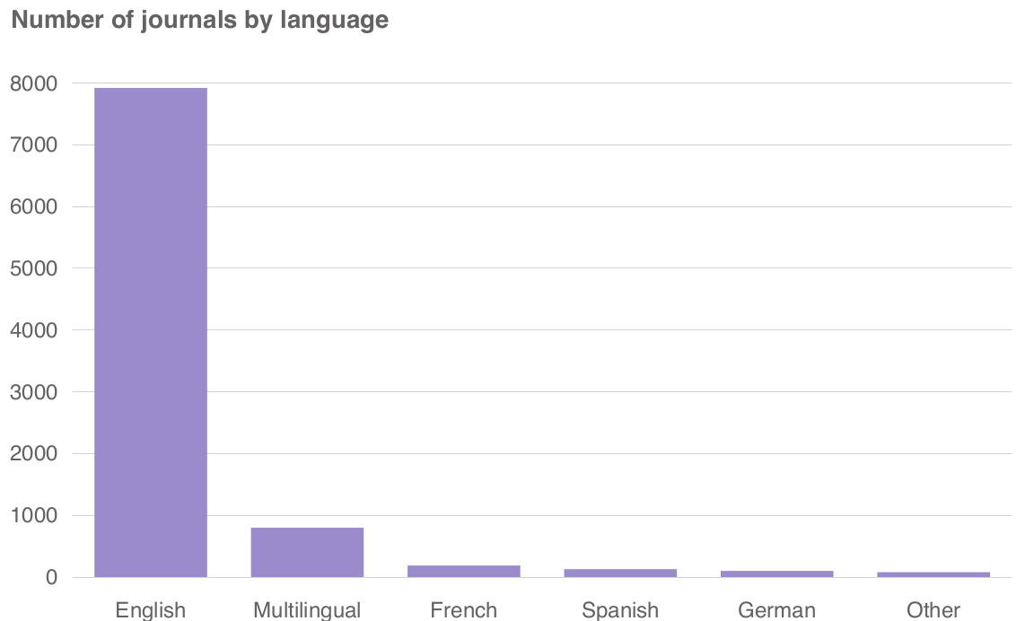
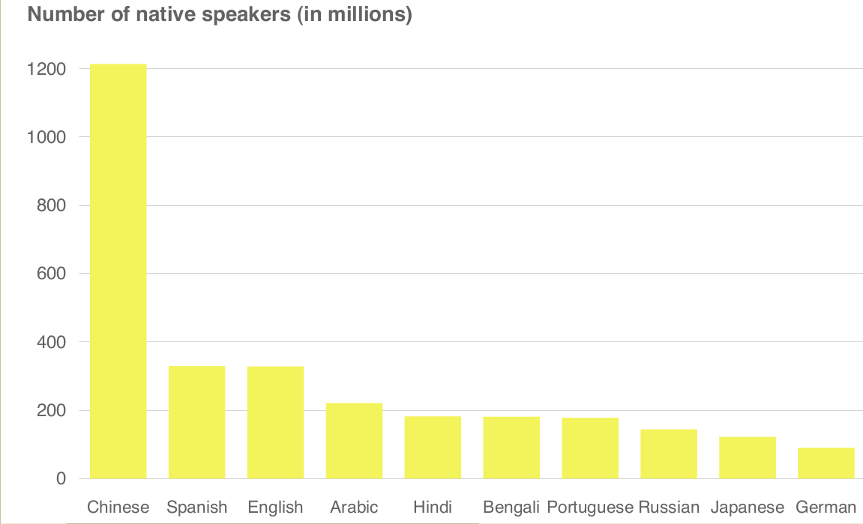

Slide 17
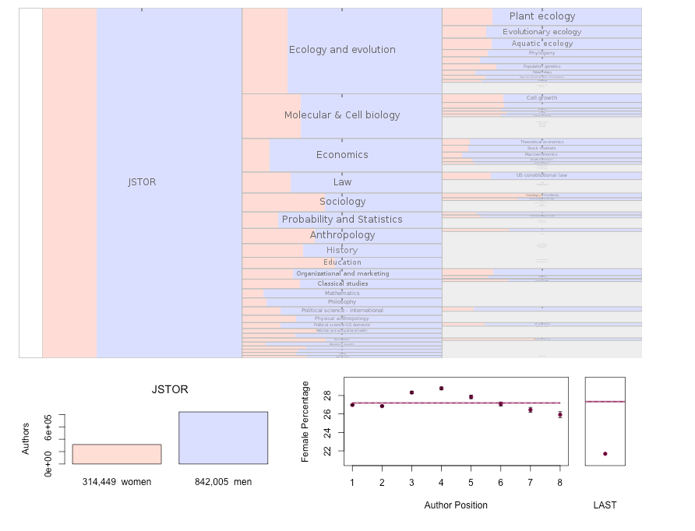
JSTOR & Gender, 1990-2011

Slide 18
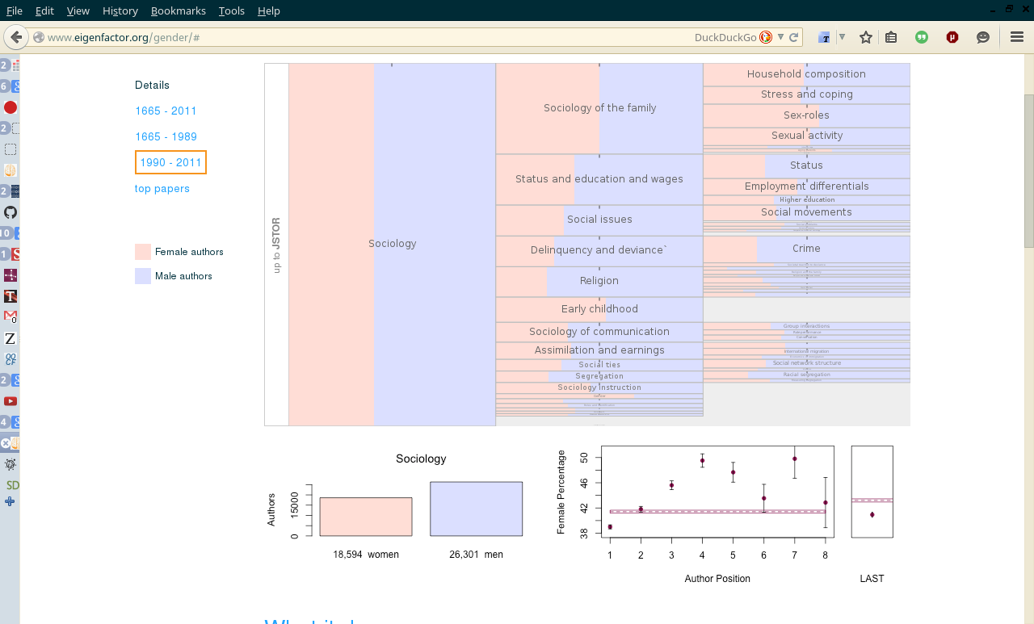
JSTOR, Sociology & Gender, 1990-2011

Slide 19
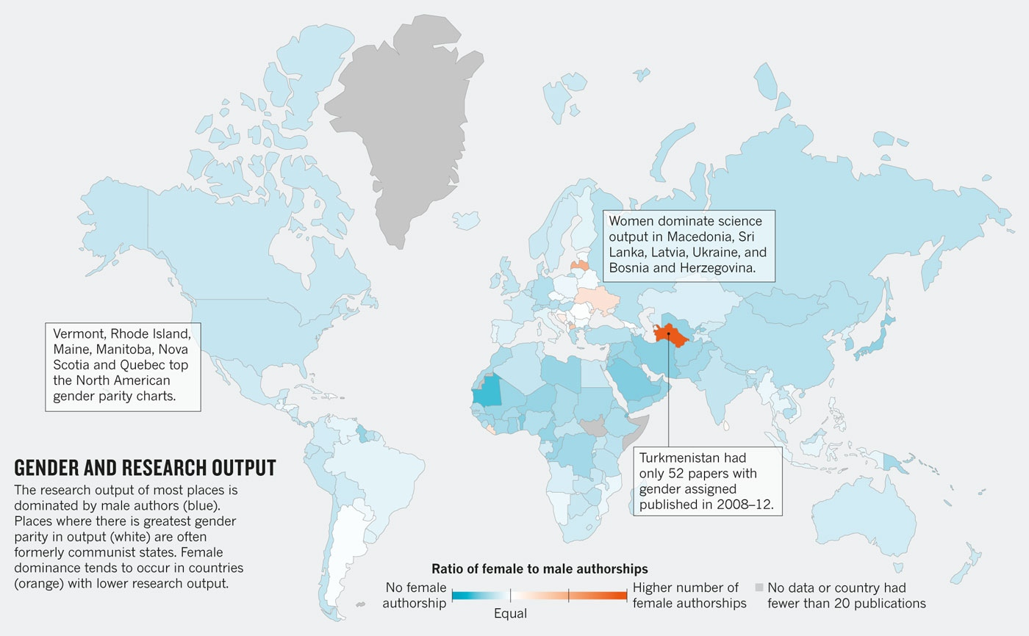
Web of Science & Global Gender

Slide 20
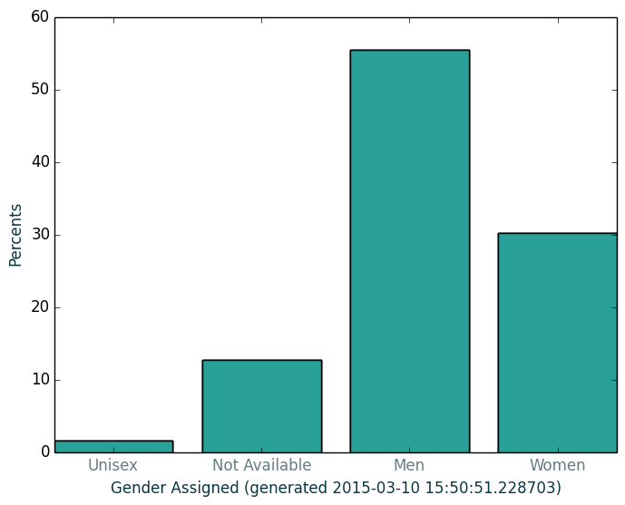
In practice: my div

Slide 21
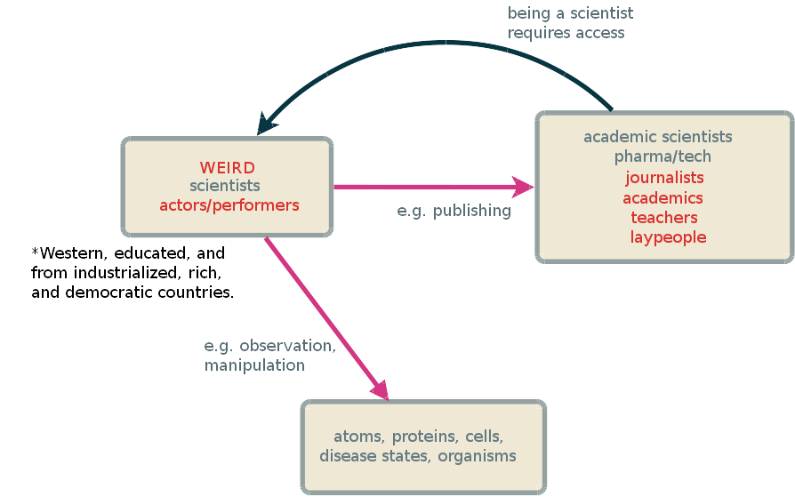

Slide 22
Objects of research

Slide 23
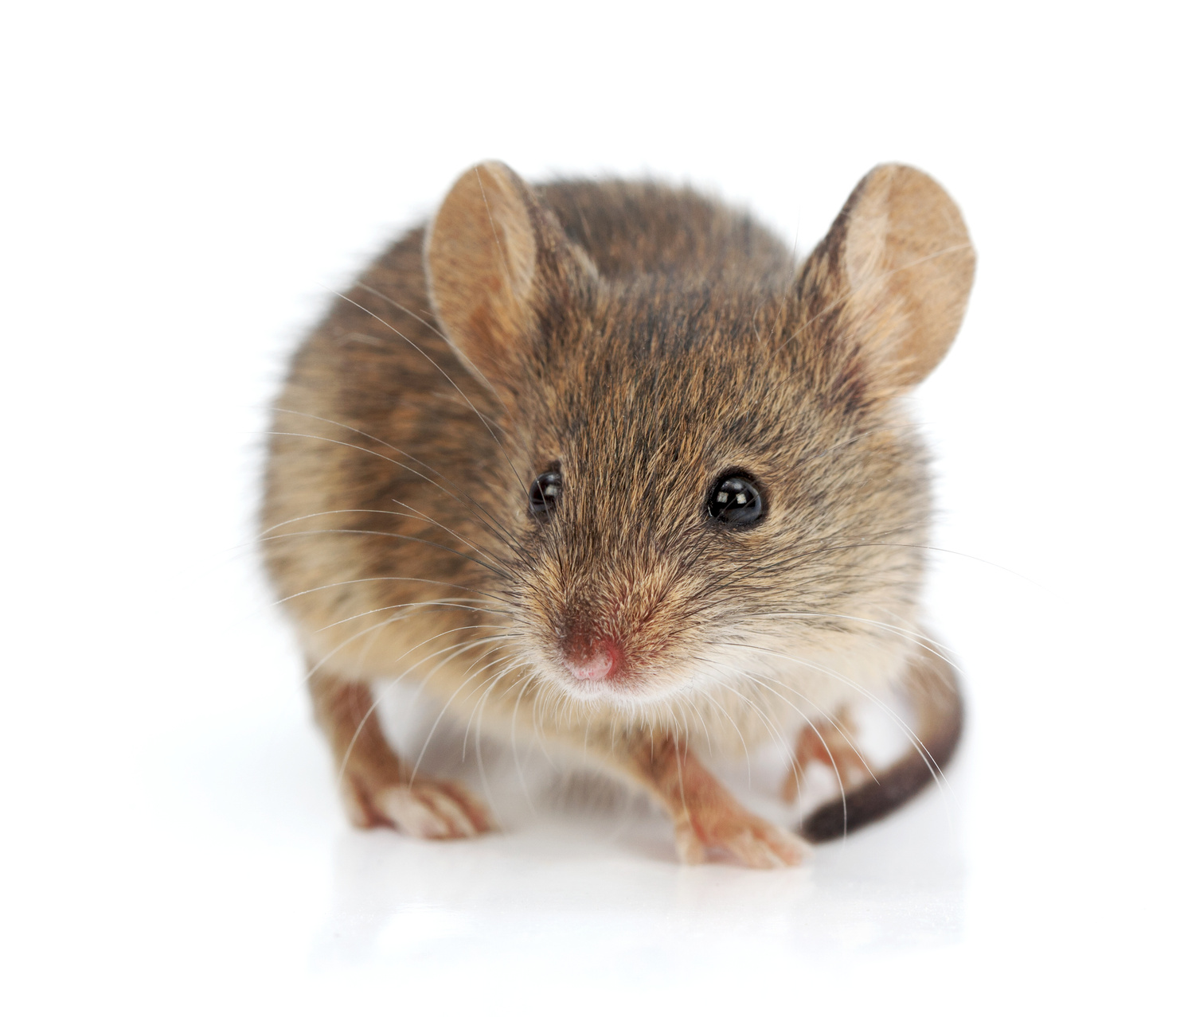

Slide 24
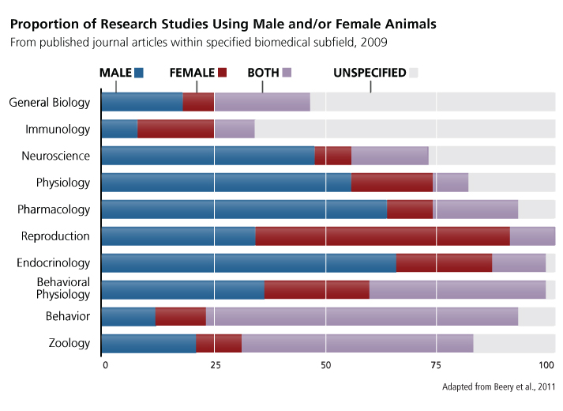
Model systems

Slide 25
Heart attacks
Major cause of death
Aspirin & protective effects
 | Men | Women
Symptoms | Chest pain
 | Left arm pain
 |  | Jaw and back pain
 |  | nausea
Mortality* | 8.3% | 11.8%
*in one study; varies

Slide 26
10/90 Gap
“. . . [diseases of] high-income countries were investigated in clinical trials seven-to-eight-times more often than. . .diseases whose burden lies mainly in low-income and middle-income countries. “
  Røttingen et al., 2013, Mapping of available health research and development data

Slide 27
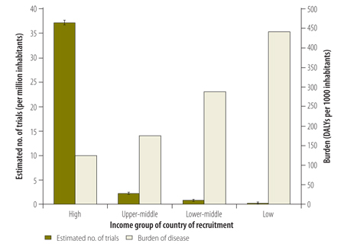
Clinical trials and income groups
WHO Bulletin 2013, Use of data from registered clinical trials to identify gaps in health research and development, Roderik F Viergever a, Robert F Terry b & Ghassan Karam

Slide 28
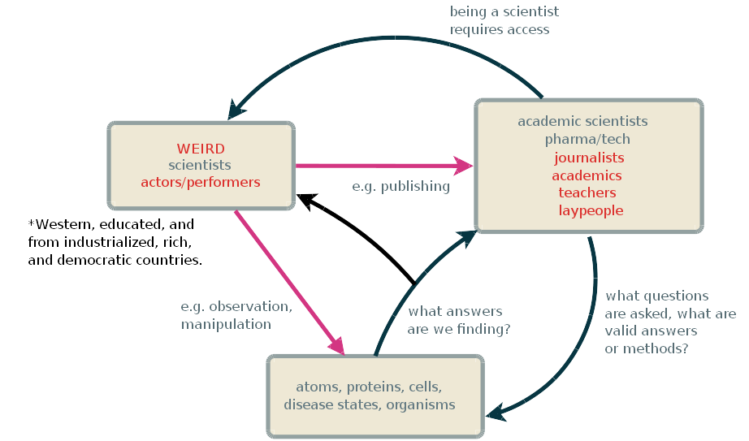

Slide 29
THANK YOU
Foundation for Psychocultural Research- Hampshire College Program in Culture, Brain, and Development

Slide 30
Contact me, please!
kgl11@hampshire.edu
literally ANYTIME

